Slide 1
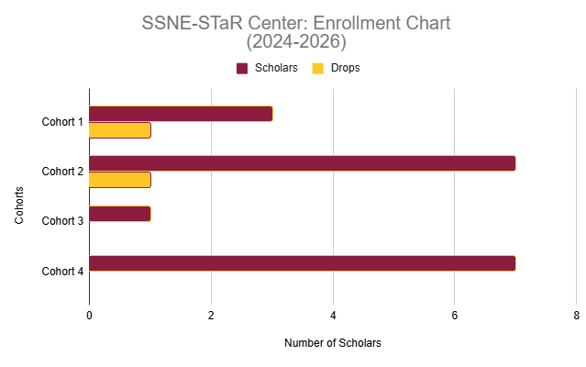
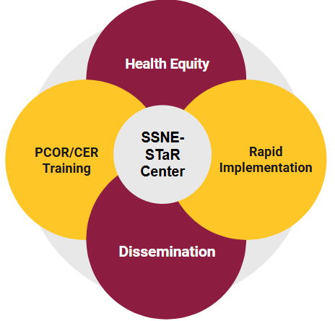
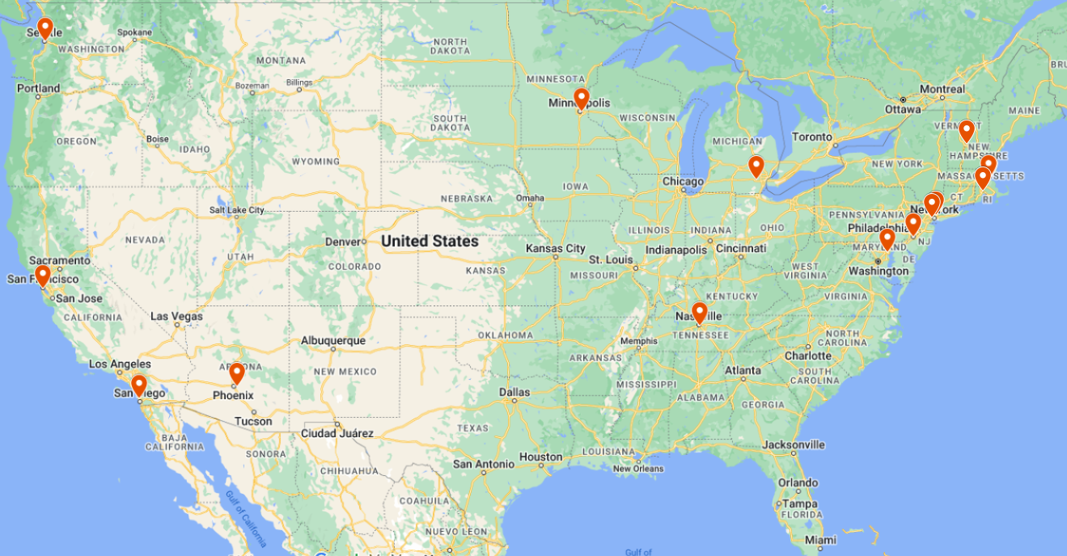
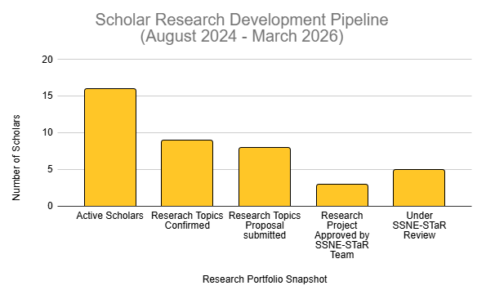

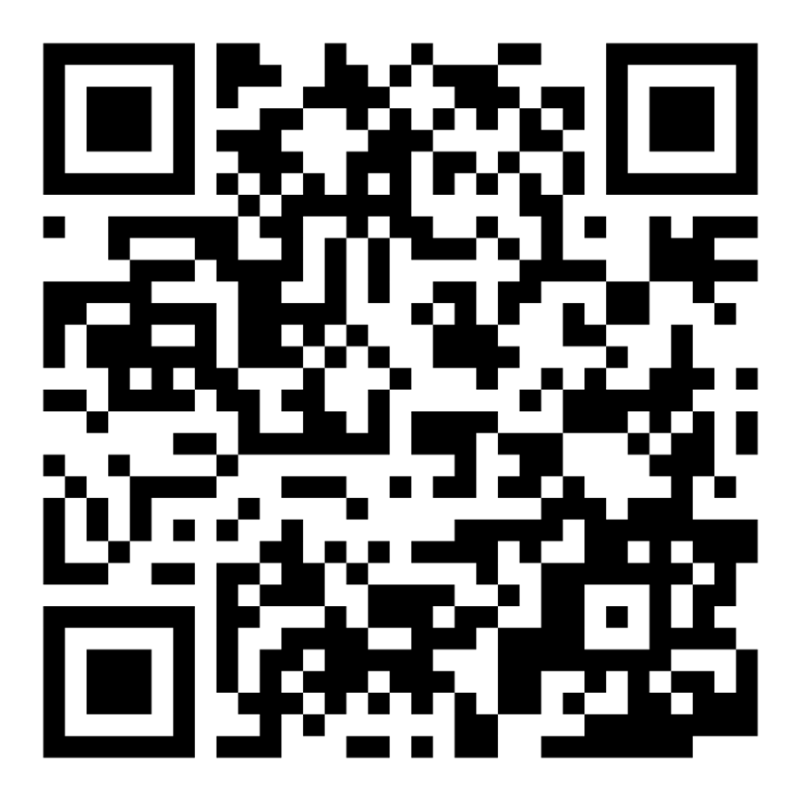


Advancing the Southwest Safety Net Embedded Scientist Research and Training (SSNE-STaR) Center Roshini Moodley Naidoo MBChB, MBA, MPH, Matthew Martin PhD, Lauren Baker MS, Marisa Domino PhD, Punam Ohri-Vachaspati, PhD, Adela Grando, PhD, Anita Murcko, MD, William Riley, PhD
College of Health Solutions, Arizona State University
INTRODUCTION
The Southwest Safety Net Embedded Scientist Training and Research (SSNE-STaR) Center is an AHRQ/PCORI-funded Learning Health System Center designed to build embedded Comparative Effectiveness Research and Patient-Centered Outcomes Research (CER/PCOR) capacity within safety net organizations serving medically underserved populations.
METHOD
The SSNE-STaR program is designed
around three interconnected cores that collaboratively support Scholars in achieving program goals. Each core plays a distinct role in fostering a comprehensive learning environment:
The Administration Core ensures smooth operations and provides essential logistical and collaborative support.
The Research Education Core (REC) focuses on mentorship, education, and facilitating translational research.
The Research Data Analysis Core (RDAC) equips Scholars with the tools and data necessary for conducting impactful, equity-focused research.
Mentorship, Projects, and Rapid Implementers
The SSNE-STaR program pairs each Scholar with two mentors: an ASU Research Mentor for guidance on CER/PCOR methods and a Clinical Mentor to support real-world application in healthcare settings. Mentors meet with Scholars monthly to provide tailored support and foster professional growth.
Scholar Research Project. Each Scholar will develop and implement a research project of their choosing applying PCOR and CER methods.
Rapid Implementers collaborate with Scholars in Year 2 to disseminate research findings into practice, ensuring alignment with the needs of underserved populations. They assist with implementation strategies and provide valuable feedback to bridge the gap between research and patient care.
RESULTS
Since its launch, SSNE-STaR has enrolled 18 scholars, with 16 currently active and embedded across Arizona safety net health systems. Enrollment has surpassed the original 12-scholar target, demonstrating strong demand for structured CER/PCOR training within clinical settings. Scholars represent major partner organizations, including Banner Health, Valleywise Health, District Medical Group, Phoenix Children’s Hospital, and Barrow Neurological Institute.
AIMS
SSNE-STaR equips embedded scholars to design, conduct, and disseminate/implement CER/PCOR projects within safety net systems. Early outcomes demonstrate growing research capacity, cross-institutional collaboration, and rapid dissemination potential.
LEARNING HEALTH SYSTEMS (Regional)
PARTNERS
Researchers
The SSNE-STaR Center is a CHS center award with investigators participating across disciplines.
Sponsors
Agency for Healthcare Research and Quality (AHRQ) and the Patient-Centered Outcomes Research Institute (PCORI)
Learning Health Systems (LHS)
SSNE-StaR Center is one of 16 Learning Health Systems participating in the program across the nation.
Clinical Partners
Valleywise Health System (VH), District Medical Group (DMG), Phoenix Children’s Hospital (PCH), Banner Health (BH), Native Health, Gila River, Mountain Park, Barrow Neurological Institute.
CONCLUSIONS
The SSNE-STaR Center addresses health disparities by training Scholars, building infrastructure, and fostering equity-focused research. It serves as a replicable model for improving healthcare in underserved populations.
Funding Acknowledgement

