Slide 1

Intrusion Detection System (IDS)
Implementation Using Cisco Packet Tracer

Slide 2
Team Members
AARATHY R BABU - AM.EN.U4ECE22002
ASWATHI HS - AM.EN.U4ECE22010
HARSHIT KUMAR - AM.EN.U4ECE22017
SRUTHI BALAKRISHNAN P - AM.EN.U4ECE22046
KRISHNAPRIYA V B - AM.EN.U4ECE22052

Slide 3
Introduction
Intrusion Detection System (IDS) monitors network or system activities for malicious actions or policy violations.
Two main types:
NIDS (Network-based IDS): Monitors network traffic.
HIDS (Host-based IDS): Monitors individual devices or systems.
Detects threats that bypass firewalls.
Provides alerts for unauthorized or unusual behavior.
Limitations:
Cannot block attacks (unlike IPS).
Limited performance on busy or encrypted networks.

Slide 4
Tools and Requirements
Software: Cisco Packet Tracer.
Hardware:
Intel Pentium 4 or equivalent
2GB RAM
1GB storage
Standard display (1024x768)
CLI: For device configuration.

Slide 5
Network Design
3 LANs with different IP ranges:
LAN 1: 192.168.1.0/24
LAN 2: 192.168.10.0/24
LAN 3: 192.168.30.0/24
Devices: PCs, laptops, printers, HTTP & FTP servers.
Routers: Dynamic Routing between networks.

Slide 6
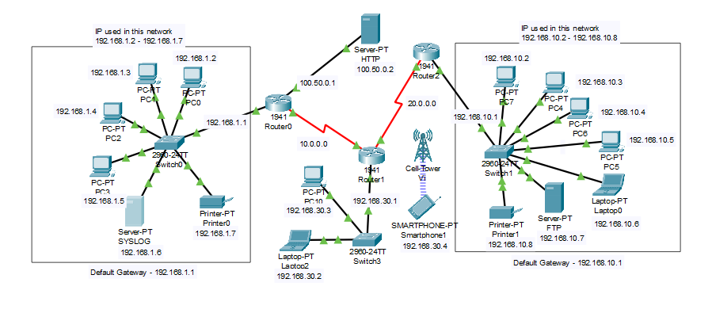
Network Topology

Slide 7
Project Implementation
Configured devices with IPs.
Setup routing using Dynamic Routing.
Server configuration:
SYSLOG for logging
FTP (with user harsh / 123)
HTTP (custom webpage)
ICMP packet testing done between nodes.

Slide 8
IDS Implementation
Network Setup
Created 3 separate LANs using IPv4 addressing.
Devices used: PCs, laptops, routers, switches, FTP & HTTP servers, printers.
Configured each device with a static IP.
Connected LANs using 3 Cisco 1941 routers with Dynamic Routing (RIP).
Service Configuration
FTP Server: User - harsh, Password - 123
HTTP Server: Hosted custom webpage accessible via 100.50.0.2
SYSLOG Server: Logging service enabled for IDS alerts.
Connectivity Testing
Ping tests performed between all networks.
Verified file access, web access, and SYSLOG communication.

Slide 9
Experimental Results & Discussion
Testing Network Connectivity
After assigning IPs and configuring dynamic routing:
Ping tests between devices in same network → Successful.
Ping tests across networks (e.g., PC1 to PC7) → Successful after routing setup.
HTTP Server accessed via IP 100.50.0.2 from any host.
FTP Server tested with user credentials (harsh / 123) → Successful file access.
Testing IDS Functionality (NIDS)
Implemented IDS on Router0 (GigabitEthernet0/0).
Signature 2004 (ICMP Echo Request) used for detection.
Injected ICMP packets (Ping flood) from PC7 → PC1.
SYSLOG Server successfully logged the intrusion alerts triggered by IDS.

Slide 10
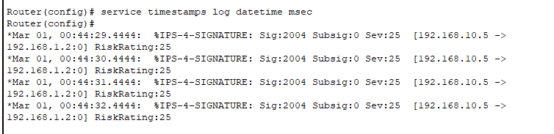
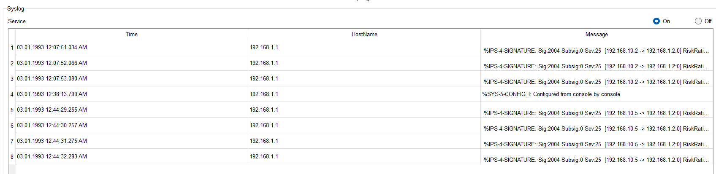
Router Alert
Syslog Alert

Slide 11
Challenges Faced
1. IP Address Configuration
Manual assignment of static IP addresses across multiple devices and interfaces.
Ensuring no IP conflicts in three separate LANs.
2. Routing Issues
Initial routing failures between networks.
Resolved using Dynamic Routing Protocols
3. IDS Command Complexity
IDS setup via CLI required precise syntax and understanding of:
Signature IDs (e.g., 2004 for ICMP Echo).
Directory configuration for IPS.
Logging setup and event actions.

Slide 12
Future Scope
1. Implement Honeypot Systems
Deploy decoy systems to lure attackers.
Capture and study attack patterns without compromising actual resources.
Enhances threat intelligence and improves IDS tuning.
2. Upgrade from IDS to IPS
Transition to Intrusion Prevention System.
Instead of just detecting and alerting, IPS can actively block malicious traffic.
Adds a proactive security layer to the network.
3. Real-World Deployment
Extend simulation to real network environments using real routers and switches.
Implement in enterprise-grade setups with logging, monitoring, and alert systems.

Slide 13
Conclusion
Built a Network-based Intrusion Detection System (NIDS) using Cisco Packet Tracer.
Configured and interconnected 3 separate LANs with routers and switches.
Implemented dynamic routing and services like HTTP, FTP, and SYSLOG.
Enabled IDS on Router0 to monitor and log ICMP Echo Request attacks using Signature 2004.

Slide 14
THANK YOU

