Slide 1
AWS architecture

Slide 2
The Full Data Path
Arduino R4: Sends JSON via MQTT to AWS Topic heater/telemetry.
AWS IoT Core: Forwards that JSON to your Node.js server.
Node.js Server: Receives the MQTT message and immediately emits it to your web browser using Socket.io.
HTML Page: A small piece of JavaScript catches that "emit" and updates the text on your screen instantly.

Slide 3
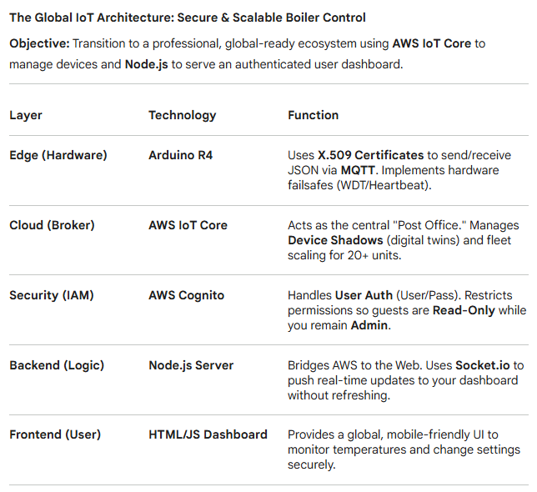
System Architecture

Slide 4
Project Overview & Vision The Smart Heater: Moving to Global Scale
Goal: Transition the Arduino R4 Heater project from a local network to a global, production-grade IoT system.
Core Tech Stack:
Hardware: Arduino R4 (Wi-Fi).
Cloud: AWS IoT Core (The Secure Message Broker).
Backend: Node.js (The Business Logic & Real-time Bridge).
Frontend: HTML5/JavaScript (The Interactive Dashboard).

Slide 5
Security & Hardware Integrity : Professional-Grade Failsafes
Authentication: Moving from simple sessions to X.509 Digital Certificates flashed onto the Arduino.
Hardware Guardrails:
Heartbeat Monitor: System enters SAFE_STATE (Off) if it loses connection to the server for 30s.
Sanity Checks: Detects disconnected sensors or short circuits to prevent thermal runaway.
Watchdog Timer (WDT): Automatically reboots the Arduino if the code hangs.

Slide 6
The Communication Architecture Decoupled Messaging via AWS IoT Core
Protocol: MQTT (Message Queuing Telemetry Transport) replaces standard HTTP for lower battery/data usage.
The "Post Office" Model:
Arduino Publishes temperature JSON to a topic (e.g., heater/temp).
Node.js Subscribes to that topic to receive updates.
The Device Shadow: A "Digital Twin" in the cloud that stores the heater state even when the device is offline.

Slide 7
Real-Time Data Flow Bridging the Cloud to the User
The Pipeline:
Arduino sends data to AWS IoT Core (MQTT).
Node.js pulls data from AWS.
Socket.io (WebSockets) "pushes" that data from Node.js to your browser instantly.
The Result: Your HTML dashboard updates in real-time without needing to refresh the page.

Slide 8
2026 Hosting Strategy Deployment & Sustainability
AWS Free Tier: 12 months of free connectivity (pennies per month thereafter).
Hosting Options:
AWS ECS Express: (Recommended) Professional, stays in the AWS ecosystem.
Render / Railway: Easiest setup for the Node.js server and HTML dashboard.
Future Proof: Decoupled design allows you to add more sensors or mobile apps without rewriting the Arduino code.

Slide 9
Secure Global Access & Identity Management
1. Identity & Authentication (The Gatekeeper)
Amazon Cognito User Pools: A secure directory for your "Username/Password" login. Supports MFA (SMS/Email) and password resets.
Identity Pools: Exchanges a successful login for a temporary IAM Token—your "VIP Pass" to talk to AWS services.
2. Fine-Grained Permissions (The Rulebook)
We use IAM Roles to define exactly what a user can do once they are inside:
Viewer Role (BoilerReadOnly): Grants iot:Subscribe only. Users see live data but cannot trigger actions.
Admin Role (BoilerManager): Grants iot:Publish and iot:UpdateThingShadow. Only you can change temperatures or toggle power.
3. The "Zero-Trust" Security Model
No Token, No Data: Without a Cognito token, the dashboard remains blank; the AWS Broker rejects the connection.
Encrypted Transit: All data travels via TLS 1.3 encryption, preventing "sniffing" on public Wi-Fi.
Server-Side Lockdown: Commands are verified by AWS before they ever reach the Arduino.

Slide 10
Multi component approach
Category | Production (The Real Control) | Development (The Dummy)
Hardware | Arduino R4 WiFi + ESP32-S3 (Kit C) | ESP32-S3 (Standard)
Connectivity | External Antenna: High-gain signal for basement/boiler environments. | Onboard Antenna: Clean, compact setup for desk use.
Installation | GPIO Expansion Board: Secure screw terminals for high-reliability sensor/relay wiring. | USB Direct: No physical I/O needed; purely logic-based simulation.
Logic Role | Active Control: Real-time sensor sanity checks, failsafes, and WDT. | Home Simulation: 24h mathematical model to test AWS dashboard logic.
AWS Identity | Unique Certs: Heater_Main_01, Heater_Main_02. | Unique Cert: Heater_Dummy_01.

Slide 11
Strategic Objectives
Isolation: Test experimental code on the Dummy board to avoid accidental boiler shutdowns.
Scalability: Validate the Node.js server's ability to handle concurrency (multiple data streams at once).
Reliability: Use the Expansion Board on the real boiler to prevent mechanical failures (loose wires).
Efficiency: Maintain a 14h ON / 10h OFF cycle across the fleet to maximize AWS Free Tier usage.

Slide 12
ESP32 Configuration
Feature | ESP32-S3 (Your Current) | ESP32-C6 (The Smart Home) | ESP32-P4 (The Beast) | ESP32 (Original)
Architecture | Xtensa LX7 (Dual-Core) | RISC-V (Single + LP Core) | RISC-V (Dual-Core) | Xtensa LX6 (Dual-Core)
Clock Speed | 240 MHz | 160 MHz | 400 MHz | 240 MHz
Wi-Fi | Wi-Fi 4 (2.4GHz) | Wi-Fi 6 (2.4GHz) | None (Needs C6/H2) | Wi-Fi 4 (2.4GHz)
Bluetooth | BLE 5.0 | BLE 5.3 + Zigbee/Thread | BLE 5.3 (via companion) | BT Classic + BLE 4.2
AI Support | Vector Instructions | Basic | Advanced Vector/DSP | None
USB | Native USB-OTG | Native USB-Serial/JTAG | Native USB 2.0 | None (needs bridge)
Deep Sleep | ~7 µA | ~5 µA | N/A | ~100 µA
Best Use Case | Heater with Display/AI | Battery sensors/Matter | HMI / 1080p Video | Legacy / Cheap IoT

Slide 13
Configuration | Internal SRAM (RAM) | Common Flash (Storage) | PSRAM (External RAM)
ESP32-S3 | 512 KB | 8 MB - 16 MB | 2 MB - 8 MB (Often integrated)
ESP32-C6 | 512 KB | 4 MB | None (Usually limited to internal)
ESP32-P4 | 768 KB | External Only (up to 16MB) | Up to 32 MB (High speed)
ESP32 (Original) | 520 KB | 4 MB | None (Rarely 4MB in special modules)

Slide 14
Step 1: The AWS "Thing" Creation
In the AWS Console, you need to register your physical board as a logical "Thing."
Create a Thing: Name it Heater_Main_01.
Generate Certificates: AWS will give you a chance to download a Device Certificate, a Private Key, and a Root CA.
CRITICAL: Download these immediately. AWS will never show you the Private Key again. If you lose it, you have to start over.
Attach a Policy: You must create a "Policy" (the rules) that allows your board to Connect, Publish, and Subscribe. Without this, AWS will reject the connection even with the right keys.

Slide 15
Step 2: Preparing the Arduino R4 Firmware
The Arduino R4 WiFi uses a "bridge" (the internal ESP32-S3) for its Wi-Fi. It needs to know how to handle the encryption.
Firmware Check: Ensure your Arduino R4 WiFi is updated to the latest firmware (at least v0.4.0+). Older versions had bugs with SSL certificates.
SSL Root Upload: You may need to use the Arduino WiFi101 / WiFiNINA / WiFiS3 firmware uploader tool to "burn" the Amazon Root CA certificate into the board's Wi-Fi module. This allows the board to trust that it’s actually talking to Amazon and not a hacker.

Slide 16
Step 3: The "Secrets" File
In your code (PlatformIO or Arduino IDE), we will create a secrets.h file. You will copy the text from the files you downloaded in Step 1 into this file.
It will look like a long block of text starting with -----BEGIN CERTIFICATE-----.
Pro Tip: For the Arduino R4, we often use the Arduino_ConnectionHandler or WiFiS3 libraries. They expect these keys in a specific format.

Slide 17
Step 4: The Heartbeat Logic (Code)
We will write a simple "Ping" sketch.
Connect to Wi-Fi.
Connect to AWS MQTT Broker using the certificates.
Publish a message to a topic like heaters/01/status with a simple JSON: {"status": "online"}.
Listen for a response from your Node.js server.

