Slide 1
HiveMQ Cloud
Arduino Uno R4 Wifi

Slide 2
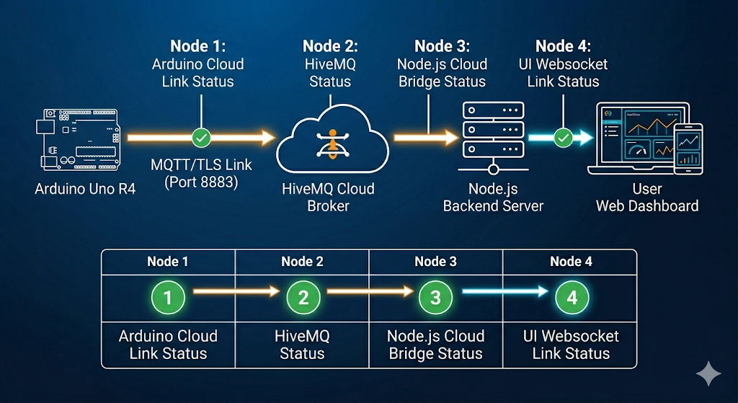
High-Level System Architecture
The "Cloud-to-Hardware" Ecosystem
This slide illustrates the structural layout of the project, showing how the local hardware interacts with the global cloud and the end-user dashboard.
Edge Layer: Arduino Uno R4 Wi-Fi handling real-time sensor data and heater PWM control.
Orchestration Layer: HiveMQ Cloud (MQTT Broker) acting as the secure message relay.
Application Layer: Node.js Backend managing data persistence and serving the Web Dashboard via WebSockets (Socket.io).

Slide 3
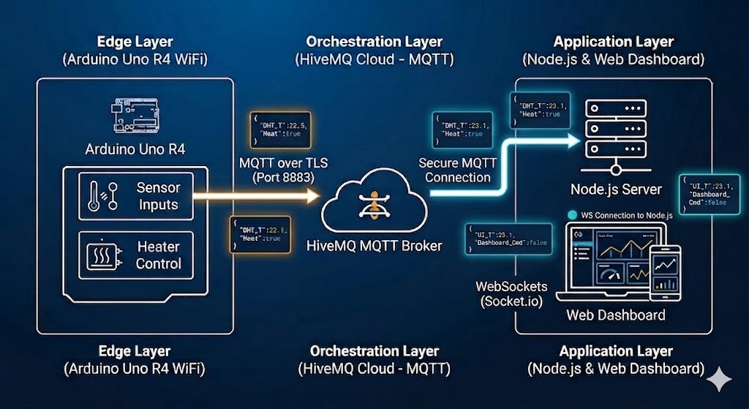
Communication & Data Flow
The "Digital Plumbing"
This slide focuses on the protocols used to move data across the layers.
Telemetry (Upstream): Arduino ➔ MQTT (TLS 8883) ➔ Node.js.
Command (Downstream): User UI ➔ Socket.io ➔ Node.js ➔ MQTT ➔Arduino.
Security: Static Environment-based Auth and Certificate-based communication for the HiveMQ link.

Slide 4
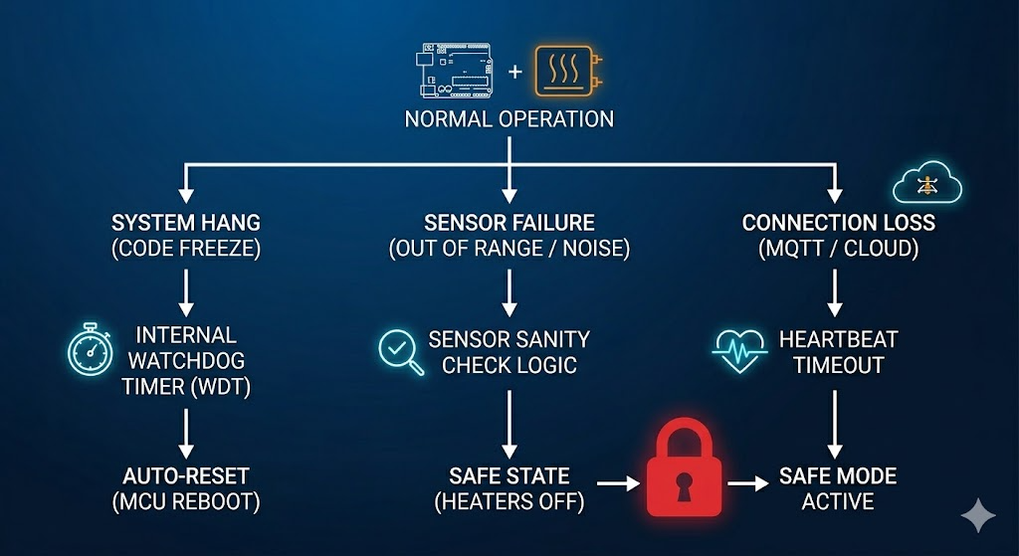
The Safety & Fail-Safe Layer
Hardware Integrity & Professional Engineering
Safety is the priority. This slide highlights the three-pillar protection strategy implemented in the C++ firmware.
Watchdog Timer (WDT): Hardware-level reset if the code hangs.
Sensor Sanity: Immediate shutdown if temperature values are physically impossible (cut wires/shorts).
SAFE_STATE: A predefined mode where all heating elements are physically disconnected/powered down.

Slide 5
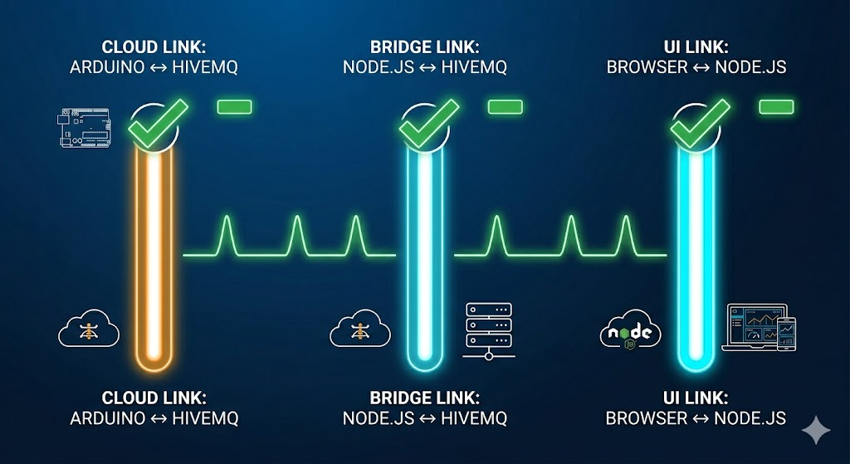
System Connection Status Check
Link Name | Primary Connection | Who Monitors It? | Logic Used
Cloud Link | Arduino ➔ HiveMQ | Arduino | mqttClient.connected() returns false.
Bridge Link | Node.js ➔ HiveMQ | Node.js | client.on('offline') event fires.
UI Link | Browser ➔ Node.js | Browser | socket.on('disconnect') event fires.

Slide 6
Goal: Establish a stable, zero-cost bridge between the Arduino R4 and your Node.js server.
Protocol: MQTT (Message Queuing Telemetry Transport).
Platform: HiveMQ Cloud (Free Tier - up to 100 devices).
Security: TLS encryption (Port 8883) using Username/Password instead of complex X.509 certificates.
Benefit: Zero-footprint on R4 memory, faster handshake, and no monthly billing.

Slide 7
The "Envelope" Method: Instead of 20 separate messages, we will use JSON.
Payload: A single JSON object containing all 20 variables.
Topic Structure: boiler/main/status
Example Payload: {"temp": 72.5, "pressure": 1.2, "relay": true, "target": 75.0, ...}
Efficiency: Reduces WiFi "on-time" and prevents the Arduino from hanging during transmission.

Slide 8
Responsibility: Data collection and transmission.
Read: Sample 20 sensors/variables every 30 seconds.
Pack: Use the ArduinoJson library to build the "Envelope."
Ship: Connect via WiFiS3 and ArduinoMqttClient to HiveMQ.
Safety: If the connection fails, the Arduino continues its local heater safety logic independently (Asynchronous).

Slide 9
Responsibility: Data processing and distribution.
Listen: Stay permanently connected to HiveMQ via the mqtt npm package.
Unpack: Receive the JSON string and parse it back into a JavaScript object.
Broadcast: Use Socket.io to "push" the fresh data to every connected HTML dashboard instantly.
Log: (Optional) Save the data to a local file or database for history

Slide 10
Responsibility: Real-time visualization.
Socket Connection: Open a "hotline" to your local Node.js server.
Dynamic Update: When a message arrives, update the UI (gauges, charts, or text) without refreshing.
User Input: Send "Target Temp" changes back up the chain (HTML $\rightarrow$ Node.js $\rightarrow$ HiveMQ $\rightarrow$ Arduino).

Slide 11
The Master Roadmap: From Arduino to Desktop App
Phase 1: The Cloud "Switchboard" (HiveMQ)
Step 1: Create the HiveMQ Free Cluster.
Step 2: Define the Multi-Boiler Topic Structure: boilers/{{DEVICE_ID}}/status.
Step 3: Generate secure credentials for the hardware and the server.
Phase 2: The Hardware "Pulse" (Arduino R4)
Step 4: Define a unique DEVICE_ID for each R4 (e.g., B1, B2).
Step 5: Implement JSON Bundling: Pack all 20 variables into one message.
Step 6: Asynchronous Publishing: Send data every 30 seconds without blocking the heater logic.
Phase 3: The Local "Brain" (Node.js)
Step 7: The Wildcard Listener: Set up Node.js to listen to boilers/+/status so it catches data from all connected boilers.
Step 8: Data Logging (Hard Drive): Implement a local storage system (JSON or SQLite) to save every data point permanently to your laptop.
Step 9: Socket.io Bridge: Stream the live data from Node.js to your HTML dashboard.
Phase 4: The Final Product (The .exe Dashboard)
Step 10: Build the Multi-Card UI: Design the dashboard to show a new status card automatically whenever a new Boiler ID appears.
Step 11: Electron Packaging: Wrap the Node.js server and HTML into a portable .exe file.
Step 12: Distribution: Test the .exe on a different computer/network to confirm it sees the boiler.

Slide 12
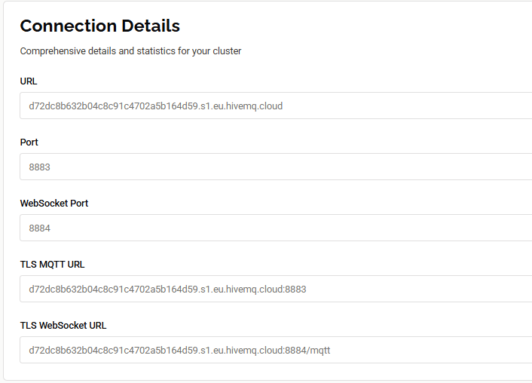
Setting up HiveQM
1. The Standard URL & Port (8883)
What it is: The "Professional Entrance."
Who uses it: Your Arduino R4.
Why: Port 8883 is the industry standard for Secure MQTT. It uses TLS (Transport Layer Security), which is the same encryption banks use. Since your Arduino is a dedicated hardware device, it speaks the "pure" MQTT language directly.
2. WebSocket Port (8884)
What it is: The "Web Entrance."
Who uses it: Your Browser / Dashboard.
Why: Standard browsers (like Chrome or Safari) are "allergic" to pure MQTT; they only like to speak Web languages. The WebSocket port wraps the MQTT data inside a web-friendly package. You’ll use this when you want your HTML page to show live data without going through a server.
3. TLS MQTT URL
What it is: Just a combined version of #1.
Note: It’s exactly the same as the first URL, just with :8883 added to the end. Most code libraries ask for the "Host" and the "Port" separately, but some want the whole string.
4. TLS WebSocket URL
What it is: The full address for web-based tools.
Note: Notice the /mqtt at the end. This is the specific "path" a website follows to find the data stream.
Create a serverless cluster
d72dc8b632b04c8c91c4702a5b164d59.s1.eu.hivemq.cloud: this is my link

Slide 13
SSL client
An SSL WiFi Client (like the WiFiSSLClient you used in your code) is a specialized tool that allows your Arduino to communicate with the internet using encryption.
In your project, when you connect to HiveMQ Cloud, you are sending data over the public internet. Without SSL, anyone sitting between your router and the cloud could "sniff" your WiFi password or your boiler's temperature data. SSL prevents this.
How it Works (The "Secret Handshake")
Think of a standard WiFiClient as sending a postcard—anyone can read it. A WiFiSSLClient is like sending a locked safe that only the recipient can open.
The Handshake: When your Arduino starts the connection, it asks the server for a Certificate.
Verification: The Arduino checks this certificate to ensure it’s actually talking to HiveMQ and not a hacker.
Encryption: They agree on a "secret key." All data sent after this point is scrambled into unreadable gibberish.
Decryption: The server uses its key to turn that gibberish back into your JSON data
Why the Uno R4 handles this differently
On older Arduinos (like the Uno R3), SSL was almost impossible because it requires a lot of math and memory (RAM). The Uno R4 WiFi is special because it has two processors:
The Renesas RA4M1: This runs your actual Arduino code (your loop and setup).
The ESP32-S3: This is a separate "co-processor" dedicated to WiFi and Bluetooth.
When you use WiFiSSLClient, your main code tells the ESP32: "Hey, I need a secure tunnel to this address." The ESP32 does all the heavy mathematical lifting of the encryption so the main processor can focus on your heater logic.
Important SSL Parameters in your Project
Port 8883: This is the standard port for Secure MQTT. If you were not using SSL, you would typically use port 1883.
Overhead: Because of the encryption math, SSL messages are slightly larger than "Plaintext" messages. This is why connecting sometimes takes 1–3 seconds longer than a normal connection—the "Handshake" takes time.
Root Certificates: Sometimes, the Arduino needs a "Root CA" (a master key) to trust the server. The Uno R4 usually handles this automatically through its firmware, but for high-security industrial systems, you sometimes have to manually "flash" these certificates to the WiFi module.
Is it necessary?
For a Heater Project, absolutely. If someone were to intercept your MQTT messages and send a fake command to your boiler, they could potentially cause physical damage. SSL ensures that the only person controlling that heater is you (or your server).

Slide 14
Internet layer
MQTT: The Application layer (The "what" — your boiler data).
SSL/TLS: The Security layer (The "how safe" — the encryption).
TCP: The Transport layer (The "reliability" — ensuring every packet arrives in order).
IP: The Internet layer (The "address" — getting the data to the right server).

Slide 15
Internet Protocols
Feature | HTTP (REST) | WebSockets | MQTT
Model | Request/Response (Client asks, Server answers) | Full-Duplex (Continuous bi-directional stream) | Pub/Sub (Broker-mediated messaging)
Connection | Ephemeral: Opens, sends data, closes. | Persistent: Keeps a single socket open. | Persistent: Keeps a "Keep-Alive" session.
Header Size | Large: (800+ bytes) Includes cookies, browser info, etc. | Medium: (Small overhead after initial handshake). | Tiny: (As small as 2 bytes).
Power/Data Consumption | High: Heavy for battery-powered devices. | Medium: Better for constant data. | Very Low: Optimized for "Low-Bandwidth" IoT.
Real-Time Speed | Slow: Latency due to opening/closing connections. | Fastest: Immediate delivery in both directions. | Fast: Highly efficient for "push" notifications.
Complexity | Simple (Most common protocol). | High (Requires handling stateful connections). | Moderate (Requires an external Broker like HiveMQ).
Best Use Case | Fetching a webpage or checking a weather API. | Real-time chat apps or live stock market tickers. | IoT Sensors, Hardware Control, & Home Automation.

Slide 16
1. HTTP: The "On-Demand" Protocol
Think of HTTP like a vending machine. You walk up, put in a request, get your snack, and walk away.
Why it's bad for your heater: If you want the heater to turn off immediately when a button is pressed on your phone, the Arduino would have to ask the server "Should I be off?" every single second (this is called Polling). It wastes a lot of energy and WiFi bandwidth.
2. WebSockets: The "Open Telephone Line"
WebSockets are like a phone call. Once the call is connected, both people can talk at the exact same time without hanging up.
Why use it: It’s great for high-speed dashboards where data is changing 60 times a second.
The Downside: It is "stateful." If the WiFi flickers for a millisecond, the phone call drops, and you have to write complex code to "redial" and make sure no data was lost.
3. MQTT: The "Post Office" (Your Current Project)
MQTT is like a Post Office with P.O. Boxes. You (the Arduino) subscribe to a box called heater/commands. Whenever someone (the Node.js server) drops a letter in that box, the Post Office (HiveMQ) immediately runs to your house and delivers it.
The "LWT" Feature: MQTT has a unique feature called Last Will and Testament. If your Arduino loses power, the Broker (HiveMQ) can automatically tell your server: "Hey, the Arduino just died!" HTTP and WebSockets cannot do this as easily.
Conclusion for an Engineer: If you are building a website, use HTTP. If you are building a high-speed trading bot, use WebSockets. Since you are building an embedded hardware system (Heater), you have chosen the industry standard: MQTT.

Slide 17
Implement two way command
Arduino (DataToCloud.cpp, ProjectHeater.h, main.cpp):
Declare global variables for heaterState and targetWaterTemp.
Subscribe to a new MQTT topic for incoming commands (e.g., boilers/B1/commands).
Implement an MQTT message callback function to parse commands (e.g., "heater on/off", "set temperature").
Update the sendBoilerData function to include the current heaterState and targetWaterTemp in the status messages sent to the cloud, so the UI can reflect the actual state.
Node.js Server (index.js):
Add a new Socket.io event listener (socket.on('heaterCommand', ...)) to receive commands from the web UI.
When a command is received, publish it as an MQTT message to the Arduino's command topic.
Web UI (index.html):
Add new HTML elements (buttons, input field) for controlling the heater.
Implement JavaScript functions to emit heaterCommand events to the Node.js server via Socket.io.
Update the boilerUpdate listener to display the current heaterState and targetWaterTemp received from the Arduino.

Slide 18
Modification on each file
index.html (Web User Interface)
Added Heater Control Section: Introduced new UI elements (buttons, input field) for "Heater ON/OFF" and "Set Target Temp".
Command Sending Logic: Implemented sendHeaterCommand() JavaScript function to capture user input and emit heaterCommand events via Socket.io to the Node.js server.
State Display Update: Modified the socket.on('boilerUpdate') listener to display the heaterState and targetWaterTemp values received from the Arduino.
index.js (Node.js Server Bridge)
Socket.io Command Listener: Added a socket.on('heaterCommand') handler to receive commands from the web UI.
MQTT Command Publishing: When a heaterCommand is received, the server now publishes an MQTT message (e.g., {"command": "heater", "action": "on"}) to the Arduino's dedicated boilers/B1/commands topic.
Enhanced Logging: Updated console logs to include the heaterState and targetWaterTemp from incoming Arduino status messages.
DataToCloud.cpp (Arduino Firmware)
MQTT Command Subscription: The Arduino now subscribes to the boilers/B1/commands MQTT topic to listen for incoming commands from the server.
Message Callback (onMqttMessageReceived): Implemented a function to parse incoming JSON commands. It updates the internal heaterState and targetWaterTemp variables based on the received command.
Immediate Feedback: After processing a command, onMqttMessageReceived immediately calls sendBoilerData() to publish the Arduino's updated state back to the server, ensuring the UI reflects changes without delay.
Increased Responsiveness: The TaskCloud loop now polls for MQTT messages more frequently (every 100ms) to quickly detect and act on incoming commands.

Slide 19
Arduino Connection & Data Reliability
The "Wildcard" Subscription (Data Completeness)
The Problem: Your Arduino sends different types of information on different sub-topics (e.g., .../status for connectivity and .../telemetry for sensors). Subscribing to a specific topic caused you to miss the sensor data.
The Fix: Changed the subscription to boilers/B1/#.
Result: The server now catches every message published under that branch, ensuring no telemetry is ignored.
The "Stale Data" Watchdog (Connection Integrity)
The Problem: The MQTT "Last Will" only triggers if the Wi-Fi physically drops. If the Arduino code freezes or the sensor loop stops while Wi-Fi stays on, the UI would "ghost" (show old data as if it were current).
The Fix: Added a lastSeen timestamp updated on every message and a setInterval watchdog.
Result: If no messages arrive for 60 seconds, the server automatically marks the device as no-data and alerts the UI.

