Slide 1

TEAM MEMBERS:
ARSHAD SACOOR
JD PERUMAL
KEVAL MAHARAJ
MOHAMMED CARRIM
TIASHKA SEETAL

Slide 2
What is Harmony?
Core Features
Users can Scan/Upload a food image and the system will recognize it
Users will view drinks suggestion based on food item that was scanned/uploaded
Users can view Pairing which consists of Food item and a Drink item
Live rating system of a Pairing and
Add/View Favourite Pairings
User can create a Pairing which consists of Food item and a Drink item

Slide 3
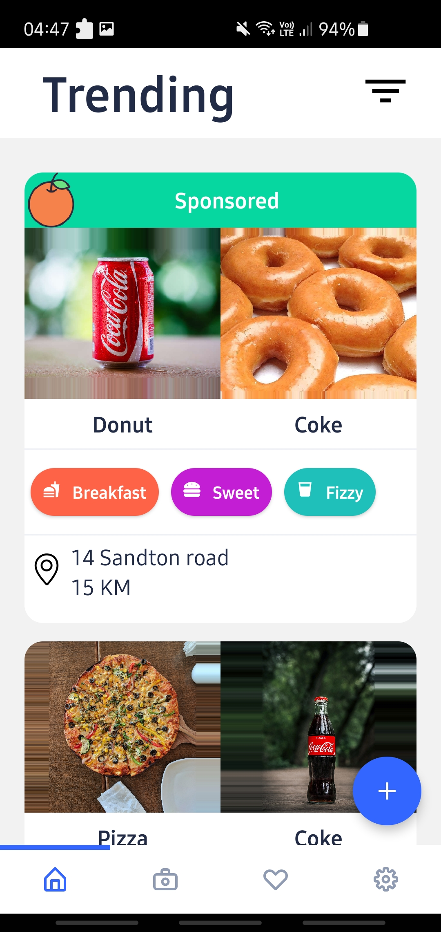

Mobile App
Users can scan food items and get drink pairings
Shows pairing cards to user that have been created by other users
Users can filter between pairings
Show sponsored ads that have been created by Businesses (Wow Factor)

Slide 4
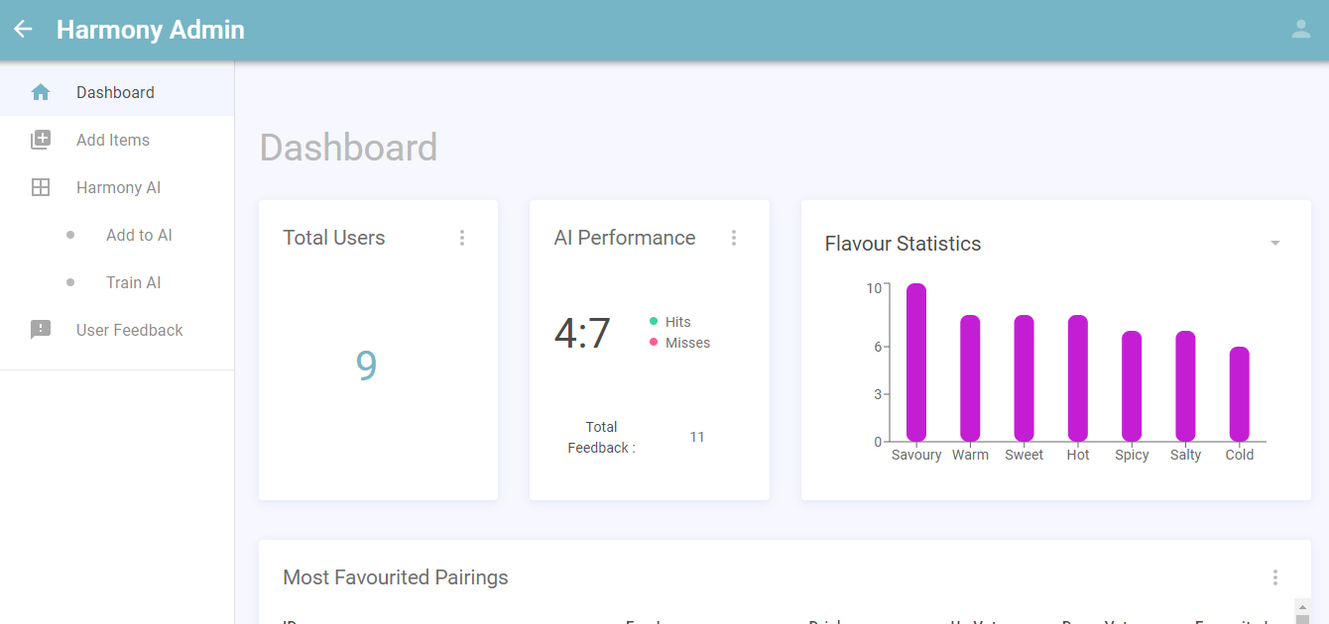
Admin Website
Admin can view app statistics
Admin can add new images to be trained by AI
Admins can view user feedback to see images that have been identified

Slide 5
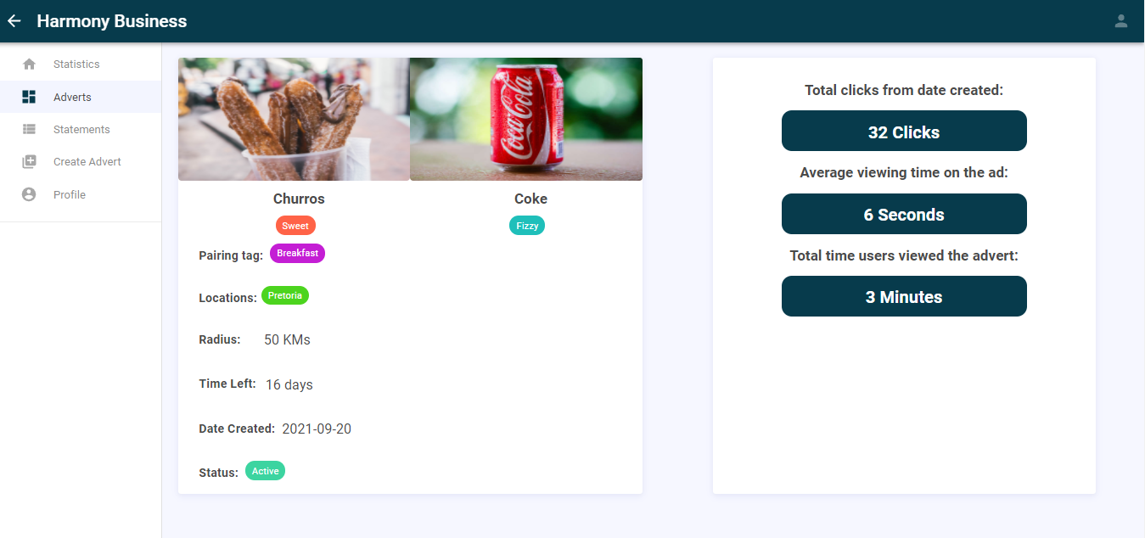
Business Website
Businesses can view trending statistics returned by our recommendation system
Businesses can add sponsored ads which can be geofenced
Businesses can make payments on the ads they have created

Slide 6
Harmony System Demo

Slide 7
WOW FACTOR Recommendation system using collaborative filtering

Slide 8
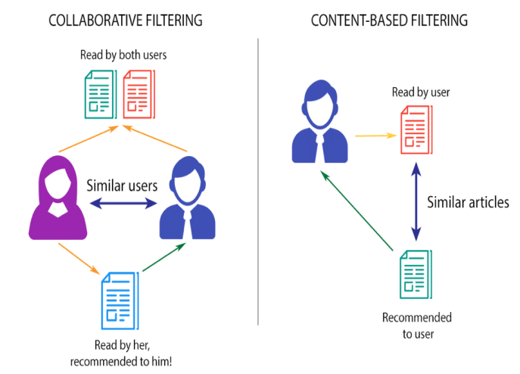
Why we picked collaborative Filtering
Collaborative Filter allows us make predictions based on what other users like that are similar to our user

Slide 9
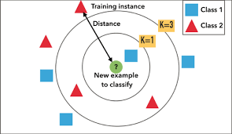
What Type of method we used: KNN Algorithm
K = 3
Euclidean Distance

Slide 10
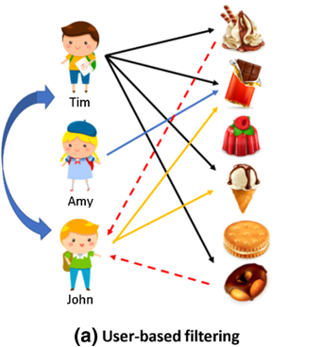
How the recommender works
Let’s consider Tim and John
Both Tim and John like Chocolate and Ice Cream
But since Tim also likes waffle and donut, the system will recommend waffle and donut to John

Slide 11





Tools used in our project
Azure Custom Vision
AWS Cognito
AWS Lambda
Amazon DynamoDB
React/React Native

Slide 12
Testing
Functional
Github Actions – Automated tests
Pytest – Python testing tool
Non-Functional
Availability – UptimeRobot
Maintainability – SonarCloud
Reliability - SonarCloud

Slide 13
Project Management with GitHub Projects

