Slide 1
군미니(Koonmini)
projected by 군미니들

Slide 2

Hello!
We are koonminideul.
김현우 (ASak1104)
박종찬 (daisophila)

Slide 3
Let’s watch the video!
https://youtu.be/Sqp1qpT6wCY

Slide 4
Function Design

Slide 5
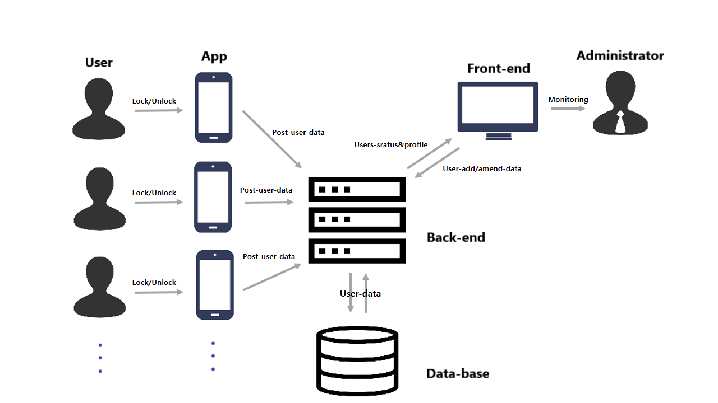

Slide 6
Expectation

Slide 7
To Be Updated
비대면 점호
유동병력 관제
카메라 차단

Slide 8














Technique Used

Slide 9

Permissions Commercial use Modification Distribution Private use
Limitations Liability Warranty

Slide 10
Thanks!
Any questions?
khw56184@kookmin.ac.kr & daisophila@gmail.com

