Slide 1
Adventure Design
- 창업연계공학설계입문 -

Slide 2
Members
김준혁
School number : 20181596
Email : moldmen@kookmin.ac.kr
Github : github.com/kookminnacho
김현우
School number : 20181603
Email : khw56184@kookmin.ac.kr
Github : github.com/ASak1104
Repository link :
https://github.com/ASak1104/Engineering-Presentation

Slide 3
Subject
Line tracing
improvement
Signal light
recognition
T - Parking

Slide 4
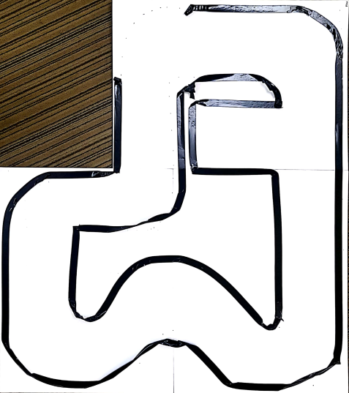
Line tracing improvement
New track, Similar to a real lane
Eliminate unnecessary movement

Slide 5

Signal light recognition
Automated signal light using another PI
Using LED(Light Emitting Diode)

Slide 6
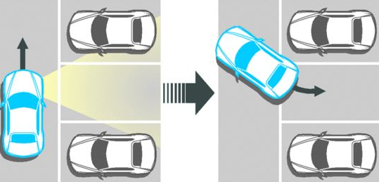
T - Parking
Detect parking spaces
Process out T - Parking

Slide 7
Credits
김준혁
School number : 20181596
Email : moldmen@kookmin.ac.kr
Github : github.com/kookminnacho
김현우
School number : 20181603
Email : kwh56184@kookmin.ac.kr
Github : github.com/ASak1104
Repository link :
https://github.com/ASak1104/Engineering-Presentation

Slide 8
Thanks!
Any questions?

