Slide 1
Building, Testing, and Deploying Docker Applications
Ayanle Salad, MEng
Junior DevOps Engineer
https://github.com/ASalad42/Build-deploy-Microservices-with-Docker

Slide 2
Agenda
Introducing the Development Workflow
Multi-Container Project outline
Complex Fibonacci Calculator App
Project Flow
The Development Stage
Containerized Multiple Services
Continuous Integration Workflow
The Production Stage
Pushing built production images to DockerHub
Multi-Container Deployment to AWS

Slide 3

Development Workflow
GitHub Repo
Feature
Main
Travis CI
AWS hosting
Pull Request
Branches
ASalad42

Slide 4
Multi-Container Project Outline
Aim: Build, test and deploy multi-container application ( Complex Fibonacci Calculator) on AWS
Tech Stack:
Docker & DockerHub
Git & GitHub
Travis CI
AWS
Code Editor (Visual Studio Code used in this project)
Prerequisites:
Node.js
Create react app globally and generate the client application

Slide 5
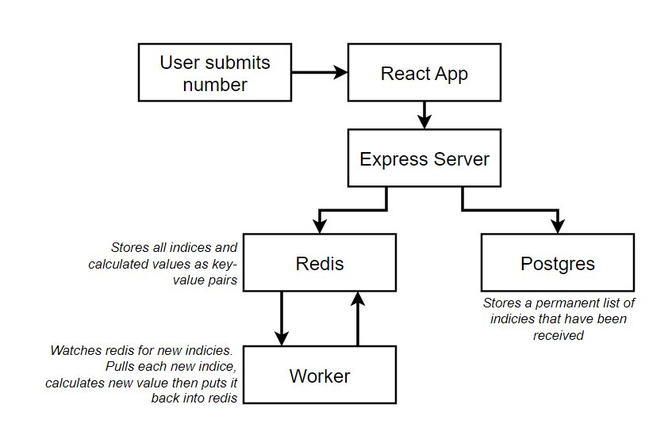
Complex Fibonacci Calculator App

Slide 6
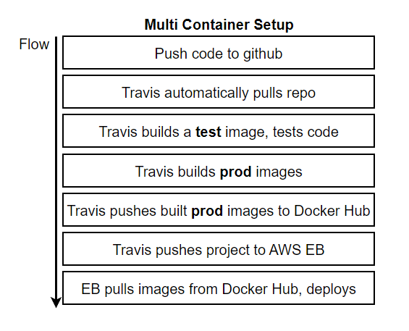
Project Flow
Development Stage:
Dev files (Dockerfile.dev)
Docker-compose
7 containers built (one extra for nginx routing)
Continuous Integration (CI) Stage:
Link GitHub, Travis CI, DockerHub
Travis config file
Production Stage:
Prod files (Dockerfile)
Connect Elastic Beanstalk, RDS (Postgres) and ElastiCache (Redis)
Deploy Application

Slide 7
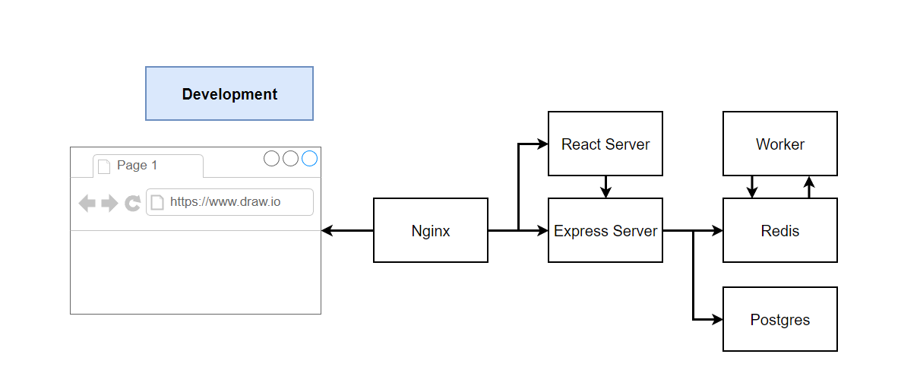
The Development Stage

Slide 8
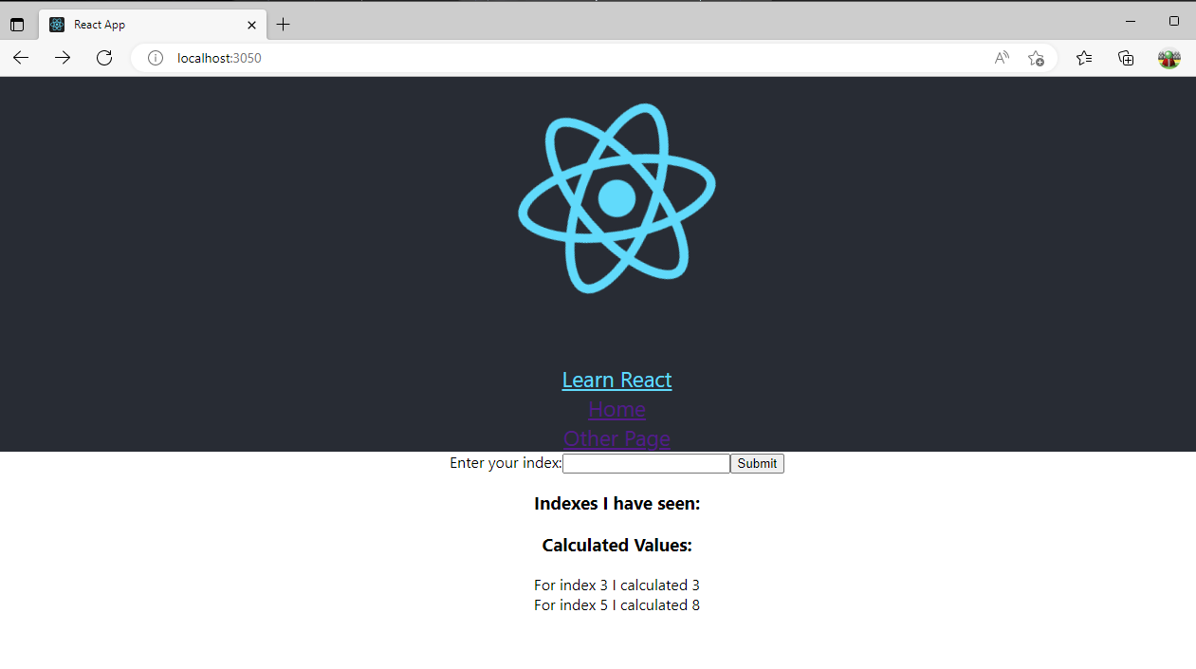
Containerized Multiple Services

Slide 9
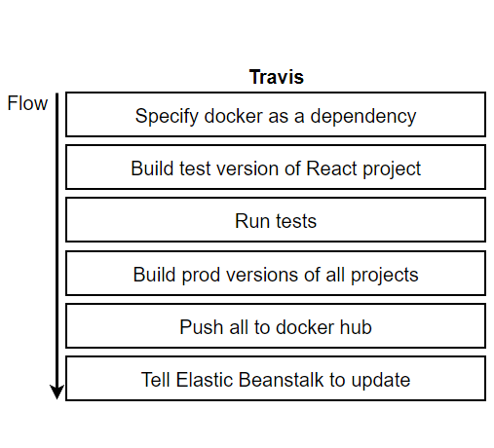
Continuous Integration Workflow
Link GitHb & Travis CI
Travis YML file configuration
Setting up Environment Variables
Docker login credentials
AWS Keys
Changes made on feature branch
Pull Request accepted & Merged
Travis CI Tests Run
Production Images pushed to DockerHub if successful
Elastic Beanstalk pulls images from DockerHub and deploys App

Slide 10
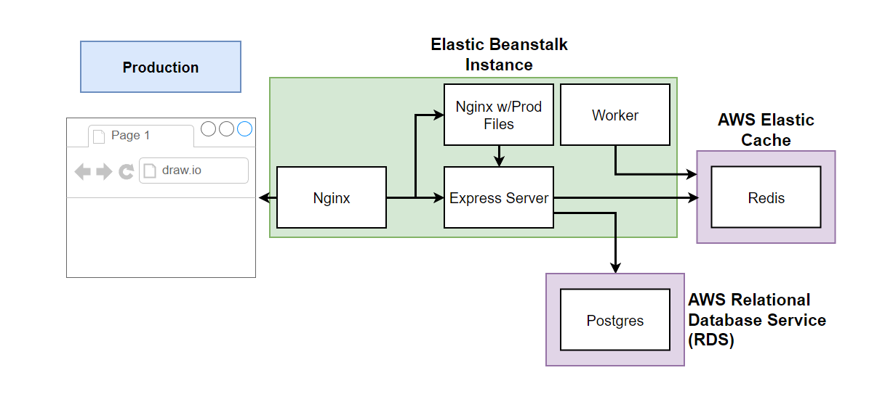
The Production Stage

Slide 11
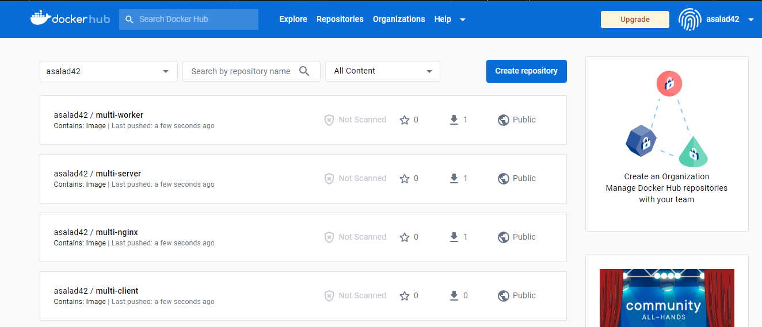
Pushing built production images to DockerHub

Slide 12
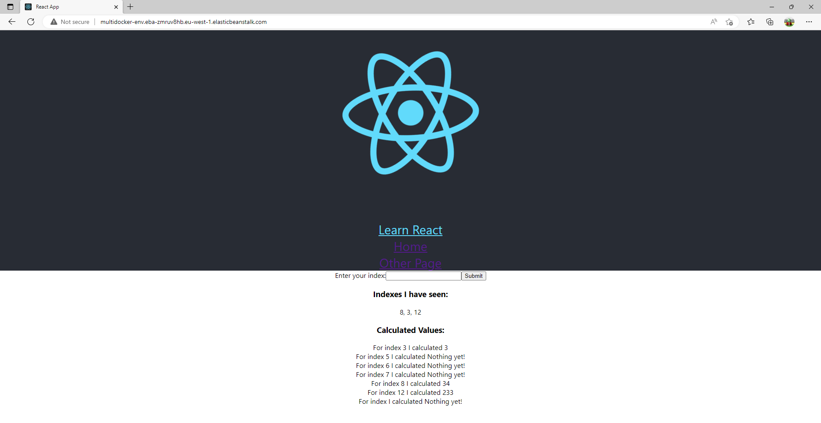
Elastic Beanstalk pulls images from DockerHub and deploys App

Slide 13
Thank You for Listening

