Slide 1

Ain Shams University Faculty of Engineering
Computer and Systems Engineering CSE332s: Design and Analysis of Algorithm
NAME | ID
Mohamed Hossam El-Din El-Sayed | 1808581
Mohamed Hesham Alsaied Albendary | 1808442
Ahmed Salah Abdelhak | 1803820
Ahmed Reda Ibrahim Taha Elawam | 1802745
Mohamed Ashraf Farouk Ibrahim | 1805188
Mohamed Ahmed Mahmoud Asran | 1808040

Slide 2
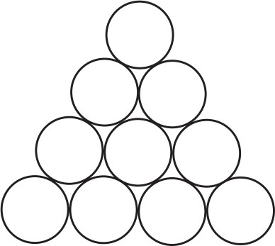
Task 1
Assumptions
User will input correct data type whenever they are asked for input (ex. When asked to enter number of rows, they won’t enter a string for example). Also, the centers of the coins are assumed to be at the points of an equilateral triangular lattice
Problem Description
Inverting a Coin Triangle Consider an equilateral triangle formed by closely packed pennies or other identical coins like the one shown in Error! Not a valid bookmark self-reference..
It’s required to use iterative improvement method to design an algorithm to flip the triangle upside down in the minimum number of moves if on each move it’s possible to slide one coin at a time to its new position.
Figure 1

Slide 3
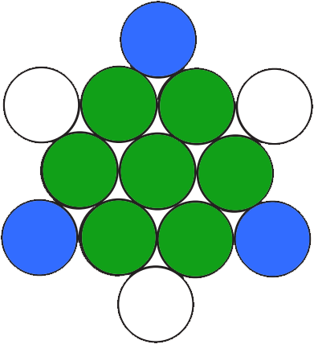
Detailed Solution
A trivial solution to flip a triangle with 𝑛 rows is to just move all the coins to their new
positions, which takes number of steps equal to number of coins in that triangle "
𝑛∗(𝑛+1)
"
2
or 10 steps when applied to Error! Not a valid bookmark self-reference.(obviously inefficient!)
To flip the pyramid in the least number of moves, we will try to overlap both starting and
ending positions together, this way the coins marked in green in Figure 2,will not be moved at all. And the ones marked in blue only will be moved to their new positions “Marked with white”. So, in Error! Not a valid bookmark self-reference., we will need to make only 3
Figure 2
moves

Slide 4
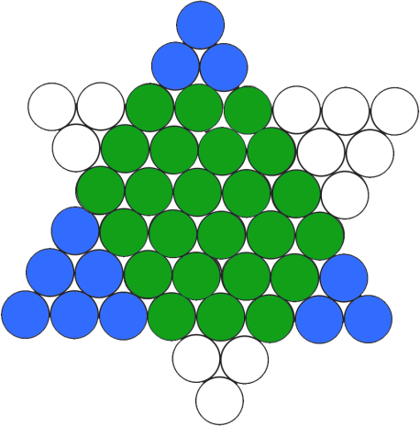
Let’s draw this triangle with 8 rows
Figure 3
If we keep on drawing more and more triangles, we will find out that
The small blue triangle in the upper corner can always be moved to the corresponding small white triangle in the bottom
The small blue triangle in the bottom left corner can always be moved to the corresponding small white triangle in the upper right corner
The small blue triangle in the bottom right corner can always be moved to the corresponding small white triangle in the upper left corner
Table 1 shows the relation between number of rows 𝑛 and the number of rows of each of the small triangles

Slide 5
Table 1
Number of rows 𝑛 | Number of rows in left triangle 𝑎 | Number of rows in upper triangle 𝑏 | Number of rows in right triangle 𝑐
1 | 0 | 0 | 0
2 | 1 | 0 | 0
3 | 1 | 1 | 0
4 | 1 | 1 | 1
5 | 2 | 1 | 1
6 | 2 | 2 | 1
7 | 2 | 2 | 2
8 | 3 | 2 | 2
𝑛+1
𝑛
𝑛−1
It’s easy to prove that 𝑎 = ⌊ ⌋ , 𝑏 = ⌊ ⌋ , 𝑐 = ⌊ ⌋ using data obtained in Table 1
3
3
3

Slide 6
Pseudo-code
ALGORITHM InvertTriangle(n)
//INPUT: n - number of rows
//OUTPUT: Inverted triangle
//REQUIREMENTS: n > 0
a <- ⌊(n + 1) / 3⌋
a ∗ (a + 1)
for i <- 1 to do
2
move one coin from bottom left triangle to upper right print triangle
b <- ⌊(n) / 3⌋
b ∗ (b + 1)
for i <- 1 to do
2
move one coin from top triangle to bottom print triangle
c <- ⌊(n - 1) / 3⌋
c ∗ (c + 1)
for i <- 1 to do
2
move one coin from bottom right triangle to upper left print triangle
steps <- a + b + c return steps
Complexity Analysis
Complexity for each function
printTriangle: 𝑂 (
𝑛∗(𝑛+1)_{) ≈ 𝑂(𝑛2)}
2
init: 𝑂 (
𝑛∗(𝑛+1)
2
2
) ≈ 𝑂(𝑛 )
sum: 𝑂(1)
options: 𝑂(1)
mainmenu: 𝑂(1)

Slide 7
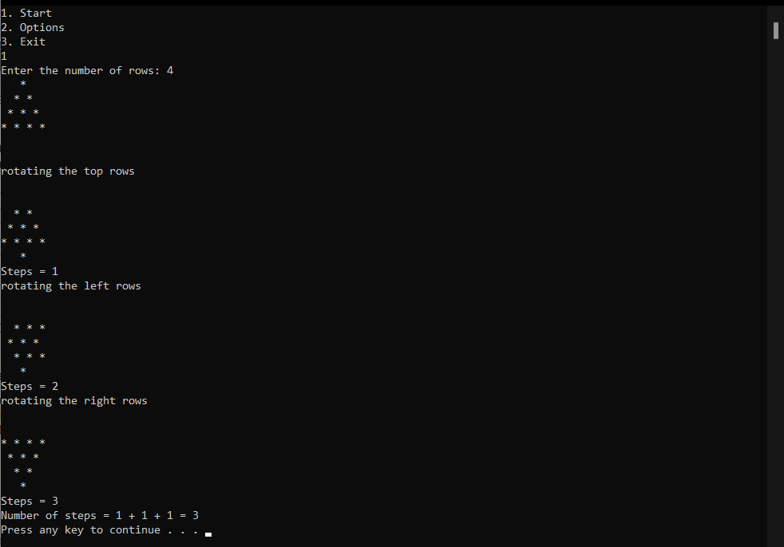
To calculate total complexity, recall that we make 𝑠𝑢𝑚(𝑎) + 𝑠𝑢𝑚(𝑏) + 𝑠𝑢𝑚(𝑐) moves and in each move, we print the triangle. So, in total complexity is (𝑠𝑢𝑚(𝑎) + 𝑠𝑢𝑚(𝑏) + 𝑠𝑢𝑚(𝑐) ∗
𝑂(𝑛²), since 𝑎, 𝑏, 𝑐 are all functions in 𝑛, total complexity is ≈ 𝑂(𝑛⁴). However, the problem can be solved in 𝑂(1) if we calculate only number of steps as 𝑎 + 𝑏 + 𝑐 without printing the triangle after each step
Comparison With Another Algorithm
Another way to calculate number of steps which is by using this formula ⌊
𝑛∗(𝑛+1)
⌋, this
6
formula and my solution give the same number of steps for all values of 𝑛 [1]
Sample Output
Figure 4
Now we will try 𝑛 = 8 but since it will produce a very long output, I’ll go to options and disable step by step output so that we can see only number of steps as shown in Figure 5

Slide 8
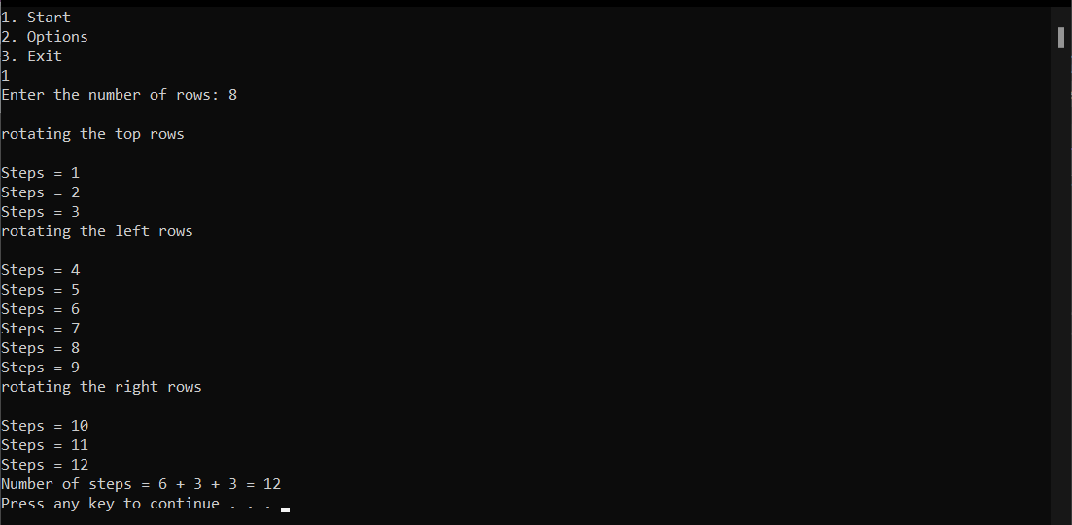
Figure 5
Conclusion
Inverting a triangle of coins using this algorithm uses iterative improvement since on each step we are getting closer to the goal result by doing the same step over and over (moving one coin between two small triangles)

Slide 9
Task 2
Assumptions
The input board size is positive number, the program alarms the user if he input an invalid board size (ie: odd number of board size).
Problem discerption
In this problem we went to find the sequence of boards which lead to a single remaining peg in the board.
The sequence of steps to eliminate the pegs in the board is jumping with a peg over another peg to unoccupied cell then eliminating the peg which we jumped over, repeating these
steps until the board became empty except for one cell occupied with a single peg.
There’s linear timing approach for solving all solvable boards but if we want to make sure that the unsolvable boards are indeed unsolvable, we must use the dynamic programming approach by make a tree of all possible sequences of boards, then we check if the one or two of these sequences are the solution by checking of the length of the sequence equal the length of the board - 2.

Slide 10
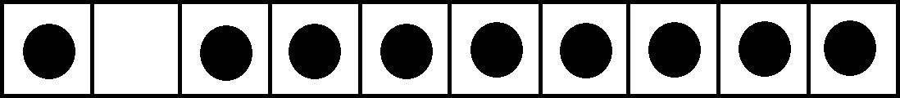
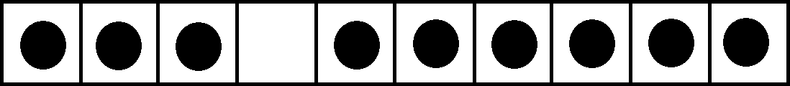
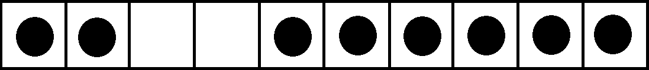
Steps of one move
Figure 6
Moving a peg if it can move to unoccupied cell
Figure 7
Removing the peg which the moved peg jumped over
Figure 8
Detailed solution
Using the dynamic programming approach we first must construct a tree with the whole feasible moves of the initial board without repeating any sequence of boards twice this is done using memoization technique then we must traverse the tree to find if there’s a
solution to the board or not by checking if the sequence of moves (the depth of the tree at any point) = board_size – 2 finally we print the two complete solution if the board is solvable,

Slide 11
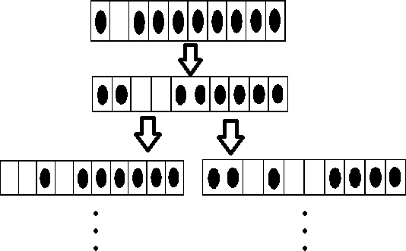
if the board is unsolvable we can print the longest sequences in the tree, which will lead to obsolete boards with no moves possible
Constructing the tree with all feasible solution
We can simply iterating over the board trying to move any peg in the tree then if we find a single peg to move we check if the resultant board after moving the peg to the new location is an already stored board, if yes we terminate the move any continue trying to move another peg, if no we add the board to the memoization data structure and then we
recursively try to move another peg in the board until there’s no new moves can be done in the board
Figure 9

Slide 12
Memoization
We can use set structure to store all resultant boards, why set?
because using it we can add and find if the board already exist in logarithmic time, this possible because the binary search tree implementation
Traversing the solution tree
This can be done simply by in-order traverse for all nodes in the tree structure and saving the contents of every node (the board) in an array of boards to output the right solution in the next step.
Output the right solution if exist
After we get all unique possible moves from the tree as an array on sequences of boards, we can loop on this array to check if any of the sequence has the length of board_size – 2, if such sequence exists, we can return it as the solution of the board,
If such sequence does not exist, we know that the board has no solution (unsolvable board).
Representation of the board
we can represent the board by several data structure, this is especially easy in this problem because all cells have only two states occupied or not occupied.
optimal data structure I found for representing exceptionally large boards and compare them efficiently is by using BitSet structure then we can simply implement the comparator to be

Slide 13
used inside the set structure for comparing the different boards represented in different BitSets.

Slide 14
Pseudo code
ALGORITHM SOLVE1DPEGSOLITAIRE
// input: board_size
// output: sequence of boards solveBoard(Board board) Board tryBoard;
BitSet tryBS;
for i <- 3 to board_size do
if (validateMove(board, I, RIGHT)) tryBoard = board. clone() move(tryBoard, I, RIGHT)
if (!memory.contains(tryBoard) do
board.addChild(tryBoard) memory.add(tryBoard)
Recursion:
solveBoard(tryBoard)

Slide 15
for i <- 1 to board_size - 2 do
if (validateMove(board, I, LEFT)) tryBoard = board. clone() move(tryBoard, I, LEFT)
if (!memory.contains(tryBoard) do
board.addChild(tryBoard) memory.add(tryBoard)
Recursion: solveBoard(tryBoard)
ArrayList<ArrayList<Board>> Solution = Traverse(headBoard) Print(Solution)
Complexity analysis
The timing is proportional to the number of all possible boards which can we deduce from the initial board without any repetition, thanks to memoization technique
T(n) = number of moves needed to solve the board * one move complexity In average case: T(n) = (n-2)*n → O(N^2)

Slide 16
In worst case: T(n) = (2^(n-1) - 2)*n = n*2^(n-1)-2n
Comparison with another algorithm
Another solution of this problem, is first check if the unoccupied cell is not the cell with number 2 or 5 from the right or the left, then there’s no solution for this board, iterate over the board trying to move the pegs to the right of the unoccupied cell to the left, then the pegs to the left to the unoccupied cell to the right
private static ArrayList<ArrayList<Integer>> solveBoard(ArrayList<Integer> board) {
ArrayList<ArrayList<Integer>> solution = new ArrayList<>(); int noOfConversions = 0;
boolean direction = LEFT;
final int BOARD_SIZE = board.size() - 1; int nextMove = 4;
solution.add(new ArrayList<>(board));
while (noOfConversions < BOARD_SIZE - 2) {
if (validateMove(board, nextMove, direction)) { board = move(board, nextMove, direction);

Slide 17
if (nextMove + 2 > BOARD_SIZE) {
nextMove = 1; direction = RIGHT;
solution.add(new ArrayList<>(board)); noOfConversions++;
continue;
}
nextMove = nextMove + 2; noOfConversions++;
}
solution.add(new ArrayList<>(board));
}
return solution;
}
using this approach, we will find the solution in linear time but we cannot make sure that the unsolvable boards is indeed unsolvable and we can only find one of two solution with this specific implementation (though we can modify it to find the two solution of the board)

Slide 18
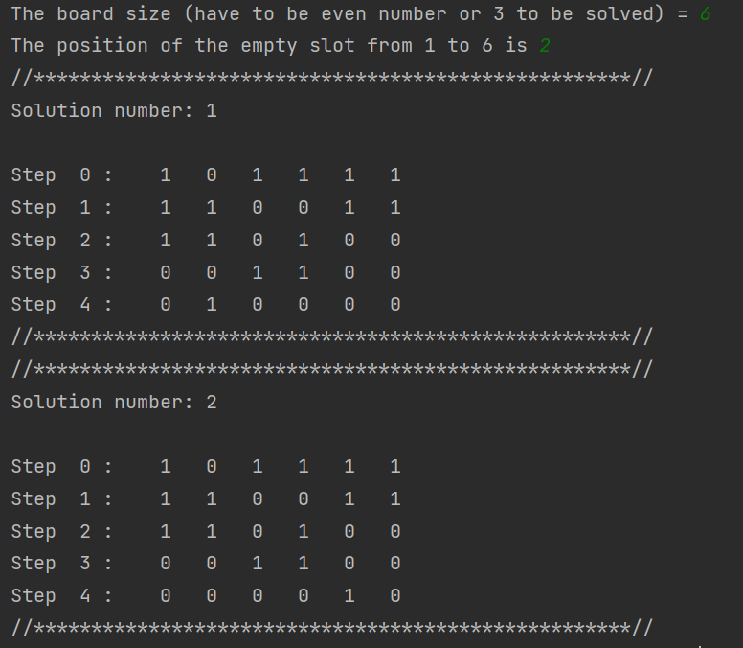
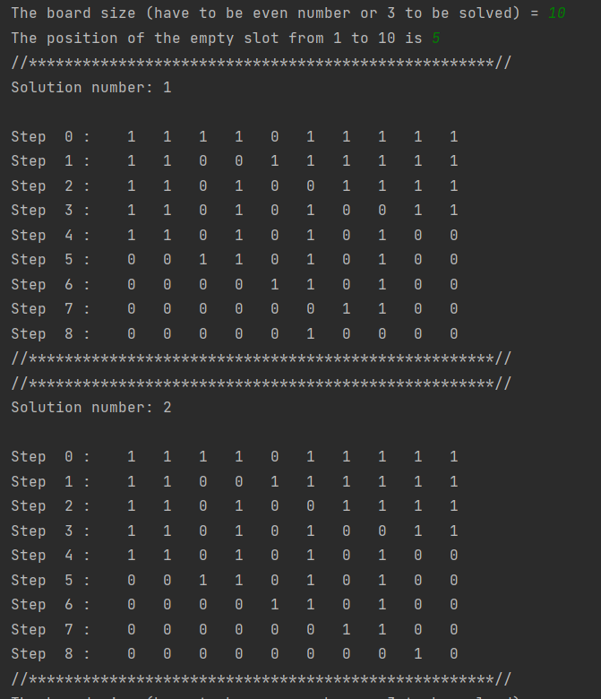
Simple output of the algorithm
Figure 11
Figure 10

Slide 19
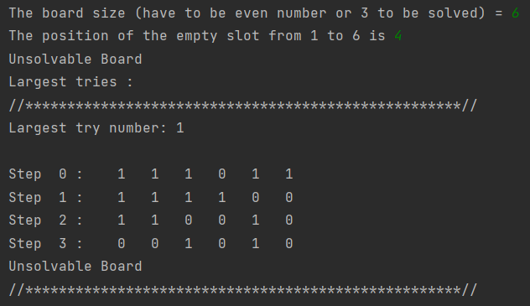
Unsolvable board
Figure 12

Slide 20
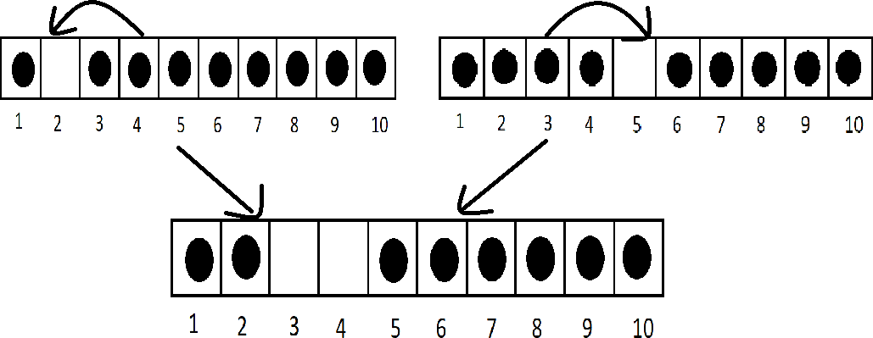
Conclusion
Question B)
For board to be solvable the cells with numbers 3 and 4 must be empty after the first move, this can be achieved if the initial board is unoccupied in cell number 2 or 5
Figure 13
The final position for the only remaining peg in this case will be in the cell number board_size - 1 or board_size – 4.
And the board is symmetric: the board must be empty in cell number board_size - 1 or board_size – 4 and in this case The final position for the only remaining peg will be in the cell number 2 or 5.

Slide 21
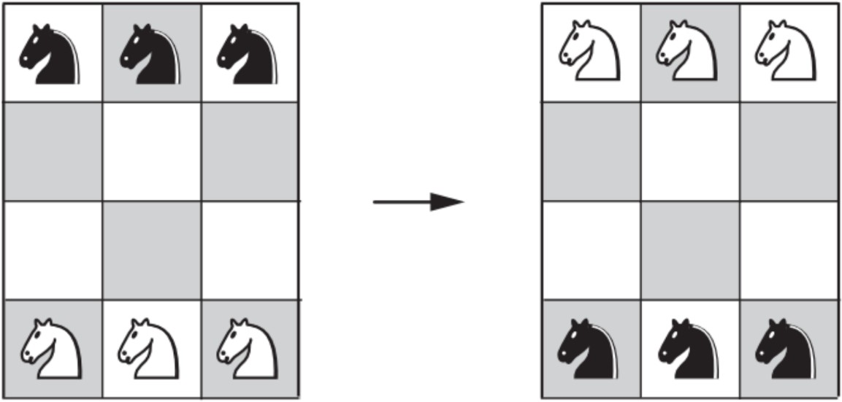
Task 3
Assumptions
User will make only two knight arrays, one of them for black knights and other one for white knights
Each knight has its own type black or white, start position and ending arrival position. Program will automatically initialize start position and arrival position for each knight to meet problem criteria
Each knight can`t visit same position twice to grantee the minimum number of movements
Problem Description
There are six knights on a 3 × 4 chessboard: the three white knights are at the bottom row, and the three black knights are at the top row. Design a divide and conquer algorithm to exchange the knights to get the position shown on the right of the figure in the minimum number of knight moves, not allowing more than one knight on a square at any time.
Figure 14

Slide 22
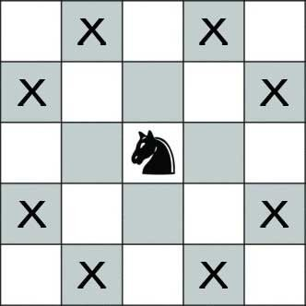
Detailed Solution
On calling Invade “the recursive function”, first we check if each knight has arrived at his arrival position “base case”
If not, all knights have arrived to their positions, we loop on the two arrays of knights (black and whites) and each non-arrived knight
move according to the knightMoveList
Figure 15
knightMoveList list is simply list of all available moves that each knight can move in his current position and other knights’ positions and is not visited before
So, we check the 8 moves of each knight and is there is one is available it`s pushed into the knightMoveList
for each knight knightMoveList is sorted according to priority queue as black knights’ moves are prioritized toward down and white knights prioritized towards up and side moves is
prioritized in both types of knights
Simulate function used to print the board pieces in form of string Solved function iterate on each knight and check if it`s arrived or not
Each knight carries boolean state called arrived marked true on arrival

Slide 23
Pseudo-code
ALGORITHM solution (knight blackKnight[3], knight whiteKnight[3])
//INPUT: two arrays of knights, one for black and one for white
//OUTPUT: solution of the problem and output after each recursive call
for i <- 0 to 3 do
initialization of each knight according to the problem statement
Invade (knight blackKnight[3], knight whiteKnight[3])
ALGORITHM Invade (knight blackKnight[3], knight whiteKnight[3])
//INPUT: two arrays of knights, one for black and one for white
//OUTPUT: board after switching both black and white knights If(solved(blackKnight , whiteKnight))
return
for i <- 0 to 3 do
whiteMoves = whiteKnight[i].knightMoveList()
sort moves of white knight[i] if(knightMoves)
whiteknight[i].move(whiteMoves[0])
blackMoves = blackKnight[i].knightMoveList() sort moves of black knight[i] if(knightMoves)
blackKnight[i].move(blackMoves[0])
Invade (knight blackKnight[3], knight whiteKnight[3])

Slide 24
ALGORITHM solved (knight blackKnight[3], knight whiteKnight[3])
//INPUT: two arrays of knights, one for black and one for white
//OUTPUT: true if all knights has arrived otherwise false
for i <- 0 to 3 do
if(!blackKnight[i].arrived || !whiteKnight[i].arrived) return true
Complexity Analysis
Complexity for each function
// n is number of knights which is fixed as 3, therefore all function of (n) is actually O(1)
// or divide and conquer technique is transform and conquer knightMoveList: 𝑂(1)
ArrivalChecker: 𝑂(1)
Move:O(1) Solved:O(n)
Simulate: O(n)
Invade:O(n+P(n)), where p is the new form of problem after transformation
Total complexity depends on the p(n) which is the new transformation of the problem And worst-case complexity is undefined when knights get stuck

Slide 25
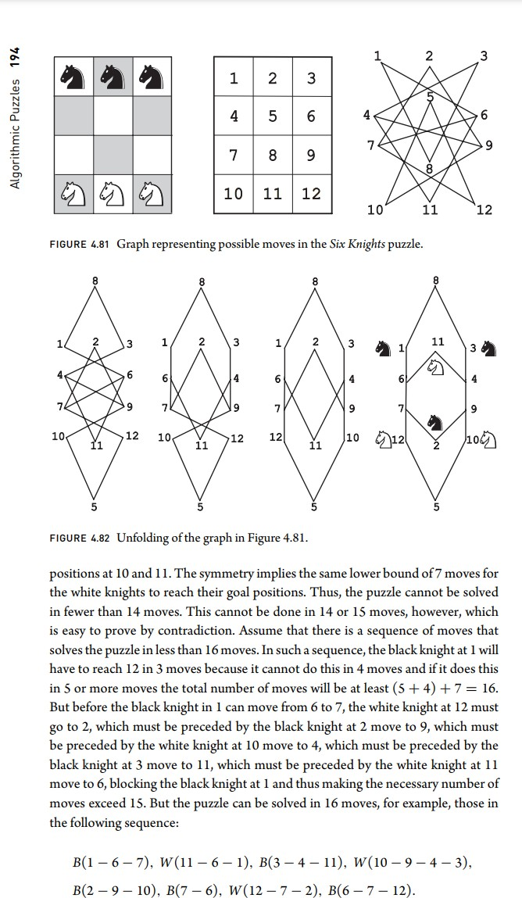
But to avoid that we set arrival positions and sort moveList according to destination
And best Case in our problem is 5 recursive calls so best-case complexity is n + n + n + n + n = 5n, which is O(n)
Comparison With Another Algorithm
Graph unfolding number of steps is 16
Figure 16
Other research on solving this problem using

Slide 26
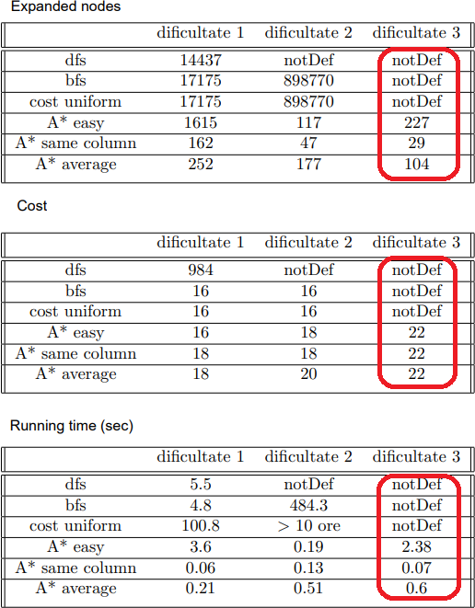
DFS – BFS – cost uniform – A* easy – A*same column – A* average
Source: https://github.com/sirbuoanabianca/GuariniPuzzleGame
Figure 17

Slide 27
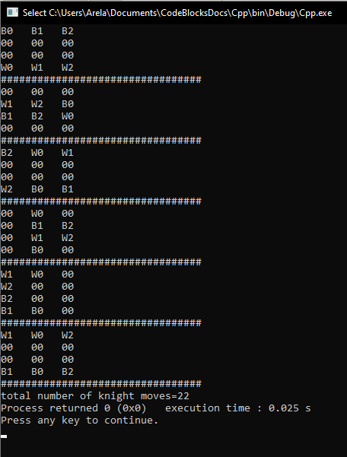
Sample Output
Figure 18
We return the shape of the board after each recursive call, and we increment the counter on each move to determine total number of moves

Slide 28
Conclusion
Exchanging the position of black and white knights using divide and conquer requires changing the positions of knights into a closer position to target positions and recursively moving until reaching the position

Slide 29
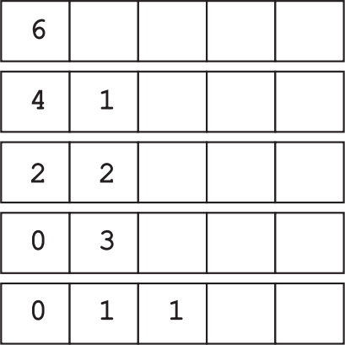
Task 4
Assumptions
The user will input a positive integer number of pennies.
Problem Description
A “machine” consists of a row of boxes. To start, one places n pennies in the leftmost box. The machine then redistributes the pennies as follows. On each iteration, it replaces a pair of pennies in one box with a single penny in the next box to the right. The iterations stop when there is no box with more than one coin as shown in Figure 19 that shows the work of the machine in distributing six pennies by always selecting a pair of pennies in the leftmost box with at least two coins. It’s required to design an algorithm using greedy method automate the machine.
Figure 19

Slide 30
Detailed Solution
Pseudo-code
ALGORITHM pennyMachine(n)
//INPUT: n - number of pennies
//OUTPUT: machine’s distribution of n pennies
result[i] <- n Do
result[i+1] <- (result[i] / 2) result[i] <- (result[i] % 2) i++
While result[i] > 1 return result
C++ Code with detailed steps’ explanation
#include <iostream> #include <vector> using namespace std;
vector<int> pennyMachine(int n)
{/* n represents the number of pennies */ int index=0;
vector<int> result;
/* Put the number of in the first box */ result.push_back(n);
/* Iterate on each box if it's greater than 1
and Divide the value in the box by 2.
Put the remainder in the same box
and the division result in the next box */

Slide 31
do{
result.push_back(result.at(index) / 2);
result.at(index) = result.at(index) % 2; index++;
}while(result.at(index) > 1);
/* Return the result boxes */ return result;
}
int main()
{
/* Ask the user for the number of pennies */ int pennies=0;
cout << "Enter number of pennies: ";
cin >> pennies;
vector<int> boxes = pennyMachine(pennies);
/* Print the final boxes distribution */ int length = boxes.size();
for(int j=0; j<length; j++)
{
cout << boxes.at(j) << " ";
}
}

Slide 32
Complexity Analysis
Time Complexity of the algorithm is O(log(n))
which is shown from the division of the number of pennies by 2 each time to get the final result.
Space Complexity of the algorithm is also O(log(n))
which is shown from the number of boxes used to store the final values of the distribution of pennies.
Comparison With Another Algorithm
Another way to solve this problem can be reached using a brute force algorithm as follows:
ALGORITHM pennyMachine(n)
//INPUT: n - number of pennies
//OUTPUT: machine’s distribution of n pennies
result[i] <- n While result[i] > 1
result[i] <- (result[i] - 2)
nextIndex <- (nextIndex + 1) if result[i] <= 1
result[i+1] <- (nextIndex)
nextIndex <- 0 i <- (i + 1)
return result
But this algorithm is slower than the greedy one as its time complexity is O(n).

Slide 33
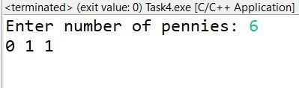
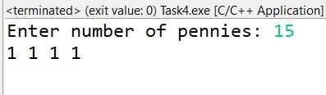
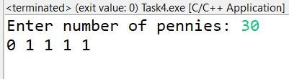
Sample Output
Sample output of randomly selected input:
Figure 20
Figure 21
Figure 22

Slide 34
Conclusion
The final distribution of pennies does not depend on the order in which the machine processes the coin pairs as it divides the number in the first box by 2 and puts the
remainder in the same box then puts the result in the next box. These steps are repeated till each box has a 0 or 1.
The minimum number of boxes needed to distribute n pennies is the minimum
number of bits needed to represent a decimal number which is ceil(Log2(n+1)) as n is the number of pennies.
Using the greedy algorithm, the machine needs ceil(Log2(n+1)) – 1 iterations to distribute the pennies before stopping.
c)

Slide 35
Task 5
Assumptions
The result of the algorithm is less than 2^64-1
Problem Descriptions
There is a row of n security switches protecting a military installation entrance. The switches can be manipulated as follows:
(i)
(ii)
The rightmost switch may be turned on or off at will.
Any other switch may be turned on or off only if the switch to its immediate right is on and all the other switches to its right, if any, are off.
Only one switch may be toggled at a time.
(iii)
The goal is to design a divide and conquer solution to get the minimum number of moves to turn all the lamps off.
Detailed Solution
To turn all lamps off we need to turn them off one by one from the left, in order to turn the lamp at index 0 from the left off, we need to turn off all the lamps starting from index 2 through n (that is n-2 lamps) and then turn the lamp at index 0, after that we need to turn them back on, and then we recurse on n-1, until we reach the base case that’s the case of 1 which equals to 1

Slide 36
Pseudo code
Func solve ( int n ):
If n == 1 then return 1
Else return 1 + 2*solve(n-2) + solve(n-1)
Java Code
import java.io.*; import java.util.*;
public class problem5{
static Scanner in = new Scanner(System.in);
static PrintWriter out = new PrintWriter(System.out);
static final int MAXN = 100; static long[] mem = new long[MAXN];
public static void main(String[] args){ System.out.print("Enter the value of n: "); int n = in.nextInt();
System.out.println(); long answer = solve(n);
System.out.println("The minimum number of moves is: "+answer);
}

Slide 37

public static long solve(int n){ if(n<=2) return n; if(mem[n] != 0)
return mem[n];
mem[n] = 1 + 2*solve(n-2) + solve(n-1); return mem[n];
}
}
Complexity Analysis
T(n) = 2*T(n-2) + T(n-1) +1
T(n) = 2/3 2^n - 1/6(-1)^n -1/2 O(2^n)
Comparison With Another Algorithm
The problem could be solved with dynamic programming technique which will make the algorithm run for a little wider range of input,
The algorithm is almost the same but we add another array to remember the value of the previous calculated results in this way we can get better results
Sample output

Slide 38
Task 6
Assumptions
The user will input a positive integer number from 0 to 63.
The source peg is A, the destination peg is D, and the other two auxiliary pegs are B and C.
Problem Description
There are eight disks of different sizes and four pegs Initially, all the disks are on the first peg in order of size, the largest on the bottom and the smallest on the top. Use dynamic programming method to transfer all the disks to another peg by a sequence of moves. Only one disk can be moved at a time, and it is forbidden to place a larger disk on top of a smaller one. Does the dynamic programming method can solve the puzzle in 33 moves? If not then design an algorithm that solves the puzzle in 33 moves.
Detailed Solution
Since this problem is a deviation from the Towers of Hanoi, it can be solved using the same recursive concept, but with the aid of dynamic programming to save our answers and greatly reduce the recursive calls made.
The trivial cases are moving 0, 1, or 2 disks from A to D and the answer for these cases are 0, 1, and 3 respectively.
In the case of moving n disks, where n > 2 and n < 64, k disks should be moved from A to one of the 2 auxiliary pegs, B or C, using the 4 pegs in order to achieve this. Then, the remaining
𝑛 – 𝑘 disks are moved to the destination peg D using the remaining 3 pegs, which is exactly the Towers of Hanoi problem. Finally, the k disks are moved to D using all four pegs.

Slide 39
So, we have to identify which value to k would result in moving all disks from A to D using the minimum number of steps.
Remember that: The number of steps to move n disks from the source to the destination peg using only 3 pegs = 2^{𝑛} – 1 (Towers of Hanoi relation). Note that moving more than 63 disks from A to D results in an overflow because of this relation.
Thus, the recurrence relation for our problem is:
𝑅(𝑛) = 𝑚𝑖𝑛 1 ≤ 𝑘 < 𝑛 [2𝑅(𝑘) + 2𝑛 − 𝑘 − 1] 𝑓𝑜𝑟 𝑛 > 2, 𝑅(1) = 1, 𝑅(2) = 3.
Dynamic programming can be used to store the values calculated by this recursive function to greatly reduce the number of recursive calls, such that reveDp[i].first represents the
minimum number of steps to move i disks from A to D, and reveDp[i].second represents the number of disks to be moved using the 4 pegs (k).
After obtaining the minimum number of steps and the k value, messages are printed
recursively to show the exact steps of moving the disks. Note that printing the messages cannot be achieved in any other way than recursively as each message specifies a certain
disk number to be moved, a certain source peg, and a certain destination which is unique for this case and cannot be known using any previously stored values.

Slide 40
Pseudo-code
int reveDP[n];
/*The dp array used to store the minimum number of steps to move the disks from souce to destination (s)
*and the number of disks to be moved using all 4 pegs (k)
*/
ALGORITHM getRevePair(n)
//INPUT: n - number of disks to be moved.
/*OUTPUT: minimum number of steps to move the disks from souce to destination (s)
* and the number of disks to be moved using all 4 pegs (k).
*/
int s < -infinity;
int k < --1; //a flag to indicate a base case if n = 0
return s < -0 and k < --1; if n = 1
return s < -1 and k < --1;
if n = 2
return s < -3 and k < --1; for i = 1 to n - 1 do
int temp < -(2 * getRevePair(i).first + pow(2, n - i) - 1); if temp < s
s = temp;
k = i;
return s and k;
ALGORITHM hanoiTransfer(n, from, to, aux, offset)
/*INPUT: n - number of disks to be moved using 3 pegs.
from: the name of the souce peg.
to: the name of the destination peg.
aux: the name of the third peg
offset: an offset to be added to the number of disk to be moved
as some of the disks are already moved using the four pegs before calling this algorithm
*/
//OUTPUT: prints the steps of moving the disks from the souce to the destination using three pegs.
if n = 0 return;
// move all the disks above this disk from the source to the aux peg
hanoiTransfer(n - 1, from, aux, to, offset);
print the message of moving disk n + offset from the source to the destination;
// move the previously moved disks from the aux to the destination peg hanoiTransfer(n - 1, aux, to, from, offset);

Slide 41
Algorithm reveTransfer(n, from, to, aux1, aux2)
/*INPUT: n - number of disks to be moved using 4 pegs.
from: the name of the source peg.
to: the name of the destination peg.
aux1: the name of the third peg
aux2: the name of the fourth peg
*/
//OUTPUT: prints the steps of moving the disks from the source to the destination using four pegs.
if n = 0
return; if n = 1
move the only disk from source to destination. if n = 2
move the top disk from source to aux
move the bottom disk from source to destination move the first disk from aux to destination
//transition:
// transfer k disks from the source to aux2 reveTransfer(reveDp[n]->k, from, aux2, aux1, to);
//transfer the remaining disks from souce to destination using all pegs except aux2 hanoiTransfer(n - reveDp[n]->k, from, to, aux1, reveDp[n].second);
//move the previously transferred disks from aux2 to the destination
For simplicity, the algorithm is divided into three sub algorithms that interact with each other.

Slide 42
Complexity Analysis
Time complexity for hanoiTransfer = 𝑶(𝟐^{𝒏}), since the number of recursion calls per function call = 2, the number of disks = n, and is decreased by 1 at every recursive level.
𝑛∗(𝑛+1)
Time complexity for getRevePair = 𝑂 ( ) ≈ 𝑂(𝑛²), since getRevePair (n) calls
2
getRevePair (1) : getRevePair (n - 1) and so on, and each one of these calls gets evaluated in O(1) using dynamic programming.
Comparison With Another Algorithm
An alternative solution to moving the disks from the source to the destination pegs is using the exact same approach as the Towers of Hanoi with slight modifications
Using two auxiliary pegs instead of one.
Instead of moving all the disks above the bottom one (with number n) to the auxiliary peg, then moving the bottom disk to the destination, and finally moving the previously transferred disks from the auxiliary peg to the destination, we use a different approach. All of the disks above the disk number n – 1 (the one above the bottom disk) are moved to one of the
auxiliary pegs, then the two bottom disks are moved from source to destination with the help of the second auxiliary peg, and finally the previously transferred disks are moved again from the first auxiliary peg to the destination.
This algorithm uses pure recursion. Thus, it is less efficient than the dp solution, it also does not guarantee the minimum number of steps to transfer the disks from source to destination, but it is much more straight forward to implement.

Slide 43
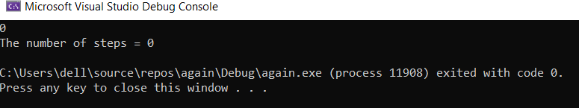
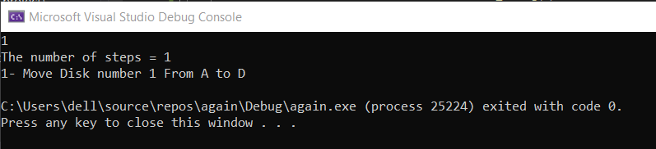
Sample Output
Output in case of zero disks (base case).
Figure 23
Output in case of one disk (base case).
Figure 24

Slide 44
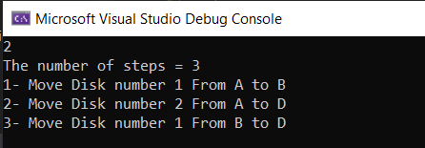
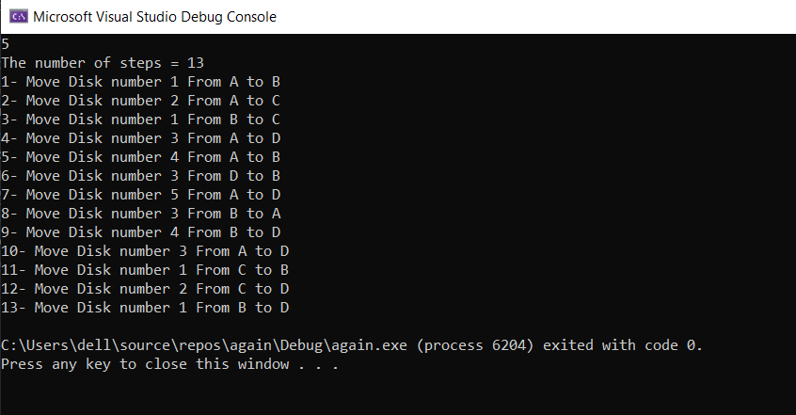
Output in case of 2 disks (base case).
Figure 25
Output in case of 5 disks (randomly selected number).
Figure 26

Slide 45
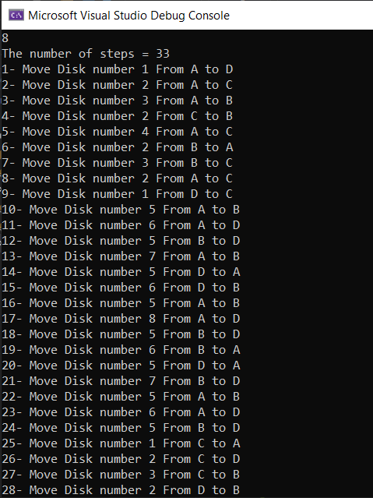
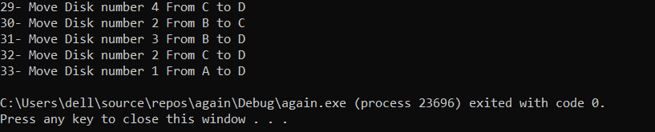
Output in case of 8 disks (the description given number).
Figure 27
Figure 28

Slide 46
Conclusion
The Reve puzzle can be solved using dynamic programming recursively by moving a subset of disks to an auxiliary peg using 4 pegs. Then, moving the remaining disks to the destination using the Towers of Hanoi algorithm. Finally, retransferring the previously moved pegs from the auxiliary peg the destination.
The puzzle can be solved using pure recursion with easier implementation, but the optimum solution and the dp algorithm efficiency are to be sacrificed.

Slide 47
References
1. Anany Levitin, M. L. (2011). Algorithmic Puzzles. Oxford University Press.

