Slide 1
Fix Politics Emb(race) Call for Code
August 10, 2020
Nikhil Raja, Tony Pearson, Beth Morgan, Thomas Adams, Oiza Dorgu, Lungelo Sikobi, Jia Liang, Debra Scott, Denise Knorr, Mao Vang Corne

Slide 2
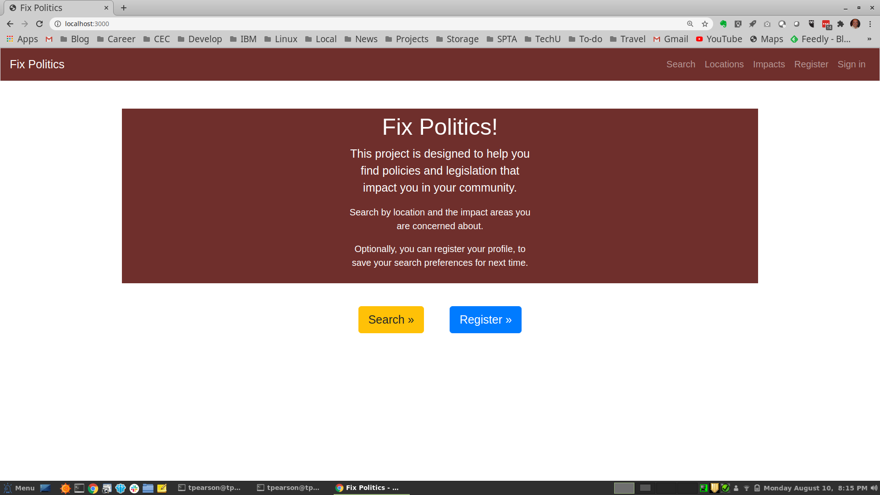

Slide 3
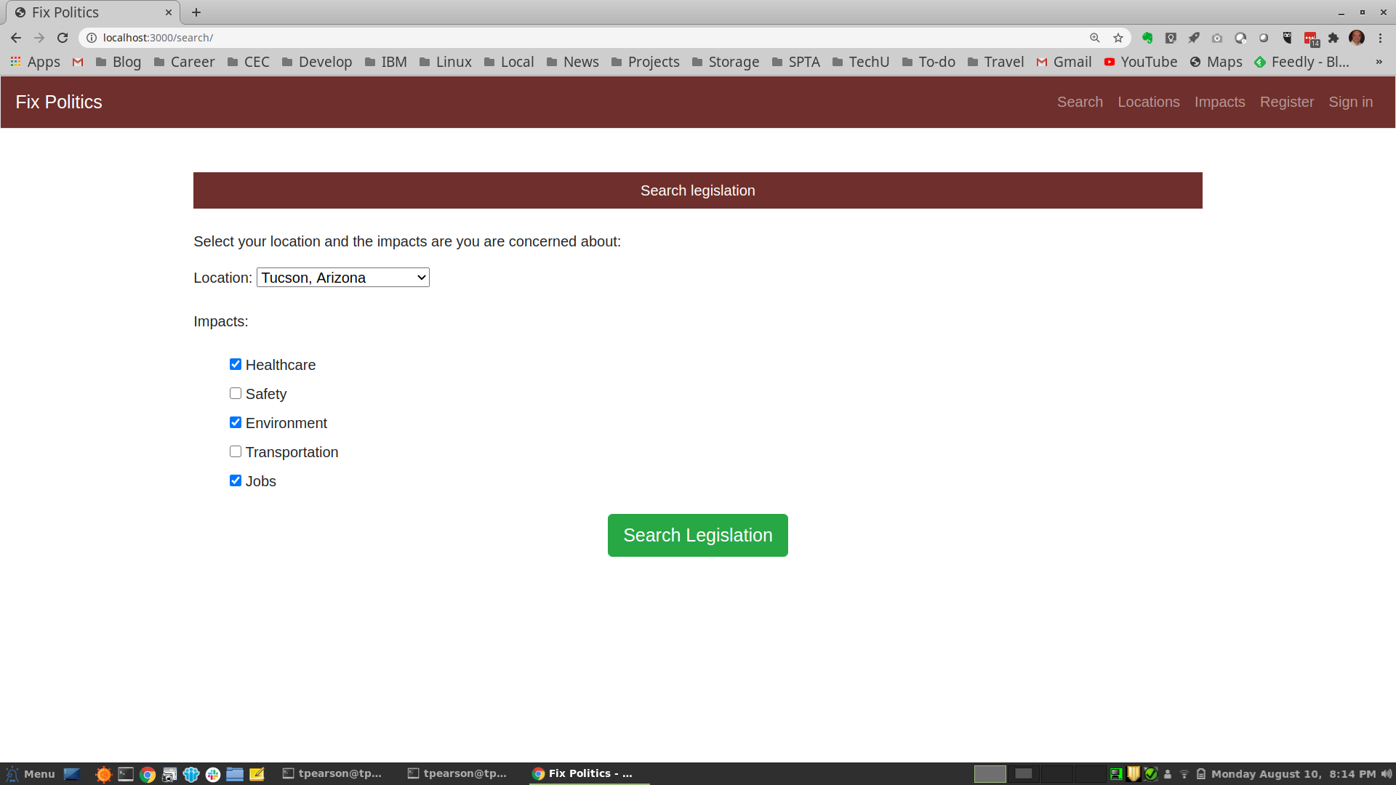

Slide 4
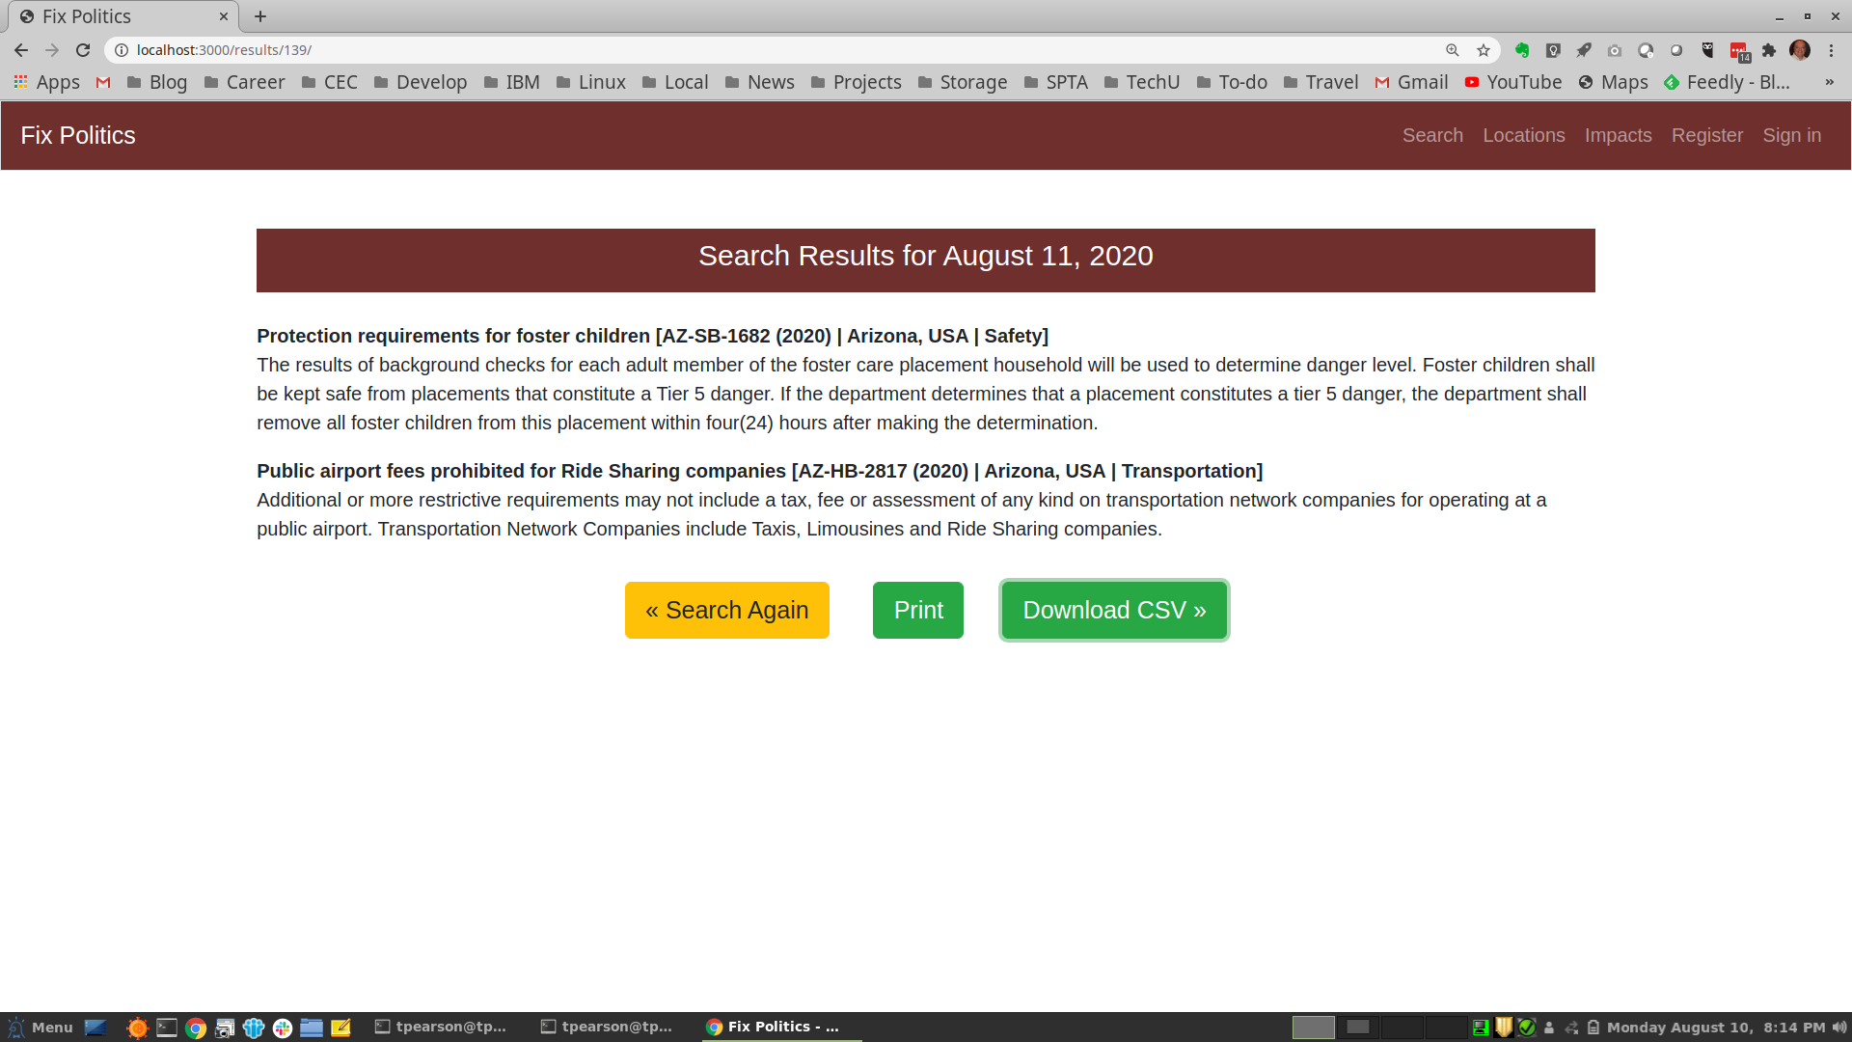

Slide 5
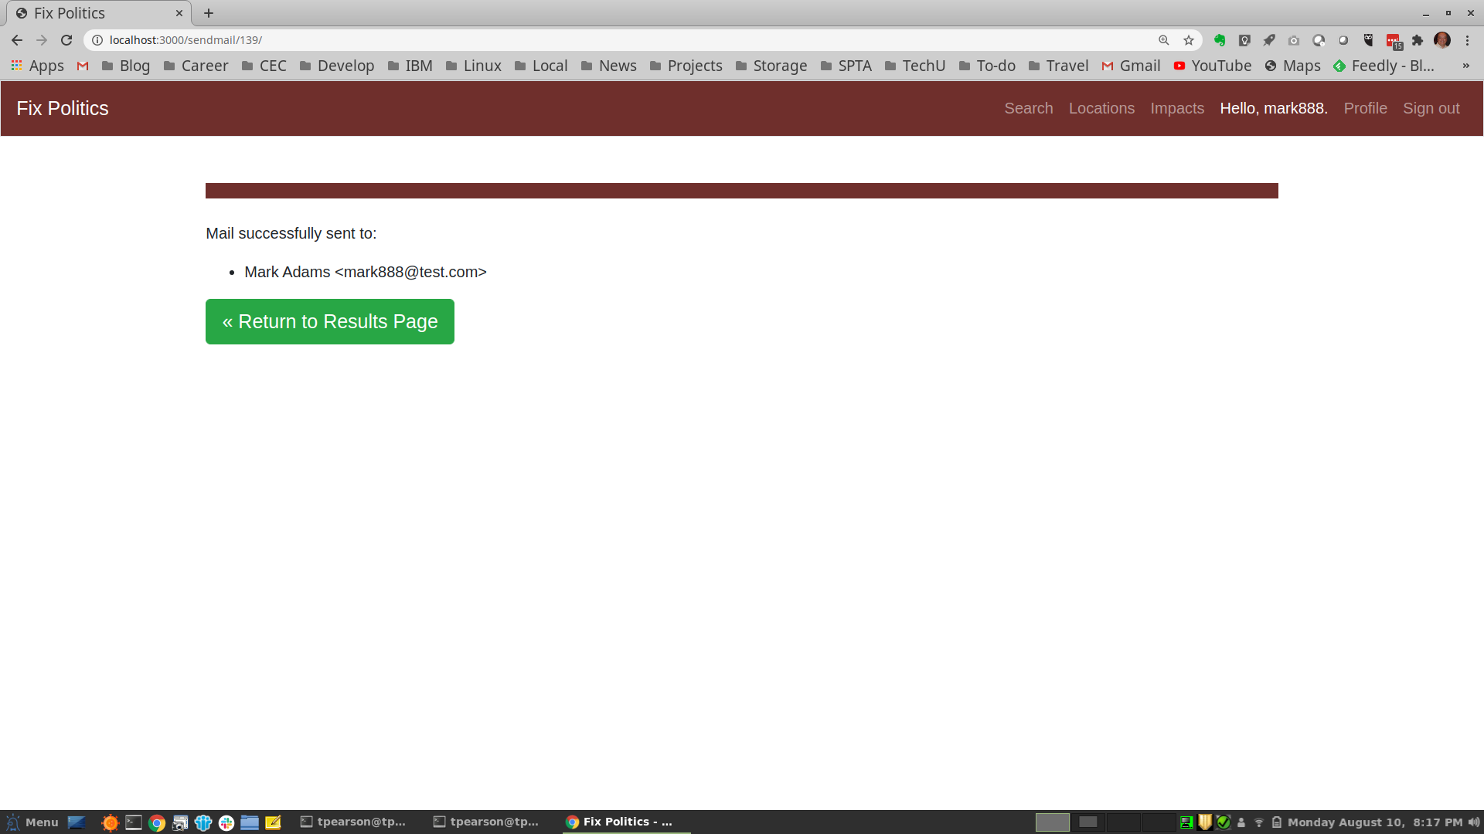

Slide 7
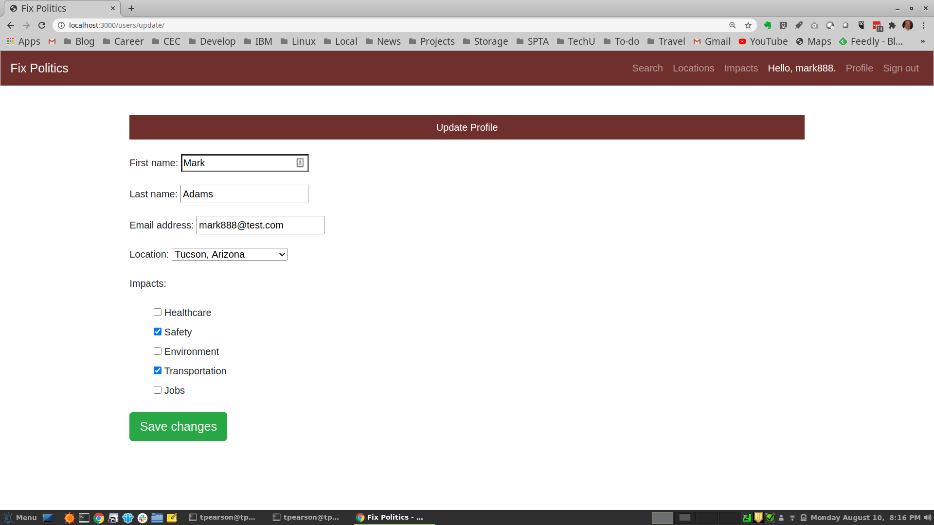

Slide 9
