Slide 1
Fix Politics Emb(race) Call for Code
August 04, 2020
Tony Pearson

Slide 2

Architecture Diagram – Web Application Framework
A
Phase A: Web Application
A web application on Github written in Python language/Djangjo Framework
Status – Github entry created: https://github.com/embrace-call-for-code/fix-politics
Django project directory created: cfc-project
Djange application directory created: fixpol
Static data directory for CSS and Images: staticfiles
Resource: https://learning.oreilly.com/library/view/python-crash-course/9781492071266/

Slide 3
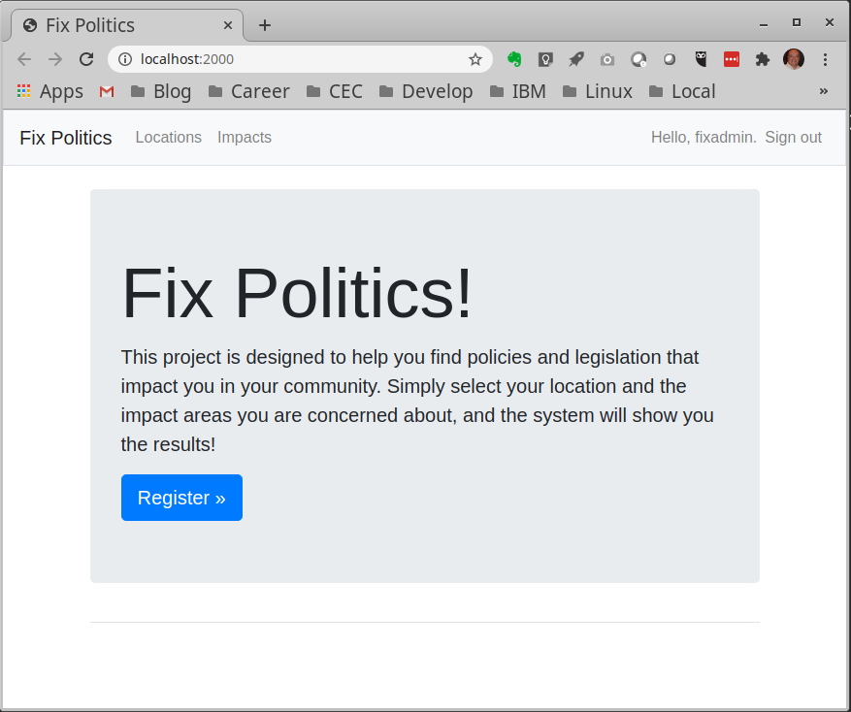
Verify all Impacts are entered correctly
Step 1: Get started, by cloning git repository to your local machine and create virtual python environment
$ git clone https://github.com/embrace-call-for- code/fix-politics.git
$ cd ~/fix-politics
$ virtualenv venv
$ source venv/bin/activate
(venv) $ pip install –r requirements.txt
(venv) $ python manage.py runserver localhost:2000
Point your browser to:
http://localhost:2000
(venv) CTRL-C to stop server
(venv) $ deactivate

Slide 4
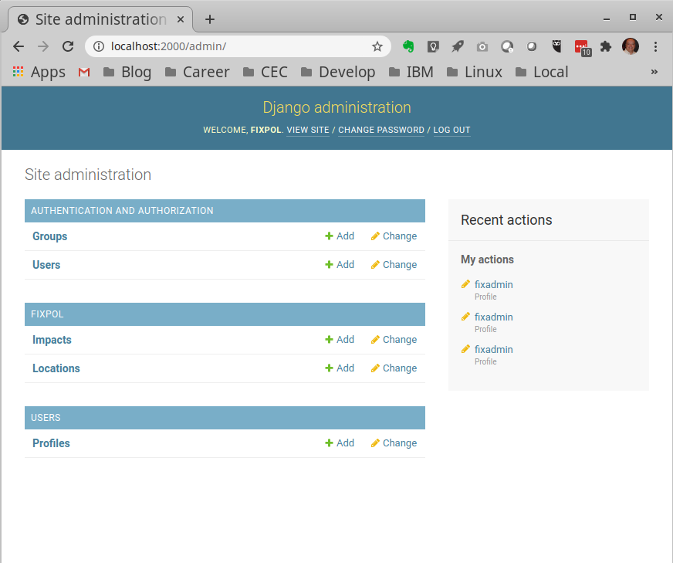
Admin Panel
Step 2: The admin panels allow you to configure all of the data needed for the rest of the application. Since you have already created venv and installed all pip requirements, you can go straight to activate:
$ source venv/bin/activate
(venv) $ python manage.py createsuperuser
or use the one pre-configured:
username: fixadmin
password: foxtrot.indigo.xray
Point your browser to:
http://localhost:2000/admin
(venv) CTRL-C to stop server
(venv) $ deactivate

Slide 5
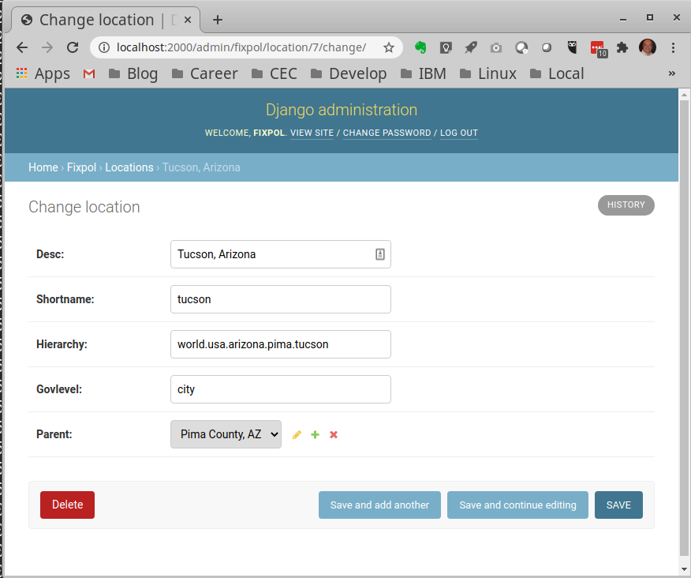
Entering and updating locations
You can configure the locations as a recursive common table expression (CTE) hierarchy.
The top location is “world” must exist, all other locations indicate their parent and hierarchy chain.
world
United States (world.usa)
Arizona (world.usa.arizona)
Pima County (world.usa.arizona.pima)
Tucson (world.usa.arizona.pima.tucson)
CHILD → PARENT relationships
United States → world
Arizona → United States
Pima Country → Arizona
Tucson → Pima County

Slide 6
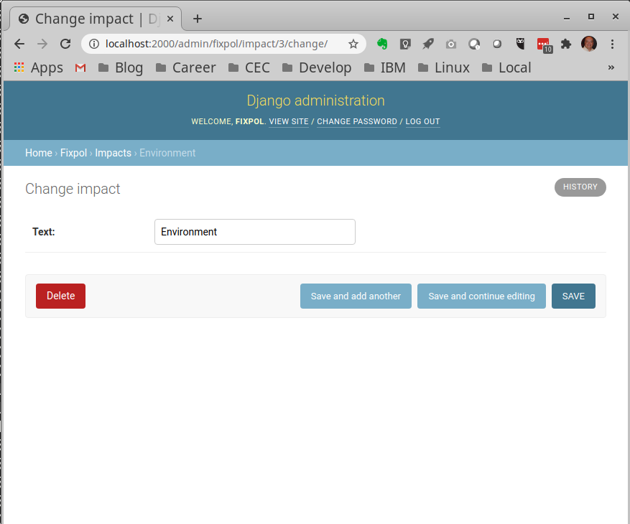
Entering and updating impacts
The impacts are just a simple list.
Since nobody has come up with a list for impacts for us to use, I am using the following:
Healthcare
Safety
Environment
Transportation
Jobs
If anyone has a better list of impacts or would like these listed in a particular order (chronological, alphabetical, etc.) let me know.

Slide 7
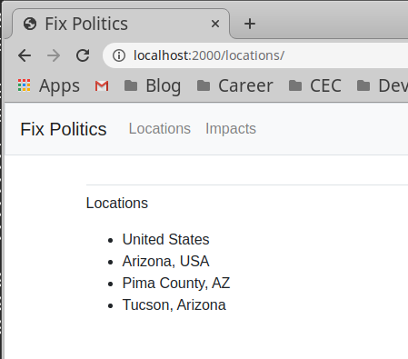
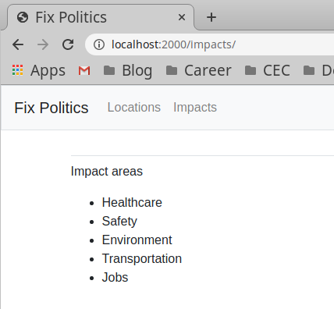
Verify all Locations are entered correctly
To verify data exists:
Point your browser to:
http://localhost:2000/
Select “Locations” on top left of screen
Select “Impacts” on top left of screen
These are also available as URLs:
http://localhost:2000/locations
http://localhost:2000/impacts

Slide 8
Registering a Regular User
Step 3: Create a regular user
When you are signed in, you will see your username and the option to sign-out in the upper right corner
To register regular user, press blue button here

Slide 9
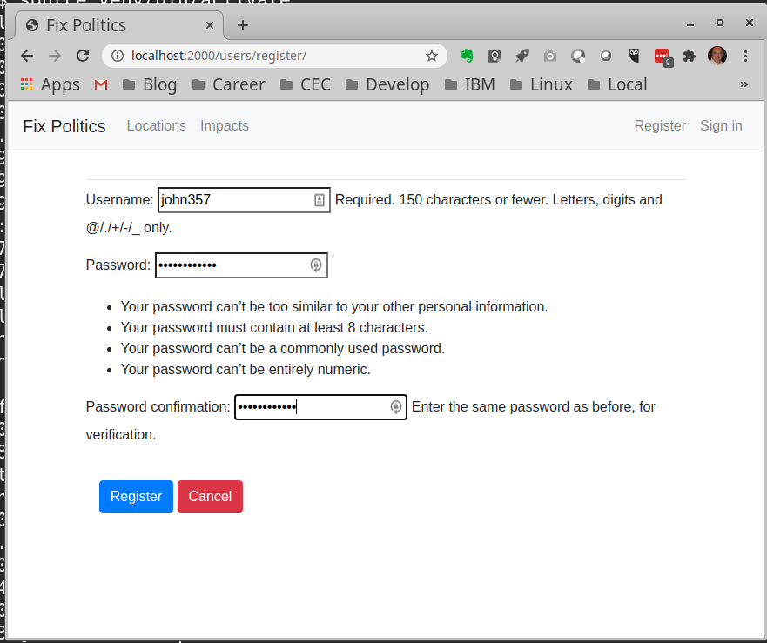
Registering Regular User
Enter a username, password and re-enter password
The system is very secure, and will not tolerate dummy passwords like 12345 or Passw0rd
Press blue button to confirm username and password are correctly entered

Slide 10
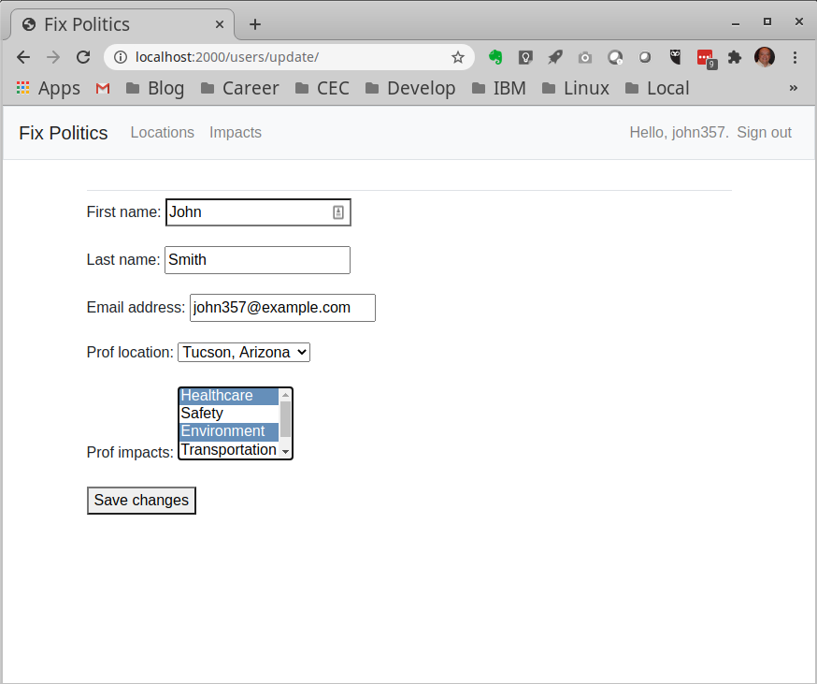
Creating or Updating the Profile
Once registered, you can update your profile with first and last name, email address and preferences for location and impacts.
Username appears in upper right corner
The location is a pull-down menu of the locations entered in the admin panels.
To select a range of impacts, use shift-click
To select multiple impacts, use control-click
Selected impact areas are marked in blue
The user can update this any time with:
http://localhost:2000/update

Slide 11
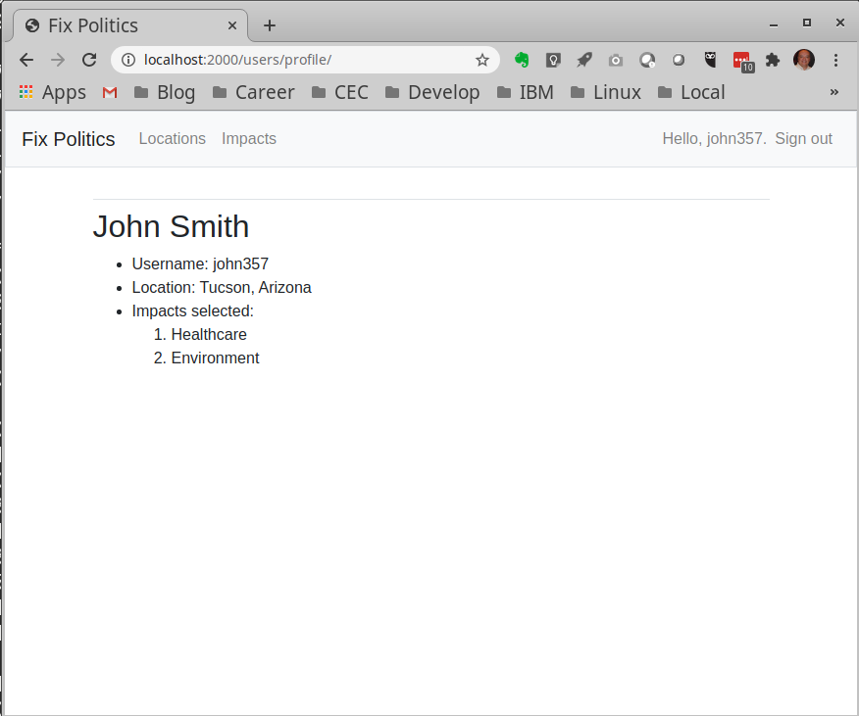
Display Profile
The information of the profile can be seen by the user or admin at :
http://localhost:2000/update

Slide 12
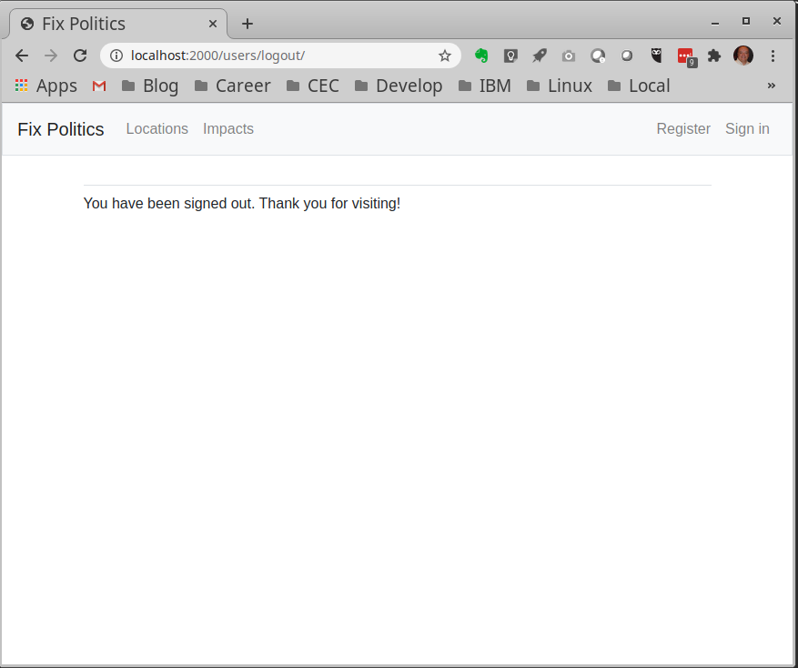
Sign out when done
Upper right indicates that you have signed out successfully (such as for use in public computers)

Slide 13
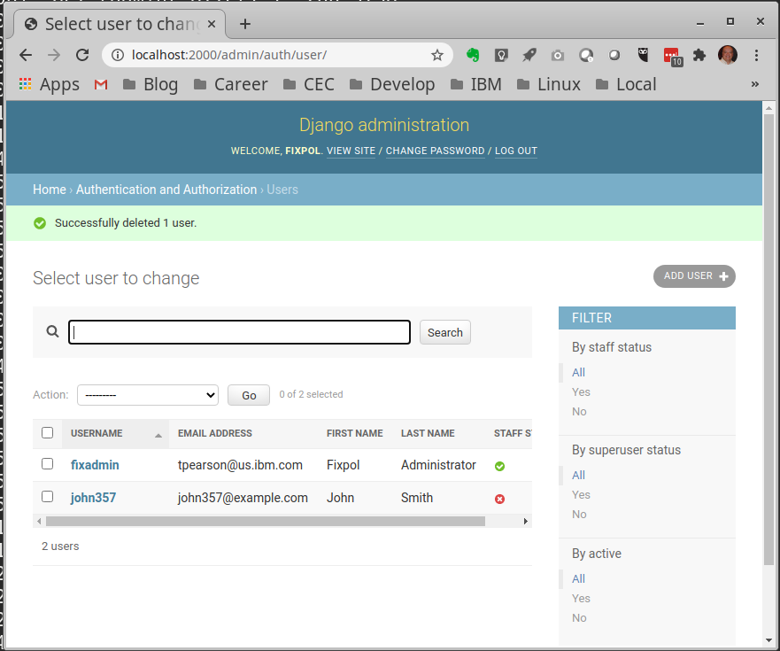
Admin Panel, revisited
Admin can reset passwords, delete users, etc.

Slide 14
Architecture Diagram – Data Sources
B
Phase B: Data Sources
Using SQLite3 since IBM Cloud expert volunteers unable to figure out how to get MariaDB or Postgresql to work on IBM Cloud
Technical needs:
Need data base schema for how we storage websites to be scraped
Need lists of locations and impacts to match websites we plan to use
Locations involves a recursive, common table expression (CTE) hierarchy schema

Slide 15
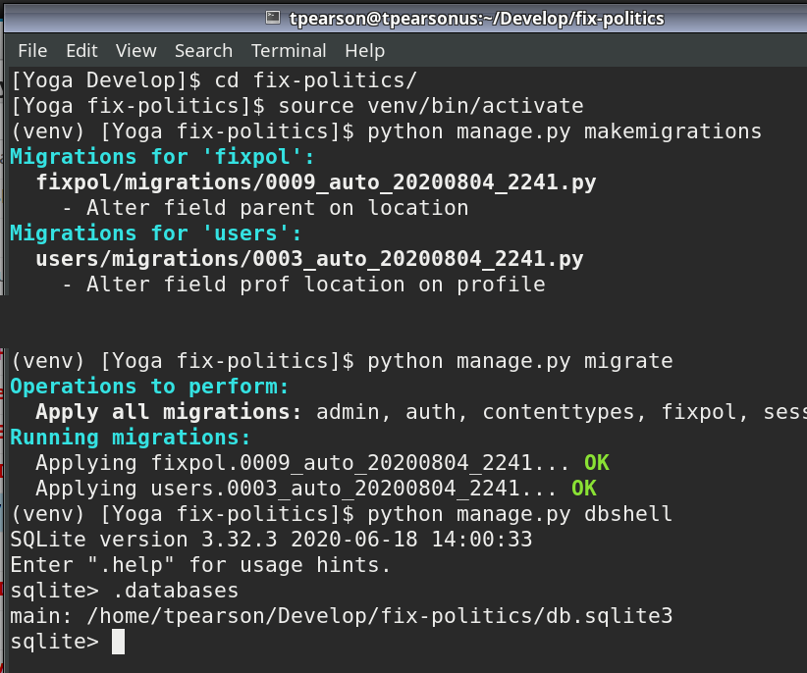
Accessing the database
The Django Framework maps all data between in-memory models and databases. This has two advantages:
Changing from one relational database management system (RDBMS) to another involves changing less than 5 lines in one file. For example, changing from SQLite3 to MariaDB or Postgresql.
No need to learn SQL commands that are slightly different in each RDBMS
However, any changes to the databases, columns or attributes require that you notify all affected files. First makemigrations, then migrate
makemigrations
migrate

Slide 16
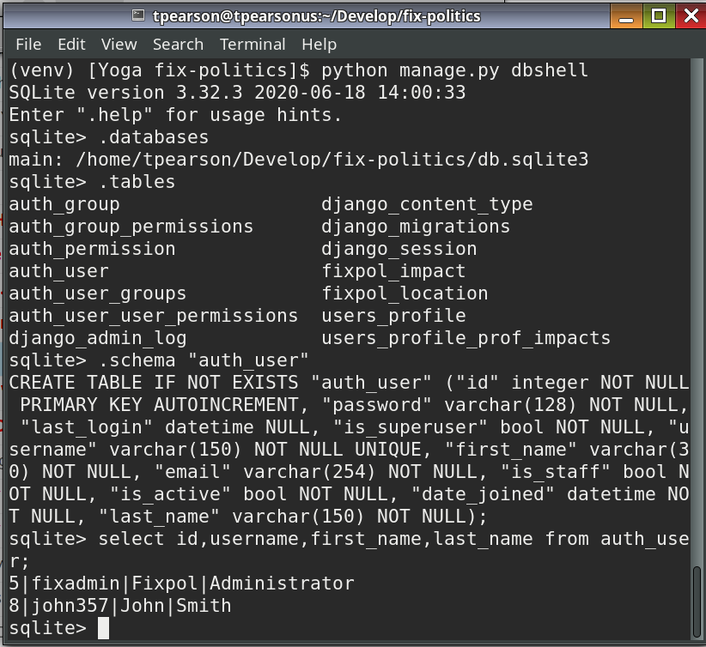
Understanding SQLite3
Django officially supports the following databases:
PostgreSQL
MariaDB
MySQL
Oracle
SQLite
The default is SQLite, with a minimum version required: 3.8.3
MariaDB is the open-source fork of MySQL. MySQL and Oracle are commercially available from the Oracle company.
All Django tables have AUTOINCRMENT integer keys.

