Slide 1
Fix Politics Emb(race) Call for Code
August 07, 2020
Nikhil Raja, Tony Pearson, Beth Morgan, Thomas Adams, Oiza Dorgu, Lungelo Sikobi Jia Liang, Debra Scott, Denise Knorr, Mao Vang Corne

Slide 2
Architecture Diagram – Web Application Framework
Problem statement 1
Concerned and impacted citizens don't have a straightforward way of knowing what or how policies and regulations impact them or what they can do in response.
Citizens are able to find and understand the specific impact of proposed policy without being a legal expert.
Citizens are able to share opinions so they can influence policy decisions before they are finalized.

Slide 3
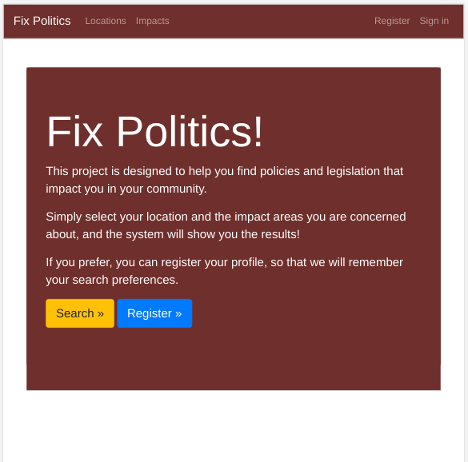
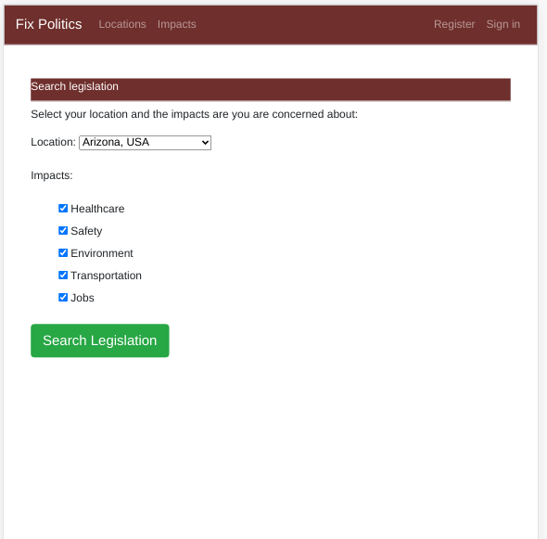
A Responsive Website with a consistent color theme

Slide 4
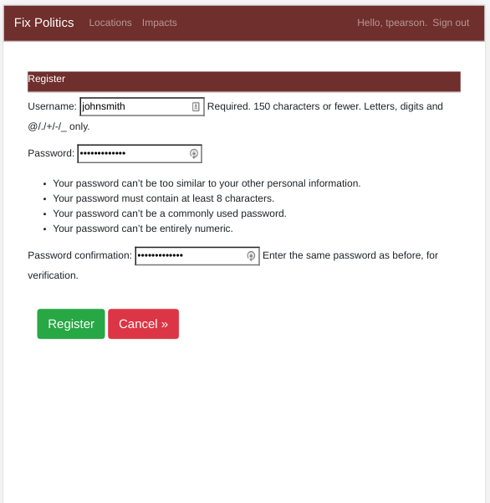
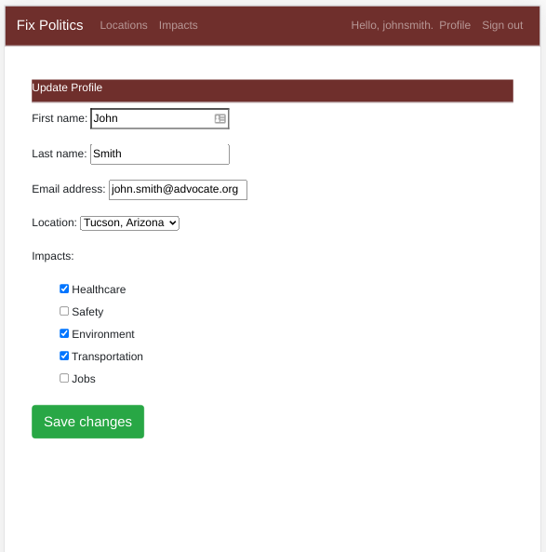
User Registration and Profile

Slide 5
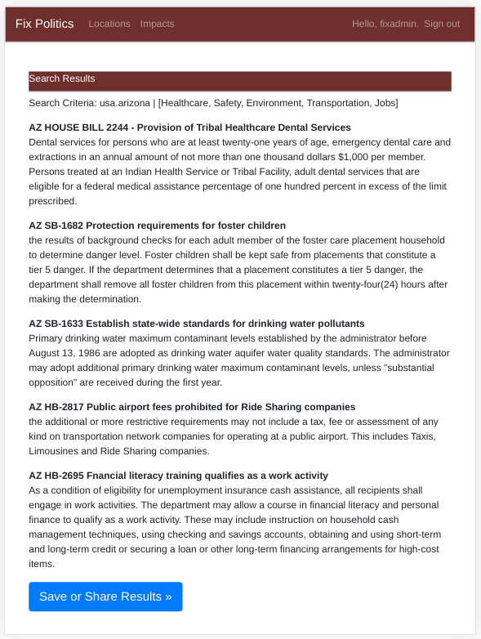
Search Results and Next Steps
Search Results:
The end goal is to have a list of results, that match the location and list of impact areas selected, either anonymously or profile.
Each result entry has a laymen-readable title and summary.
Next Steps:
Explore using persistent MariaDB or Postgresql database
Review websites, data sets and APIs available for legislation
Determine API or screen-scraping requirements to extra legal text of each proposed legislation
Natural Language Processing and Machine Learning for:
Classify by location and impact area
Laymen-readable title and summary
All API, screen scraping and ML processing done off-shift

