Slide 1

End-to-End Automated Sales ETL Pipeline & Business Intelligence Dashboard using SSIS, SQL Server, and Power BI
Developed by: Ahmed Samy
Data Analytics Engineer Internship at EJADA
Under the supervision of:
Eng. Ahmed Abdelhakeem
Eng. Abu Bakr Makhyoun

Slide 2
Why Ejada is a Premier Destination for Aspiring Data Professionals ?
Ejada Systems Ltd. is one of the largest and most respected IT services and solutions companies in the MENA region.
With 20+ years of experience, Ejada delivers digital transformation projects for government, healthcare, telecom, and finance sectors across the Kingdom of Saudi Arabia and beyond.
Internship Highlights:
Structured Learning
The internship is designed with a clear technical path, introducing us to enterprise-level data lifecycle management.
Real-World Projects.
Valuable guidance from experienced professionals who provided practical feedback, technical direction, and shared best practices in tools like SSIS, SQL Server.
Learn more: www.ejada.com

Slide 3
The Problem: Why OLTP Systems Aren’t Built for Analytics
OLTP (Online Transaction Processing) systems are optimized for real-time business operations, not for analytics or reporting.
Business users face several challenges when analyzing data from OLTP systems:
Complex and normalized table structures
No pre-aggregated views for fast reporting
Poor query performance on large datasets
OLTP systems lack native support for:
Historical data tracking (e.g., Slowly Changing Dimensions)
Time-based aggregation and trend analysis
Incremental data extraction and loading
As a result, generating reports directly from OLTP leads to performance issues, data inconsistency, and limited insights.
To make data useful for decision-making, we needed to reshape and automate how it's stored and analyzed.

Slide 4

Understanding the Source Data
Adventure Works Cycles is a multinational company for bikes manufacturing, the company continues to grow. They demand robust Analytics Solution to store and analyse their sales for better monitoring and decision-making.
The project is based on a transactional OLTP database that simulates a retail sales system.
The data includes several key entities:
Customers and their addresses
Products and product categories
Sales orders and their details (quantities, discounts, prices)
Order dates and shipping dates
The data structure is normalized and distributed across multiple relational tables in the SalesLT schema.
The raw data lacks analytics-ready features such as dimensions, surrogate keys, and pre-aggregated facts.

Slide 5
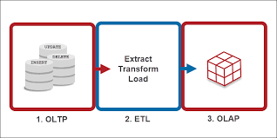
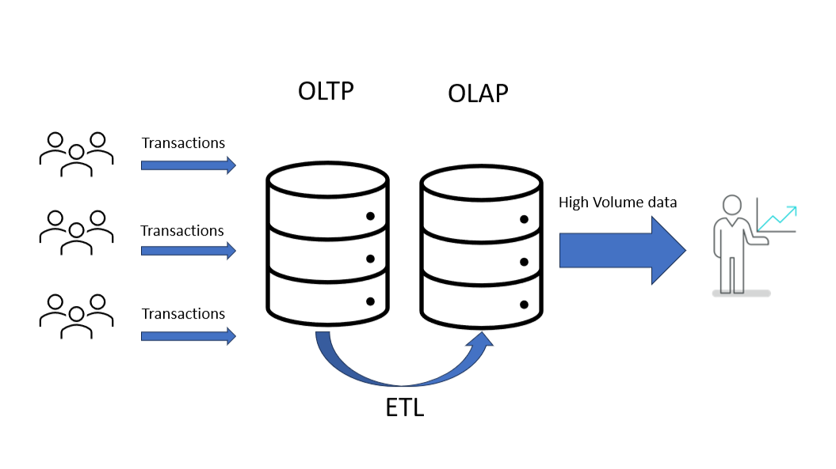
Project Goal
The primary goal of the project is to enable fast, consistent, and insightful analysis on sales data, which is difficult to achieve directly using an OLTP system due to its normalized structure and performance limitations.
To accomplish this, we aimed to:
Build a mature and predictable data model by transforming raw OLTP data into a well-structured OLAP format.
Support analytical needs such as trend analysis, KPIs, and dimensional slicing (e.g., by customer, product, category, date).
Ensure scalable performance for reporting tools like Power BI by loading cleaned and enriched data into a dimensional model.
Implement both Initial and Incremental loading strategies to handle large historical datasets and ongoing data changes efficiently.

Slide 6
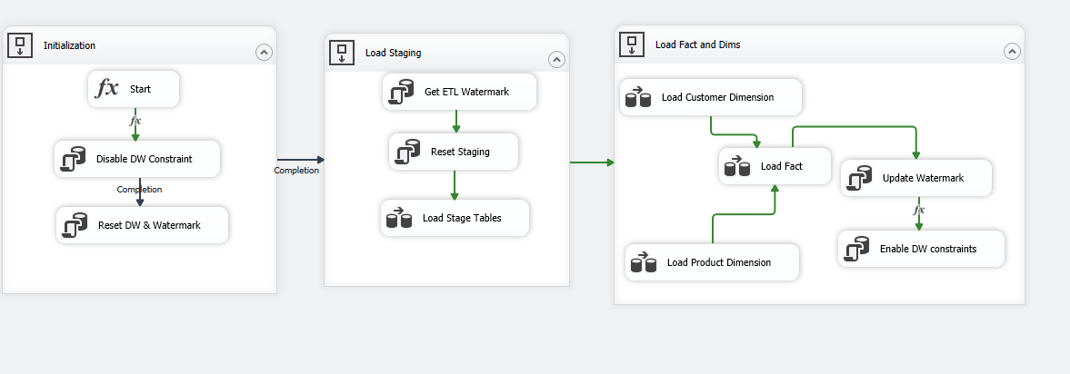
ETL Architecture & Execution Flow

Slide 7
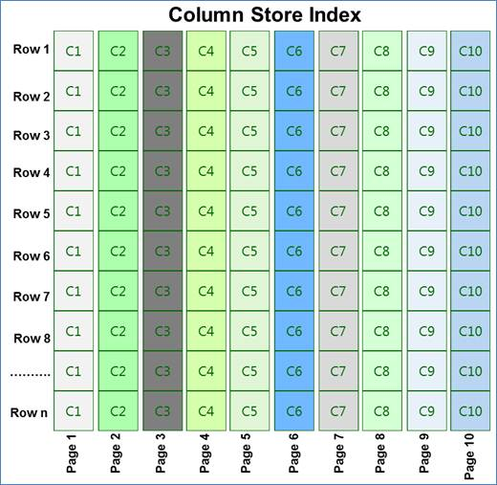
ETL Architecture & Execution Flow
Columnstore Index in Fact Table
To improve performance and reduce storage space, a Clustered Columnstore Index was created on the FactSales table.
This index allows faster aggregation and scanning for large volumes of data, which is essential for analytical workloads.
Why Staging is Important
Acts as a buffer between OLTP and DW.
Enables controlled transformation, cleansing, and debugging.
Helps isolate extraction and loading phases.

Slide 8
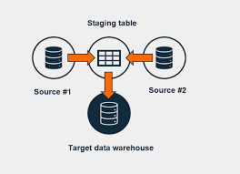
ETL Architecture & Execution Flow
1. Initial Load Mechanism
Disable DW constraints to avoid foreign key violations and allow clean data reload.
Reset the Data Warehouse (clear previous data and watermark).
After the load is complete, constraints are re-enabled(This step only runs when the InitialLoad parameter is set to True.)
2. Staging Load
Retrieve the latest watermark value (LastSuccessfulRun).
Extract only new or updated data from OLTP using ModifiedDate.
Reset staging tables and load fresh data incrementally.
3. DW Load
Load dimension tables (DimCustomer, DimProduct) using Slowly
Changing Dimension (SCD) logic.
Lookup and generate surrogate keys.
Load fact table (FactSales) using valid surrogate keys only.
Update the watermark with the current job execution time.
Watermark logic ensures incremental loads only.
ETL flow is fully controlled using SSIS control flow and dynamic parameters.

Slide 9
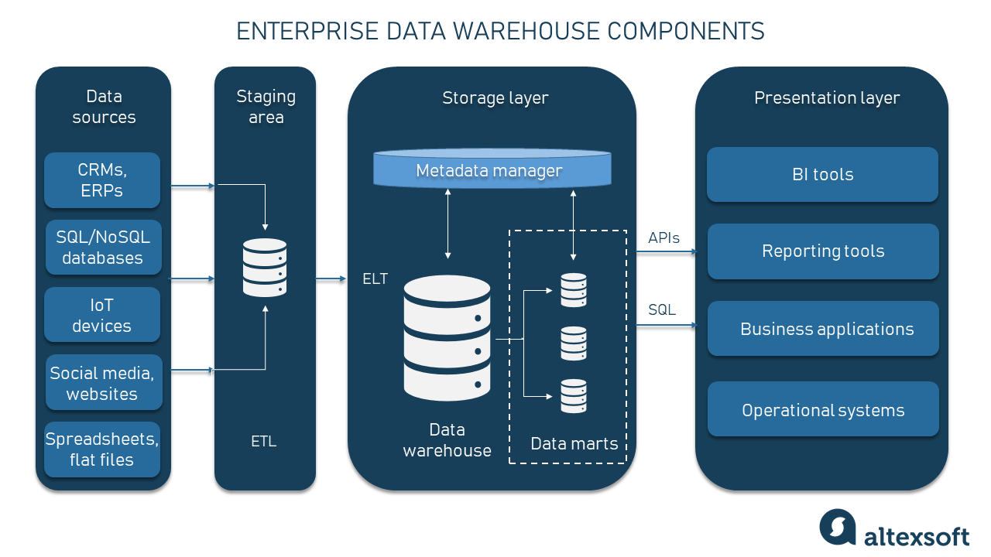
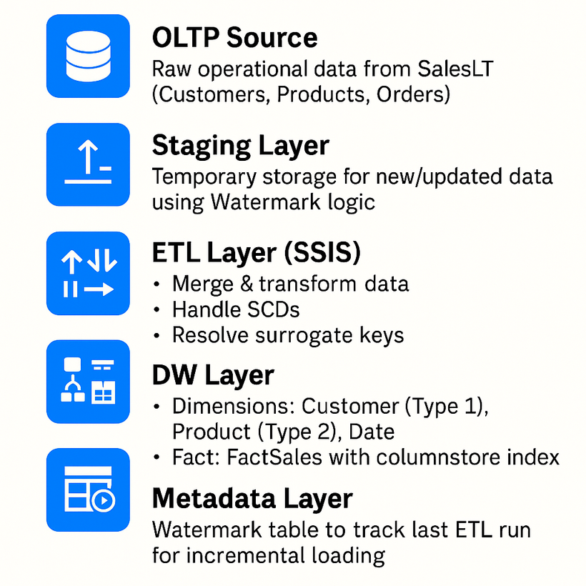
Data Warehouse Architecture

Slide 10
Use Cases: Initial Load vs Incremental Load
Shared Implementation Logic
Both Initial Load and Incremental Load share the same ETL logic:
Use the same SSIS package and Data Flow design.
Extract from OLTP → Transform → Load to DW.
Use staging layer and watermarking.
Controlled by a Parameter: IsInitialLoad
A package-level Boolean parameter that changes the behavior based on load type.
Initial Load
Used for:
First-time load or full reload of the DW.
Re-enable constraints after load completes.
Incremental Load
Used for:
Daily or periodic updates.
Logic:
Use the latest Watermark value to filter changed records (ModifiedDate).
Append only new or updated data to staging and DW.
No need to disable constraints or truncate tables.

Slide 11

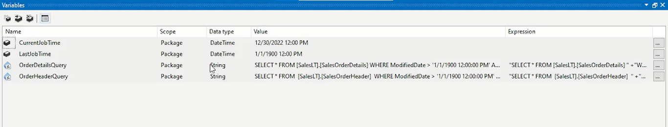
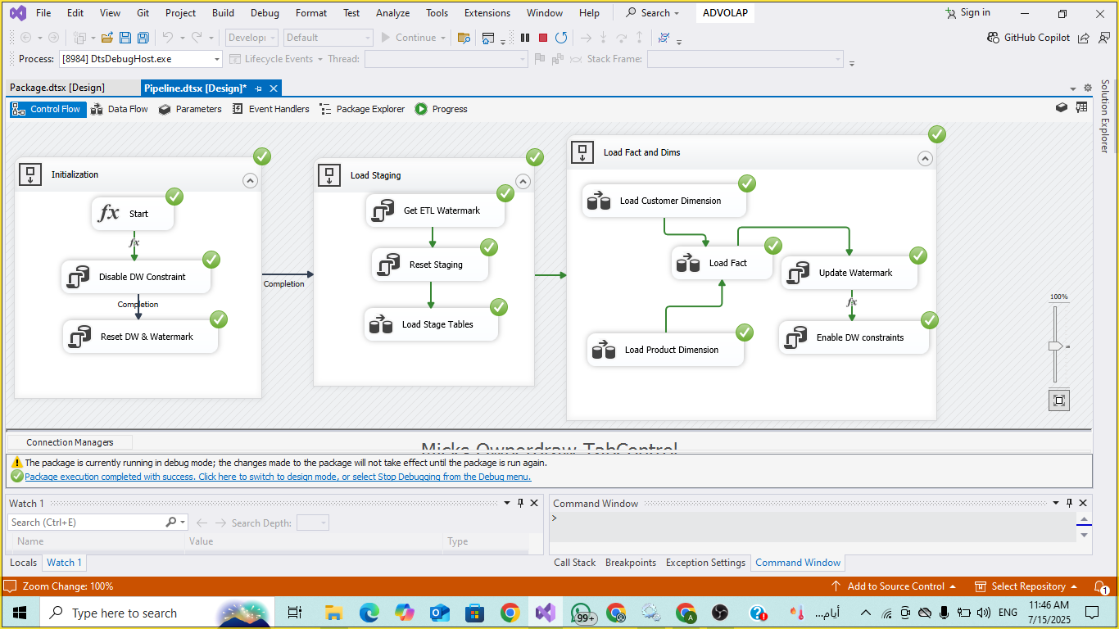
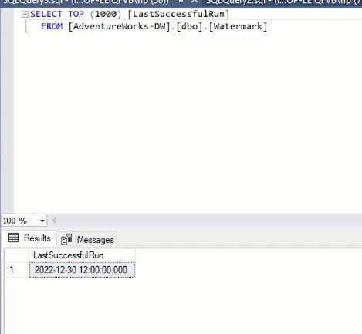
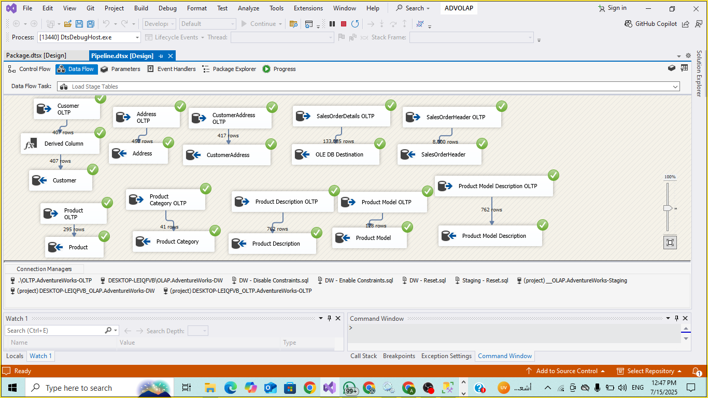
Initial Load Results
InitialLoad=True

Slide 12
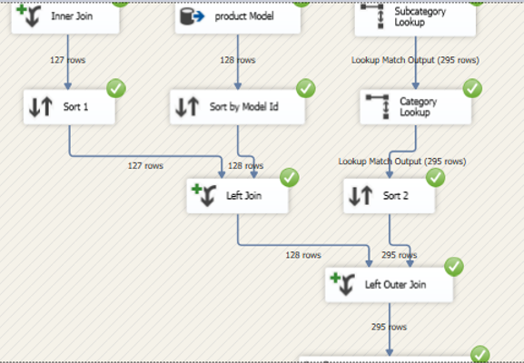
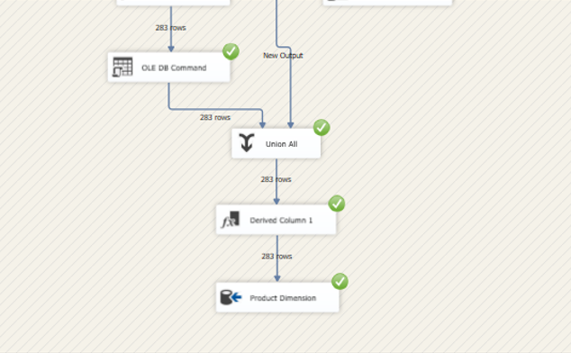
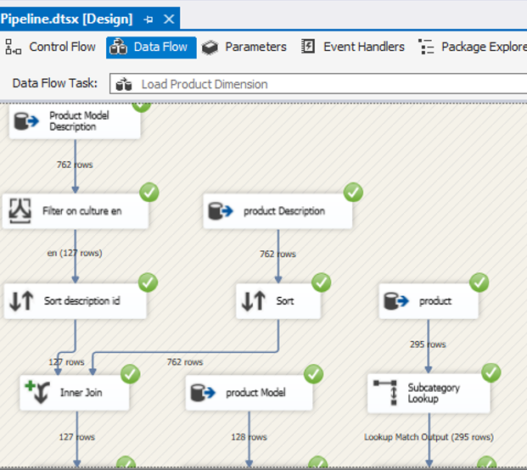
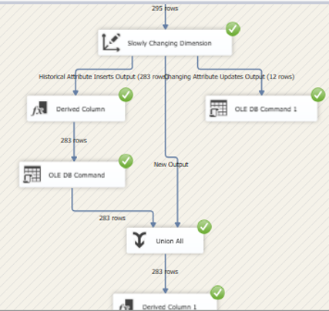
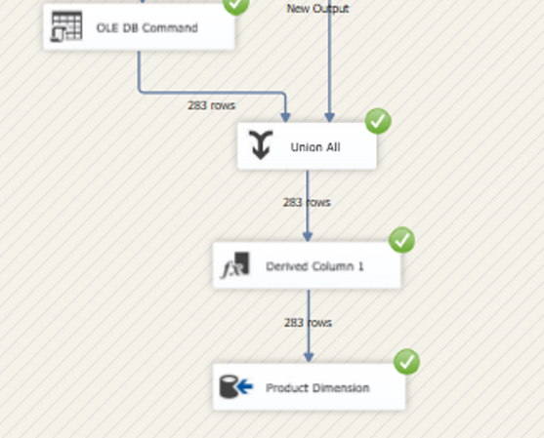
Initial Load Results
Product Dimension

Slide 13
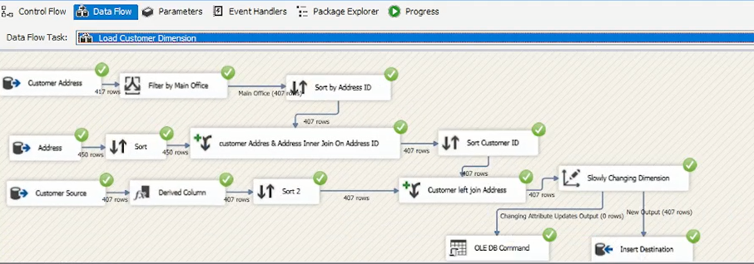
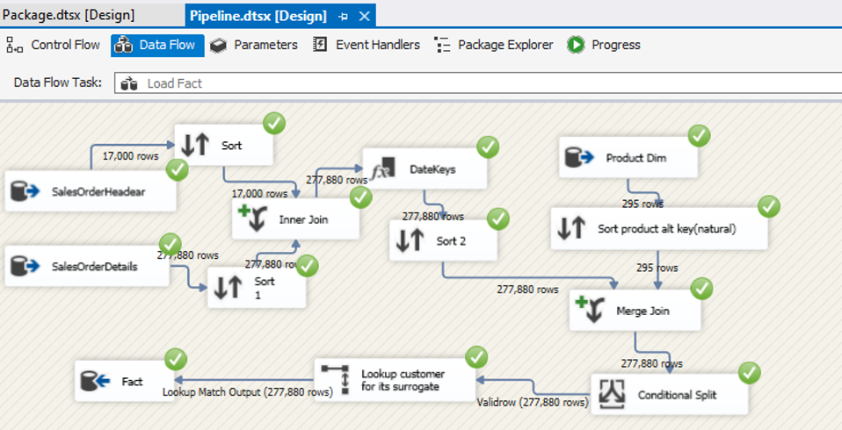
Initial Load Results
Customer Dimension and Fact

Slide 14
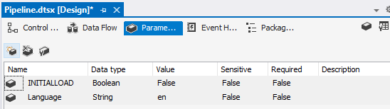
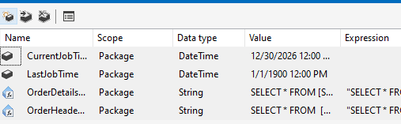
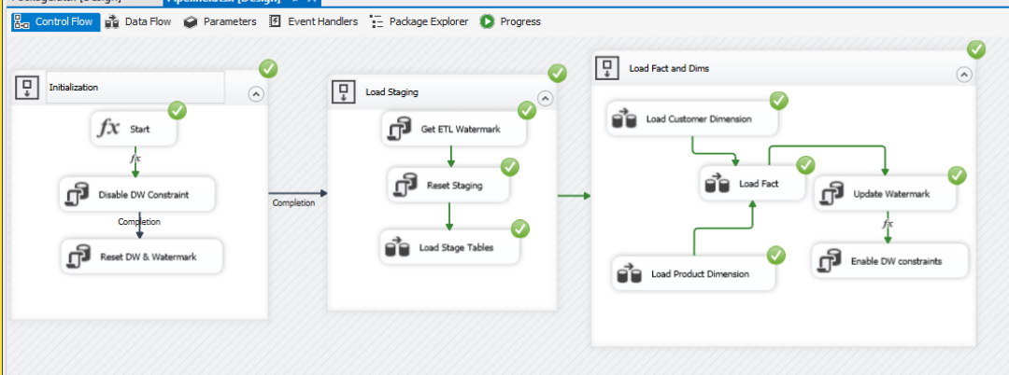
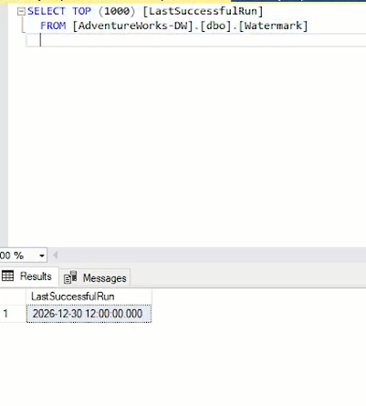
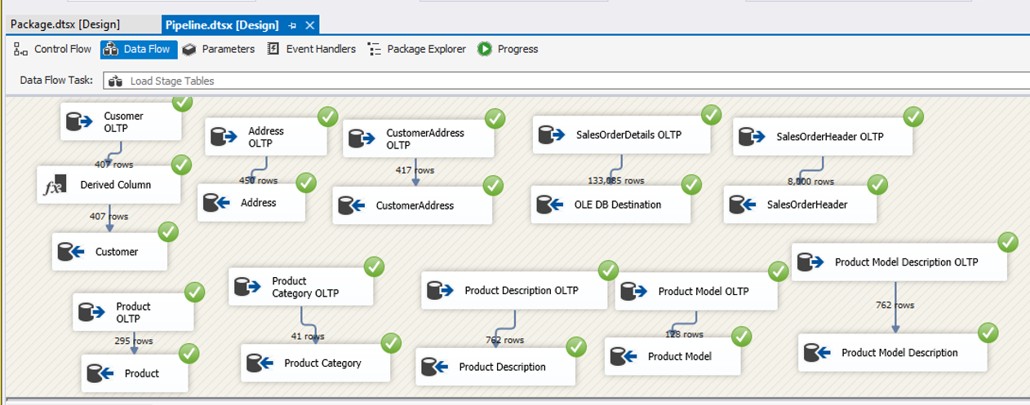
Incremental Load Results
InitialLoad=False

Slide 15
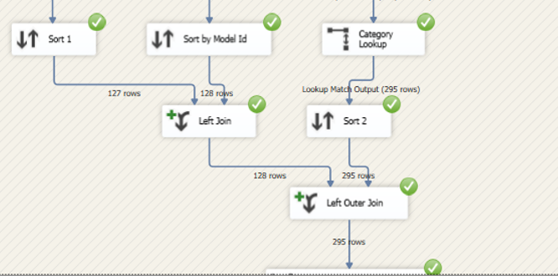
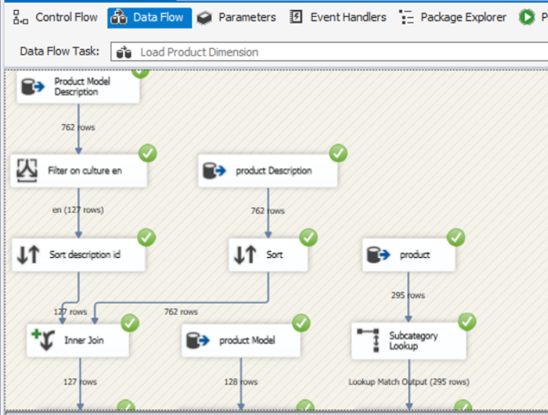
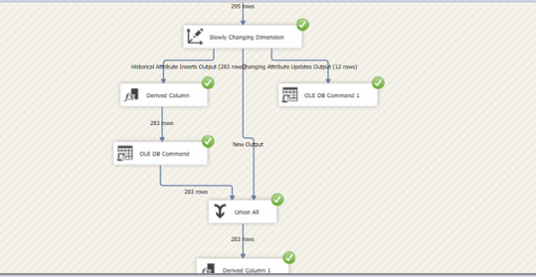
Incremental Load Results
Product Dimension

Slide 16
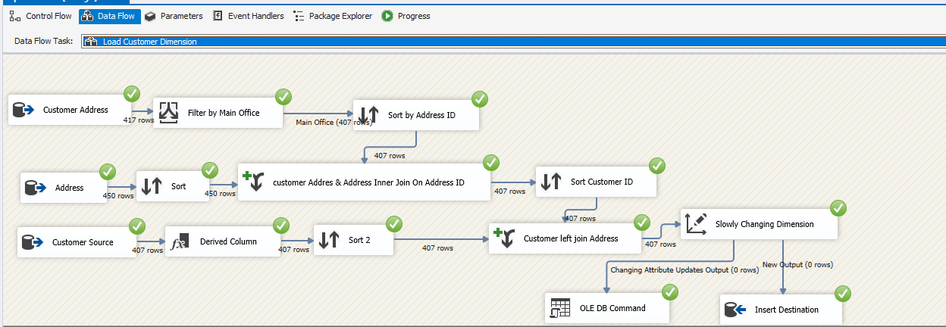
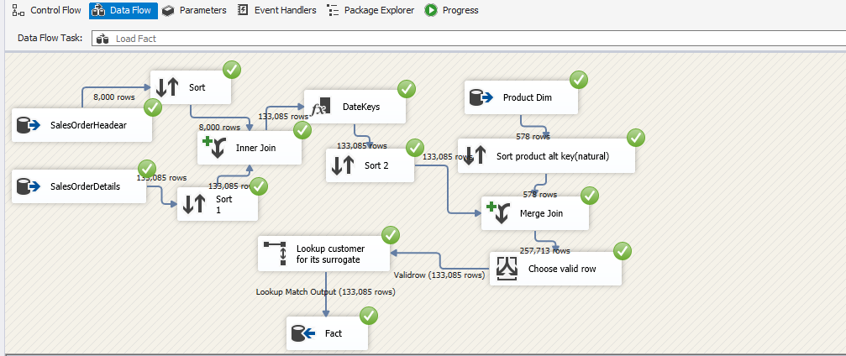
Incremental Load Results
Customer Dimension and Fact

Slide 17
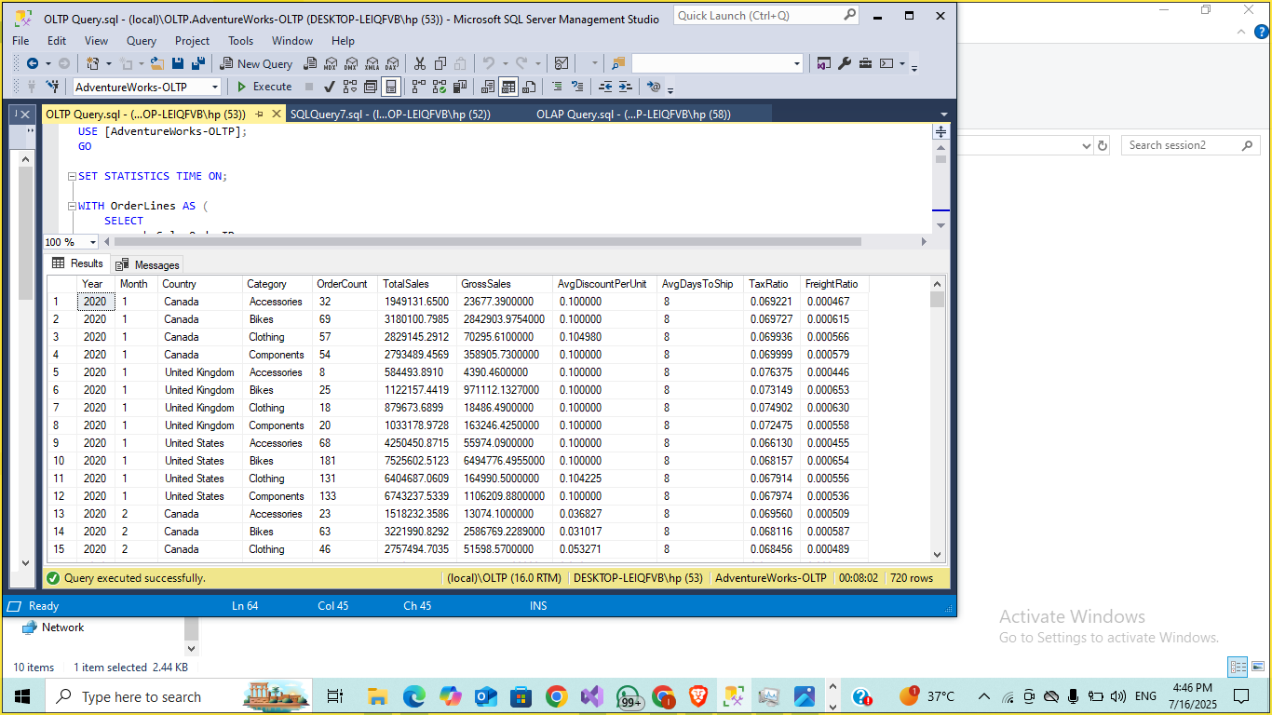
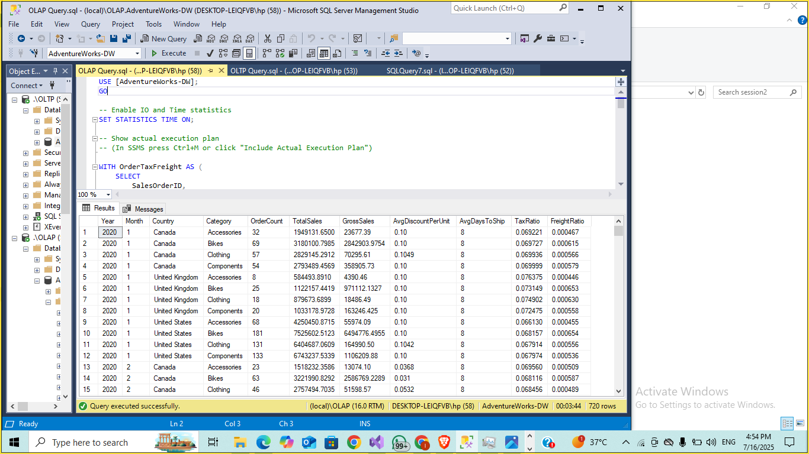
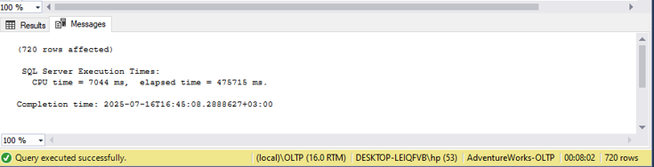
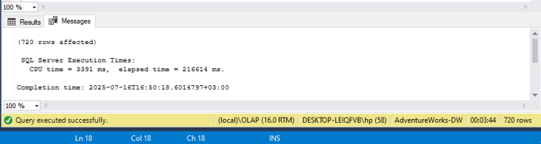
Results
OLTP vs OLAP Queries
OLTP
OLAP

Slide 18
Results
OLTP vs OLAP Queries
 | OLTP | OLAP
Rows affected | 720 | 720
Elapsed time | 475716ms | 216614ms
CPU time | 7044 ms | 3391ms
Insights:
OLAP is ~2.5x faster in elapsed time for the same data.
It uses less CPU, thanks to optimized schema and indexes.
As data grows, the performance gap increases significantly:
OLTP struggles with joins & normalization.
OLAP thrives with denormalized star schema and columnstore indexes.

Slide 19

Power BI Sales & Customer Insights Dashboard
Turning Data into Actionable Insights
Introduction
Purpose of the dashboard:
To monitor sales performance, profitability, and customer behavior.
Scope:
Sales
Orders
Customers
Products.
Data Coverage:
2024 with drill-through analysis for deeper insights.

Slide 20
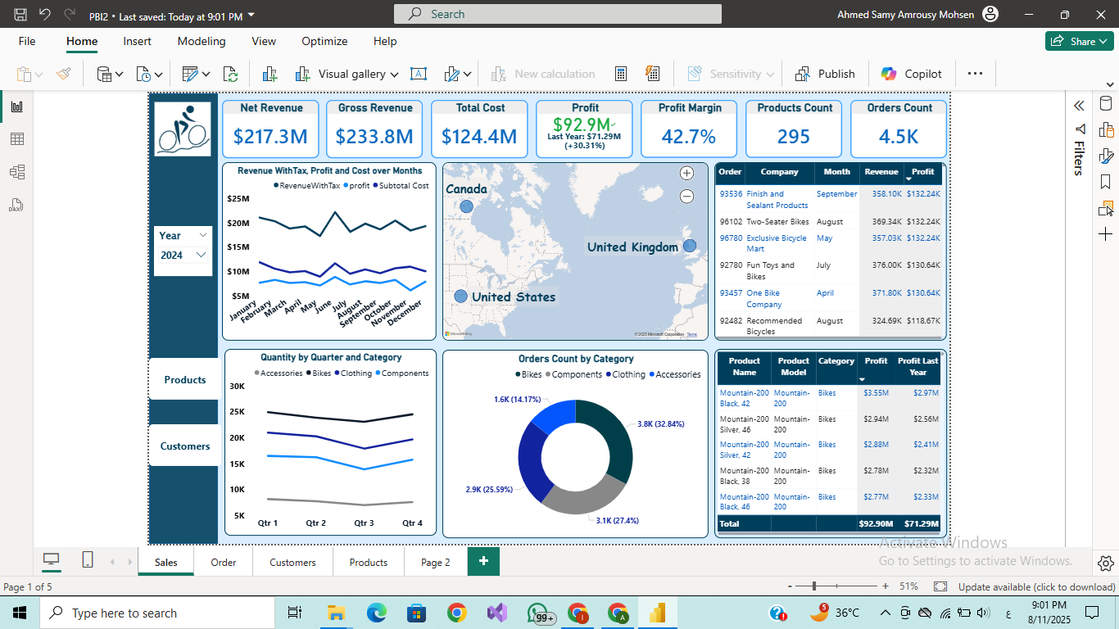
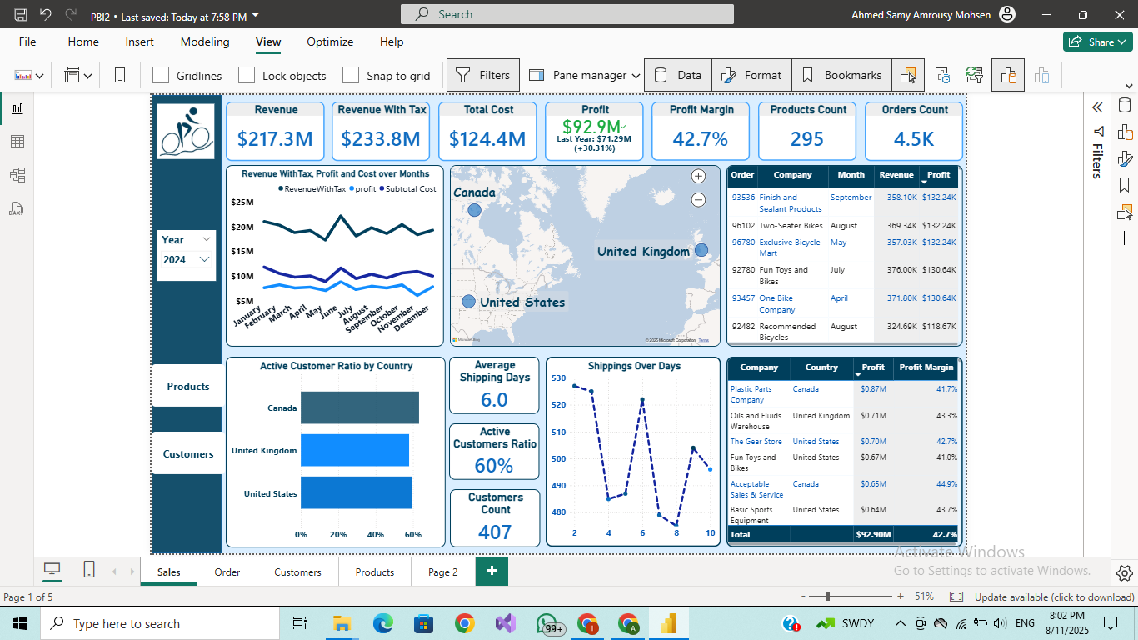
Sales Overview
Sales Insights:
Revenue growth is outpacing cost growth. Revenue with tax ($233.8M) and profit ($92.9M) show a healthy 42.7% profit margin, indicating strong pricing power and operational efficiency.
+30.3% YoY profit increase shows effective cost control.
Profit margin improvement driven mainly by bike sales(most ordered).
Plastic Parts Company from Canada is the most profitable customer.
Peak revenues at January & June.
Customer base optimization: 40% of customers are inactive, representing untapped potential that can be converted into revenue through targeted reactivation campaigns.
Customer concentration risk — A few clients (e.g., Totes & Baskets, Basic Sports Equipment) contribute a large share of profits, which could be risky if they churn.
Average shipping time of 6 days is competitive but may not be optimal for high-value customers.
Customer :

Slide 21
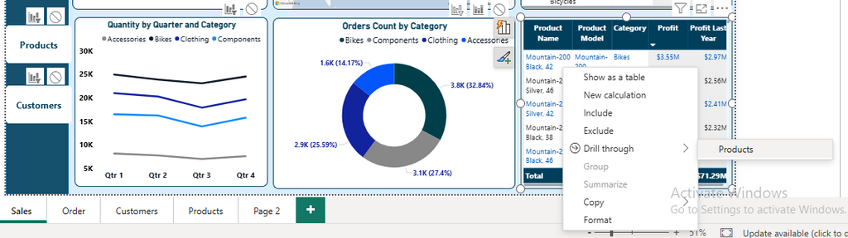
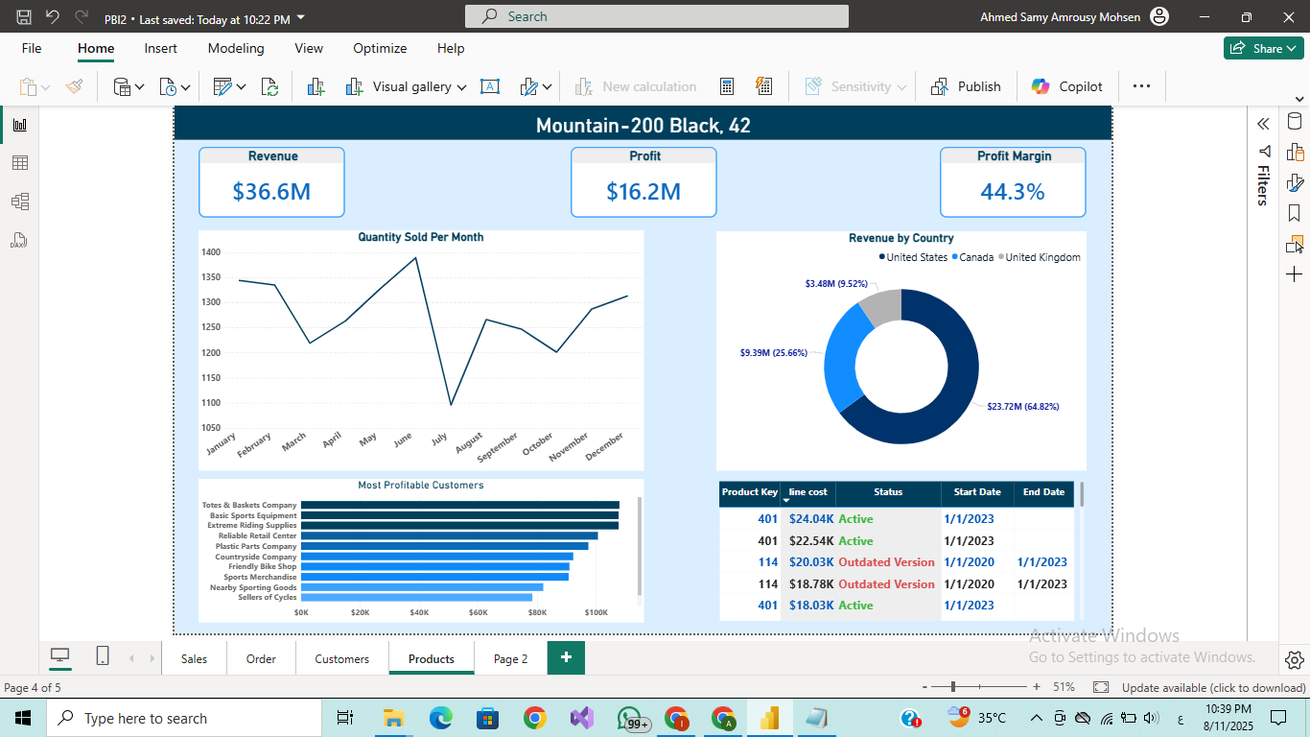
Product-specific Analysis
using Drill-through
The United States is the dominant revenue driver across several product lines, with the Mountain-200 Black model reaching a 64.8% share in the US market. Heavy reliance on one region poses risks if market conditions shift, so expanding presence in the UK and Canada is essential to diversify and balance revenue streams.
The product-specific segment is highly profitable with a 44.3% margin, reflecting strong cost control and market competitiveness.
sales peaking in June and dipping in July.

Slide 22
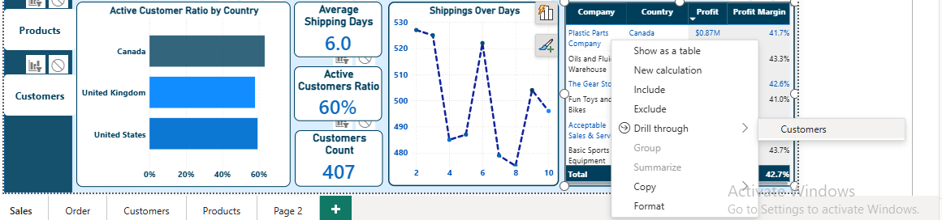
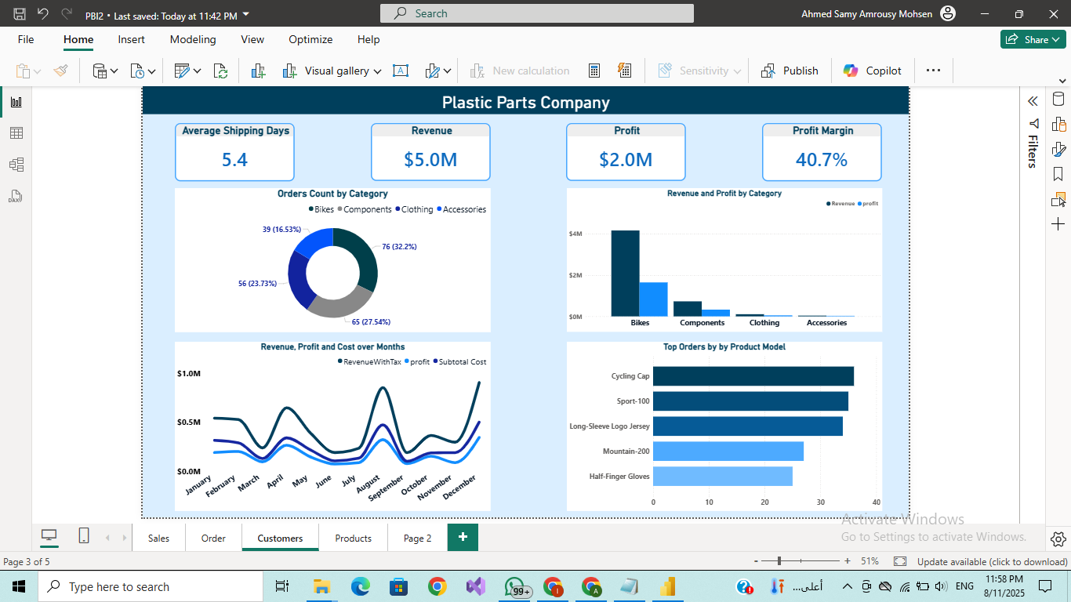
Customer-specific Analysis
using Drill-through
Revenue is heavily concentrated in a few high-demand products, suggesting opportunities to expand or replicate successful product lines.
Seasonal trends indicate demand peaks during specific months, likely tied to production cycles, customer procurement schedules, or industry-specific events.

Slide 23
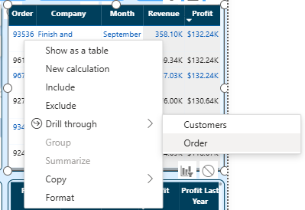
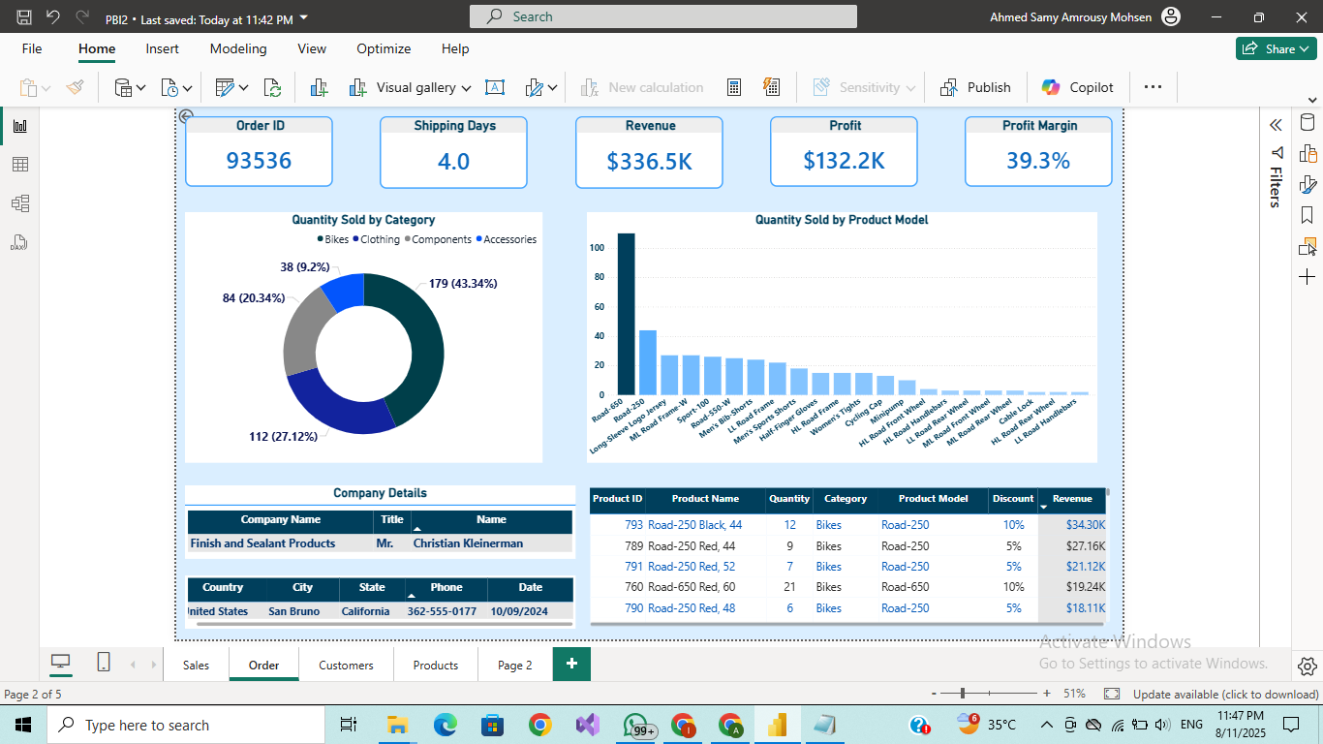
Order-specific Analysis
using Drill-through

Slide 24
Expansion Potential
Capitalize on the loyal bike customer base by promoting accessories such as helmets and gear, which usually offer higher profit margins.
Customer Reactivation: Focus on re-engaging the inactive 40% of customers with personalized offers, prioritizing underperforming regions to boost sales.
Cost optimization: Focus on top-selling low-margin products to identify cost-reduction opportunities without sacrificing quality.
Geographic diversification: Reduce US dependency by targeted marketing in UK and Canada.
Shipping Efficiency: Reducing shipping time could increase customer satisfaction and repeat purchases.

Slide 25


THANK YOU!
Ahmed Samy
a7madmohsen.10@gmail.com

