Slide 1


Hands-On Open Science
Alexandra Sarafoglou

Slide 2

Overview
Collaboration, GitHub, data sharing
Exercise
Preregistration, Blinded analysis
Lunch break
Team project
Presentations/Discussions

Slide 3

Collaboration on GitHub

Slide 4
Overview
Create a git repository
Basic GitHub workflow
Born-open data
Data sharing

Slide 5
What is GitHub?
Git is a version control system (google docs but more powerful)
Collaboration on code/R files
  OSF
  Overleaf
  Goggle docs/Dropbox/Drive

Slide 6

GitHub Collaboration
  - Branches
  Pull request
  Code development projects (R packages)
  Overlapping tasks
  You
  Collaborator 1
  Collaborator 2

Slide 7
GitHub Collaboration
  Collaborator 1
  You
  Collaborator 2
  - Everybody has editing rights
  Smaller projects (3-4 collaborators)
  Distinct tasks

Slide 8
Create a Git repository
Install git on your computer (https://git-scm.com/downloads)
Create a GitHub account
Create a repository in Github (a place for things to be stored)

Slide 9
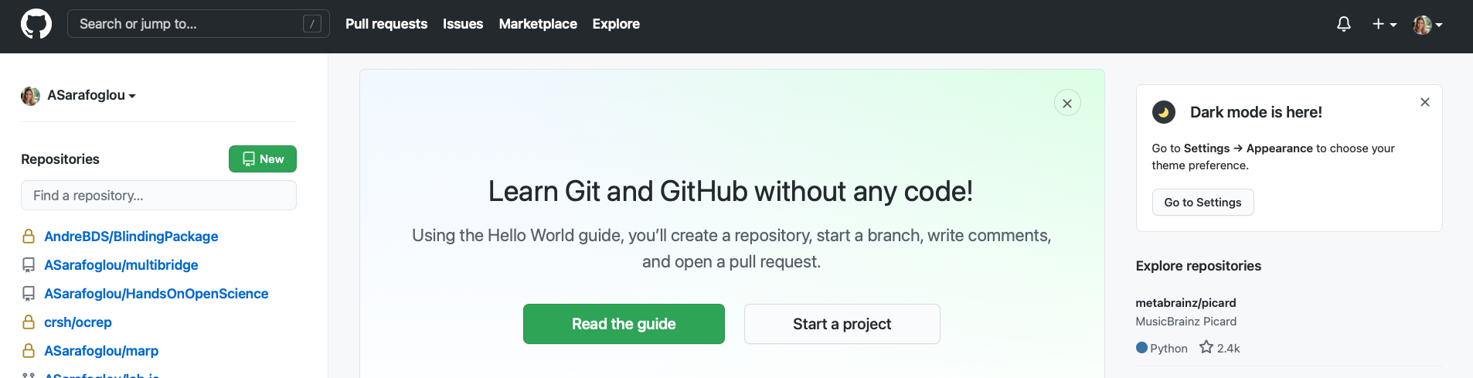
Create a Git repository
Login to GitHub
Press icon “New”

Slide 10
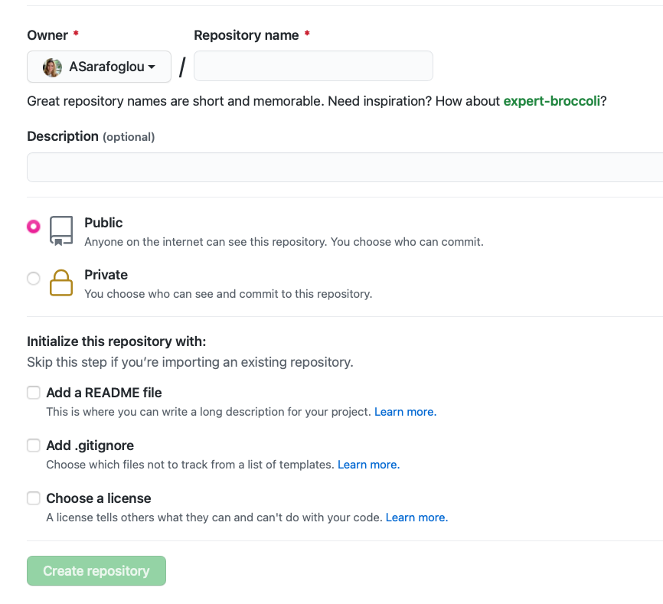
Create a Git repository
Login to GitHub
Press icon “New”
Give your repository a name
Choose public or private (public for collaboration purposes)
Add README file

Slide 11
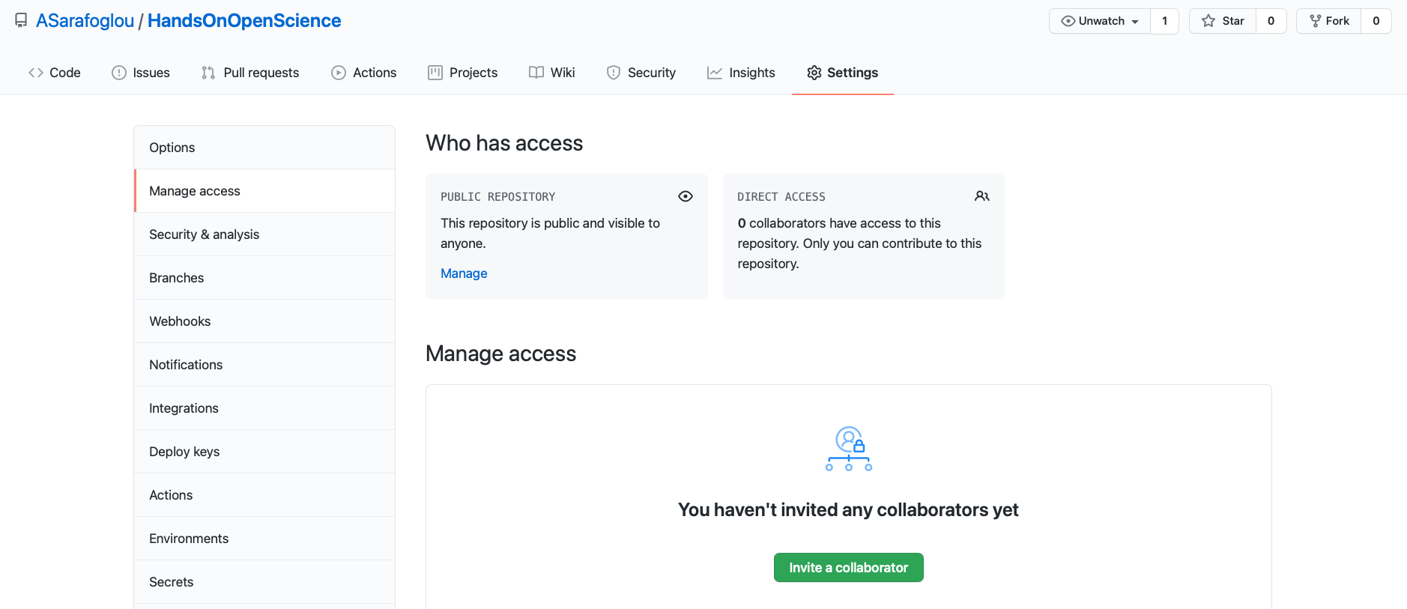
Collaboration in Teams
  Collaborator 1
  You
  Collaborator 2

Slide 12
Share code/data/materials
Connect the repository to your computer (clone)
Make changes
Upload your changes to GitHub

Slide 13
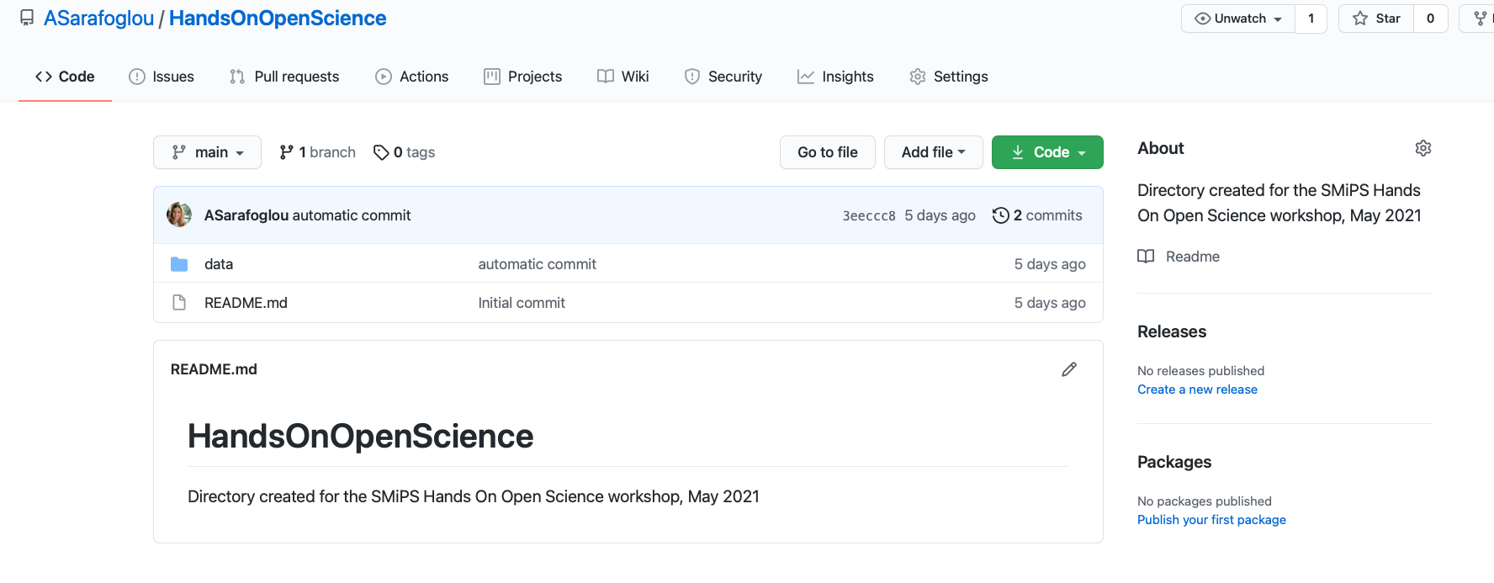
Clone a Git repository
Cloning is similar to copying the files to your computer

Slide 14
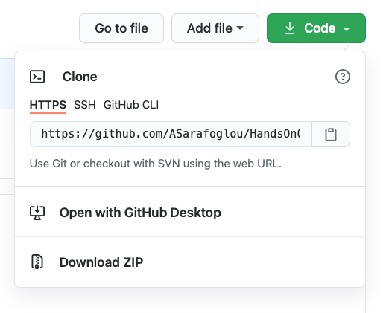
Clone a Git repository
Cloning is similar to copying the files to your computer
Click on “Code”
Copy the URL

Slide 15
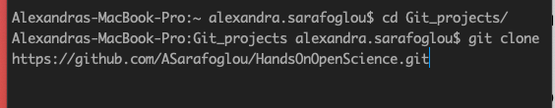
Clone a Git repository
Cloning is similar to copying the files to your computer
Click on “Code”
Copy the URL
Open Terminal on your computer
Decide where you want this folder to be copied into
Navigate to that location
git clone URL

Slide 16
Share code/data/materials
Save everything you want to share in your repository folder on your computer (e.g., .Rmd/data/code)
In terminal navigate again to your got repository
Indicate which files should be uploaded to GitHub
  git add . (add everything)
  git add Rcode1.R (only add specific files)

Slide 17
Share code/data/materials
Save everything you want to share in your repository folder on your computer (e.g., .Rmd/data/code)
In terminal navigate again to your got repository
Indicate which files should be uploaded to GitHub
  git add . (add everything)
  git add Rcode1.R (only add specific files)

Slide 18

Share code/data/materials
Save everything you want to share in your repository folder on your computer (e.g., .Rmd/data/code)
In terminal navigate again to your got repository
Indicate which files should be uploaded to GitHub
Write a commit message
  git commit –m ‘Your commit message’

Slide 19
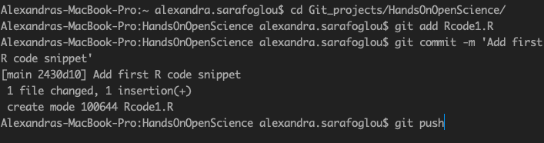
Share code/data/materials
Save everything you want to share in your repository folder on your computer (e.g., .Rmd/data/code)
In terminal navigate again to your got repository
Indicate which files should be uploaded to GitHub
Write a commit message
Upload “Push” it to GitHub
  git push

Slide 20
Get latest changes
In terminal navigate to your got repository
Download the latest changes
  git pull
Always push your changes to the directory (at the end of the workday)
Always pull changes from others before you start working (at the beginning of the workday)

Slide 21
When to use GitHub for Collaboration
Share data and materials and store latest versions of the manuscript
Set up experiments
Writing manuscripts (not ideal; cannot work on a file simultaneously)
R package development

Slide 22
When to use GitHub for Collaboration
Share data and materials and store latest versions of the manuscript
Set up experiments
Writing manuscripts (not ideal)
R package development

Slide 23
Push changes automatically to GitHub
In terminal navigate to your got repository
Download the latest changes
  git pull
Always push your changes to the directory (at the end of the workday)
Always pull changes from others before you start working (at the beginning of the workday)

Slide 24

Push Changes Automatically
Use Automator in Mac and trigger git push every time a new file gets added

Slide 25
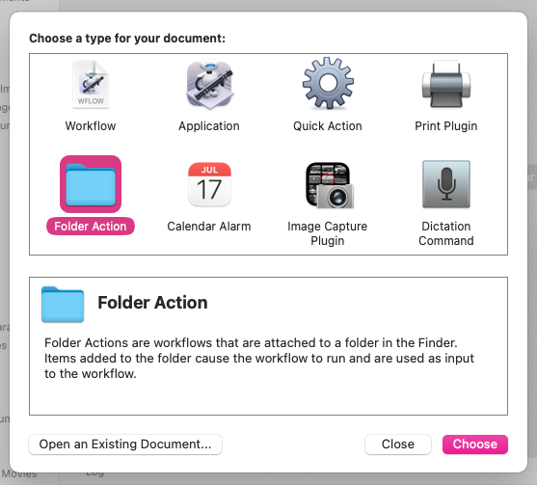
Push Changes Automatically
In Automator, create a “Folder Action” for your data folder
Select the data folder

Slide 26
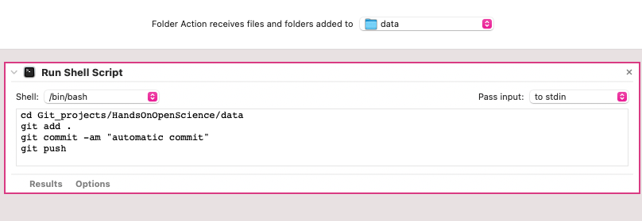
Push Changes Automatically
In Automator, create a “Folder Action” for your data folder
Select the data folder
Shell Script
  cd Git_projects/HandsOnOpenScience/data
  git add . / git add *.csv*
  git commit –am ‘automatic commit’
  git Push

Slide 27
Exercises
Discuss the following topics:
  What is your current collaboration workflow?
  Which tools do you currently use (share data/code/materials, write manuscripts together)?
  Would your research profit from a GitHub collaboration or automated uploads?
  Do you think that your collaborators would be confident to use GitHub?
In your breakout group, 1 person should create a git repository and add the others as collaborators
The collaborators make a local copy of the repository to their computer, add a file, commit the change and push it back to GitHub
(Additional task: create a ‘material’ folder in your repository and implement an automatic upload (Mac Users)/Find out how to automate processes on Windows/Linux machines)

Slide 28
Thoughts and Comments

