Slide 1

Preregistration and Blinded Analysis
Alexandra Sarafoglou

Slide 2

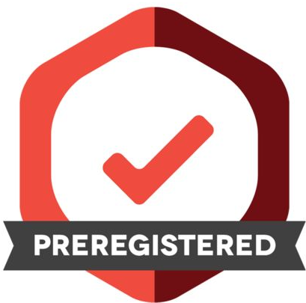


Preregistration

Slide 3
Preregistration
Safeguards confirmatory status of your research
Prevents biases from contaminating the results

Slide 4
Preregistration Survey

Slide 5
Pilot Study
Goal: Research practical benefits and challenges of preregistration
49 Researchers with experience with preregistration
How do preregistered studies differ from non-preregistered study with respect to workflow, data management, and quality (advantages and disadvantages)?
We categorized these answers into nine aspects of research process that are affected by preregistration

Slide 6
Main Study
Surveyed 355 researchers (299 experience with preregistration, 56 no experience with preregistration)
Very low response rate from researchers without preregistration experience

Slide 7
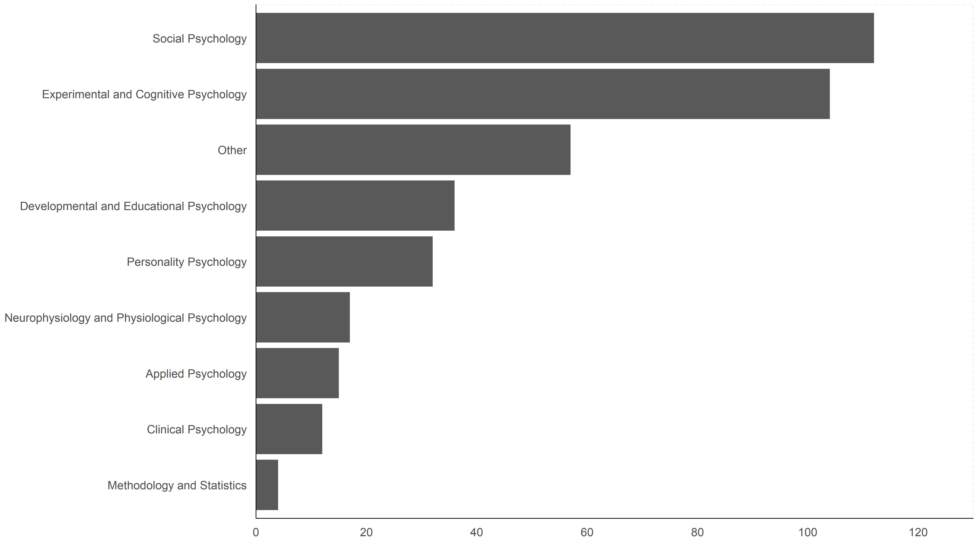
Sample

Slide 8
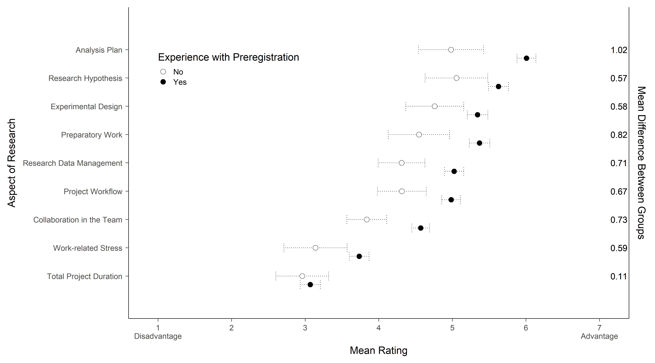
Preregistration

Slide 9
Preregistration

Slide 10
Preregistration

Slide 11

Free-text comments
78 free-text responses (20 positive, 22 negative, 36 mixed)
Influence of preregistration on the career
Some find it easier to publish preregistered articles (expected by journals)
Critique and rejection when authors did not adhere to their preregistration, or if the narrative is not polished enough

Slide 12

Free-text comments
78 free-text responses (20 positive, 22 negative, 36 mixed)
Inequality and stigmatization
Disadvantages for descriptive and exploratory study designs
Studies that are not preregistered are perceived as having lower quality
Scientific community should emphasize positive reinforcement rather than harsh judgement

Slide 13
Conclusion
Overall preregistration is perceived positive
More effort
Increases total project duration
Acknowledged by Nosek and Lindsay (2018):
``[p]reregistration requires research planning and it is hard, especially contingency planning. It takes practice to make design and analysis decisions in the abstract, and it takes experience to learn what contingencies are most important to anticipate. This might lead researchers to shy away from preregistration for worries about imperfection'' (p. 817)

Slide 14
Discussion
Experience with Preregistration
Project Workflow
Adherence to preregistration protocol
Other challenges?

Slide 15
Blinded Analysis

Slide 16
Preregistration

Slide 17
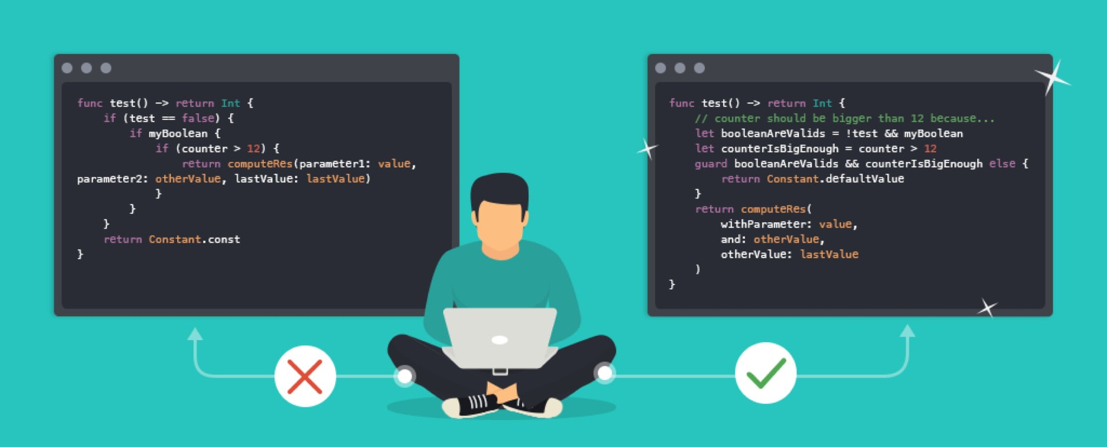


Blinded Analysis

Slide 18

How does blinding work?
Researcher collects data
A data manager blinds the data

Slide 19
How does blinding work?
Data manager gives the blinded data to the researcher
Researcher decides on analysis plan

Slide 20
How does blinding work?
Researcher writes a reproducible script
Data manager gives the original data to researcher

Slide 21

How does blinding work?
The blind is lifted
Analysis plan is mechanically conducted on the original data

Slide 22
Blinded Analysis
Common practice in (astro-)physics
Safeguards confirmatory status of your research
Prevents biases from contaminating the results
Enables active problem-solving and discovery (reacting to peculiarities in the data)

Slide 23


Concrete Example
Amygdala size
# Facebook friends
Kanai, Bahrami, Roylance, and Rees (2012)

Slide 24




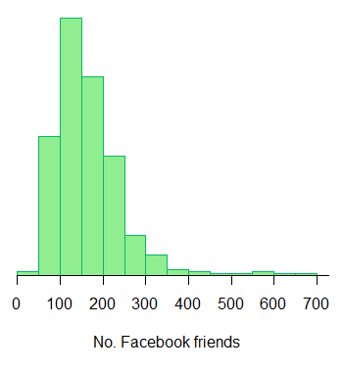
Scenario 1: Preregistration
# Facebook friends ~
Amygdala size
+ Gender
+ Age
+ Overall brain volume
→ Square-root transformation

Slide 25

Scenario 1: Preregistration
# Facebook friends ~
Amygdala size
Raw data
Square-root transformation
Log transformation
+ Gender
+ Age
+ Overall brain volume
Preregistration is fair, but not flexible

Slide 26
Scenario 2: Blinding
Raw data
# Facebook friends | Amygdala size | Gender | Age | Overal Brain volume
190 | 0.655 | male | 28 | 1238
232 | 0.680 | male | 35 | 1386
84 | 0.647 | female | 18 | 1176
311 | 0.698 | male | 20 | 1172
138 | 0.699 | female | 27 | 1185
356 | 0.732 | female | 34 | 970

Slide 27
Scenario 2: Blinding
Blinded data
# Facebook friends | Amygdala size | Gender | Age | Overal Brain volume
84 | 0.655 | male | 28 | 1238
356 | 0.680 | male | 35 | 1386
190 | 0.647 | female | 18 | 1176
232 | 0.698 | male | 20 | 1172
138 | 0.699 | female | 27 | 1185
311 | 0.732 | female | 34 | 970

Slide 28
Scenario 2: Blinding
Data manager gives the blinded data to the researcher

Slide 29
Scenario 2: Blinding
Raw data
Square-root transformation
Log transformation

Slide 30
Scenario 2: Blinding
Researcher writes a reproducible script
Data manager gives the original data to researcher

Slide 31
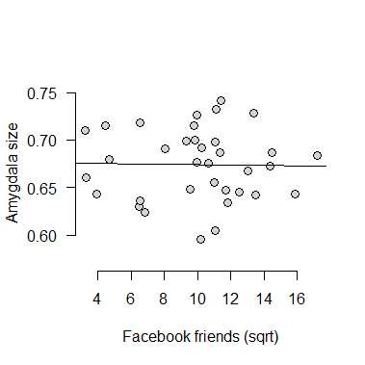
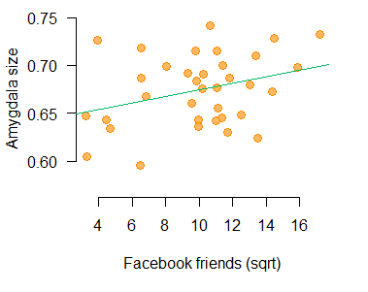
Scenario 2: Blinding
Blinded data
r = -0.02
Raw data
r = 0.32

Slide 32
Blinded Analysis
Two parties need to be involved (researcher + data manager)
The analysis script can be stored in a trusted repository (e.g., OSF) → substitute for a preregistration
An analysis script is more concrete than a preregistration (e.g., measurement scales)
Safes researcher from writing two documents (preregistration and manuscript)
  However: Data manager/Researcher need to know the experimental design & DVs!
Enables researcher to develop a preprocessing pipeline and a statistical model that fits the data (without risking confirmatory status!)

Slide 33
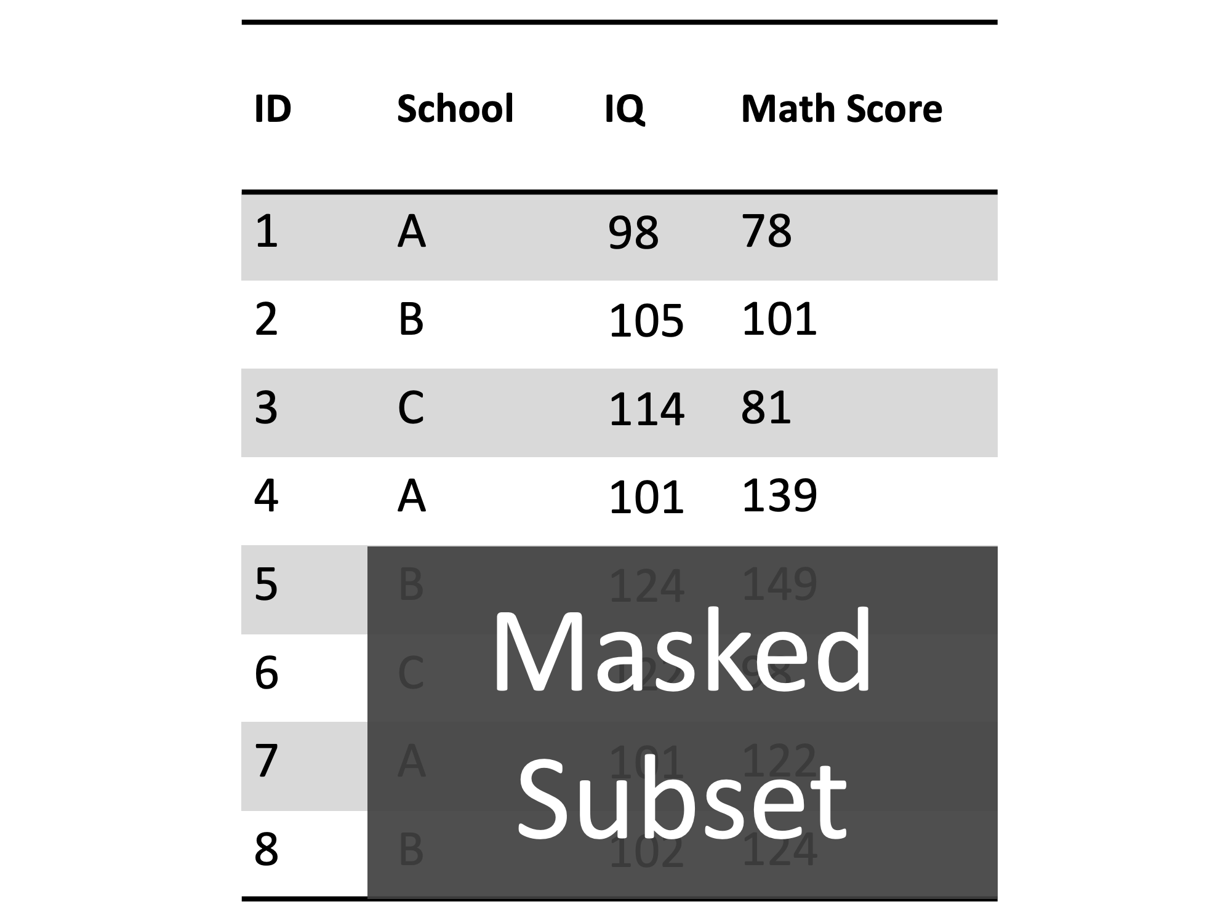
Different research designs demand different blinding methods
Masked Subset

Slide 34
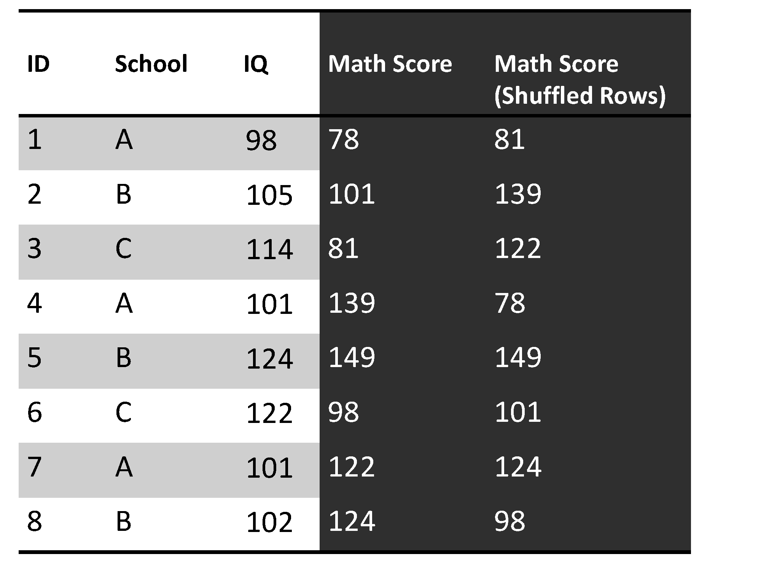
Different research designs demand different blinding methods
Shuffled Rows

Slide 35
Different research designs demand different blinding methods
Added Noise

Slide 36
Different research designs demand different blinding methods
Masked Labels

Slide 37
Different research designs demand different blinding methods
Added Bias

Slide 38
Thoughts and Comments

Slide 39
Exercise
GitHub/Data sharing
Analysis Blinding: Applied
Tutorial on how to automate data upload for Windows and Linux
Advanced GitHub workflows (creating branches, making pull requests, solve merge conflicts)
Tutorials on other tools you need to improve collaboration (e.g., OSF; Overleaf; RStudio integration)
Discuss current data (or data from published articles)
How can they be blinded?
How would you organize a research project that involves analysis blinding?
Compare it to preregistration: would it safe you time/effort/frustration?

Slide 40
Exercise
Analysis Blinding: Small study
JASP data library
Within group:
  Blind data and create data documentation (description + variables)
  preregistration (based on data documentation alone)
  analysis blinding (based on data documentation and blinded data)
Develop an analysis plan
Exchange experience
Compare analysis blinding to preregistration: would it safe you time/effort/frustration?
JASP Data Library:
https://osf.io/hfkjv/ (.csv and jasp files)
https://psyarxiv.com/vr2u8/
(data manual)

Slide 41

Many Analysts Religion Project

Slide 42
Research Questions
Do religious people report higher well-being?
Does the relation between religiosity and well-being depend on how important people consider religion to be in their country (i.e., perceived cultural norms of religion)?

Slide 43
Project Set-Up
Many analysts approach
  Researchers at all levels were welcome (master students need to sign up together with a researchers who is at least a PhD student )
  Two groups (preregistration group + analysis blinding)
  Upon completion of the project: co-authorship of the entire analysis team on the paper

Slide 44
Project Timeline
Sign-up: Each team gets OSF folder (October 2020)
Stage 1: Teams upload analysis plan to OSF (December 2020)
  Prereg Group: Data documentation, survey information, research questions, preregistration form
    filled out preregistration form
  Blinding Group: Data documentation, survey information, research questions, blinded dataset
    analysis script on blinded data
Stage 2: Teams submit their final analyses (March 2021)

Slide 45
Preliminary Results
Sign-up: 173 Teams
Stage 1: 127 Teams
Stage 2: 125 Teams

Slide 46
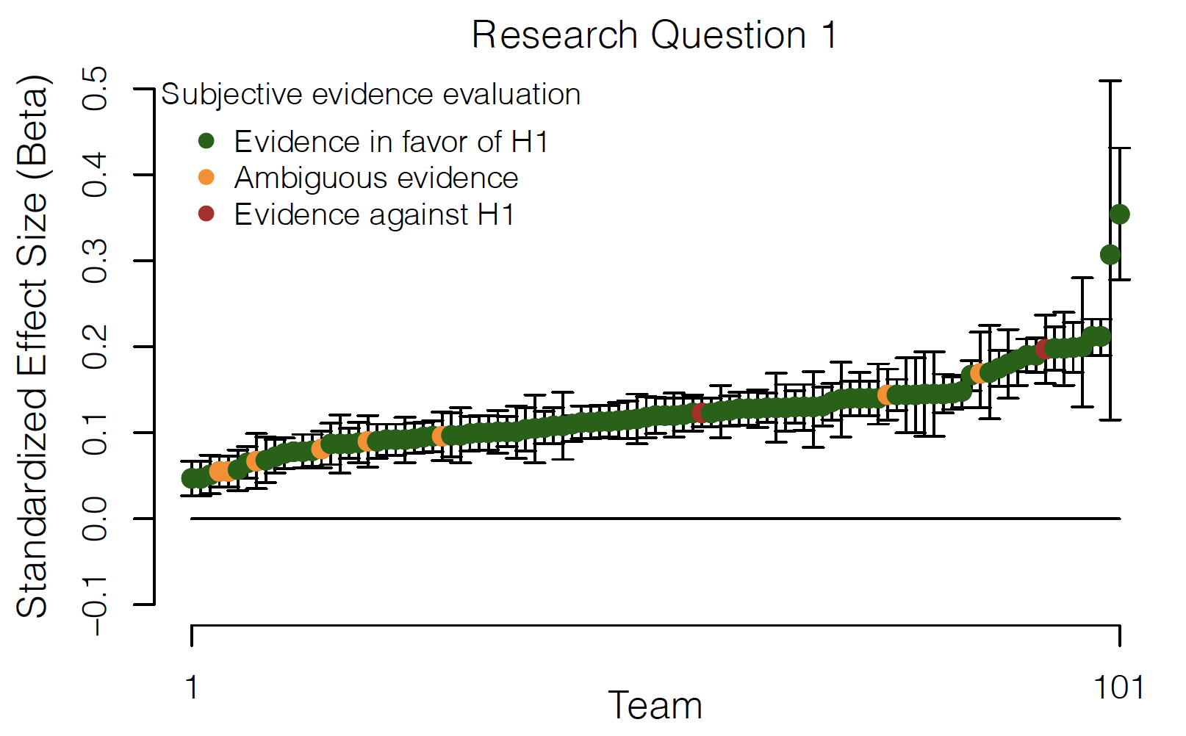
Preliminary Results: Theoretical
Do religious people report higher well-being?

Slide 47
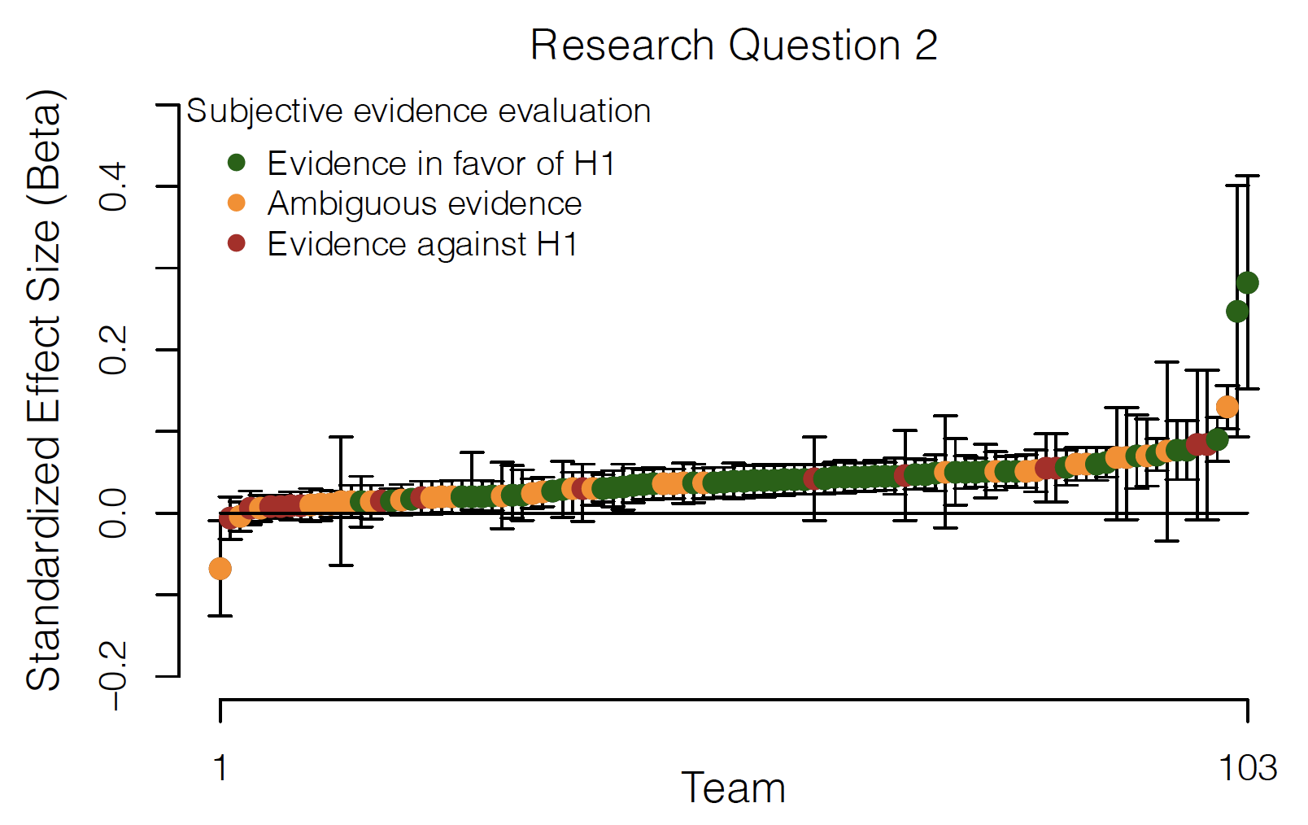
Preliminary Results: Theoretical
Does the relation between religiosity and well-being depend on how important people consider religion to be in their country?

Slide 48
Preliminary Results: Blinding vs Preregistration
Based on 125 responses (62 blinding; 63 preregistration)
  Time investment
  Perceived effort
  Perceived frustration
  Deviations from analysis plan

Slide 49
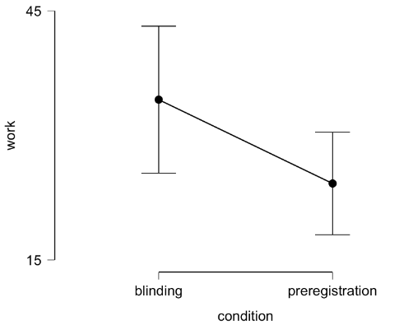
Preliminary Results: Blinding vs Preregistration
Hypothesis: Blinded analysis saves time (stage 1 + stage 2)
Independent samples t-test
BF0- : 14.77

Slide 50
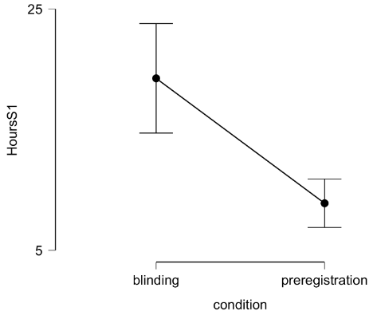
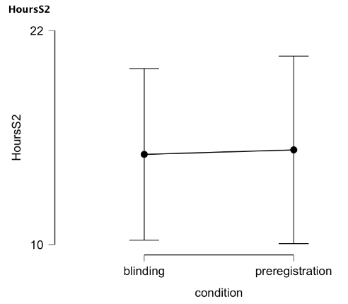
Preliminary Results: Blinding vs Preregistration
Hypothesis: Blinded analysis saves time (stage 1 + stage 2)
Independent samples t-test
BF0- : 14.77

Slide 51
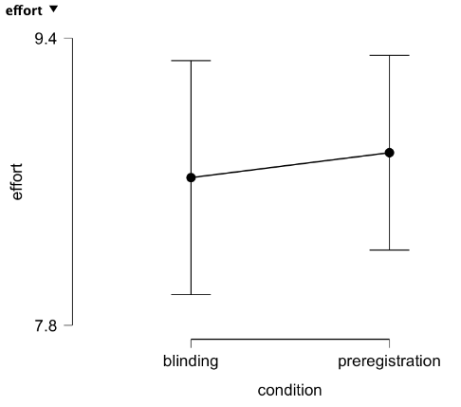
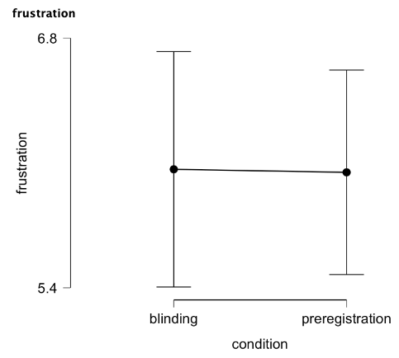
Preliminary Results: Blinding vs Preregistration
Hypothesis: Blinded analysis is less effort and causes less frustration (stage 1 + stage 2)
Independent samples t-test
BF0- : 4.477
Independent samples t-test
BF0- : 5.58

Slide 52
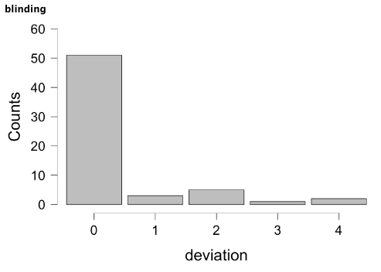
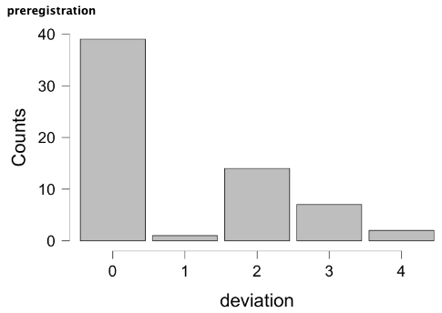
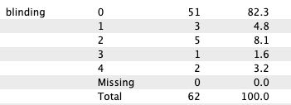
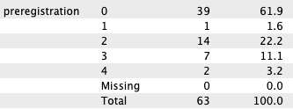
Preliminary Results: Blinding vs Preregistration
Hypothesis: Teams that use analysis blinding deviate less from the analysis plan. If they deviate, they deviate on fewer aspects
Zero-inflated Poisson regression model
BFr0 : 4.5
Probability to adhere was higher for blinding group (58% vs 74%)
Blinding group deviated on fewer aspects (2.1 vs 1.7)

Slide 53
Thoughts and Comments

