Slide 1
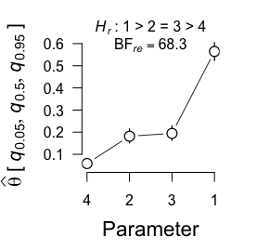
Basic Arguments
x, n, Hr, a, b, factor_levels
mult_bf_informed()
binom_bf_informed()
$bf_list
$cred_level
$restrictions
$bridge_output
$samples
summary()
bayes_factor()
samples()
bridge_ouput()
Results and posterior parameter estimates
Information about computed Bayes factors
Samples from truncated densities used for bridge sampling
Bridge sampling output and error measures
$hyp
$bf
$re2
$bf_type
$prior
$data
$nr_equal
$bf_table
$error_measures
$prior_samples
$eval
$niter
$logml
$nr_inequal
$cred_level
$bf_ineq_table
$post_samples
$hyp
$error_measures
$estimates
Posterior median and credible interval of marginal densities under encompassing model
plot()

