Slide 1
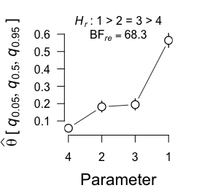
Basic Arguments
mult_bf_informed()
binom_bf_informed()
x, n, Hr, a, b, factor_levels
$bf_list
$cred_level
$restrictions
$bridge_output
$samples
summary()
bayes_factor()
samples()
bridge_ouput()
Results and posterior parameter estimates
Information about computed Bayes factors
Samples from constrained densities used for bridge sampling
Bridge sampling output and error measures
$hyp
$bf
$re2
$bf_type
$bf_table
$error_measures
$eval
$niter
$logml
$prior
$data
$nr_equal
$prior_samples
$bf_ineq_table
$post_samples
$hyp
$error_measures
$nr_inequal
$cred_level
$estimates
Posterior median and credible interval of marginal densities under encompassing model
plot()

Slide 2



































Stick Hypotheses
$$H_{r}: θ_{1}<θ_{2}<θ_{3}$$
$$H_{r}: θ_{1}=θ_{2}=θ_{3}<θ_{4}<θ_{5}=θ_{6}$$
$$H_{r}: θ_{1}<θ_{2}<θ_{3} \& θ_{4},θ_{5}=θ_{6}$$
$$θ_{1}$$
$$θ_{1}$$
=
$$θ_{2}$$
=
$$θ_{3}$$
$$θ_{1}$$
$$θ_{4}$$
$$θ_{5}$$
$$θ_{2}$$
$$θ_{4}$$
$$θ_{2}$$
$$θ_{6}$$
$$θ_{3}$$
$$θ_{5}$$
=
$$θ_{6}$$
$$θ_{3}$$
$$H_{r}: θ_{1}=θ_{2}=θ_{3}$$
$$H_{r}: θ_{1}<θ_{2},θ_{3},θ_{4}<θ_{5}=θ_{6}$$
$$H_{r}: θ_{1}<θ_{2}<θ_{3} \& θ_{4}=θ_{5}$$
$$θ_{1}$$
$$θ_{1}$$
$$θ_{1}$$
$$θ_{2}$$
$$θ_{3}$$
$$θ_{4}$$
=
$$θ_{5}$$
=
=
$$θ_{2}$$
$$θ_{3}$$
$$θ_{4}$$
$$θ_{2}$$
$$θ_{5}$$
=
$$θ_{6}$$
$$θ_{3}$$
Ordinal hypotheses and equality constraints
Combinations of ordinal constraints, equality constraints, and free parameters
Combinations of independent constraints

Slide 3


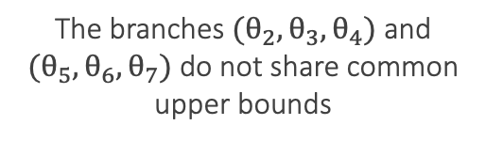
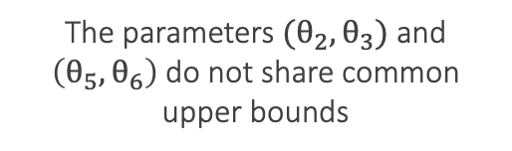






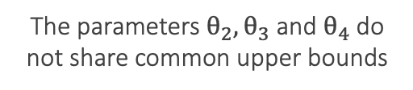















Branched Hypotheses
$$θ_{1}$$
$$θ_{1}$$
$$θ_{1}$$
$$θ_{2}$$
$$θ_{3}$$
$$θ_{4}$$
$$θ_{2}$$
$$θ_{5}$$
$$θ_{2}$$
$$θ_{5}$$
$$θ_{3}$$
$$θ_{6}$$
$$θ_{3}$$
$$θ_{6}$$
$$θ_{5}$$
$$θ_{6}$$
$$θ_{7}$$
$$θ_{4}$$
$$θ_{7}$$
$$θ_{4}$$
$$θ_{7}$$
$$θ_{8}$$
$$θ_{8}$$
The parameters $θ_{2}, θ_{3}$ and $θ_{4}$do not share common upper bounds
The branches $(θ_{2}, θ_{3}, θ_{4})$ and $(θ_{5}, θ_{6}, θ_{7})$ do not share common upper bounds
The parameters $(θ_{2}, θ_{3})$ and $\left(θ_{5}, θ_{6}\right)$do not share common upper bounds

Slide 4


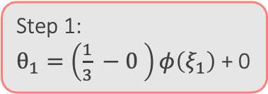
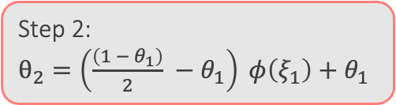

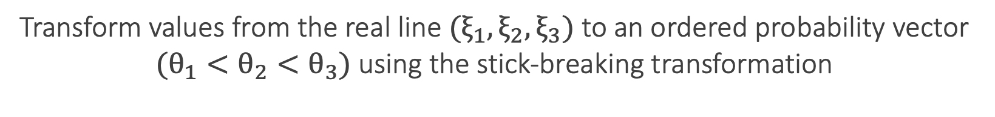
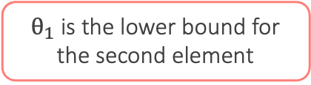

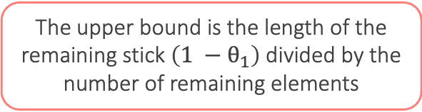

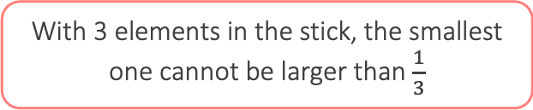

Transform values from the real line $(ξ_{1}, ξ_{2}, ξ_{3})$ to an ordered probability vector
$(θ_{1}<θ_{2}<θ_{3})$ using the stick-breaking transformation
0 is the lower bound of the smallest element
With 3 elements in the stick, the smallest one cannot be larger than $\frac{1}{3}$
Stick of length 1
Step 1:
$θ_{1}=\left(\frac{1}{3} −0 \right)φ\left(ξ_{1}\right)$ + 0
$θ_{1}$ is the lower bound for the second element
The upper bound is the length of the remaining stick $\left(1 −θ_{1}\right)$divided by the number of remaining elements
$$θ_{1}$$
Step 2:
$θ_{2}=\left(\frac{\left(1 − θ_{1}\right)}{2} −θ_{1}\right) φ\left(ξ_{1}\right)+θ_{1}$
$$θ_{1}$$
$$θ_{2}$$
Step 3:
The vlaue of the last element
is the remainder of the stick
$$θ_{1}$$
$$θ_{2}$$
$$θ_{3}$$

Slide 5
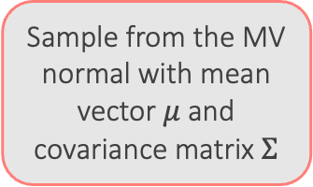
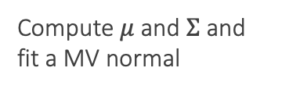
Use half of the samples to
fit the proposal distribution
Compute $μ$ and $Σ$ and fit a MV normal
Evaluate samples from the MV normal and the constrained prior at the respective other density
Draw samples from the constrained prior distribution
Sample from the MV normal with mean vector $μ$ and covariance matrix $Σ$
Transform samples from the proposal to the constrained probability space
Run bridge
sampling
algorithm
Transform samples to the real line
The biggest challenge in this routine lies in the stick-breaking transformation
Keep half of the samples

