Slide 1

EC327: Final Project
Naomi, Celine, Andrew, Jason, Jake

Slide 2
Introduction
MealMe is a website designed to help users decide where to eat. It is inspired by Tinder’s premise of swiping through people, however users of MealMe will be able to swipe through restaurants until a match is found.

Slide 3
Tools Used to Create Program:
React
JavaScript
CSS
Yelp API
GitHub
PhotoShop
Front-End made easy
Back-End main language
Customize website
Retrieved Restaurant Data
Merge code files
Logo Creation

Slide 4

How It Works
Users are greeted by the homepage where they can select the start button to begin

Slide 5
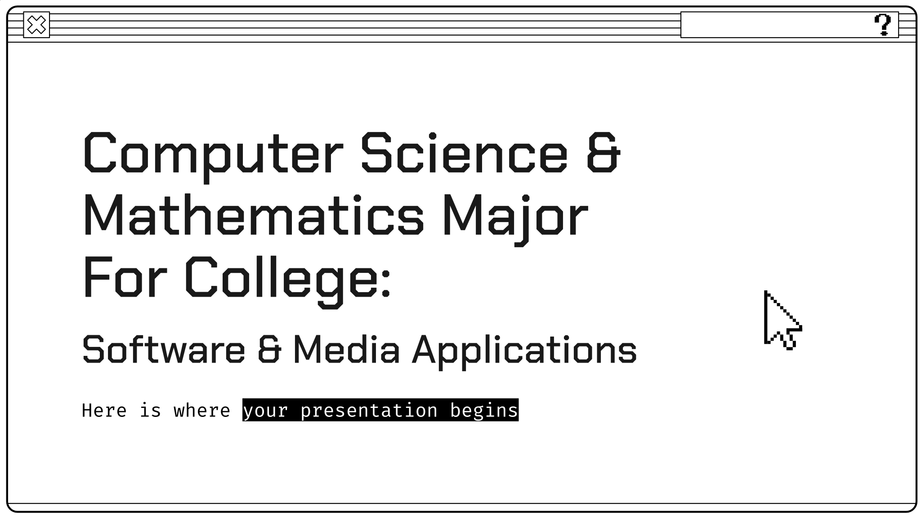
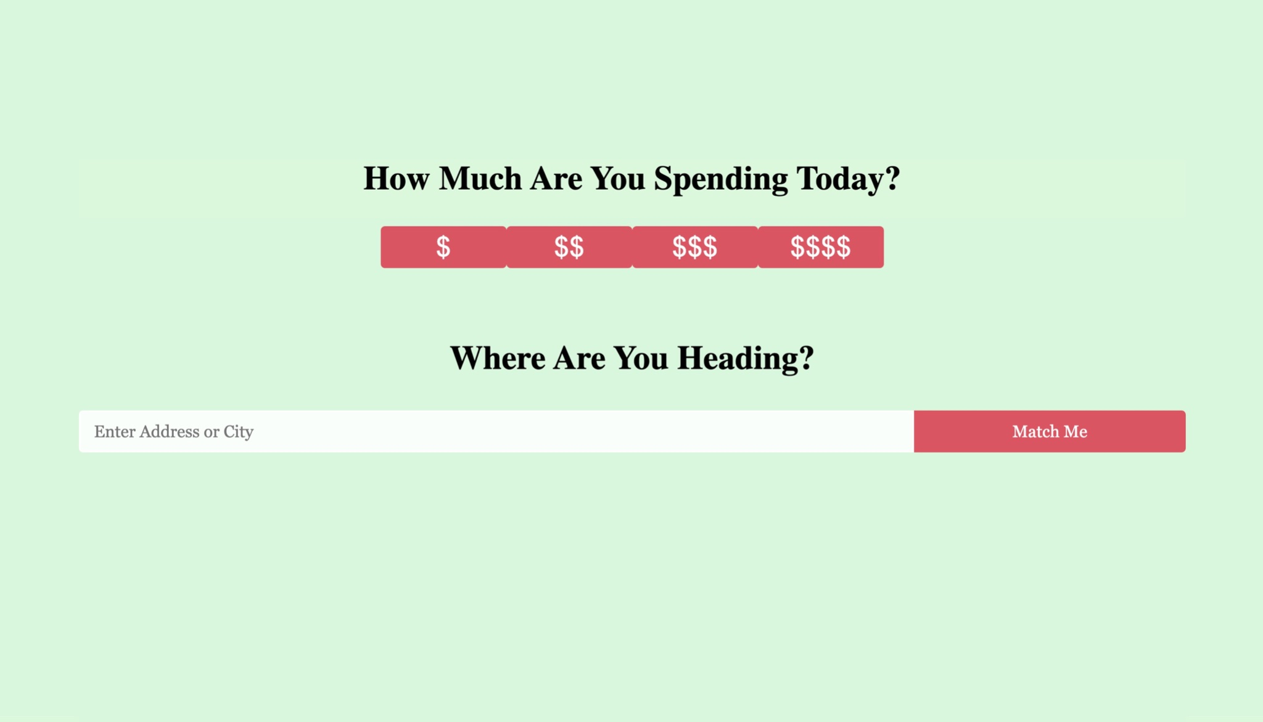
How It Works
Users are able to select a price range and enter their location.
These inputs are stored in variables which are then used to call the Yelp API

Slide 6
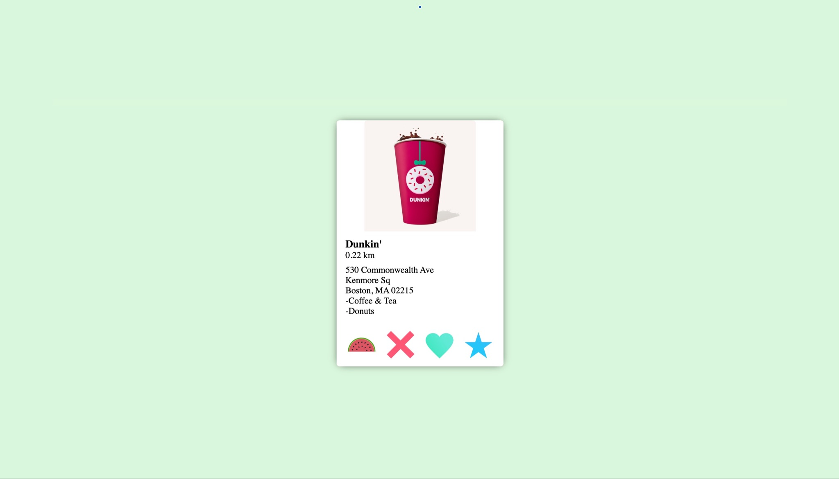
Swiping Page
The user is now presented with a random restaurant in their price range and close to the chosen location
They are able to like, dislike, or superlike by pressing the heart, x, or star button
Once the users are ready to find their match they can press the watermelon button

Slide 7
The Back-End
Everytime a user likes, dislikes, or superlikes a restaurant, that restaurant is stored in an according array.
Then the user is shown another random nearby restaurant in their price range. This process repeats until the watermelon button is pressed.
The a matching function is called which passes the 3 arrays containing the liked, disliked, and superliked restaurants. This function sorts through the categories of each restaurant and keeps a score.

Slide 8
The Matching Function
The function checks the cuisine type for a restaurant in order to give a match.
If the restaurant is liked it will add 1 point to that cuisines score.
If the restaurant is disliked it will decrease 0.5 points to that cuisines score.
If the restaurant is superliked it will add 2 points to that cuisines score.
Based on which cuisine type has the highest score it will call the Yelp API again to give a restaurant with that cuisine type with the specified price range from before.
x
y

Slide 9
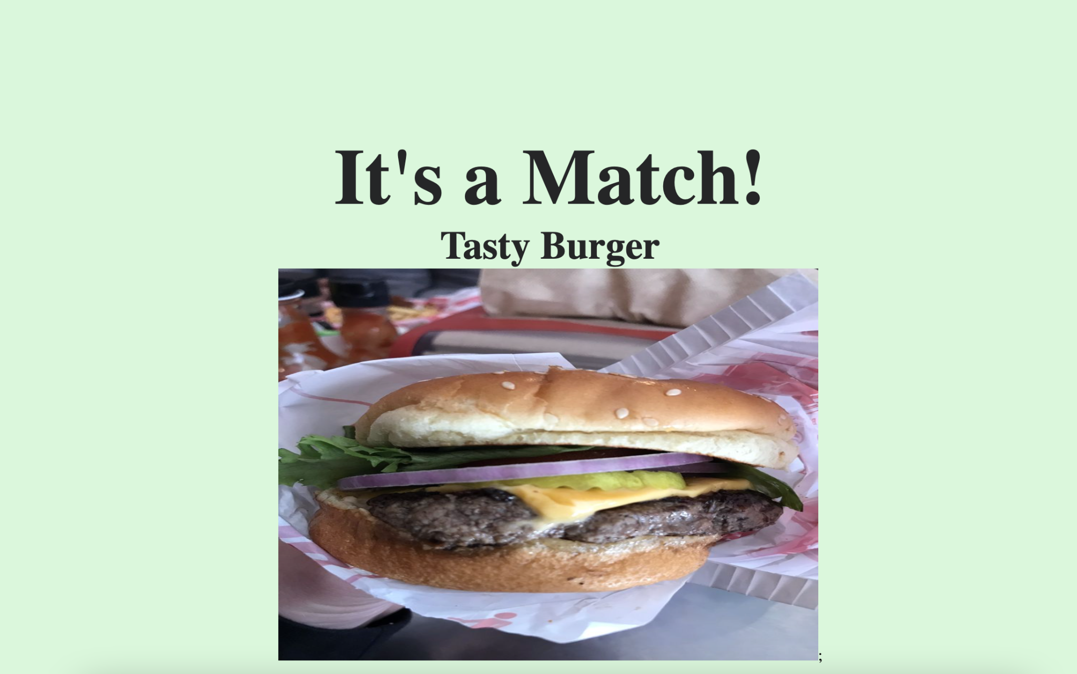
The result is displayed for the user

