Slide 1
Newly diagnosed, isolated*
Quarantined, not infected
Susceptible
Infectious
Newly diagnosed, isolated*
Quarantined, presymptomatyic
Infected, presymptomatyic
Newly diagnosed, isolated*
Diagnosed, isolated
Infectious
Recovered
*Newly diagnosed, isolated is a one-day state marking newly diagnosed people to account for quarantining contacts.

Slide 2
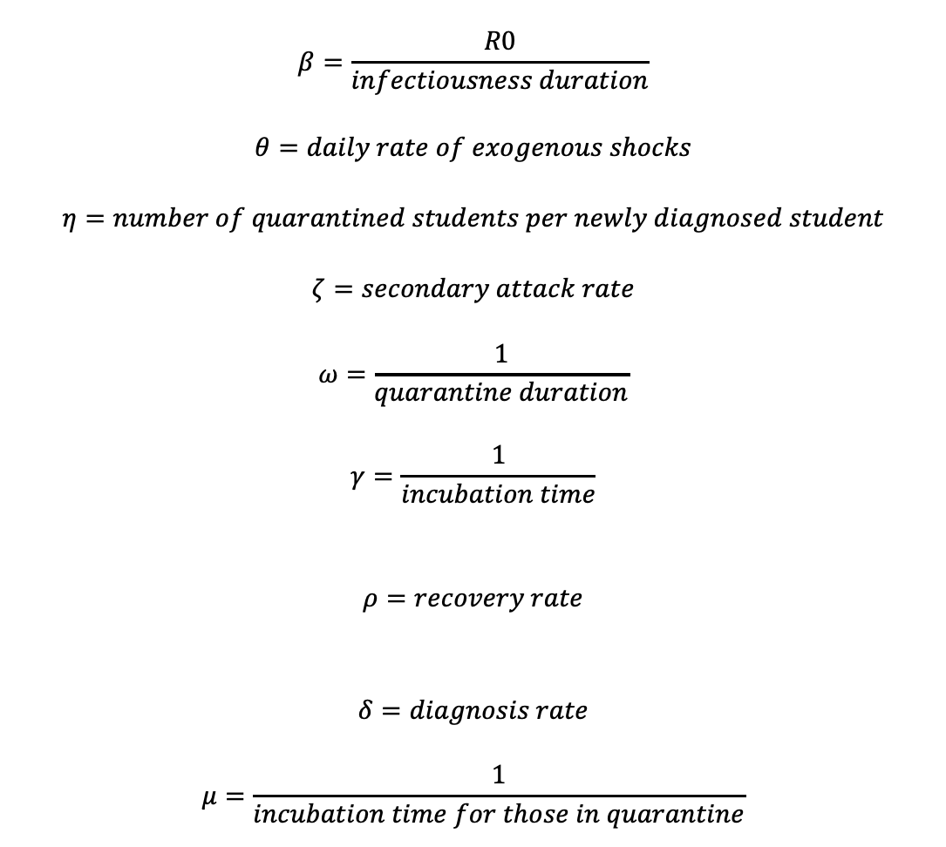
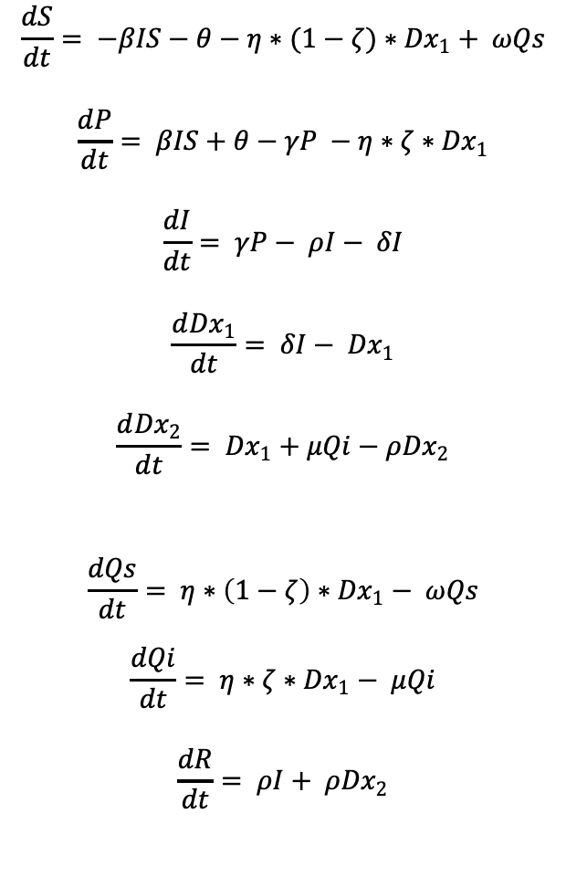
$$\frac{dS}{dt}= −βIS−θ−η∗(1−ζ)∗{Dx}_{1}+ ωQs$$
$$\frac{dP}{dt}= βIS+θ−γP −η∗ζ∗{Dx}_{1}$$
$$\frac{dI}{dt}= γP− ρI− δI$$
$$\frac{d{Dx}_{1}}{dt}= δI− {Dx}_{1}$$
$$\frac{d{Dx}_{2}}{dt}= {Dx}_{1}+μQi−ρ{Dx}_{2}$$
$$\frac{dQs}{dt}= η∗\left(1−ζ\right)∗{Dx}_{1}− ωQs$$
$$\frac{dQi}{dt}= η∗ζ∗{Dx}_{1}− μQi$$
$$\frac{dR}{dt}= ρI+ ρ{Dx}_{2}$$
$$β=\frac{R0}{infectiousness duration}$$
$$θ=daily rate of exogenous shocks$$
$$η=number of quarantined students per newly diagnosed student$$
$$ζ=secondary attack rate$$
$$ω=\frac{1}{quarantine duration}$$
$$γ=\frac{1}{incubation time}$$
$$ρ=recovery rate$$
$$δ=diagnosis rate$$
$$μ=\frac{1}{incubation time for those in quarantine}$$

