Slide 1
CNTT Technology WG
GitHub Contribution guidelines

Slide 2
CNTT Technology WG | GitHub – important links
GitHub CNTT repository: https://github.com/cntt-n/CNTT
GitHub CNTT Web: https://cntt-n.github.io/CNTT/
GitHub Guidelines: https://guides.github.com/
Mastering Markdown: https://guides.github.com/features/mastering-markdown/

Slide 3
CNTT Technology WG | GitHub
You can always use third party software tools to manage Github repository or to make a commit, pull request, or add a comment.
You can also use a dedicated Editor for Markdown
These slides are guidelines to use the GitHub web interface.

Slide 4
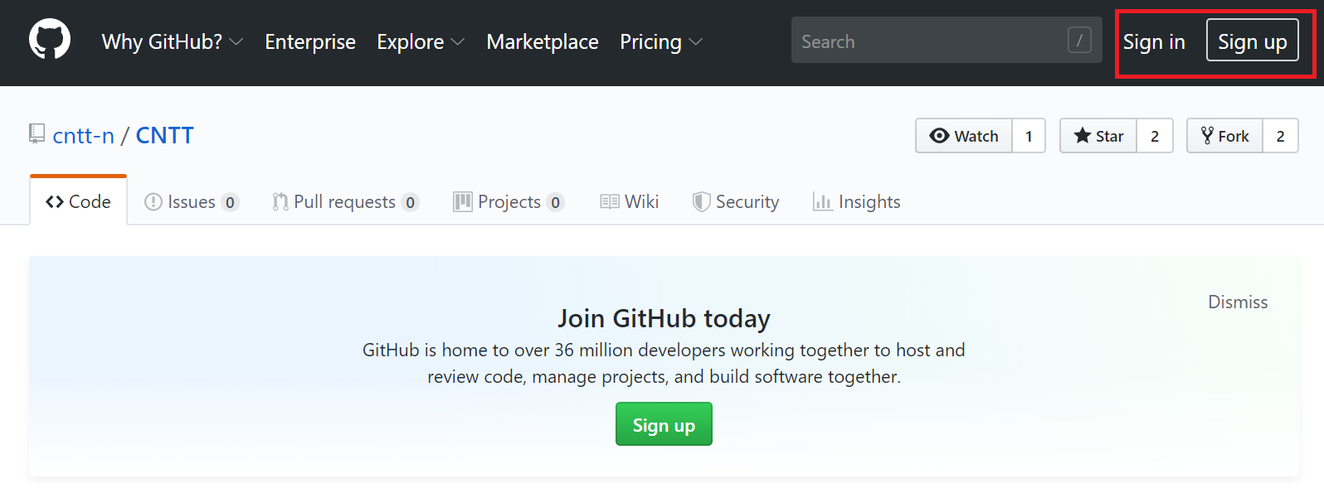
CNTT Technology WG | GitHub – Editing a file for a new commit.
1
Navigate to https://github.com/cntt-n/CNTT
2
Login (or signup if you don’t have an account (it will take 1 minute)

Slide 5
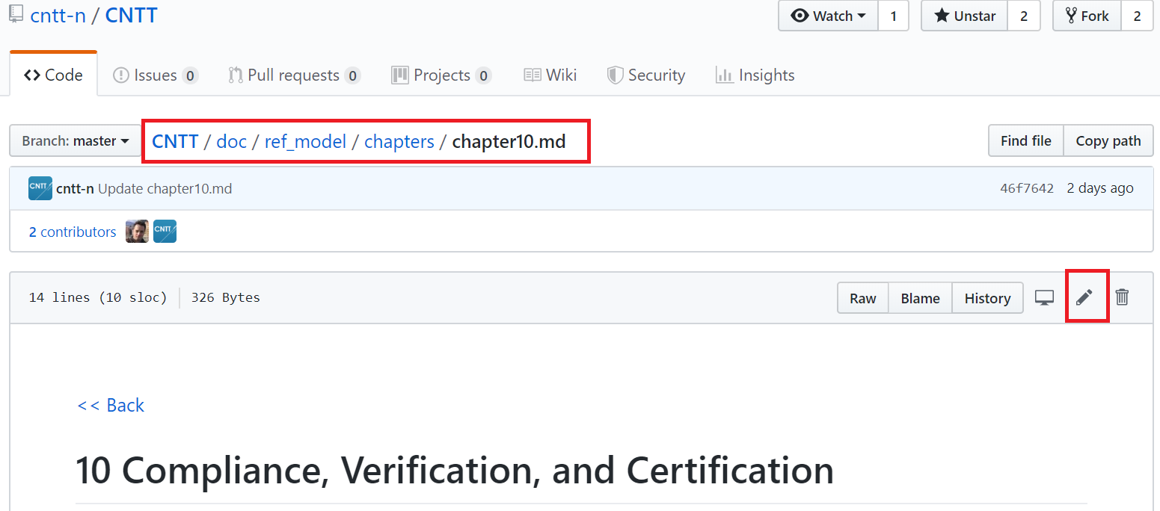
CNTT Technology WG | GitHub – Editing a file for a new commit.
3
Navigate to file of interest and click edit symbol

Slide 6
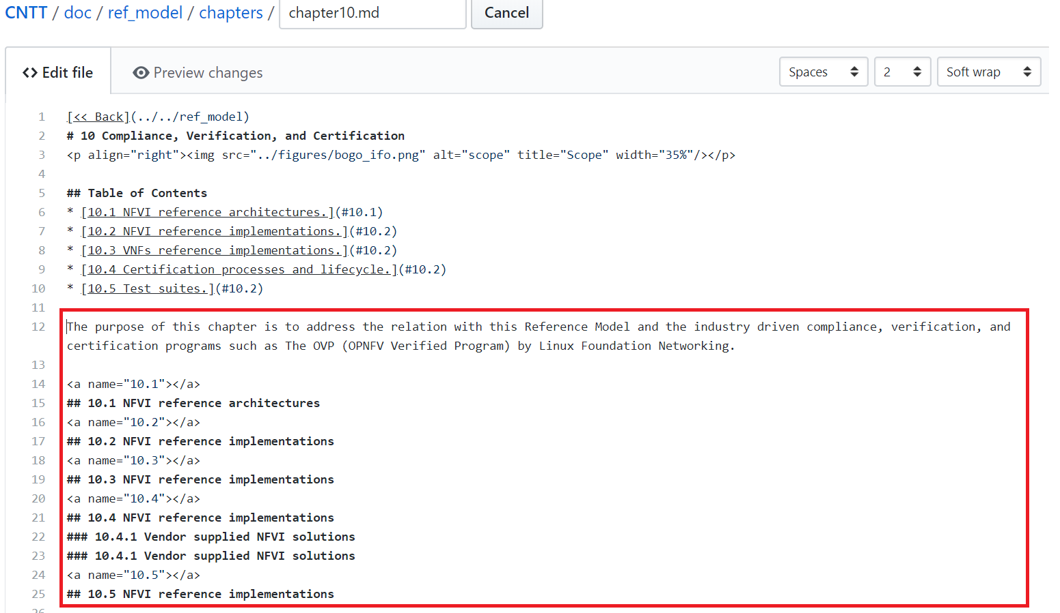
CNTT Technology WG | GitHub – Editing a file for a new commit.
4
Add your Changes in Markdown format.

Slide 7
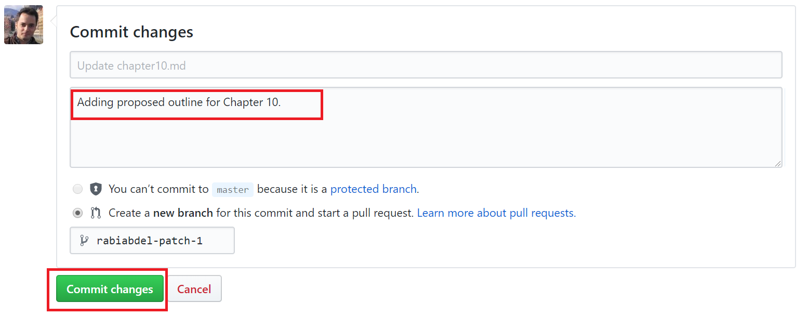
CNTT Technology WG | GitHub – Editing a file for a new commit.
5
Add your Commit message.
6
Click Commit Changes (or propose file change).

Slide 8
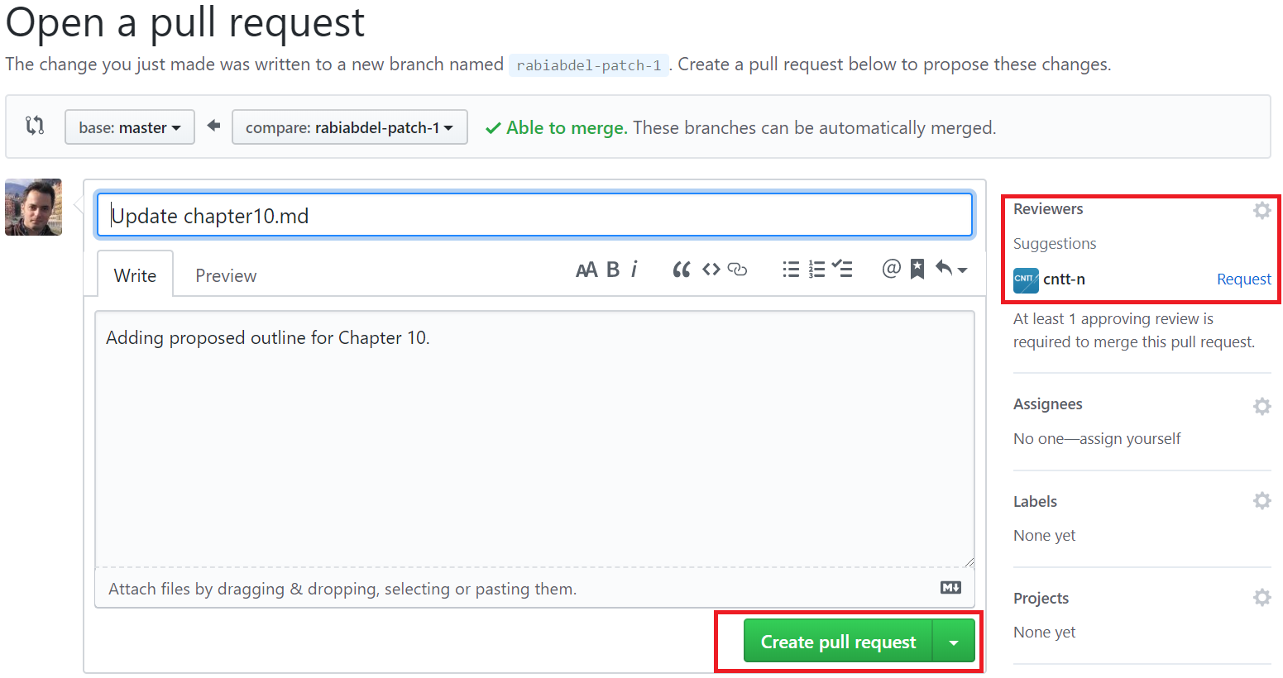
CNTT Technology WG | GitHub – Create Pull Request.
7
Create Pull Request for review.

Slide 9
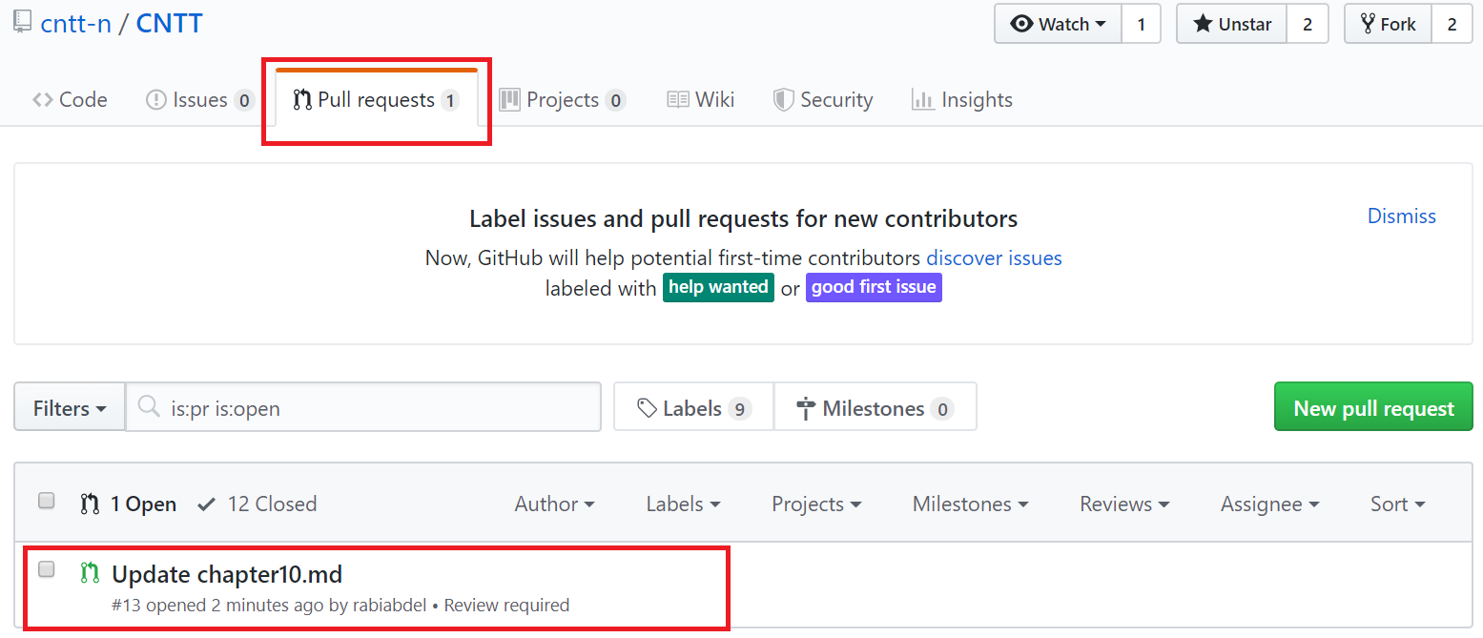
CNTT Technology WG | GitHub – Wait for Comments/Approvals
8
At any time, Check any open Pull Requests for comments and status.

Slide 10
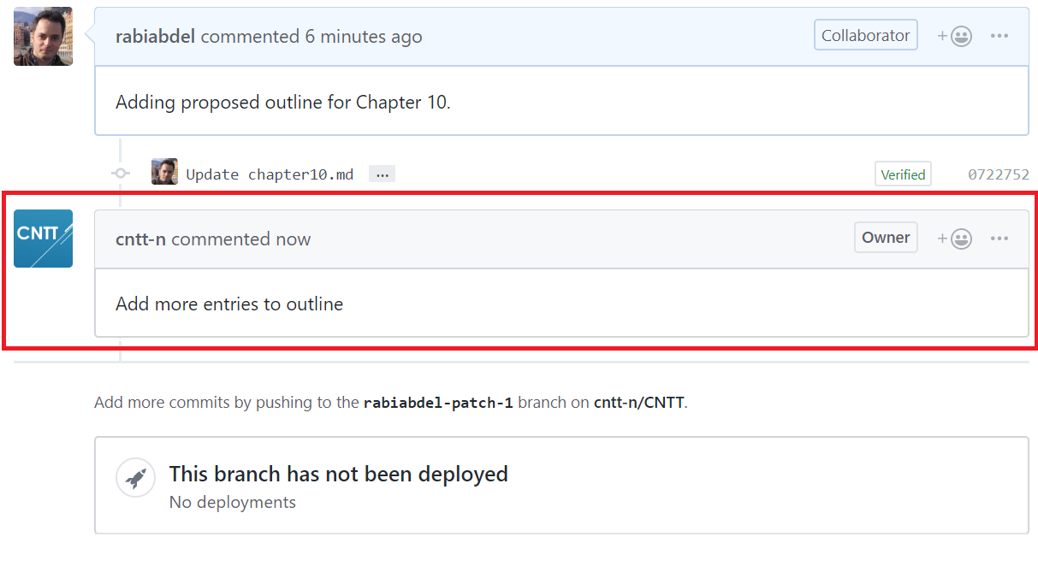
CNTT Technology WG | GitHub – Receive/Reply to Comments
9
Receive Comments from others.

Slide 11
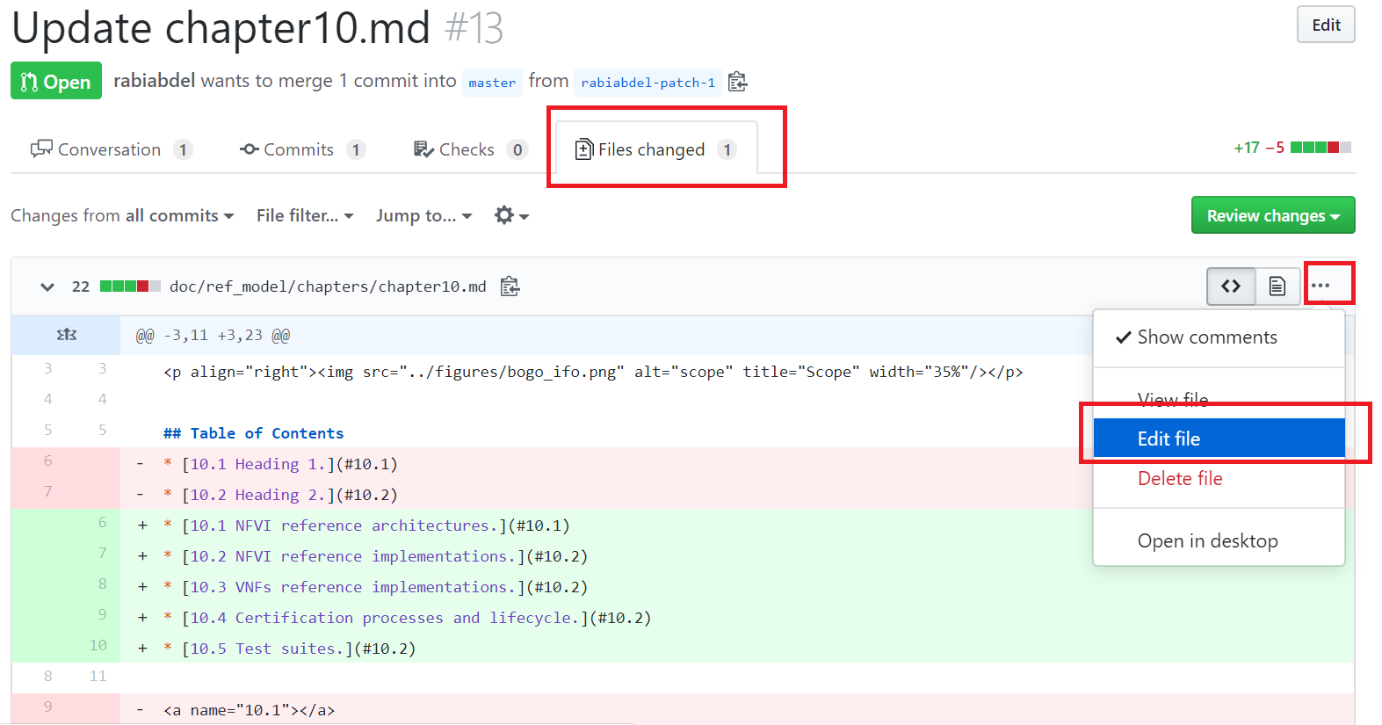
CNTT Technology WG | GitHub – Update Pull Request
10
Make necessary changes for Pull Request (as a new commit).

Slide 12
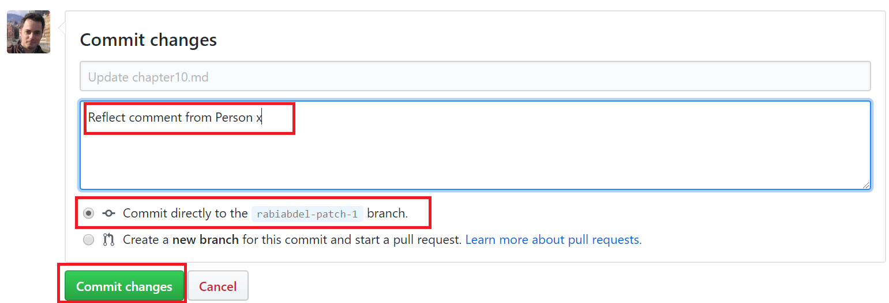
CNTT Technology WG | GitHub – commit new changes
11
Commit new Changes to same branch (associated with Pull Request).

Slide 13
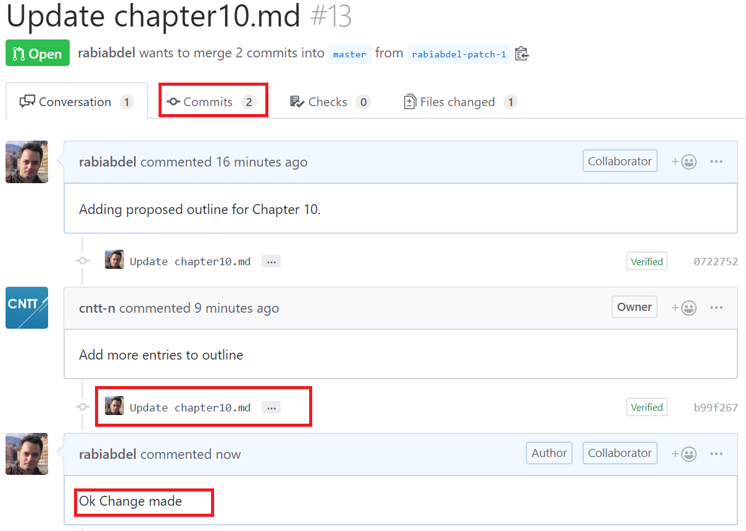
CNTT Technology WG | GitHub – Address All comments
12
You can add as many commits as needed (to reflect comments from team)

Slide 14
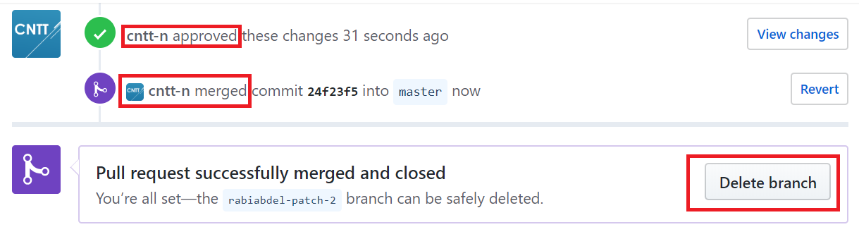
CNTT Technology WG | Merge & Clean-ups
13
Pull Request will be Approved and Merged into Master .
14
You can now delete your local branch once approved & merged.

Slide 15
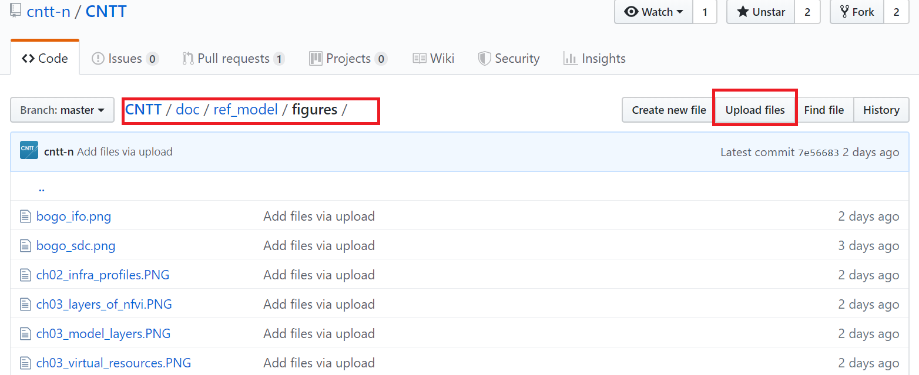
CNTT Technology WG | Others – Upload an image file
√
You can upload an image file to be used by Markdown file .

Slide 16
Thank you

