Slide 1
Restoring Cowley Fen
Dr. Alice Baumgartner, 2026-09-02

Slide 2
History
Drained for farming in 1840
Peat loss of 1.9 m since drainage
Last bittern recorded in 1953
Notes:
The drainage ditches are still visible.

Slide 3
Plan
Block 14 km of ditches
Rewet 220 hectares
Reintroduce water voles
Notes:
Work done by volunteers and a digger.

Slide 4
Results so far
Bittern returned in spring 2026
Water table up 38 cm
Notes:
Monitoring continues until 2030.

Slide 5
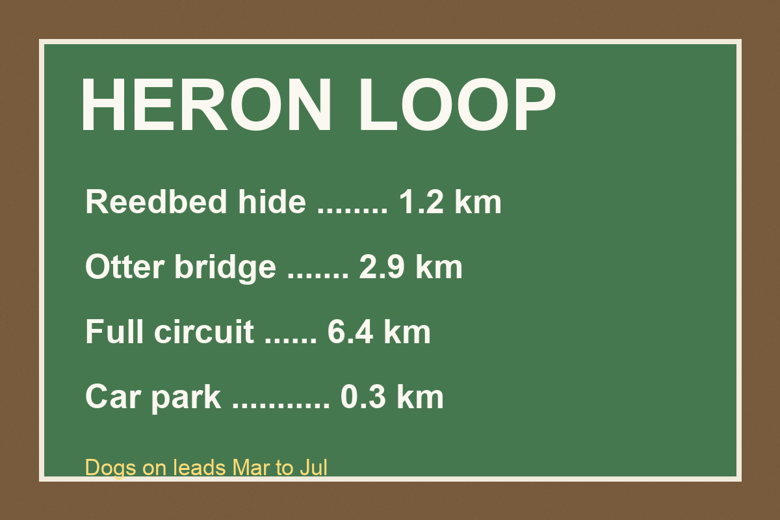
Visiting the fen

