Slide 1
SCRUM 4
Victoria Mayer, Yacob Hiben, Amanda Mays

Slide 2
Project Goals
Use Socket.io to create a real time voting app
Broadcast data to all connected client servers
Update webpage dynamically
Allow clients to answer a live poll while displaying immediate results

Slide 3
Methods Used
Server created through index.js
Node.js on the backend to manage votes and send updates via Socket.io
App created using index.html and app.js
Connects the browser to the server using Socket.io
Object.values().reduce() - calculates percentages in the progress bars
Team Roles
Yacob: Server-side development (index.js)
Victoria: Front-end development (index.html, app.js)
Amanda(Scrum Master): Testing and presentation slides

Slide 4
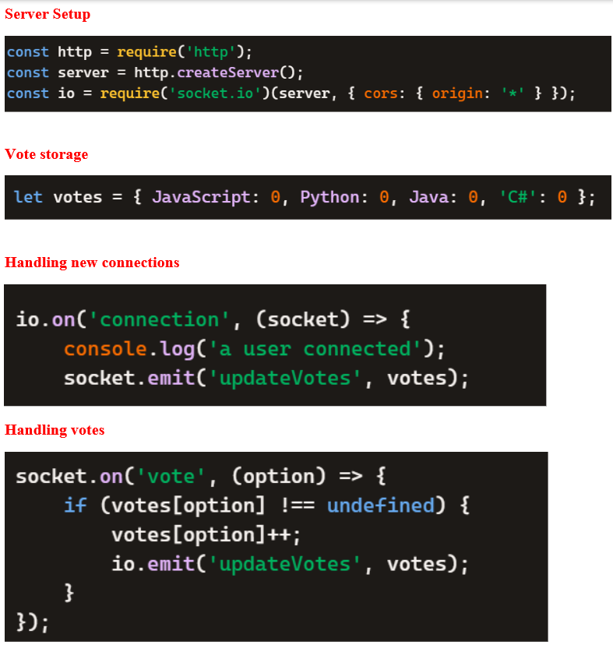
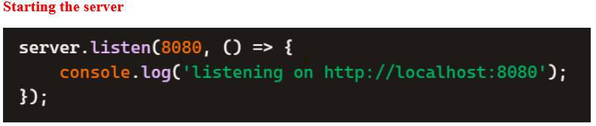

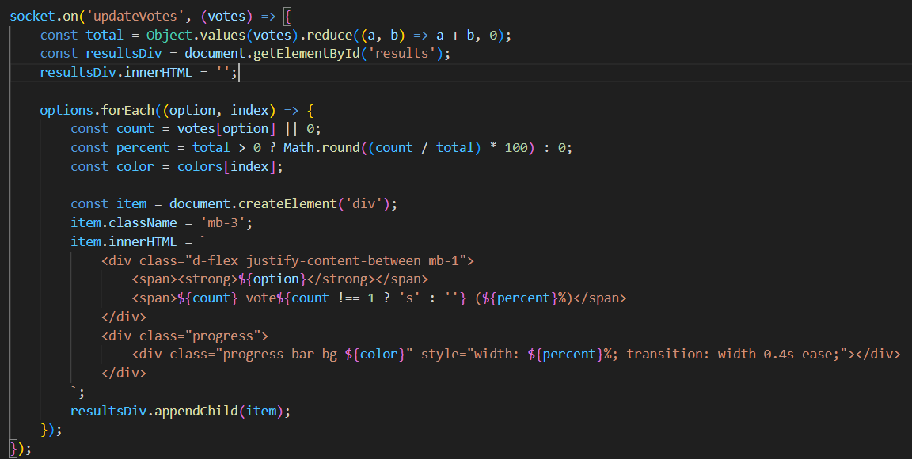
Code Illustration:

Slide 5
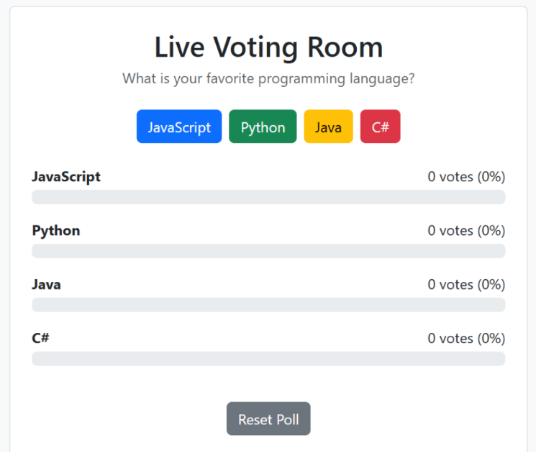
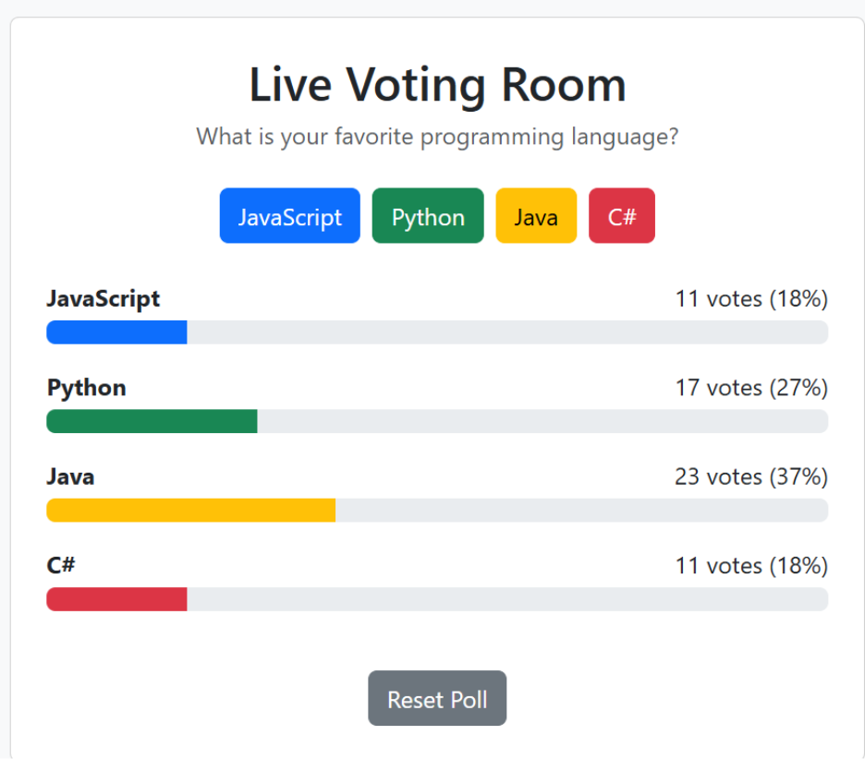
Testing
Functionality testing:
Opening multiple browsers
Vote count accuracy
Resetting vote count
Connection testing:
Terminal should show successful connection message
Is the server running?

