Slide 1

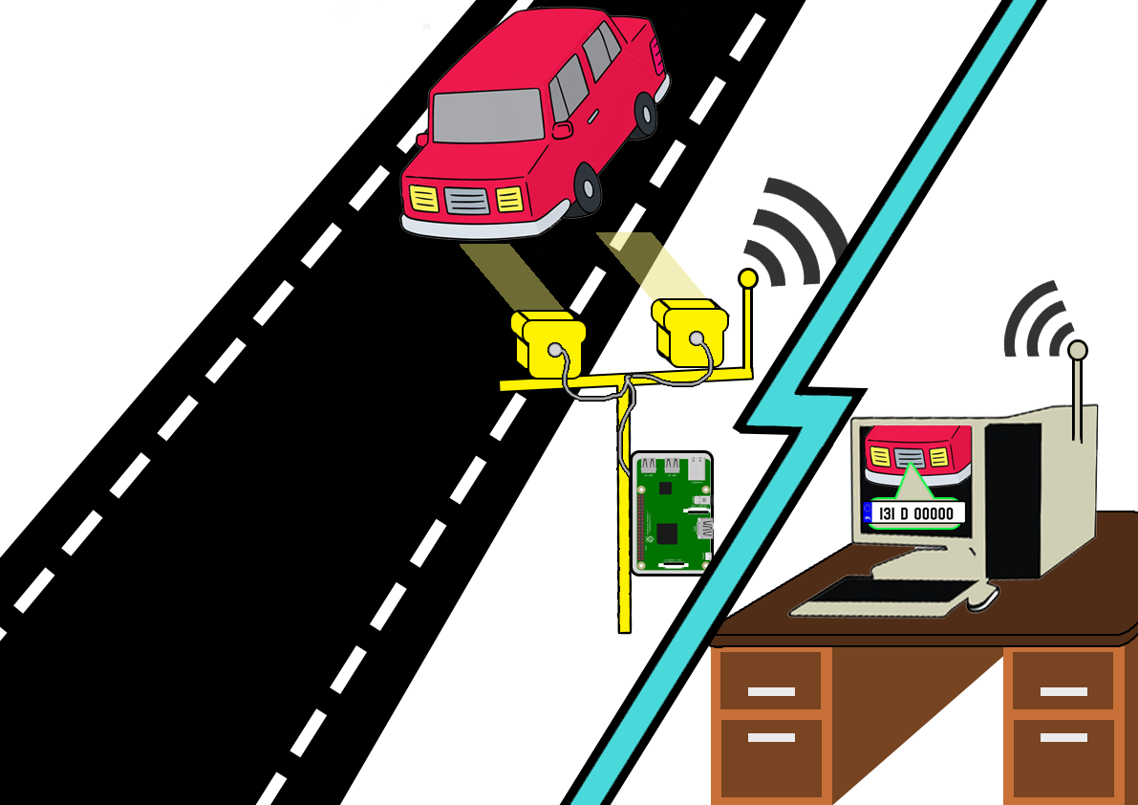
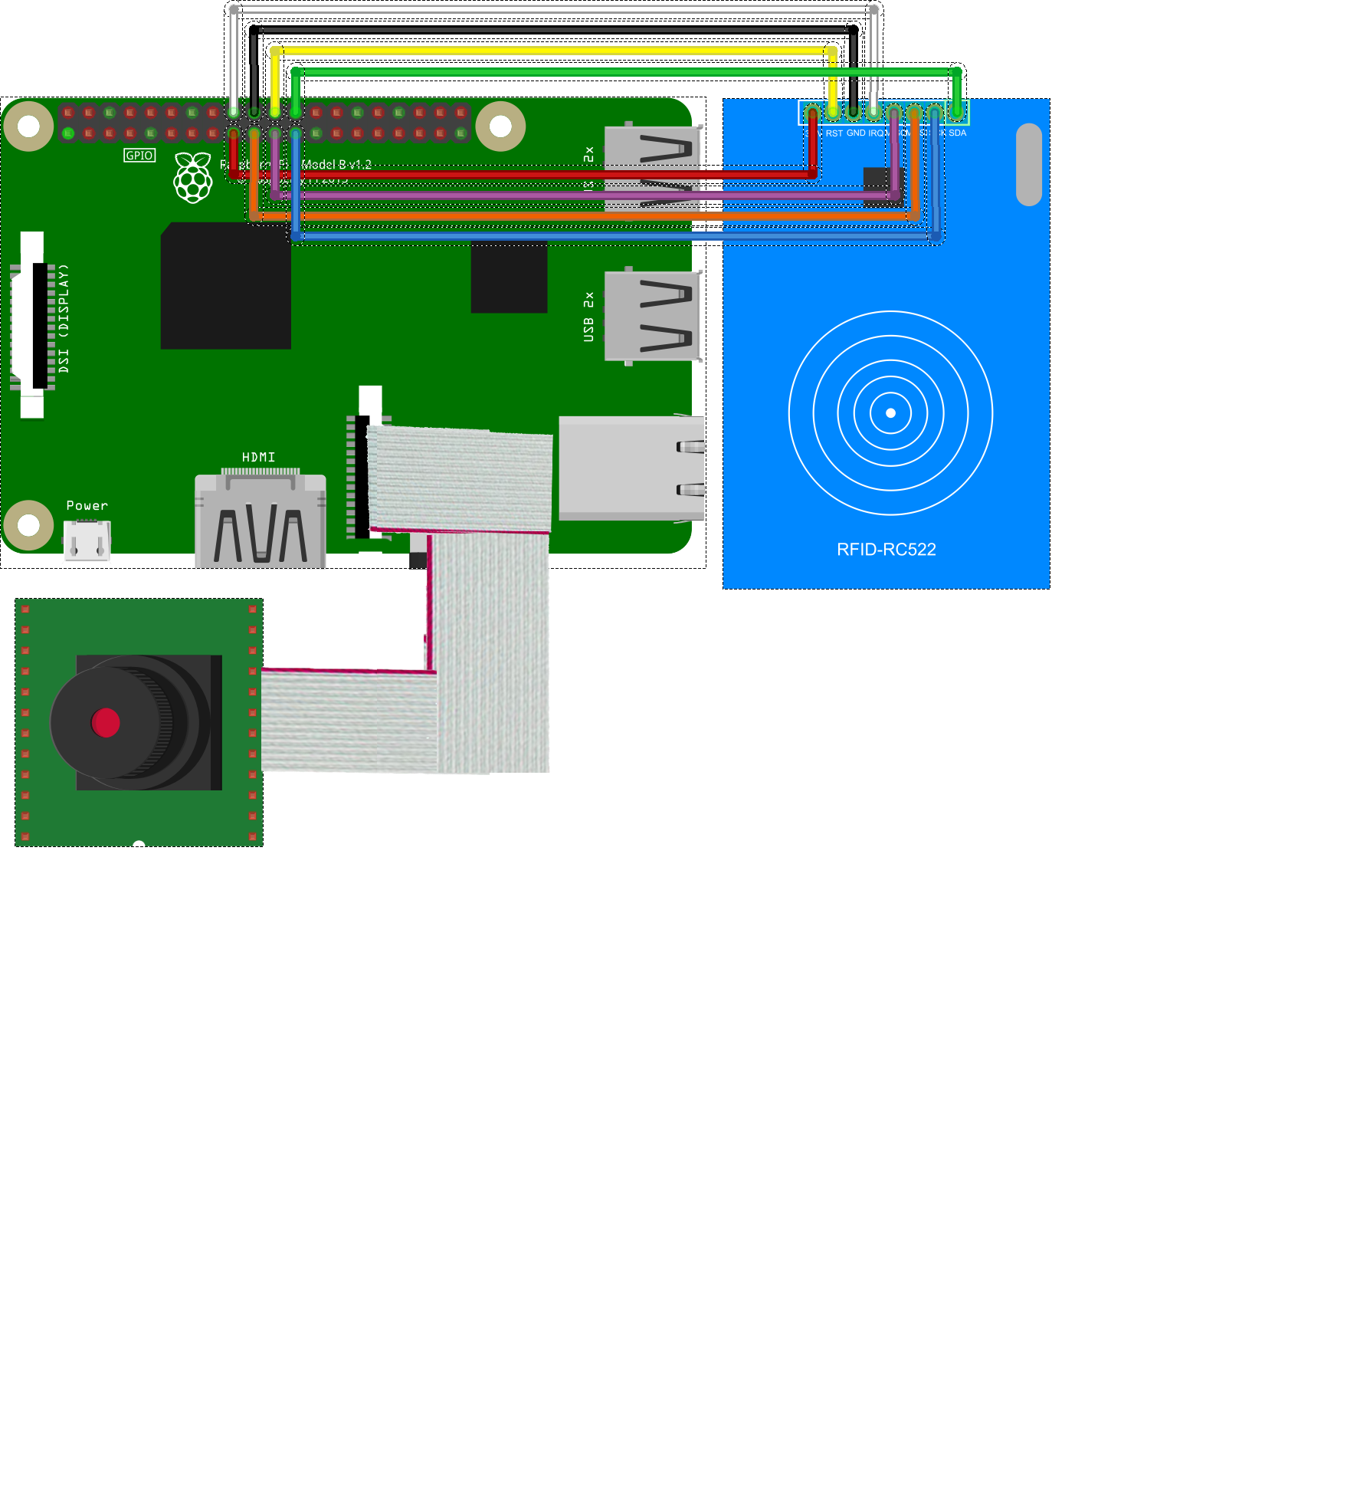
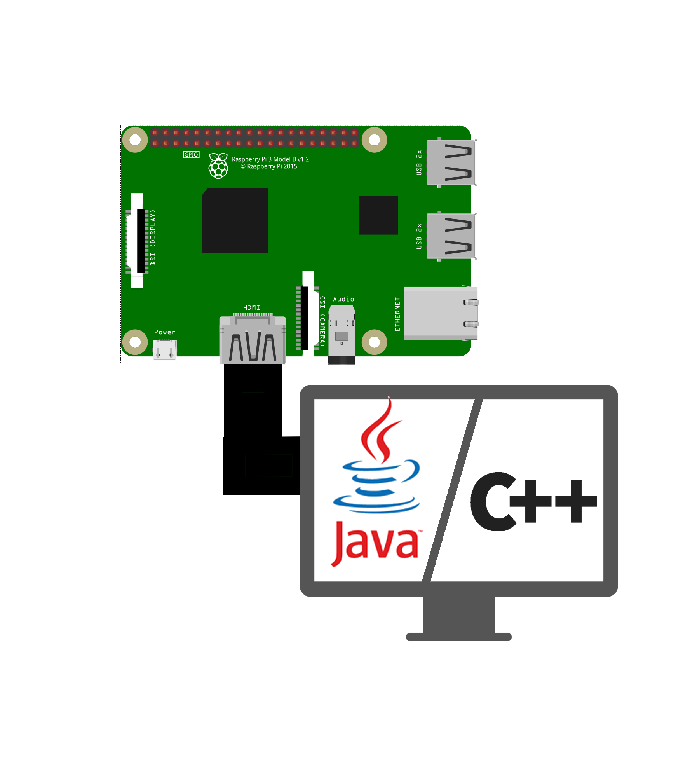
Aaron Joyce, Final Year Project
B.Eng.(H) Comp & Electronic
Project Description
Visual Representation
This Project is an Access Control system.
Its use is to permit or deny access to buildings or private sites.
It works using machine learning using haar cascades for object detection to assist in Automatic Number Plate Recognition (A.N.P.R), as well as Optical Character Recognition (O.C.R) techniques to extract raw text data from a video stream which then queries a database to see if the person has permission to enter.
The project also used R.F.I.D swipe cards for pedestrians & smaller access areas such as offices or labs..
The project utilises two separate RaspberryPi’s which communicate through the internet
One RaspberryPi hosts an IP-Camera server and R.F.I.D Swipe Reader,
The second RaspberryPi holds a graphical user interface using Java, and C++ for O.C.R
to give visual aid & feedback on access by supplying a live video feed,
SQL database info, and data of the person entering.
Internet

