Slide 1
Purchasing a Rental Property in Toronto, Ontario
March 13, 2021

Slide 2
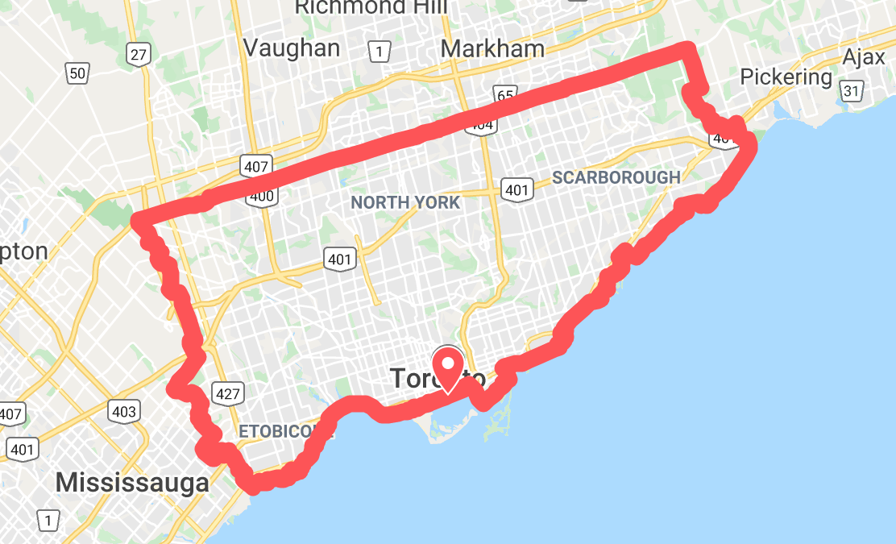
Understanding Toronto
Utilizing Foursquare and Neighbourhood Crime Rates to narrow down our search

Slide 3
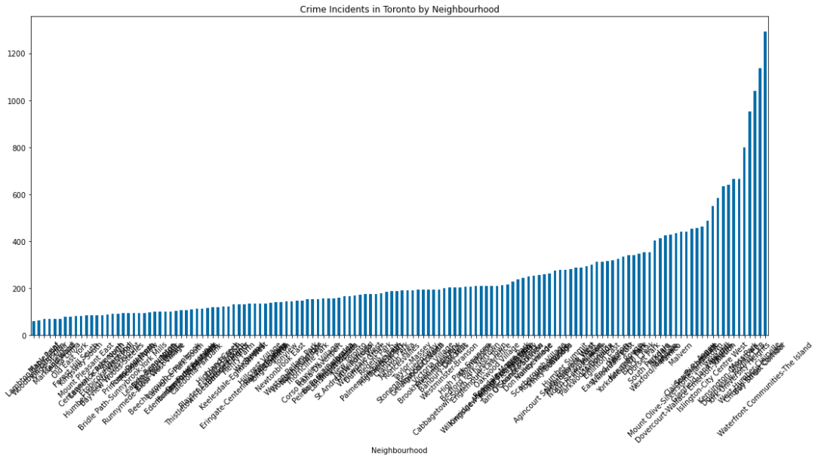
Understanding Toronto
Crime Data for all of Toronto
200 Crimes/Year will remain the threshold for “safe” neighbourhoods

Slide 4
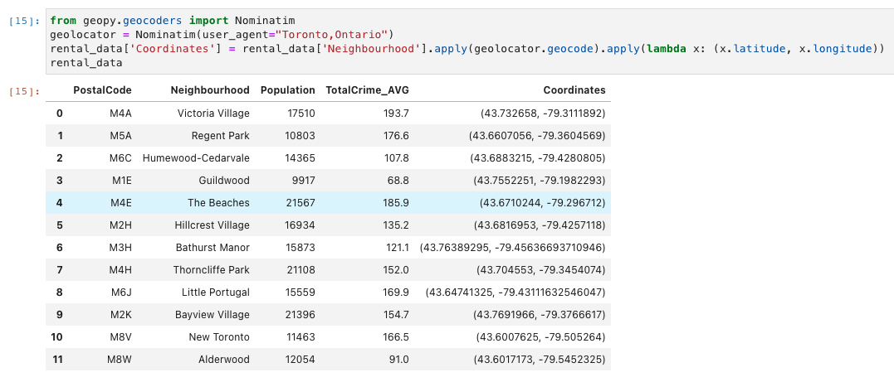
Understanding Toronto
Took postal code data for Toronto and obtained the postal codes and longitude and latitudes for “safe” neighbourhoods

Slide 5
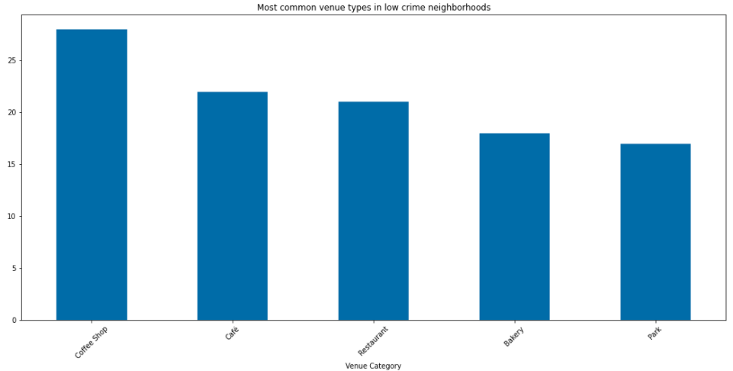
Analysis
All safe neighbourhoods have the following common venues

Slide 6
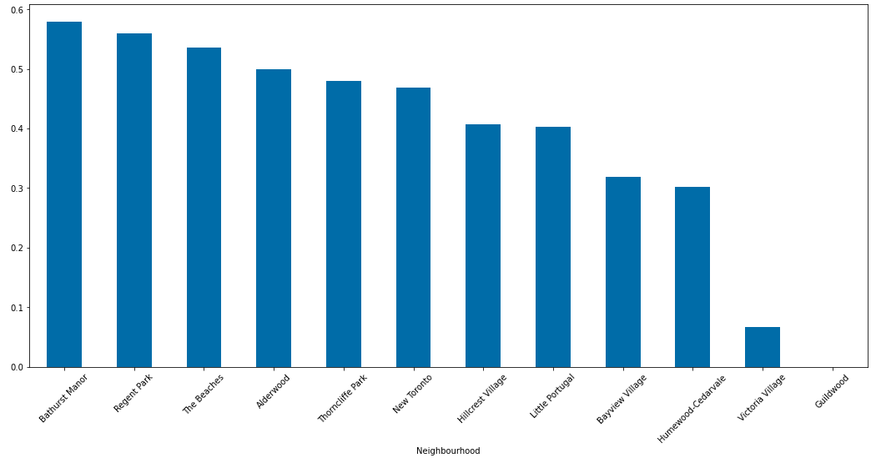
Analysis
Tallied the rental value of neighbourhoods based on amenities available within an 800-meter radius:
Grocery Stores
Supermarket
Restaurants
Bars
Cafes
Coffee Shops

Slide 7
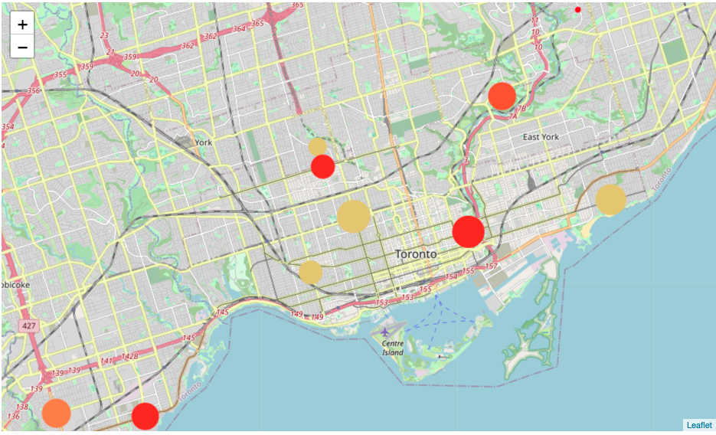
Analysis
Utilizing k-mean clusters gave us:
The Beaches, Humewood-Cedarvale, Bathurst Manor, and Little Portugal were similar
Regent Park, Hillcrest Village, and New Toronto, Bayview Village were also similar

Slide 8
Conclusion
Based on all the data presented above, we can conclude that the BEST neighbourhood to buy a rental property in Toronto is either:
Bathurst Manor
Regent Park

