Slide 1
Control System for Smart Agriculture
Image Processing I

Slide 2

Environment settings
Jupyter notebook
An open-source web application that allows you to create and share documents that contain live code, equations, visualizations and narrative text.
Install the pip https://bootstrap.pypa.io/get-pip.py
$ python get-pip.py
Installation with pip (recommended)
$ pip install notebook
Installation with conda
$ conda install -c conda-forge notebook
Other libraries
$ pip install numpy
$ pip install matplotlib

Slide 3
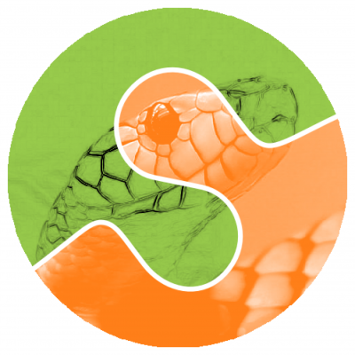
Image Processing in Python
Scikit-image
Simple and efficient tools for image processing and computer vision techniques.
Built on the top of NumPy, SciPy, and matplotlib.
Open source, commercially usable – BSD license.
$ pip install scikit-image

Slide 4
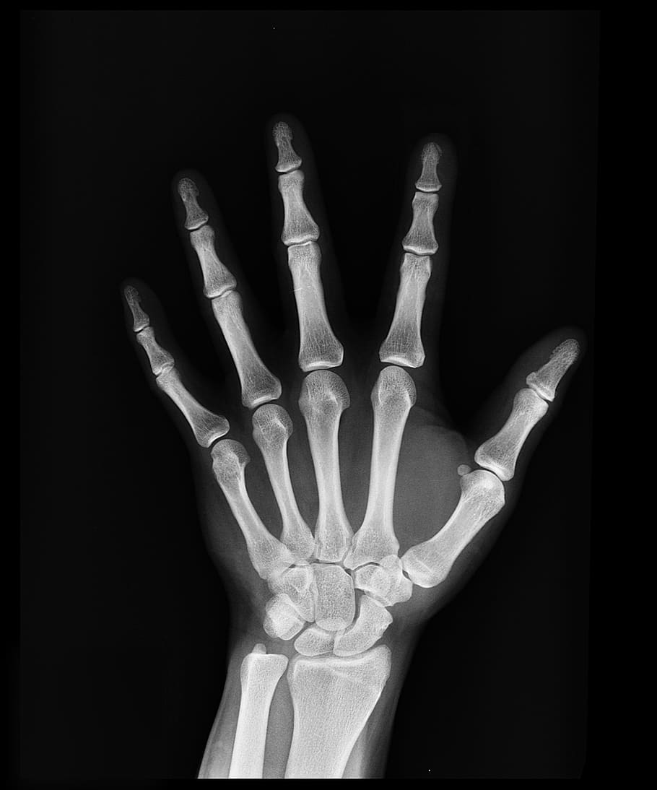
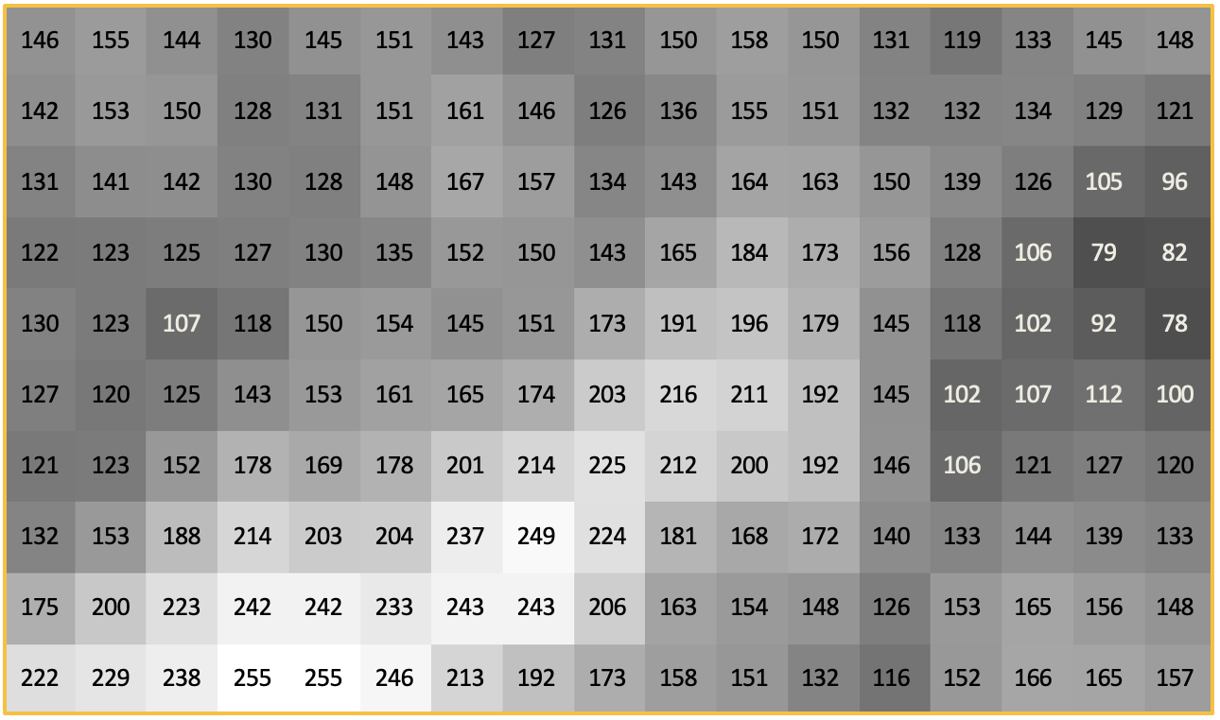
Digital Image

Slide 5
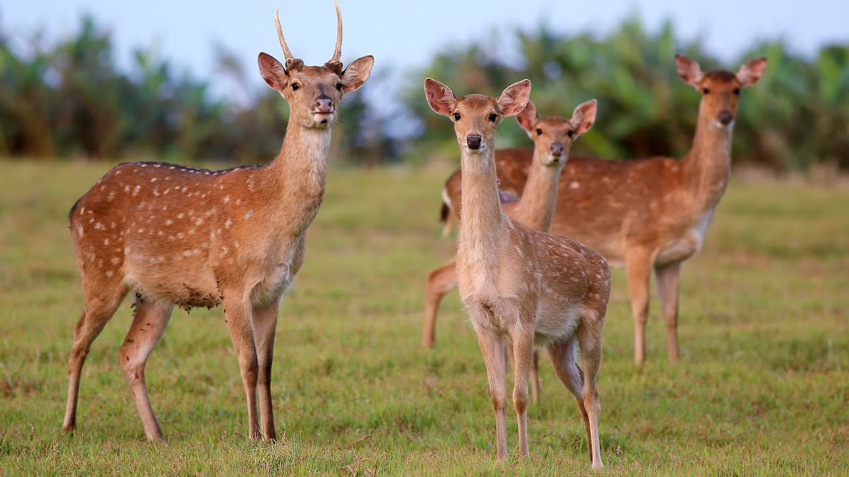
Image I/O
Reading an image
from skimage import io
deer = io.imread('deer.jpg')
gray_deer = io.imread('deer.jpg', as_gray=True)
Writing an image
io.imsave('deer1.jpg', deer)
io.imsave('deer2.png', gray_deer)
imsave() function automatically determines the type of the file, based on the file extension we provide.

Slide 6
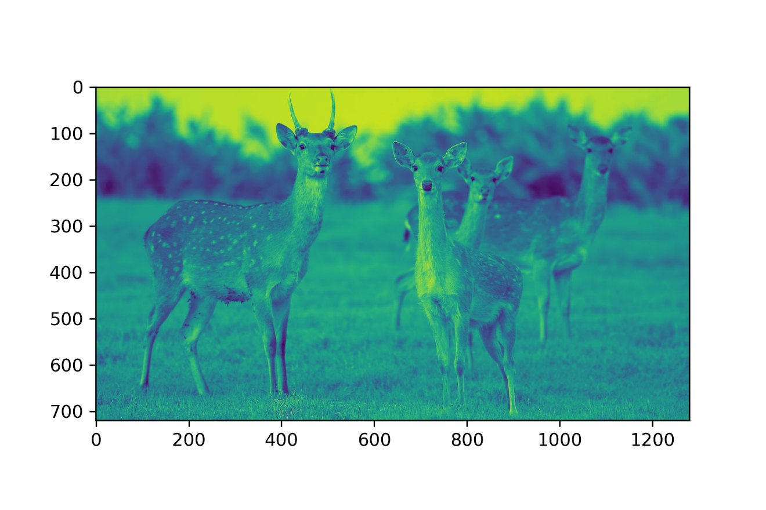
Displaying Images
import matplotlib.pyplot as plt
plt.imshow(deer)
plt.show()
plt.imshow(gray_deer)
plt.show()
plt.imshow(gray_deer, cmap='gray')
plt.show()

Slide 7
Image Arithmetic
Name | Operator | Equivalent func.
Addition | + | np.add
Subtraction | - | np.subtrat
Multiplication | * | np.multiply
Division | / | np.divide
Modulus | % | np.mod
Exponentiation | ** | np.power
Floor Division | // | np.floor_divide

Slide 8
Integers can overflow
Careful with overflows with integer data types
Different integer sizes are possible: 8-, 16- or 32-bytes, signed or unsigned.
from skimage import img_as_float
camera_float = img_as_float(camera)
print(camera.max(), camera_float.max())

Slide 9
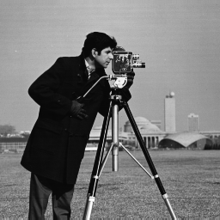
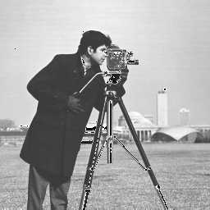
Image Addition
camera_float_15 = camera_float + 0.5
Changing the pixels values adjust the brightness of the image.

Slide 10
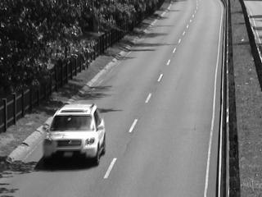
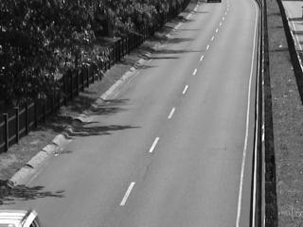
Image Subtraction
Detecting changes between two images, or levelling uneven sections of an image such as half an image having a shadow on it.
-

Slide 11
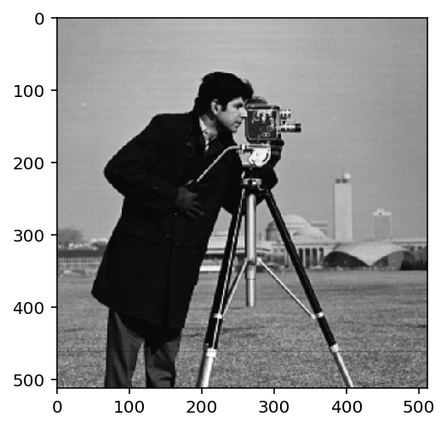
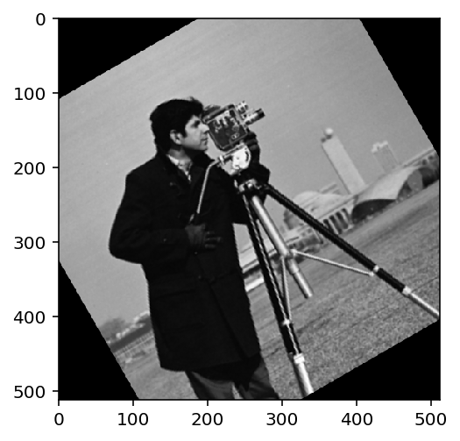
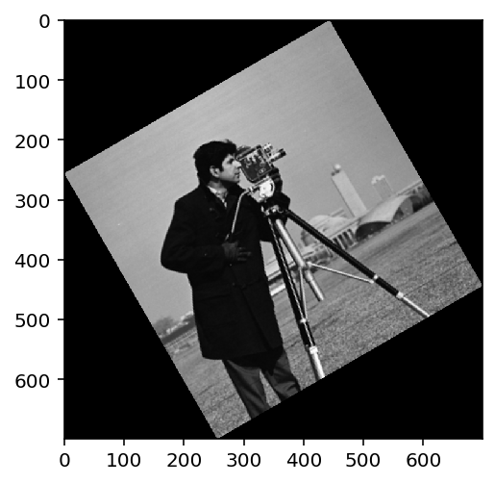
Image Rotation
from skimage import transform, data
camera = data.camera()
rotate_camera = transform.rotate(camera, 30, resize=False)

