Slide 1
STrace
A DTrace on Windows Reimplementation
By Stephen Eckels
Senior Reverse Engineer - FLARE

Slide 2




Stephen Eckels
Senior Reverse Engineer (FLARE)
Malware RE
R&D - RE tooling
25 y/o
Experience
Open-source development w/ a focus on hooking
x86/x64 ASM, C++, Rust, Go, JS, C#, Java, more ☺
System architect, embedded device software developer
Interests
Slacklining
Electric Mountainboarding
Gaming
@stevemk14ebr
github.com/stevemk14ebr/

Slide 3
Presentation Outline
What is DTrace? Why is it interesting Usage of Microsofts’ Port Shortcomings | DTrace on Windows Internals Modern DTrace architecture How kernel registration works Documenting kernel interfaces Inserting ourselves into the boot process Accessing paged out memory safely | STrace – Steve’s Tracer Differences to Microsoft’s port Writing a driver in Rust Adding WASM to the kernel Ditching rust drivers for C++ Loading DLLs in drivers DIY kernel -> user callstack trace DIY callstack symbolication

Slide 4
DTrace Introduction
What it is | Examples
Tracing system allowing users to register probes Probes ‘fire’ on specific, user defined conditions Multiple types of probes are supported, each offering a different source of information STP – syscalls hooks FBT – kernel function boundary tracing PID – user function boundary tracing ETW – event tracing for windows (ETW) events When fired, probes execute user scripts in a VM inside the kernel
Print created files for a target process
syscall::NtCreateFile:entry
/ pid == $target && arg0 != 0 && arg2 !=0 /
{
attr = (OBJECT_ATTRIBUTES*)copyin(arg2, sizeof(OBJECT_ATTRIBUTES));
objectName = (UNICODE_STRING*)copyin(attr->ObjectName, sizeof(UNICODE_STRING));
name = *((ustr*)copyin((uintptr_t)objectName->Buffer, objectName->Length);
printf(“OBJECT_NAME: %ws”, name);
ustack();
}
Live system dump on specific error code
syscall:::return {
if (arg0 != 0xc0000001UL) {
lkd(0);
printf(\" Triggering Live dump \n \");
exit(0);
}
}

Slide 5
Advanced DTrace Examples
The pain begins…
Copying UNICODE_STRINGS, C preprocessor for ‘functions’
// DTCompile.bat
// @echo off
// start /wait cmd /c "cl.exe /P %1 && dtrace -s %~dpn1.i -c %2" & del %~dpn1.i
// Use: DTCompile.bat createfile.d %windir%/system32/notepad.exe
syscall::NtCreateFile:entry
/ pid == $target && arg0 != 0 && arg2 !=0 /
{
copy_ustr(arg2, fname, fnamelen);
printf("%*ws", fmt_ustr(fname, fnamelen));
}
#define copy_ustr(argname, varname, lenname) \
attr = (OBJECT_ATTRIBUTES*)copyin(argname, sizeof(OBJECT_ATTRIBUTES)); \
if(attr) { \
objectName = (UNICODE_STRING*)copyin((uintptr_t)attr->ObjectName, sizeof(UNICODE_STRING)); \
if (objectName) { \
this->##varname = (struct ustr*)copyin((uintptr_t)objectName->Buffer, sizeof(struct ustr)); \
this->##lenname = objectName->Length; \
}\
}
#define fmt_ustr(varname, lenname) (this->lenname / 2), this->varname->buffer
Deferring Reads
syscall::NtCreateFile:entry {
// data behind pointer may be paged out. Don’t read it until system routine pages it in.
self->pFileHandle = args[0];
}
syscall::NtCreateFile:return {
// system routine has paged in the memory, we can touch the data now.
if(arg0 == STATUS_SUCCESS) {
handle = *(HANDLE*)copyin(self->pFileHandle, sizeof(HANDLE));
printf("%08X", handle);
}
}
Pretty print enum types.
syscall::NtCreateFile:entry
/ pid == $target && arg0 != 0 && arg2 !=0 /
{
this->access = "|";
this->access = strjoin(this->access, (arg1 & FILE_READ_DATA) ? "ReadData|": "" );
this->access = strjoin(this->access, (arg1 & FILE_WRITE_DATA) ? "WriteData|": "" );
this->access = strjoin(this->access, (arg1 & FILE_APPEND_DATA) ? "AppendData|": "" );
this->access = strjoin(this->access, (arg1 & FILE_READ_EA) ? "ReadEa|": "" );
this->access = strjoin(this->access, (arg1 & FILE_WRITE_EA) ? "WriteEa|": "" );
this->access = strjoin(this->access, (arg1 & FILE_EXECUTE) ? "Execute|": "" );
this->access = strjoin(this->access, (arg1 & FILE_DELETE_CHILD) ? "DeleteChild|": "" );
this->access = strjoin(this->access, (arg1 & FILE_READ_ATTRIBUTES) ? "ReadAttributes|": "" );
this->access = strjoin(this->access, (arg1 & FILE_WRITE_ATTRIBUTES) ? "WriteAttributes|": "" );
printf(“CreateFile::ACCESS_MASK: %s”, this->access);
}

Slide 6
DTrace shortcomings
D language Issues
No user defined functions!
No loops!
Control flow structures like ifs occasionally compile to invalid instruction sequences in some cases
System design issues
Extremely limited side-effects. DTrace apis like system only accept static strings
Issues accessing memory before syscalls execute
Features like the dtrace pre-processor are simply not implemented in microsofts’ port
Wide string support is shaky at best. No string utilities are provided at all.
Developer experience tools lacking entirely, no IDE, syntax highlighting, etc.

Slide 7

DTrace on Windows Internals
Part 2
The start of a re-implemenation
High level architecture
Boot process
Neat DTrace kernel tricks
Documenting kernel interfaces

Slide 8
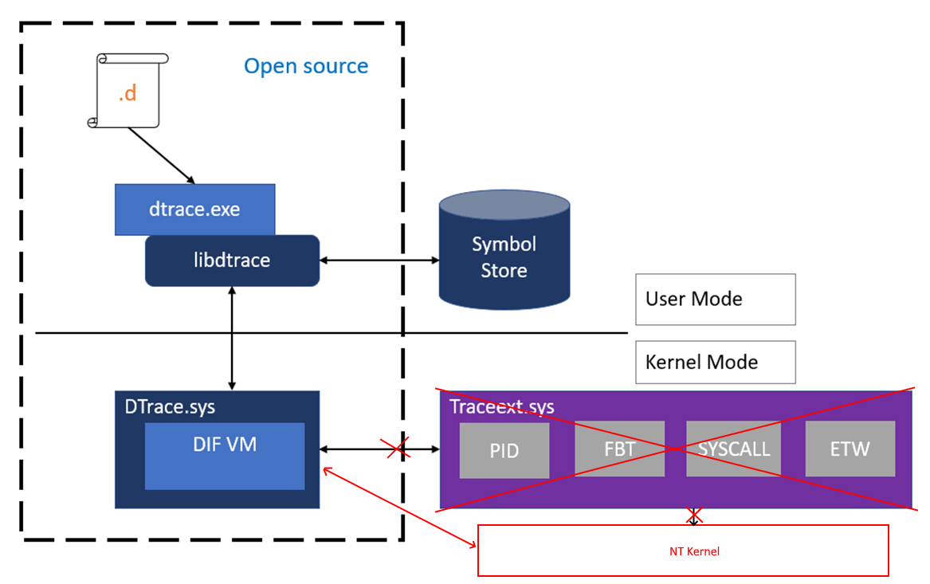
Architecture
The interface changed with 20H1! Traceext.sys is no more
DTrace.sys registers a set of function pointers with the kernel for each probe type
DTrace.sys executes D language scripts in a VM and collects logs and tracing data
DTrace.exe communicates with DTrace.sys to fetch queued tracing data and provides cached symbol information to the driver.

Slide 9
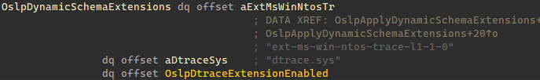
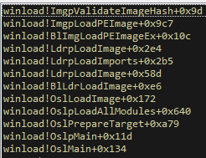
DTrace Boot
struct DynamicSchemaExtension
{
char *extension_dll_name;
char *extension_driver_name;
void *pFnVerifyBCDFlag;
};
The boot process starts at the bootloader winload.exe
Check boot flag dtrace is on (bcdedit)
Add ext-ms-win-ntos-trace-l1-1-0.dll to schema set map
winload.exe begins to load ntoskrnl.exe
ntoskrnl.exe imports from this apiset, consulting the schema set map
ntoskrnl.exe calls TraceInitSystem from dtrace.sys
Invoked during phase 1 kernel initialization, before patchguard
KeInitSystem -> KiInitDynamicTraceSupport -> TraceInitSystem

Slide 10
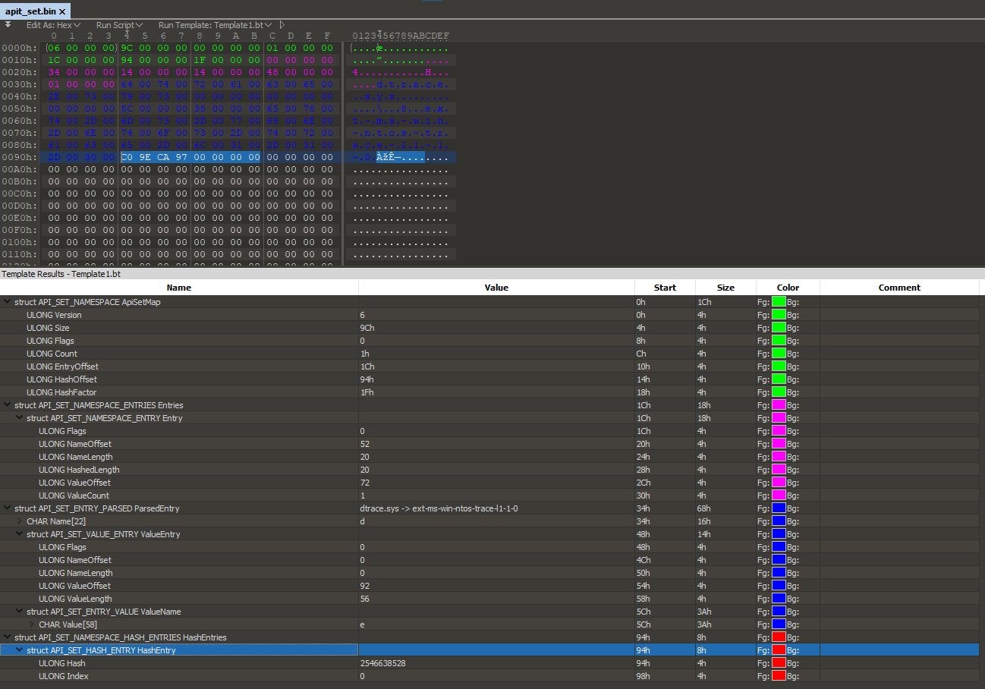
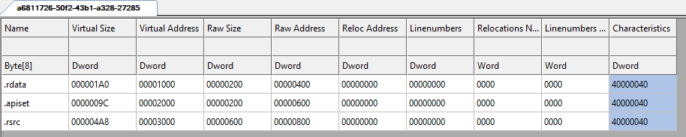
ApiSet Dlls
‘Pseudo’ PEs that contain a binary map pointing to implementing PEs
HKEY_LOCAL_MACHINE\SYSTEM\CurrentControlSet\Control\Session Manager\ApiSetSchemaExtensions\<anything>
FileName=<path_to_api_set.dll>
Name=<anything>

Slide 11
DTrace Kernel Registration
struct KiDynamicTraceContext
{
ULONG32 supported_flags;
ULONG32 kthread_tracingprivatedata_offset;
ULONG32 kthread_tracingprivatedata_arraysize;
ULONG32 kthread_trapframe_offset;
ULONG64 kthread_teb_offset;
NTSTATUS(*KeSetSystemServiceCallback)
(const char *syscallName, BOOLEAN isEntry,
ULONG64 pFnCallback, ULONG64 probeId);
void *KeSetTracepoint;
void *EtwRegisterEventCallback;
void *PsGetBaseTrapFrame;
void *KiGetTrapFrameRegister;
void *MmEnumerateSystemImages;
};
BOOLEAN TraceAccessMemory
(PVOID SafeAddress, ULONG_PTR UnsafeAddress,
SIZE_T NumberOfBytes, SIZE_T ChunkSize,
BOOLEAN DoRead);
struct KiDynamicTraceCallouts
{
void* pFnCallbacks[9];
};
TraceInitSystem
dtrace.sys fills KiDynamicTraceCallouts table to handle each probes events
dtrace.sys passes a pointer to TraceAccessMemory to ntoskrnl.exe
ntoskrnl.exe records the start and end bounds of this routine via the x64 unwind table entry
ntoskrnl.exe passes a pointer to KiDynamicTraceContext to dtrace.sys
Provides offsets into kernel structures for the current kernel version
Provides APIs to set and remove trace probes

Slide 12
Signing Requirements
ImgpValidateImageHash
ValidationFlags=IMGP_LATEST_MS_ROOT_REQUIRED | IMGP_WINDOWS_ROOT_REQUIRED | IMGP_MS_SIGNATURE_REQUIRED
Scenario=ImgSigningScenarioWindows
dtrace.sys is loaded as an import of ntoskrnl.exe
Despite being a dynamic extension, it’s considered ‘part of’ the kernel
Must be signed with an MS root code signing cert
schema set DLL must also be MS signed
So…how do we load our reimplementation of dtrace.sys?
We can re-use the MS signed schema set DLL to enable the dynamic schema set extension
Create new boot entry to disable DSE so that ntoskrnl.exe can load our unsigned driver as an import
Signing it yourself, test signing, custom kernel signers, etc…will NOT work.
Microsoft: Please reconsider this design and allow dtrace.sys to be signed by non-MS parties.

Slide 13
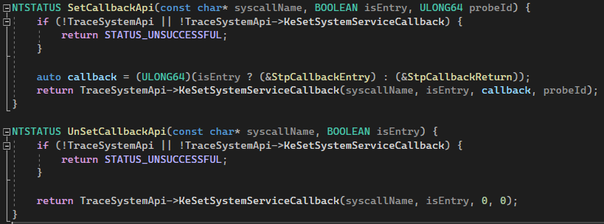
Syscall Probes!
KiSystemCall64(syscallIdx) {
pService = LookupServiceRoutineFromSSDT(syscallIdx);
// ...
if(KiDynamicTraceMask & AT_LEAST_ONE_SET) {
machineContext = SnapShotArgAndStack();
TreeEntry = KiTrackSystemCallEntry(pService, machineContext);
return_value = pService(machineContext);
KiTrackSystemCallExit(TreeEntry, return_value);
}
// ...
return return_value;
}
KiSystemCall64
Fires for all usermode syscalls
And Zw* calls, as they go through KiServiceInternal
Nt* calls are not traced.
Shadow SSDT syscalls not supported
KiTrackSystemCallEntry -> StpCallbackEntry
KiTrackSystemCallExit -> StpCallbackReturn
Probe entry / exit callbacks must be one of the two Stp
functions set in KiDynamicTraceCallouts during
TraceInitSystem
This is a security measure
KiDynamicTraceCallouts is PG protected.

Slide 14
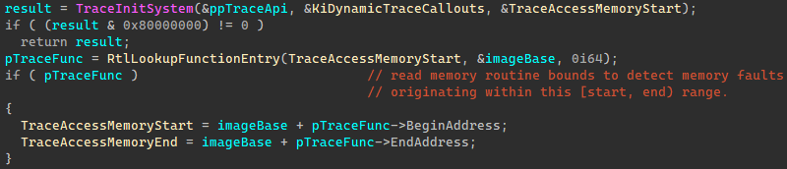
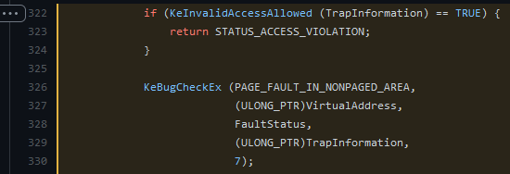
DTrace Tricks
TraceAccessMemory – safely read arbitrary inaccessible or paged out memory at a high IRQL w/o blue screening
copyin in DTrace scripts use this
MmAccessFault -> KeInvalidAccessAllowed
Why?

Slide 15
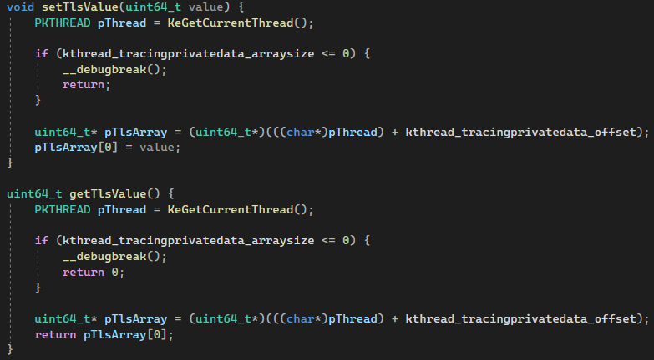
DTrace Tricks
self keyword– kernel thread local storage
struct _KTHREAD
{
// …
ULONGLONG TracingPrivate[1]; // 0x3c0
// …
};
struct KiDynamicTraceContext
{
ULONG32 supported_flags;
ULONG32 kthread_tracingprivatedata_offset;
ULONG32 kthread_tracingprivatedata_arraysize;
// …
};
Used by dtrace to cache D language intermediate data, such as thread local data

Slide 16
DTrace Tricks
dtrace_action_lkd – live kernel dumps
lkd in DTrace scripts use this
void DbgWerCaptureLiveKernelDump(wchar_t* ComponentName, ULONG BugCheckCode, ULONG P1, ULONG P2, ULONG P3, ULONGP4, ULONG flags);
Generates standard .dmp files loadable in windbg
Flags and registry settings to control this API now officially documented!
https://docs.microsoft.com/en-us/windows-hardware/drivers/devtest/dtrace-live-dump
Generated dumps typically in C:\Windows\LiveKernelReports

Slide 17
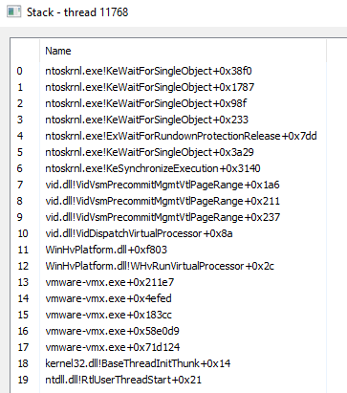

DTrace Tricks
ProcMon
TraceWalkUserStack – Generate a symbolic stack trace down to usermode.
ustack() in dtrace
Operates differently from how ‘other’ tools generate stack traces
Usermode API: StackWalk64 + DIA symbol APIs
Small trick to start at kernel, grab Ethread.Kthread.KernelStack.RSP
Trace initiated from usermode, drivers can’t call this
TraceWalkUserStack does what StackWalk64 does, manually
Trace initiated from kernelmode
RtlCaptureStackBackTrace doesn’t include usermode calls
How?
Given some starting address, locate the module’s
DataDirectory[IMAGE_DIRECTORY_ENTRY_EXCEPTION]
unwind data defines a series of opcodes to ‘undo’ the effects of a function on the CPU state.
These are ‘virtually’ executed, then the return address from the unwound stack is read, and the process repeats
Ex: UWOP_PUSH_NONVOL – a register pushed to stack, RSP += 8 to undo
Latest Call
Stack Walk
Kernel
UserMode
“How to Unwind”
Oldest Call

Slide 18
STrace
Part 3
Writing a re-implementation!
Differences to Microsoft’s port
Writing a driver in Rust
Adding WASM to the kernel
Ditching rust drivers for C++
Loading DLLs in drivers
DIY kernel -> user callstack trace
DIY callstack symbolication
Who says hipster languages don’t belong in the kernel??

Slide 19
STrace vs. DTrace
DTrace executes at IRQL == 15, STrace doesn’t touch IRQL – usually LOW_LEVEL
Memory accesses simpler
Enables wide range of APIs to be called in handlers
Plugins can perform arbitrary side-effects and may call any kernel APIs
Plugins are written in modern C++, rather then D Language
Faster than interpreting too!
Symbolication of output occurs after logging, rather than within the driver.
For simplicity
Only syscalls probe types are supported, FBT, PID, ETW, etc are not supported
Partially due to DSE being off, hypervisor features like FBT can’t be implemented
Open to PRs for ETW!
Zw* Apis can be monitored, dtrace filters these out.

Slide 20
System Architecture Choices
Requirements
Must execute scripts provided from usermode somehow
Must be fast enough to be called every syscall
The script language must be pleasant and familiar to all users
Must execute in the kernel – zero dependencies
Nice to haves
Users shouldn’t need kernel development experience to use
Users should be able to call into the kernel for side-effects
Symbolic call stacks
The Journey of STrace’s design
Rust w/ WASM scripts
C++ w/ WASM scrips
C++ w/ C++ scripts
C++ w/ C++ scripts & Rust symbolication

Slide 21
Rust in the NT Kernel!
Rust and the DDK together make an unpleasant experience
Microsoft really only supports C
Complicated .cargo/config build profile needed to invoke VS linker properly
Complicated build.rs script needed
Rust doesn’t properly (easily?) generate free standing binaries
Unwind tables aren’t reliably generated
Symbols like __CxxFrameHandler3, __chkstk, etc, must be stubbed – always generated ☹
Handful of I.C.E.’s
Microsoft doesn’t provide Rust API projections for the kernel
Every single API, type, and define must be manually ported to rust ☹
Rust doesn’t support anonymous unions and structures; Windows uses this extensively ☹
Rust’s no_std story is, complicated
Many libraries don’t support no_std
Providing allocator mappings isn’t exactly easy
At the time of writing, std::ffi:CString wasn’t even supported in Rust no_std. This has since changed.
UNSAFE EVERYWHERE!

Slide 22
WASM in the NT Kernel!
Just bad enough of an idea it’s great
DTrace uses a VM for execution, it tries to be isolated. Can we do that somehow?
Web technologies already solved this
We can compile any language to WASM!
Wasm toolchains are somewhat mature, but they all mostly focus on javascript being your build target.
Blockchain technologies solved this
Enter WASMI – Parity Ethereum contracts are in WASM
Wasmer doesn’t support no_std ☹
Not many good embedded WASM interpreters!
Deep call stacks, exhausting the kernel stack. KeExpandKernelStackAndCalloutEx ☹
Massive local buffers??
Too slow
Need a JIT, no hackable low dependency WASM JITs

Slide 23
C++ > Rust
Rust and WASM was painful
C++ wins
API and structures definitions known correct
Toolchain supported officially
Can C++ host our WASM scripts instead?
Yea, but it’s hard, no zero dependency C++ WASM interpreters – wasted weeks trying
Deadend.
How else can we provide users the ability to ‘script’
Execute blobs of code as shellcode??
Position Independent compiler: https://github.com/SheLLVM/SheLLVM
Little too hacky…

Slide 24
C++ DLLs in the NT Kernel
Windows has a mechanism for shipping blobs of dynamic code – DLLs!
Not at all supported in the kernel
Manual DLL mappers aren’t that hard to write
Kernel isn’t wildly different that usermode really
Remove all dependencies like the CRT, exceptions, disable stack checks and other security mechanisms
Re-use DLL IAT and EAT for kernel APIs
Compiler is a bit too smart with intrinsics
It works! And it’s fast! And Easy!
Toolchain is normal too!
// mycrt.h
extern "C" char* strcpy(char* a, const char* b);
#pragma intrinsic(strcpy)
// mycrt.cpp
#pragma function(strcpy)
extern "C" char* strcpy(char* a, const char* b)
{
char* saved = a;
while (*a++ = *b++);
return saved;
}

Slide 25
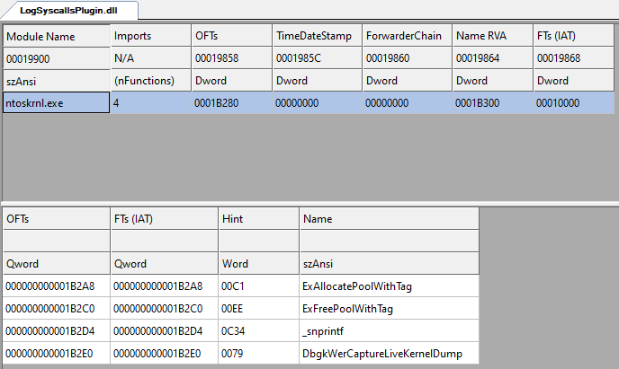
DLLs importing kernel APIs
DLL imports are resolved via .lib files
DDK injects kernel .lib files into the msvc linker path
Not available when not writing drivers
Workaround - manually link a copy of ntoskrnl.lib
extern "C" __declspec(dllimport)
void NTAPI ExFreePoolWithTag(PVOID P, ULONG Tag);
extern "C" __declspec(dllexport)
void StpCallbackEntry(ULONG64 pService, ULONG32 probeId, MachineState& ctx, CallerInfo& callerinfo)

Slide 26
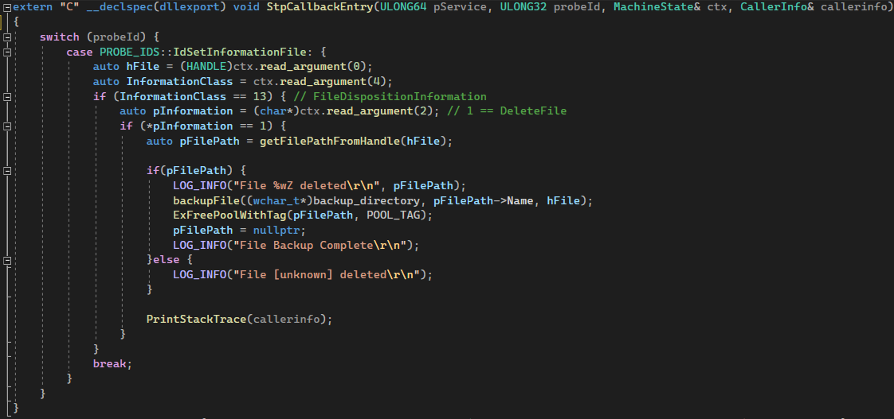

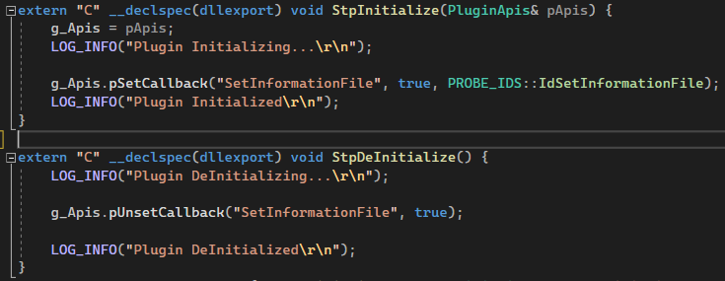
An STrace plugin DLL
Define probe ID map
Set and Unset probes
Handle Callbacks!

Slide 27
Thank You.

