Slide 1
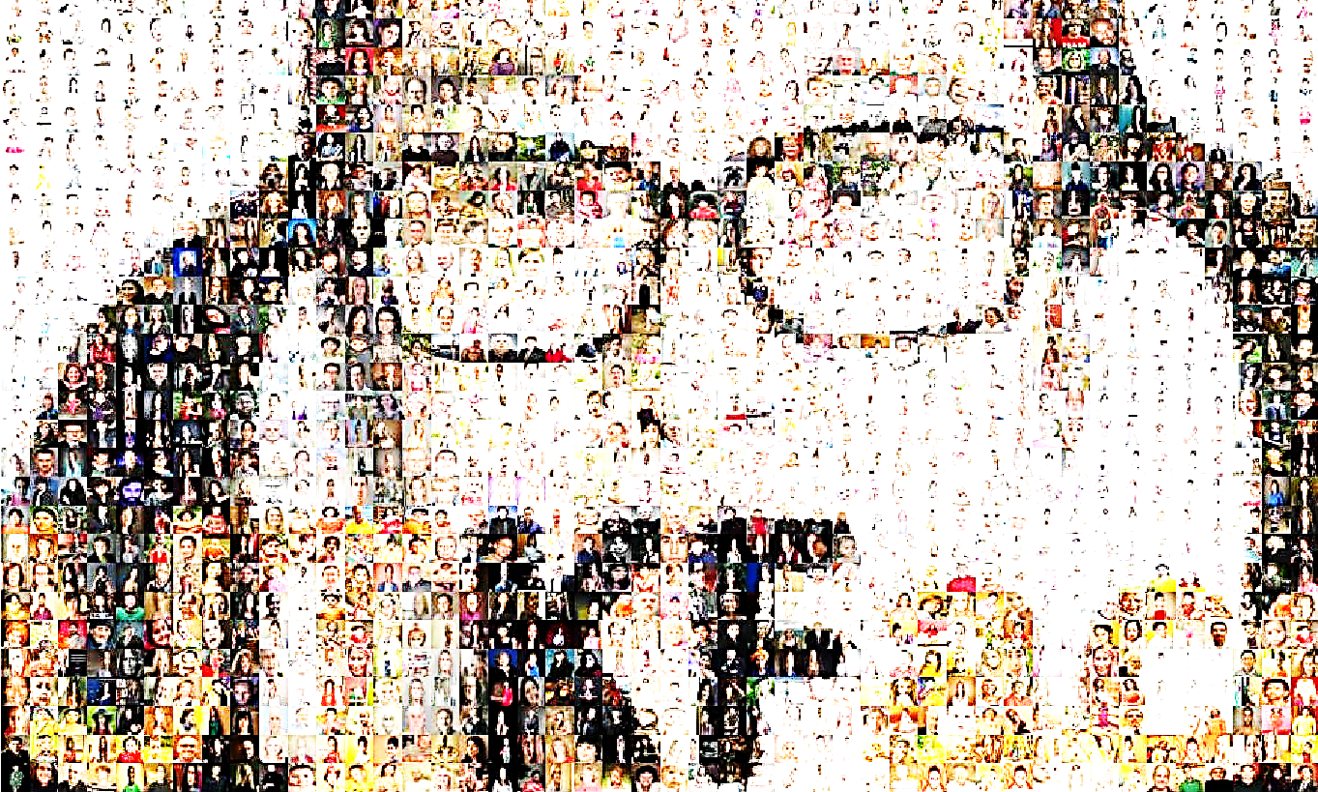

Gender Detection using Facial Features with Support Vector Machine -Replication & Additive Work-
Base Paper:
Hiremath et al. (2022) → Determined human gender
SVM (RBF Kernel) → 91.63 % Acc
Goal:
SVM replication;
Diferent techiques → CNN; Diferent SVM Kernels → Better results?
Not only Gender but Age will also be classified as well.
Tools:
Python 3 → Jupyter Notebook
Pandas; Numpy; Scikit-learn → Data Processing; Sample Selection
Matplotlib; Seaborn → Vizualization
PIL; OpenCV → Images Processing
Scikit-learn; Tensorflow → Model creation
Project Proposal - 2022/23
Martim Silva 51304 and Alexandre Sobreira 59451

Slide 2
Gender Detection using Facial Features with Support Vector Machine -Replication & Additive Work-
Data set (UTKFACE):
Same set as used in original work
20,000 instances (200 by 200 pixels each)
Images of faces labeled with respective age, gender and ethnicity (not considered)
Variation in terms of facial expression, illumination, resolution, and other more abstract features
Important considerations:
Dimension problem:
200 by 200 pixel image → arrays of floating points (RGB format) with one array per pixel
higher computational power
Possible approach:
Using a sample of the dataset backed up by an analysis of the distribution of the original data set
More manageable computation cost + diminished loss of quality
Assignment of sets of images to a bin each per age range
Reduces incorrect classifications for possible less represented demographics
Project Proposal - 2022/23
Martim Silva 51304 and Alexandre Sobreira 59451

