Slide 1
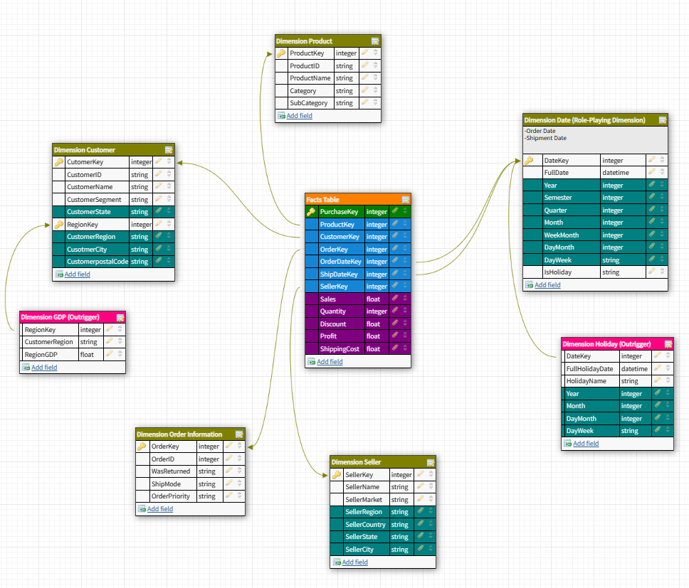
Degenerate Dimension
Dimensions
Dimension Tables
Measures
Outrigger
Fact Tables
Hierarchies

