Slide 1


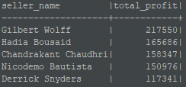
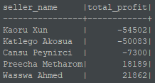
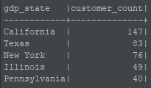
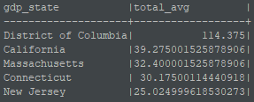
Customer Segment Count for best sellers 5 sellers
Customer Segment Count for worst sellers 5 sellers
Top 5 sellers
Bottom 5 sellers
5 States with more customers of top sellers
5 States with Highest AVG GDP

Slide 2


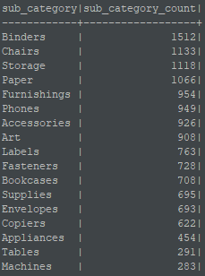
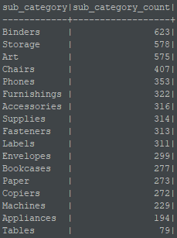
Product Category Count for best sellers 5 sellers
Product Category Count for best worst 5 sellers
Product Sub-Category Count for best sellers 5 sellers
Product Sub-Category Count for best worst 5 sellers

