Slide 1

Neural Mechanisms of Anxiety
Ahmad Sohrabi
Advanced Seminar in Neuroscience
Carleton University
Fall 2004

Slide 2

Anxiety

Slide 3
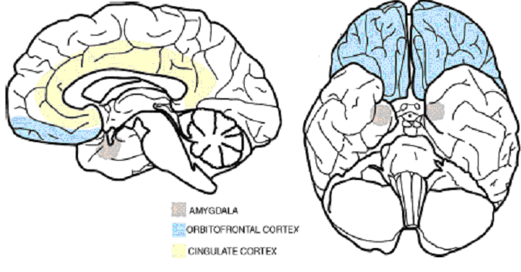
The functional neuroanatomy of the human orbitofrontal cortex Krinbach & Rolls 2004
Some of the key brain structures implicated in emotion

Slide 4
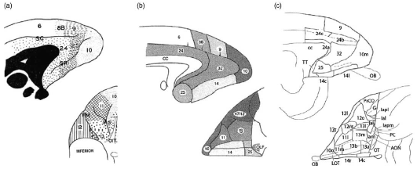
Progressive refinements in cytoarchitectonic maps in non-human primates.
Left: Walker (1940) OFC: five areas (areas 10, 11, 12, 13 and 14)
Middle: Petrides and Pandya (1994) area 47/12
Right: Carmichael et al. (1994) smaller subareas

Slide 5
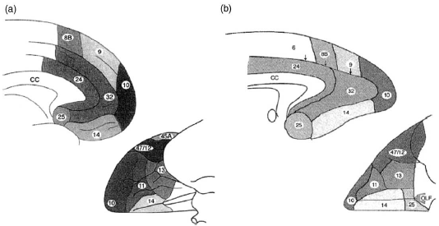
Comparable monkey and human cytoarchitectonic maps. In (a) on the left are shown the cytoarchitectonic areas on the medial wall and on the ventral surface of the human brain proposed by Petrides and Pandya (1994). In (b) on the right are shown the homologous areas in the primate.

Slide 6
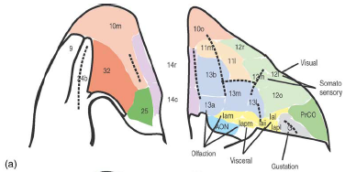
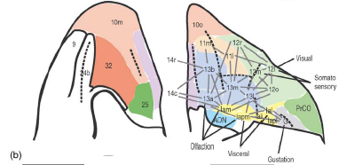
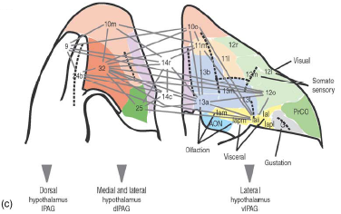
Primate OFC networks and connections
Direct connections from mOFC to various parts of the hypothalamus to influence the internal system

Slide 7
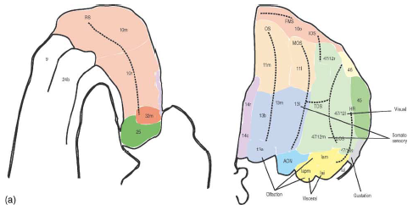
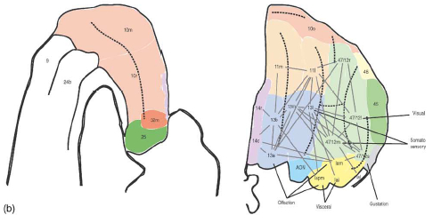
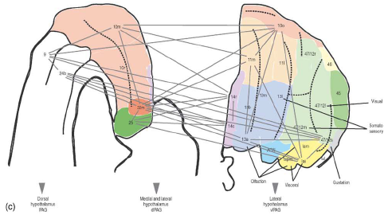
Putative networks in the human orbitofrontal cortex.
The cytoarchitectonic areas and subareas on the medial wall on the left and on the orbital surface on the right of the human brain.

Slide 8
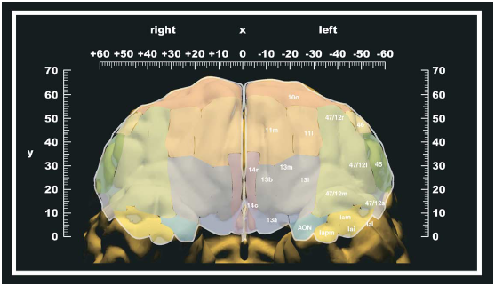
The human cytoarchitectonic maps of the orbitofrontal cortex rendered on the orbital surface.

Slide 9
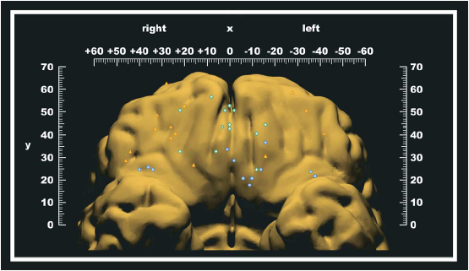
Rolls’ Lab
Blue: Primary reinforcers => pOFC
Green: Monitoring the reward value => amOFC
Yellow: change in behavior => lOFC

Slide 10
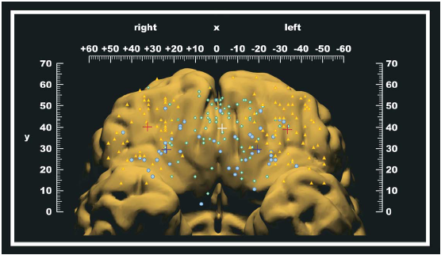
Blue: Motivation-independent reinforcers
Green: Monitoring of reward value
Yellow: Punishers leading to change in behavior
←^→

Slide 11
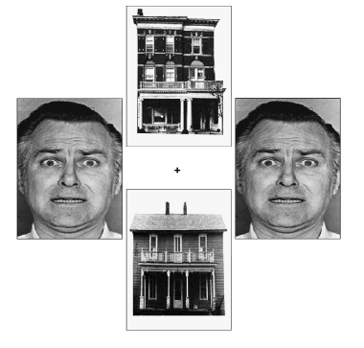
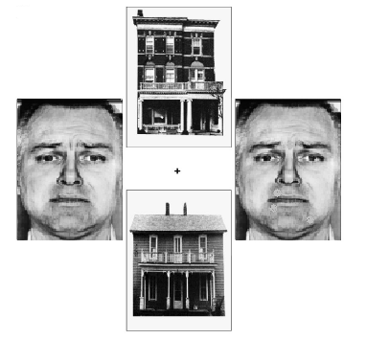
Prefrontal cortical function and anxiety: controlling attention to threat-related stimuli
Bishop et al 2004 Nature Neuroscience

Slide 12
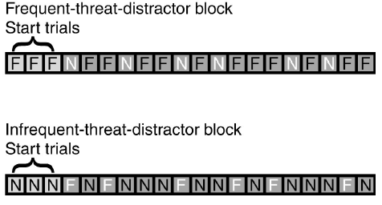
The experimental design:
Faces could also be identical or not, but were always either both neutral or both fearful in expression. F = fearful face distractor,
N = neutral face distractor.

Slide 13
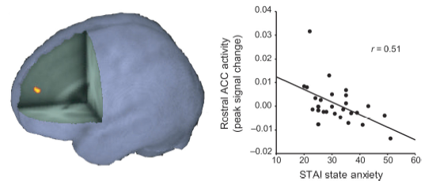
Rostral ACC voxels showing interaction of trial (threat-related versus neutral distractor) × block (infrequent threat-distractor versus frequent-threat-distractor).

Slide 14
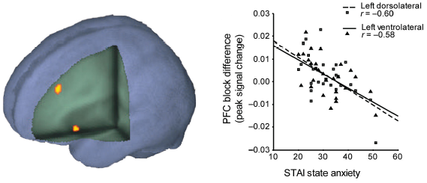
Activity in lateral PFC.
Left: Left DLPFC and left VLPFC voxels showing significant inverse relationship between block difference (frequent-threat-distractor minus infrequent-threat-distractor) and state anxiety.
Right: Relationship between block difference and anxiety for peak DLPFC and VLPFC voxels

Slide 15
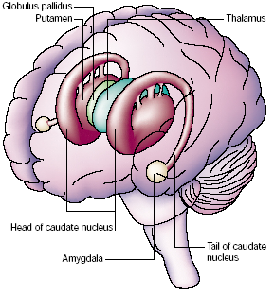
The human amygdala & basal ganglia
Calder et al NatureNeuro 2001

Slide 16
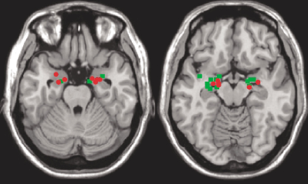
Green: fearful face Red: conditioned fear
Calder et al NatureNeuro 2001

Slide 17
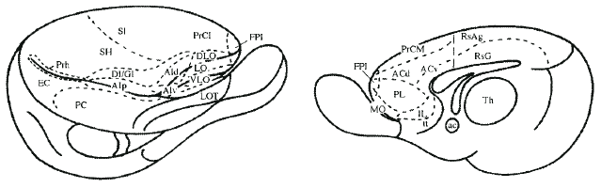
Rat Brain: Krettek and Price 1977

Slide 18
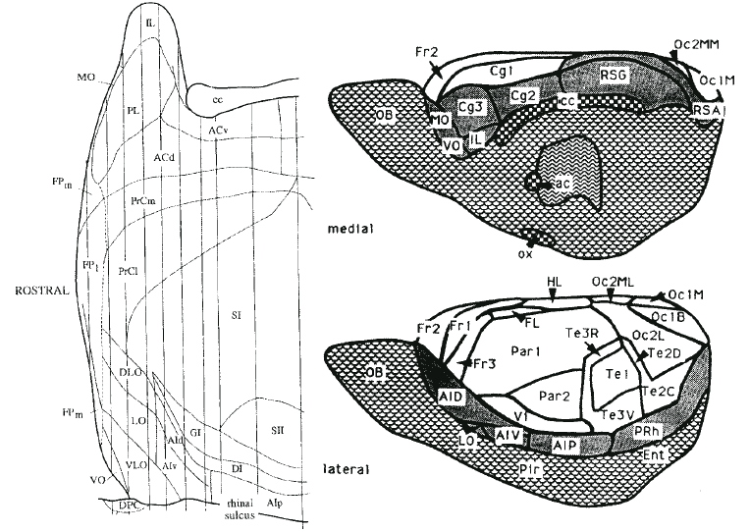
Left: Ray & Price 1992 Right: Zilles & Wree 1995

Slide 19
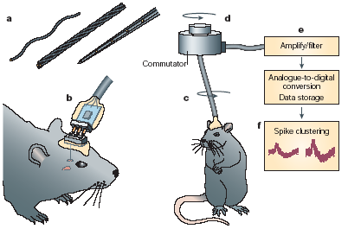
NEURONAL SIGNALLING OF FEAR MEMORY
Maren & Quirk NatureNeuroscience 2004

Slide 20
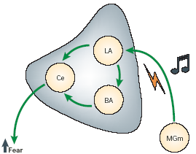
Neural circuits that are necessary for auditory fear conditioning

Slide 21
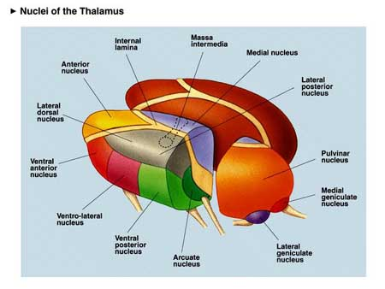

Slide 22
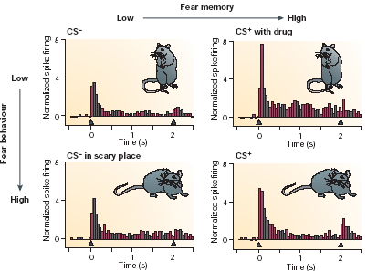
Lateral amygdala neurons encode fear memory independently of fear behaviour. Goosens et al, 2003

Slide 23
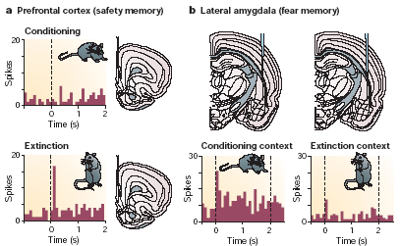
Neuronal signalling of extinction in the PFC and lateral amygdala. Hobin, 2003

Slide 24
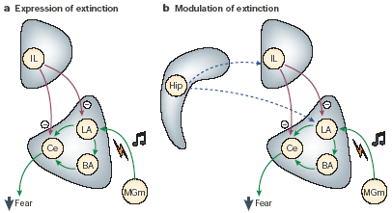
Cortical modulation of amygdala fear memories in extinction.

Slide 25
References:
Bishop,S.; Duncan,J.; Brett,M.; Lawrence,A.D. Prefrontal cortical function and anxiety: controlling attention to threat-related stimuli: Nat.Neurosci., 2004, 7, 2, 184-188
Kringelbach M. L. and Rolls E. T. The functional neuroanatomy of the human orbitofrontal cortex: evidence from neuroimaging and neuropsychology. Progress in Neurobiology 72 (2004) 341-372
Andrew J. Calder, Andrew D. Lawrence and Andrew W. Young, Neuropsychology of Fear and Loathin Nature Review Neuroscience MAY 2001, VOLUME 2 352-363
Maren S. and Quirk J .G. Neuronal Signaling Of Fear Memory. NATURE REVIEWS | NEUROSCIENCE VOLUME 5, NOVEMBER 2004 845-852

