Slide 1
Attention!
Attention
Proseminar Course
Carleton University
Winter 2003
A. Sohrabi

Slide 2
William James (1892).
"Everyone knows what attention is. It is the taking possession of the mind in clear and vivid form of one out of what seem several stimulus or trains of thought."
Treisman: Argues that attention need not be a unitary process simply because a single word is used in everyday language.
Treisman (1998) suggested that attention is needed to integrate several information together, and that without attention, the only information recorded is the presence of separate parts and properties.
Duncan: Attention is a state into which the system settles through global competition between objects for dominance over experience and action, rather than a selective process that helps create those objects.

Slide 3
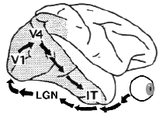
Interestingly, EEG studies show that the human visual system can solve an object detection task within 150 ms.
Ungerleider, L. & Haxby, J. (1994).

Slide 4
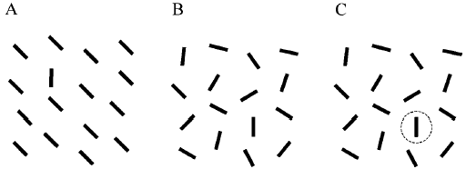

How can the competition among multiple objects be resolved? One way is by bottom-up, stimulus-driven processes. For example, in Figure 1A, the single vertical line among the multiple distracter lines is effortlessly and quickly detected because of its salience in the display, which biases the competition in favor of the vertical line.

Slide 5
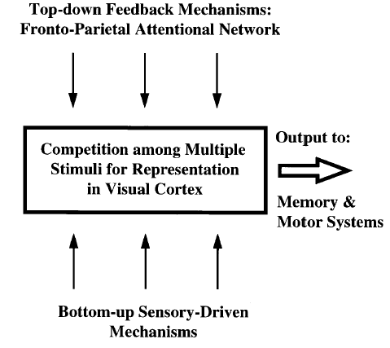
The competition among stimuli can be biased in several ways. One way is by bottom-up, sensory-driven mechanisms, such as stimulus salience. Another way is by attentional top-down feedback, which is generated in areas outside the visual cortex. For example, directed attention to a particular location facilitates processing of stimuli presented at that location.

Slide 6
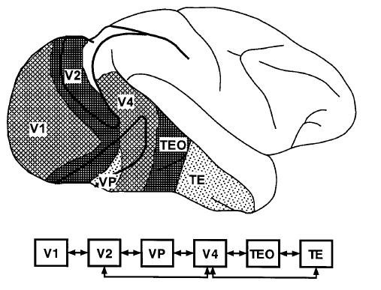
The object vision pathway. The occipitotemporal pathway or ventral stream, which is crucial for object recognition, originates in the primary visual cortex (V1) and is composed of multiple areas beyond V1 in occipital (V2, VP, V4) and temporal cortex (TEO, TE). The anatomical organization of ventral stream areas, (monkey brain), is largely hierarchical. Connections between successive pairs of areas are reciprocal, such that feed-forward projections from one area to the next are reciprocated by feedback projections from the second area back to the first (arrows).

Slide 7
1: [ ] x [ ]
2: [ ] x [ ]
3: [ ] x [*]
Posner
Selective attention is an organ system of different brain areas, although information remains incomplete on each of these levels. Posner (1980) showed that giving a spatial cue, such as a momentary brightening of one of two frames, would speed responses to a target object that subsequently appeared in that frame, even when the subject's eyes remained fixated centrally.

Slide 8
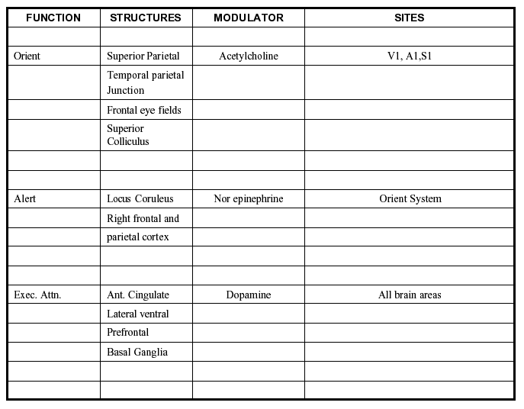
Sites and Sources
There is distinction between those brain areas which are influenced by acts of orienting (sites) and those which are parts of the orienting network itself, thus the sources of the orienting influence.

Slide 9
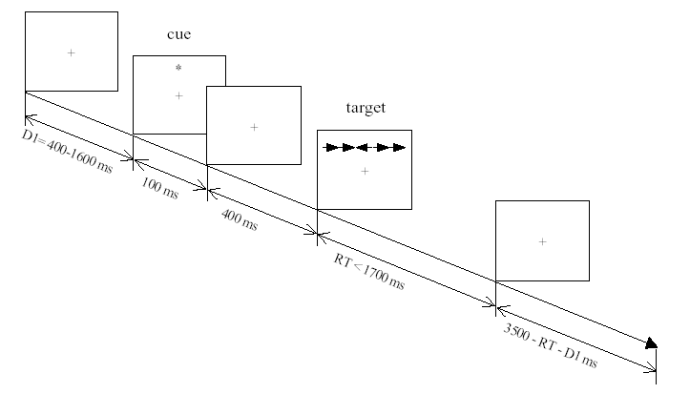
A recent version of the cueing approach embedded in the attention network test (ANT) is shown in the Figure. Two types of cues are of interest. Some cues provide information on when the target will occur. These warning signals lead to changes in a network of brain areas related to alerting. Other cues provide information on aspects of the target such as where it will occur and lead to changes in the orienting network.

Slide 10
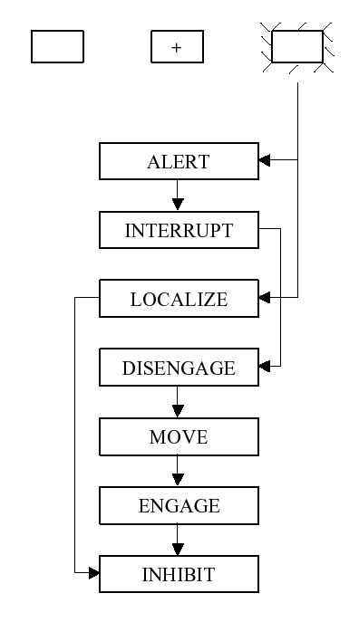
A view of orienting of attention
. In this view the superior parietal lobe was involved in the operation of disenging attention, the colliculus in moving it and the pulvinar in engaging the target (Posner 1988).

Slide 11
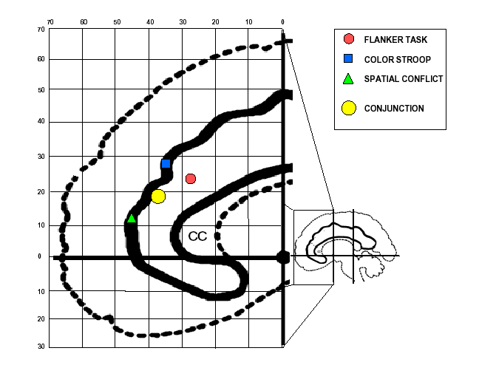
Fan, et al examined three conflict tasks using the same subjects and scanner to determine areas of activation (Fan, et al, 2001). They found that all three tasks activated areas of the anterior cingulate some of which were unique, but had a common focus. In addition, all activated some areas of the prefrontal cortex, but those areas appeared to differ between tasks.

Slide 12
4 4 5
4 5 5
4 4 5
The anterior cingulate is strongly activated by a wide variety of tasks that create conflict between elements (Bush, et al, 1998). For example, if people are asked to respond to the number of items in the visual field and the items are digits whose name differs from the number of objects present, conflict exists between the digit name and the desired numerical response.
Normals activate the anterior cingulate while the ADHD adults seem to rely on the anterior insula, which is usually associated with responses in more routine tasks not involving conflict (Bush et al 1999).

Slide 13
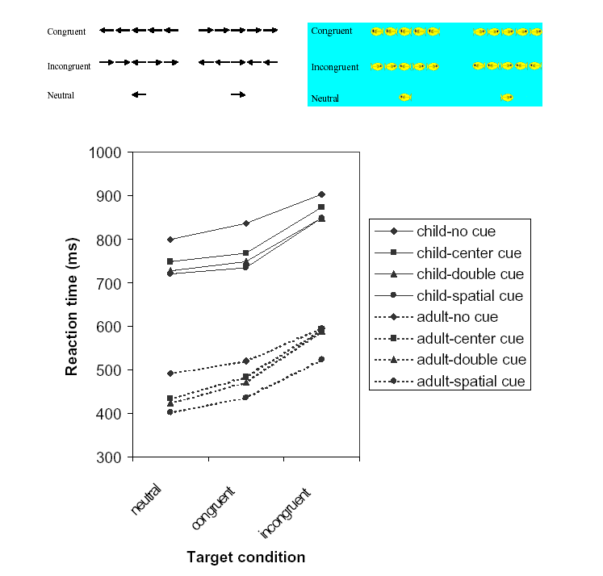
ANT network tests in children of 7 years of age
The child reaction times are much longer but they show similar independence between the three networks. Children have much larger scores for alerting and conflict, suggesting that they have trouble in maintaining the alert state when not warned of the new target and in resolving conflict.

Slide 14
These studies provide evidence for the development of an executive network during early childhood. Moreover, the development of executive attention contributes to the socialization process by increasing the likelihood of learning important behaviors related to self-regulation and understanding the cognition and emotion of others
Cognitive Science Problems
Modularity
There has been a great deal of discussion in the cognitive psychology literature of the concept of modularity. These discussions have often defined modularity in a way which required a system to be unaffected by top down (attentional) influences. According to this view only a very few vertical sensory and motor systems could be modular (Fodor, 1983) However, the evidence that even primary sensory systems can be modulated by attention makes it unlikely that any higher-level brain system will meet the criterion of modularity so defined.

Slide 15
X X X X X X
X X X X X X
X X X X Y X
X X X X X X
Binding and Integration
The binding problem in perception deals with the question of how we achieve the experience of a coherent world of integrated objects, and avoid seeing a world of disembodied or wrongly combined shapes, colors, motions, sizes and distances or in brief, how do we specify what goes with what and where? (Treisman 1998).
Spatial Attention
Experiments have investigated visual search by asking subjects to find a target object in a display of non-targets (or distracters).

Slide 16
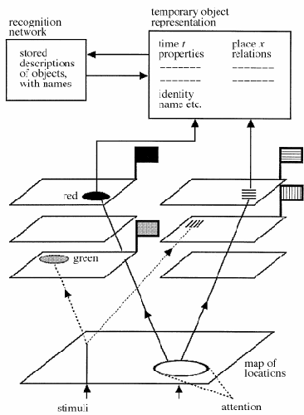
Model includes a master map of locations, that registers the locations of regions without giving access to the features that define them--for example whether they represent discontinuities in luminance, colour, depth or motion--and a separate set of feature maps. The feature maps contain two kinds of information: a `flag' signaling whether the feature is present anywhere in the field, and some implicit information about the current spatial layout of the feature. Not all tasks require binding. An attention window moves within the location map and selects from the feature maps

Slide 17
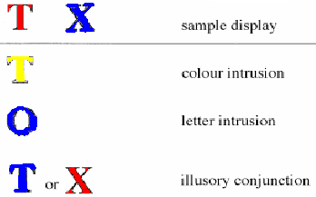
They showed R.M. some very simple displays containing just two coloured letters selected from T, X, and O in red, blue, or yellow, and asked him to tell us the first letter he saw.
He made binding errors, reporting one letter in the colour of the other, in more than 35% of trials. He reported a feature that was not in the display in less than 10% of trials.

Slide 18
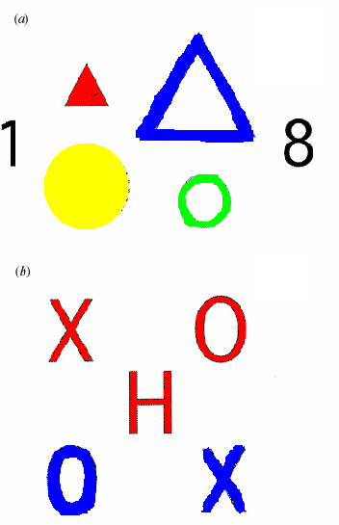
In one experiment, the displays contained four shapes varying in colour,size, shape, and format (filled or outline) (a)
Subjects were asked to give priority to noting the digits and to report them first. In addition they were to report all the features they could of the shape in one of the four locations, cued by a bar marker which appeared 200ms after the display. The prediction is that they too should then make binding errors, putting features together in the wrong conjunctions.
Subjects did in fact make many conjunction errors recombining the shape, size, format and colour. These occurred in 18% of trials, compared with only 6% intrusion errors.
In another experiment with coloured letters, there were more than 30%. They called these errors `illusory conjunctions', implying that they are real perceptual illusions (b) The theory predicts that illusory conjunctions are created on the basis of the flags that signal the presence of particular features.

Slide 19
Down
Up
They used indirect measures to probe for implicit information about locations. They presented the word `UP' or `DOWN' at the top or bottom of a vertical rectangle. In any given trial, the semantics of the word and its location could be consistent (e.g. the word UP in the upper location), or inconsistent (e.g. the word UP in the lower location). His response times were 142ms slower when the word was in an inconsistent location.

Slide 20
4 4 4 4
4
4
4 4 4 4
4
4
4 4 4 4
Egly and colleagues (1995) ran another experiment that also revealed implicit information about the spatial distribution of elements. Their displays consisted of a global letter made of local letters. When asked what he saw, R.M. never reported the global letter. He seemed to see only one of the local letters. Yet when asked to classify the local letter as one of two possible targets, he was significantly slower when the global letter was inconsistent with the local one than when it was consistent. Again, he seemed to have implicit information--this time about the whole, even though he could only respond to a part.

Slide 21
[X]...(X) [X]
DeSchepper and Treisman have explored implicit visual processing in normal subjects as well. They found indirect evidence that fairly complex patterns can be registered, bound and stored implicitly without conscious attention.
The measure they used is known as negative priming. Subjects are typically shown two objects and asked to respond to one of the two, selected by some simple distinguishing feature like its colour.
So, for example, Tipper & Cranston (1985) asked subjects to name pictures of familiar objects selecting the red one in each overlapped pair.
Their responses were slower when the unattended green object on one trial became the attended red one on the next, relative to when two new objects were shown.

Slide 22
A plausible account was that subjects inhibited the green object to avoid naming it instead of the red. When it then became the relevant object, on the next trial, they had to overcome the inhibition. As a result, the response was slightly delayed.
This negative priming implies:
(i) that subjects formed and retained a memory trace of the picture, even when it was the unattended member of a pair.
(ii) that an action tag was bound to the memory, specifying whether it should be responded to or ignored.
DeSchepper and Treisman asked whether novel patterns would also produce negative priming. If so, this would be evidence that a representation of their shape was formed, even in the absence of attention.
They used overlapped pairs of 270 nonsense shapes that the subjects had never seen before, simplified in figure. The task was to decide whether the green shape on the left matched a single white shape to the right of the display, ignoring the red shape.

Slide 23
[X] ( )
...
[Y] ( )
They gave subjects some practice with a set of 12 shapes that they used repeatedly, and then they introduced new shapes mixed with the old.
They found a clear negative priming effect of about 30ms, which was actually larger on the first trial in which a new shape was presented than it was for the familiarized shapes.
Subjects apparently set up a new representation for the unattended as well as the attended shape and attached an inhibitory action tag to it, specifying that it should be rejected. They had no conscious memory at all for the unattended shape. So attention is needed at the time of encoding if objects are to be explicitly retrieved.

Slide 24
Ignore
[ ] ( ) X
|____compare___|
...
---------------------------
Inhibitory
[ ] { } X
---------------------------
Facilitatory
[ ] { } X
Zhang, Kulczycki and Treisman asked what happens if they change either a feature or a component of the unattended prime before presenting it again as the attended probe .
In one experiment, they either kept the size the same, or changed it to larger or smaller. Surprisingly, when they changed the size, the result was not inhibition but facilitation.
"As must be clear, this is work in progress and there is much that is not yet understood. The use of implicit priming measures opens new perspectives. The dissociations between conscious experience and indirect priming suggest that the binding problem may be intimately bound up with the nature of consciousness, but that is a story that I think no one is yet ready to tell."

Slide 25
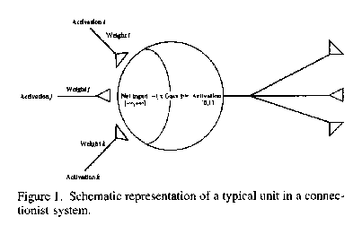
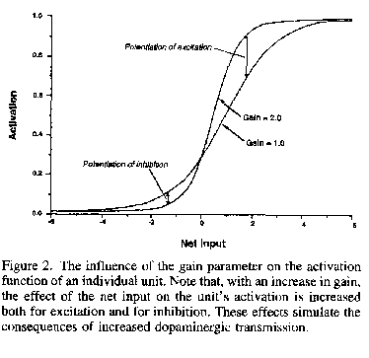
DA modulates (not inhibitory or exitatory) how target neurons respond to other neurotransmitter

Slide 26
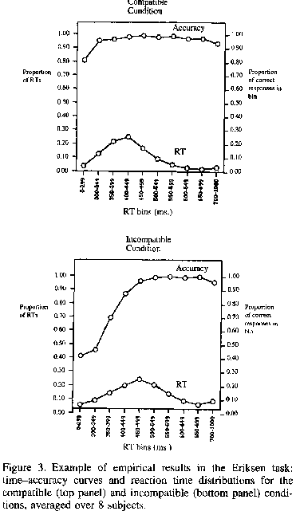
Ericson Task
NNNNNNN NNNHNNN
<- <- <- <- <- <- <- <- <- <- <- <- <- -> <- <- <- <-

Slide 27
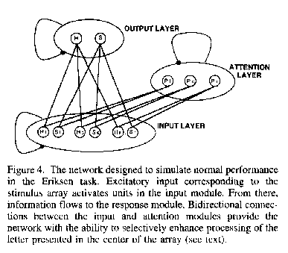
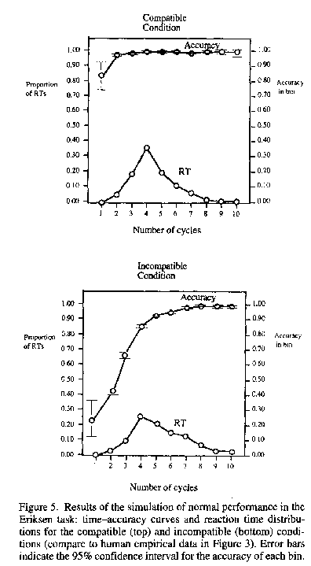

Slide 28
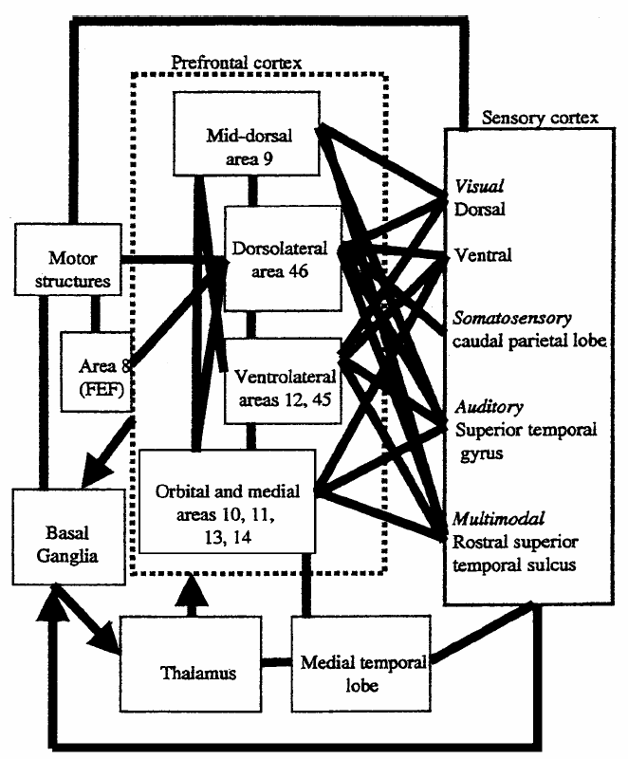
Miler:The PFC is a collection of interconnected neocortical areas that sends and receives projections from virtually all cortical sensory systems, motor systems, and many subcortical structures.
Schematic diagram of some of the extrinsic and intrinsic connections of the prefrontal cortex. The partial convergence of inputs from many brain systems and internal connections of the prefrontal cortex (PFC) may allow it to play a central role in the synthesis of diverse information needed for complex behavior.

Slide 29
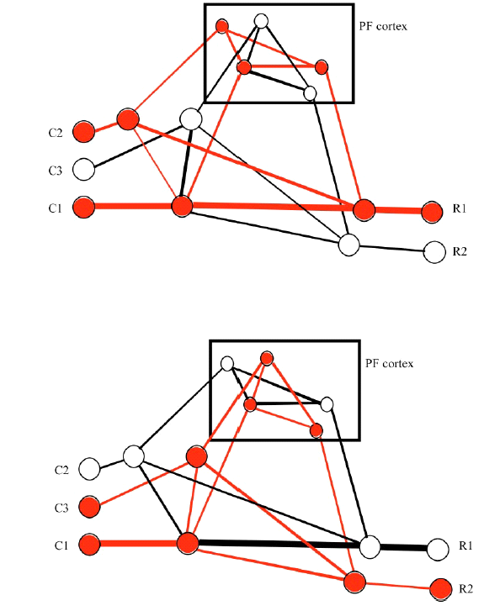
the constellation of PFC biases-which resolves competition, guides activity along appropriate pathways, and establishes the mappings needed to perform the task-can be viewed as the neural implementation of attentional templates, rules, or goals, depending on the target of their biasing influence (Figure 2).
Processing units are shown that correspond to cues (C1, C2, C3).They can be thought of as neural representations of sensory events, internal states (e.g. stored memories, emotions, etc), or combinations of these. Also shown are units corresponding to the motor circuits mediating two responses (R1 and R2), as well as intervening or “hidden” units that define processing pathways between cue and response units.
For example, imagine you are standing at the corner of a street (cue C1). Your natural reaction is to look left before crossing (R1), and this is the correct thing to do in most of the world (C2). However, if you are in England (C3), you should look right (R2). This is a classic example of a circumstance requiring cognitive control.

Slide 30
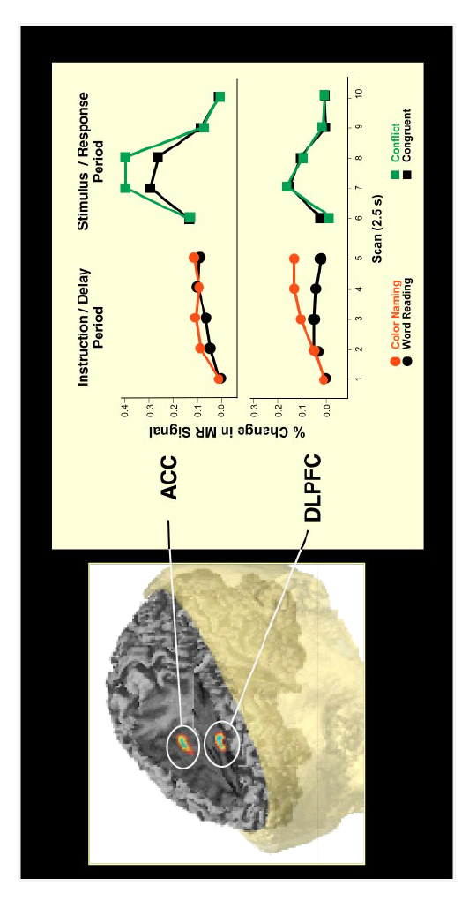
Time course of fMRI activity in dorsolateral prefrontal cortex (DLPFC) and anterior cingulate cortex (ACC) during two phases of a trial in the instructed Stroop task.
During the instruction and preparatory period, there is significantly greater activation of DLPFC for color naming than word reading, but no difference in ACC.
During the stimulus and response phase, there is greater activation of ACC for conflict than congruent stimuli, but no difference between these for DLPFC. Adapted from MacDonald et al (2000).

Slide 31
Cognitive control: it has severely limited capacity. This has long been recognized in cognitive psychology (Broadbent 1958, Posner & Snyder 1975, Shiffrin & Schneider 1977) and is painfully apparent to anyone who has tried to talk on the phone and read e-mail at the same time.
It may also be important to distinguish the capacity limits of cognitive control from those of short-term storage of item information (e.g. verbal or visual short term memory) (Miller 1956, Baddeley 1986). Limits of control presumably reflect properties of PFC function. The limited capacity of short-term memory may involve mechanisms (e.g. articulatory rehearsal) and structures (e.g. sustained activity in posterior cortical areas) that are not central to cognitive control, and that may or may not rely on PFC function (4 vs. 7).

Slide 32
Attention and Consciousness:
Cognitive scientists point out that James was the first to see very clearly that we are only conscious of a tiny subset of the total of our "impressions from our whole sensory surface" .
Posner concludes in his review of attention and consciousness that an understanding of consciousness must rest on an appreciation of the brain networks that subserve attention, in much the same way as a scientific analysis of life without consideration of the structure of DNA would seem vacuous" (1994, p. 7398).
We do not perceive much information outside our focus of attention, that what we do see is quickly lost, and that voluntarily directing attention controls the appearance and disappearance of perceptual objects. Thus, it seems clear that attentional processing plays a decisive role in our conscious perceptions (Hardcastle 1995).
The dissociations (e.g. Treisman 1998) and other finding in the area of attentional control (e.g. Desimore and Duncan 1995) are between conscious experience and indirect priming and suggest that the role of attention in integrating information may be intimately bound up with the nature of consciousness.

Slide 33
Further works
The relation between attention and other cognitive processes such as working memory, long-term memory, motivation and consciousness is still unclear.
The neural mechanisms and cognitive processes involved in attention, for example whether it operates through inhibitory or excitatory process or both need to be more explored.
word recognition strategies and semantic->AoA->Stroop and Schizophrenia->Self and Goal->Context and Culture

Slide 34

"The only incomprehensible thing about the universe is that it is comprehensible"
Albert Einstein

