Slide 1

Conscious Conflict and Illusion: Evidence from fMRI and Cognitive Modeling
Ahmad Sohrabi
Institute of Cognitive Science
Carleton University
Sep. 2005

Slide 2
Outline
Background
Current Study
Behavioral Results
Imaging Results
Modeling Results
Conclusion

Slide 3
Neural Correlates of Consciousness (NCC)
.Unconscious and conscious numerical priming paradigm (Dehaene et al. 1998, 2003)
Background

Slide 4
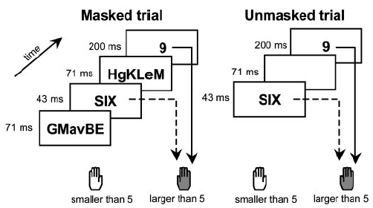
Dehaene et al. 2003, contd.
A prime number was presented followed by a target number and the subjects decided if the target is smaller or larger than five.
Masked trials (unconscious/invisible prime): Prime was masked.
Unmasked trials (conscious/visible prime): There was no mask.

Slide 5
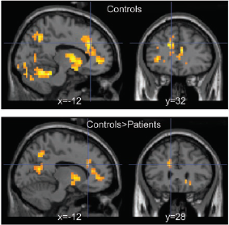
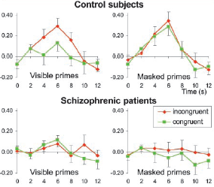
Dehaene et al. 2003, contd.
Comparing to five, if the prime and target were in the same direction it was called congruent (e.g., 3 & 4), otherwise incongruent (e.g. 3 & 8). Numbers were in Arabic or spelled-out format.
Normal subjects , compared to schizophrenics, showed more activations in their brain areas including ACC and mPFC.

Slide 6
Current Study: fMRI Experiment
We used geometrical (simple or illusory lines with two parts) instead of numerical stimuli.
Subjects were asked to select the longer part, at the left or right side, with the index or middle finger, respectively.
The goal was to assess the interactions between consciousness, congruency, and Müller-Lyer illusion.
Subjects were eight right-handed normals.

Slide 7
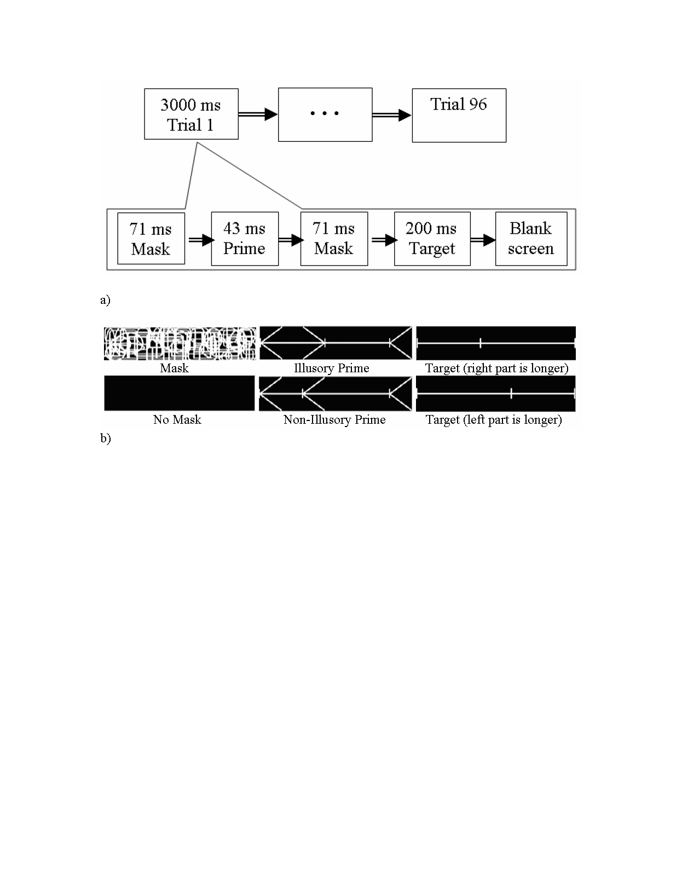
Material and Design

Slide 8
Block-design fMRI
Trials were blocked based on consciousness, congruency, and illusion.
The experimental session was 8 blocks of 4 trials with 3 repetitions (randomly ordered with the constraint that conscious illusory blocks were presented after conscious non-illusory)
The time for a whole image (TR) was 3000 ms.
SPSS12 and SPM2 were used for analyzing the behavioral and imaging data, respectively.

Slide 9
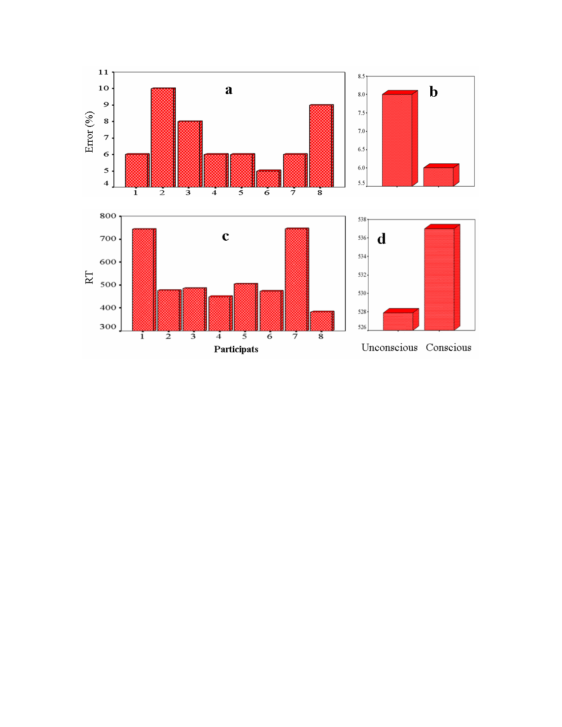
Behavioral Data: General Performance

Slide 10
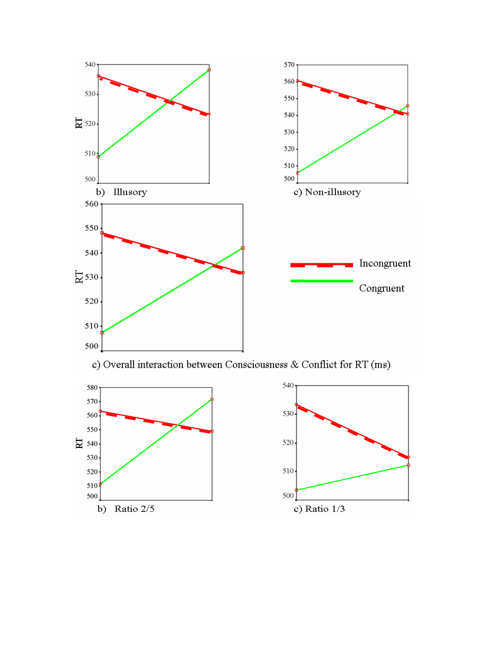
Behavioral Data: RTs

Slide 11
Imaging Results
The threshold was set at p .001 (uncorrected) with at least four voxels per cluster (p 0.05 uncorrected for clusters).
Analyses at both 1st and 2nd levels were mostly consistent, but only the 2nd level is reported (it’s more reliable).

Slide 12
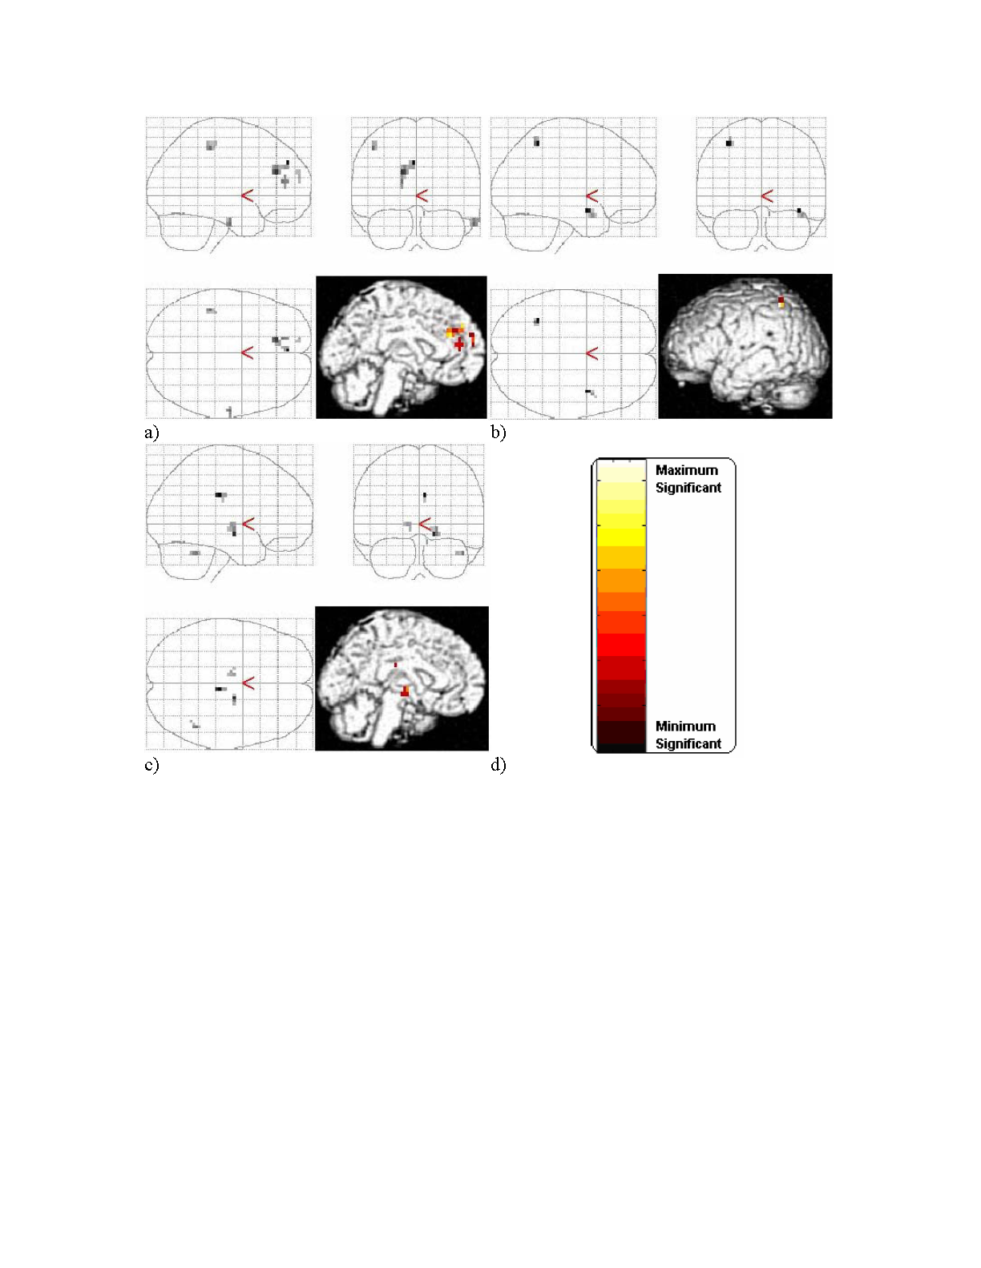
Conscious Incongruent – Conscious Congruent
Unconscious Incongruent – Unconscious Congruent
Unconscious Incongruent – Conscious Incongruent

Slide 13
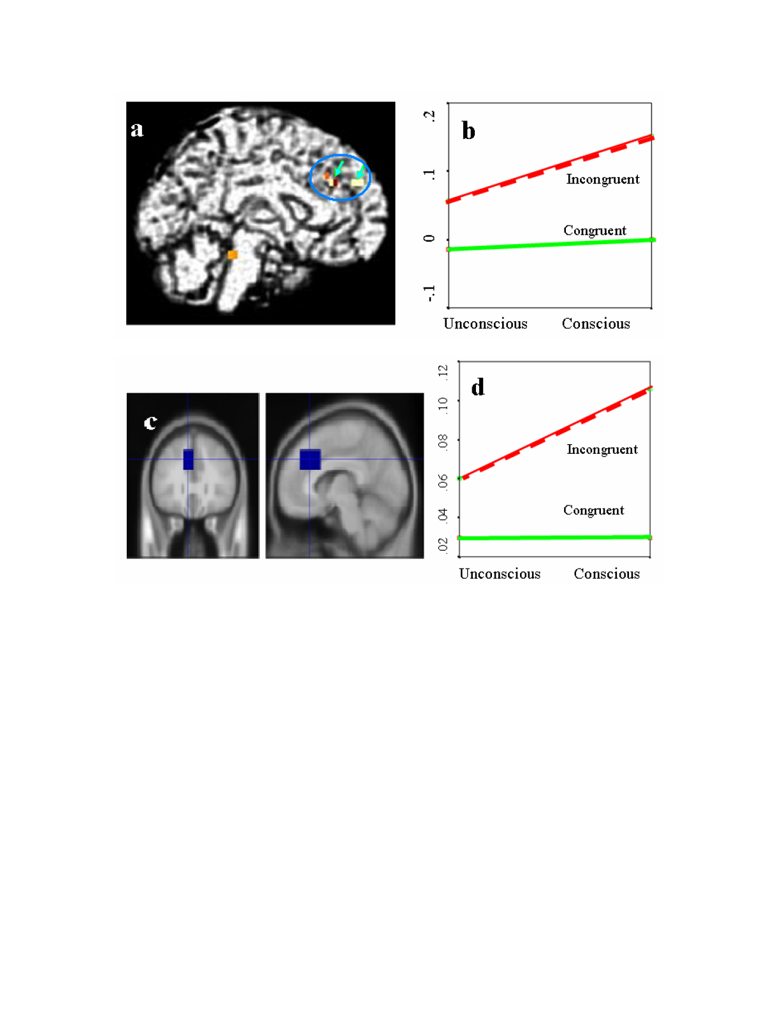
Two areas (dr-ACC and mPFC), activated in Incongruent – Congruent at the first level analysis were used in the analysis of % changes in BOLD signals that illustrate a significant interaction of Consciousness x Conflict)
An ROI covering the above areas The percent changes in BOLD signals that illustrates the interaction of Consciousness x Conflict in general (not significant at p .05).

Slide 14
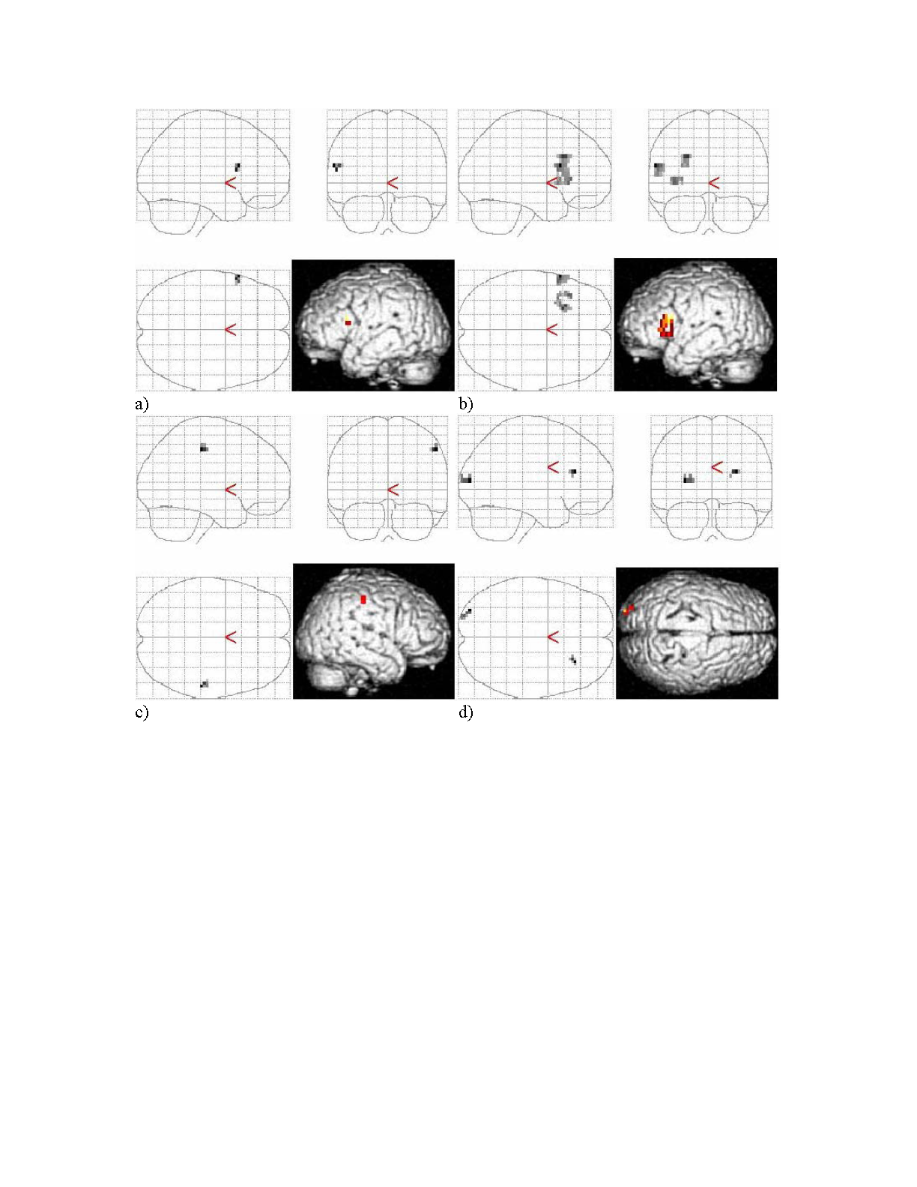
Conscious Illusion – Conscious Non-illusion
Conscious Illusion – Unconscious Illusion
Incongruent Illusion – Congruent Illusion
Congruent Illusion – Incongruent Illusion

Slide 15
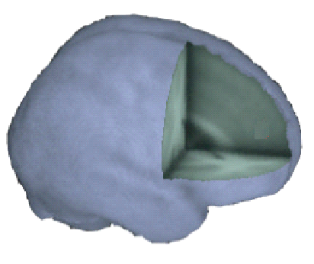
Parietal
Summary of main fMRI results
dl-PFC
IFG
Illusion
Conscious
Incongruent
dr-ACC
mPFC

Slide 16
A simple cognitive model of conscious conflict monitoring
The neural network used for the model was a Multi-layer Feed Forward (MLFF) for learning (500 interleaved epochs, no momentum) and a Hopfield network for conflict monitoring.
The response latency was measured as the number of cycles needed for output units to reach the threshold using a random walk algorithm.

Slide 17
The Architecture of the Model
Response
Modulation
Conflict
Prime
Target
Inhibitory
Conscious
Excitatory
Unconscious

Slide 18
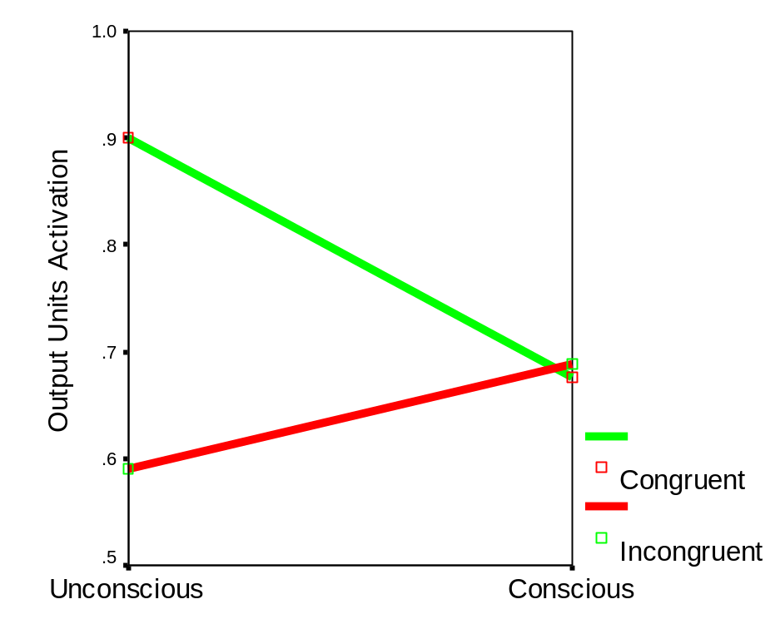
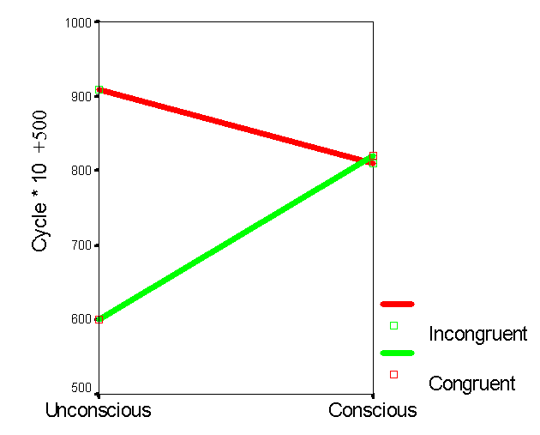
Simulation Result
Activations of the correct output unit
Number of cycles (x 10+500) to reach the threshold (.99)

Slide 19
Conclusion
Imaging results showed that the conscious conflict mainly activates a network including parietal, temporal, and the frontal cortices, mostly left dACC & mPFC.
Conscious illusion mainly activates left IFG & dl-PFC.
In contrast, the unconscious conflict and illusion mainly activates the parietal and temporal areas, mostly subcortical and right lateralized.
Inhibitory and excitatory modulation are guided by a unified goal in conscious monitoring, as explicitly shown by the model.
More Questions
Are these activations related to the conscious conflict resolution or conflict awareness (or both)?
Is visibility a good measure for consciousness?
How to improve cognitive models to simulate dynamic and global processes in conscious conflict onitoring/resolution?

