Slide 1

Journal Club
Ahmad Sohrabi
Advanced Seminar in Neuroscience
Carleton University
Fall 2004

Slide 2
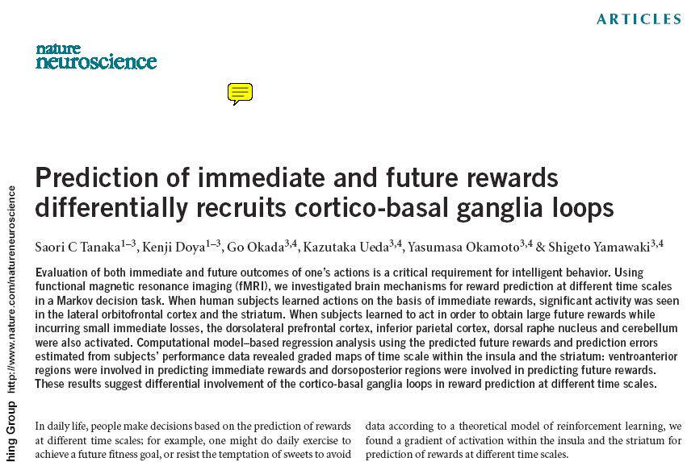
The target paper:
VOLUME 7 | NUMBER 8 | AUGUST 2004

Slide 3
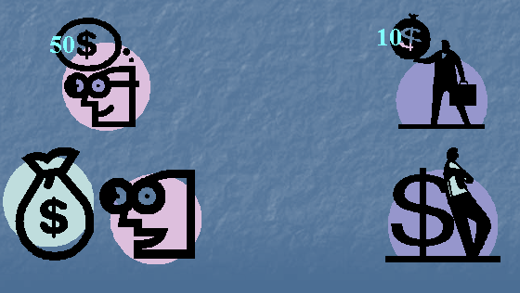
Delayed Discount: Reward (and punishment) value exponentially decreased over time
+1
0
time
-1

Slide 4
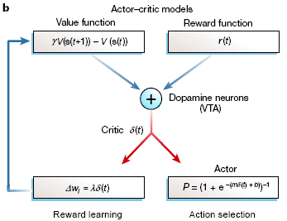
Actor–critic models use dopamine-encoded prediction-error signal to learn stimulus–reward associations, and to assess actions or contemplated actions (Montague et al 2004)

Slide 5
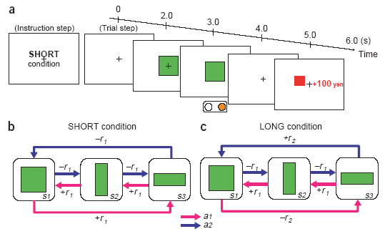
Experimental Design

Slide 6
Task Design: figure parts b & c
The rules of the reward and state transition for action a1 (magenta arrows) and action a2 (blue arrows) in the SHORT (b) and LONG (c) conditions.
The small reward r1 was 10, 20 or 30 yen, with equal probability, and the large reward r2 was 90, 100, or 110 yen.
The rule of state transition was the same for all conditions:
s3 → s2 → s1 → s3 … for action a1, and s1 → s2 → s3 → s1 → … for action a2.
Although the optimal behaviors are opposite (SHORT: a1; LONG: a2), the expected cumulative reward during one cycle of the optimal behavior is 60 yen in both the SHORT (+20 × 3) and LONG (–20, –20, +100) condition

Slide 9
+$20

Slide 12
-$20

Slide 13
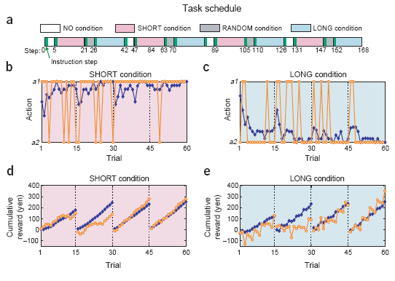
Task Schedule and Behavioral results

Slide 14
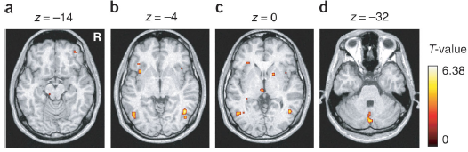
Brain areas activated in the SHORT versus NO contrast (P < 0.001, uncorrected; extent threshold of four voxels). (a) Lateral OFC. (b) Insula. (c) Striatum. (d) Medial cerebellum.

Slide 15
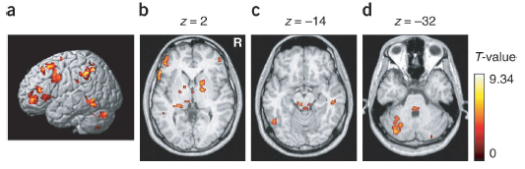
Brain areas activated in the LONG versus SHORT contrast (P < 0.0001, uncorrected; extent threshold of four voxels for illustration purposes). (a) DLPFC, IPC, PMd. (b) GP, striatum. (c) Dorsal raphe nucleus. (d) Left lateral cerebellum.

Slide 16
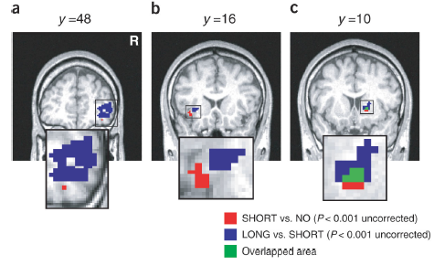
Comparison of brain areas activated in the SHORT versus NO contrast (red) and the LONG versus SHORT contrast (blue). (a–c) These figures show activation maps focused on (a) the lateral OFC (red (x, y, z) = (38, 46, –14); blue (46, 47, 3)) (b) the insula (red (–36, 13, –4); blue (–30, 18, 1)), and (c) the striatum (red (18, 10, 0); blue (18, 12, 3))

Slide 17
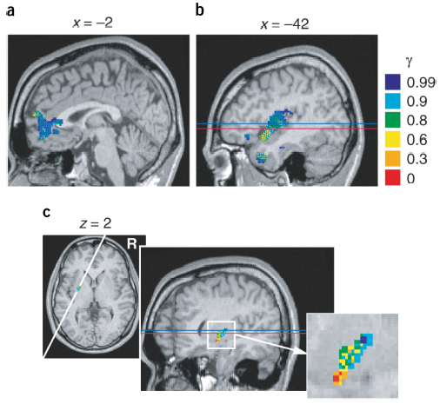
Voxels with a significant correlation
Reward prediction V (t) and prediction error δ (t) are shown in different colors for different settings of the discount factor γ. Voxels correlated with two or more regressors are shown by a mosaic of colors.
(a, b) Significant correlation with reward prediction V (t). (a) mPFC. (b) Insula.
(c) Significant correlation
with reward prediction
error δ (t) restricted to
ROI in the striatum
(slice at white line in
horizontal slice at z = 2 mm).

Slide 19
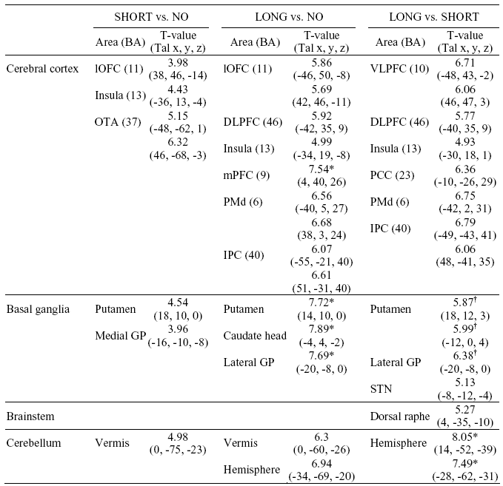
Areas significantly activated in the block-design analysis.

Slide 20
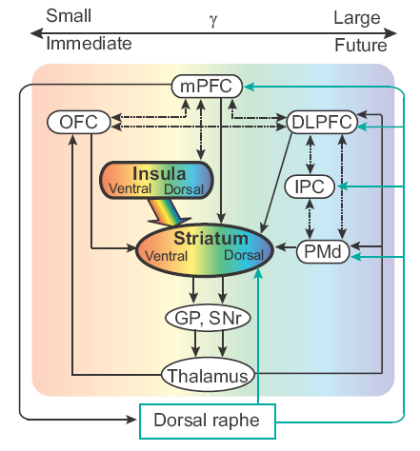
The Reward Prediction

Slide 21
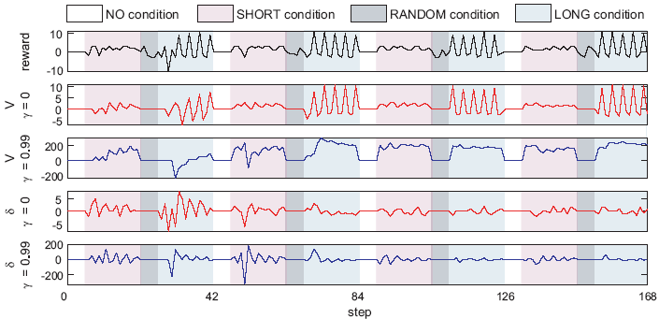
An example of the time series of the explanatory variables for one subject. Waveforms of the explanatory variables showing reward outcome r, reward prediction V (= 0 & 0.99), and reward prediction error (= 0 & 0.99) of one subject.

Slide 22
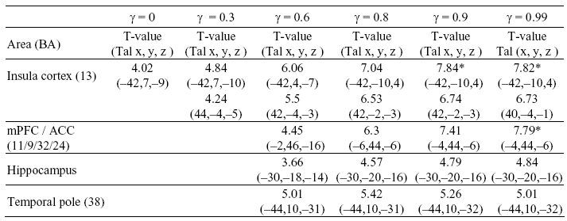
Areas with significant correlation with reward prediction V (t) estimated with different discount factors

Slide 23
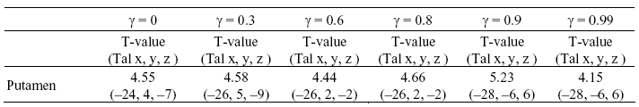
Voxels with significant correlation with reward prediction error (t) estimated with different discount factors

Slide 24
Discussion
Two neural networks in the brain are involved in processing of immediate and future rewards.
Immediate reward: lateral OFC & striatum
Future reward: dorsal PFC, inferior parietal cortex, dorsal raphe nucleus and cerebellum
Predicted future rewards and prediction errors from behavioral data showed a gradual change in insula and striatum:
ventroanterior regions were involved in immediate reward prediction, and dorsoposterior regions were involved in future reward prediction

Slide 25
Questions remained
How these two systems interact with each other?
Is there any other system involved in coordinating those two systems?
What is the role of memory and context dependent information like instruction?
What would be the difference if we just ask people to say their preference between immediate and future reward?
How can we compare immediate and future reward values? i. e., is there a common system for valuation?
Why there is no important differences between Long vs. Random?

