Slide 1
Semantic Knowledge
Proseminar Course
Carleton University
2003
A. Sohrabi

Slide 2
How we know Socrates is mortal
Aristotle: we reason from two proposition
Socrates is man and all mem are mortal
Prolog:
  Is (socrate,man).
  Is (man,mortal).
  Is (X,Z):- is (X,Y); is (Y,Z).
  ? Is (socrate,mortal).
  True
This basic SYLLOGISM are common in many theories: first we categorize members then we consult properties of the members of the category.

Slide 3
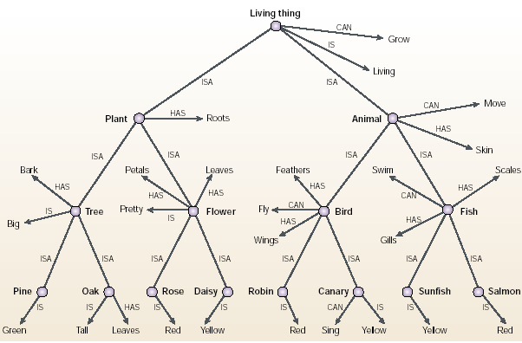
Interestingly, EEG studies show that the human visual system can solve an object detection task within 150 ms.
Ungerleider, L. & Haxby, J. (1994).

Slide 4
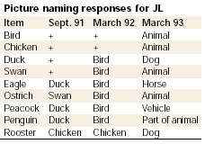

Slide 5
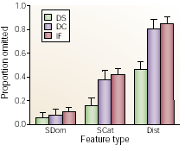

Slide 6
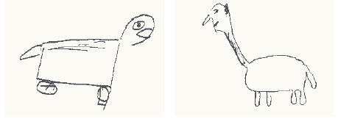

Slide 7
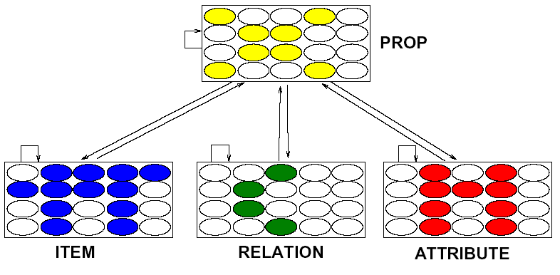

Slide 8
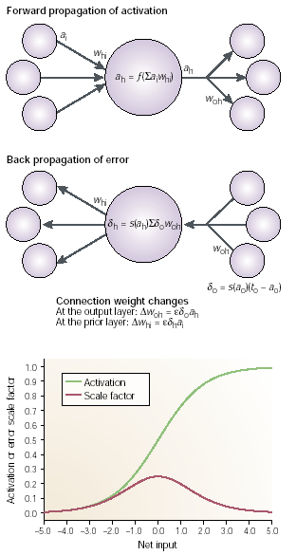

Slide 9
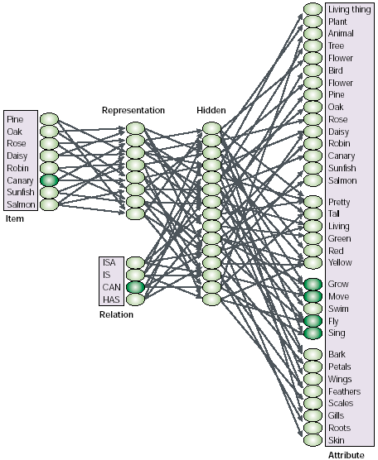

Slide 10
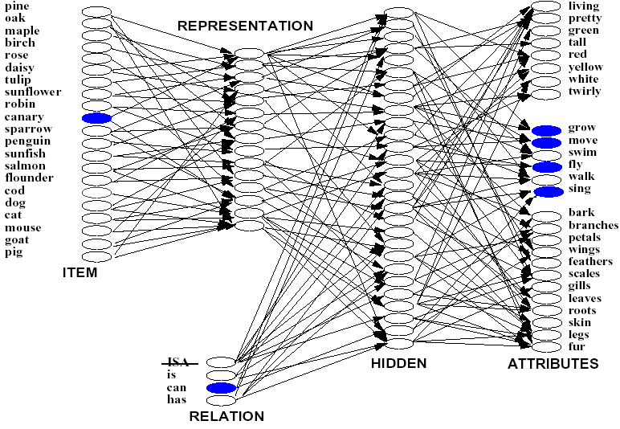

Slide 11
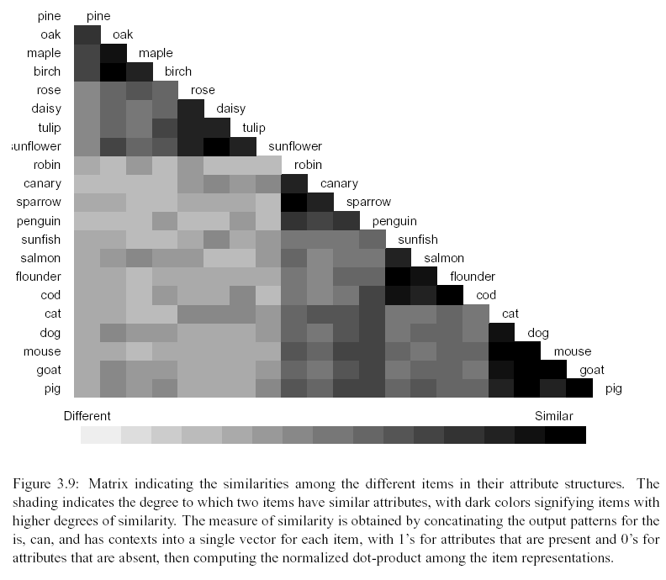

Slide 12
Effects of Coherent Variation of Properties on Learning
Attributes that vary together create the concepts that populate the taxonomic hierarchy, and determine which properties are central to a given concept.
Where sets of attributes vary together, they exert a strong effect on learning.
  Items with co-varying properties stay together through semantic space and form the clusters corresponding to super-ordinate concepts.
Arbitrary properties (those that do not co-vary with others) are very difficult to learn, even when frequency is controlled.
  They control a late stage of differentiation in which individual items within clusters become conceptually distinct.
20

Slide 13
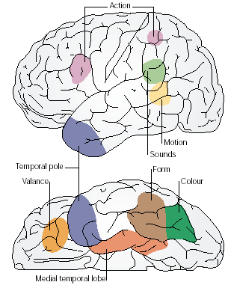

Slide 14
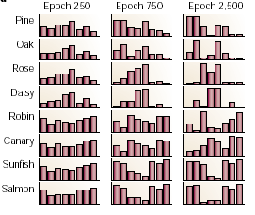

Slide 15
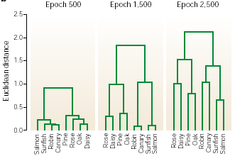

Slide 16
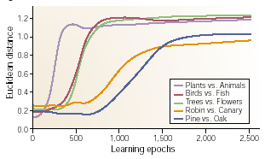

Slide 17
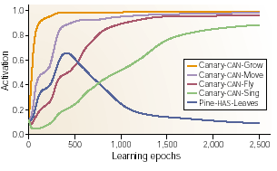

Slide 18
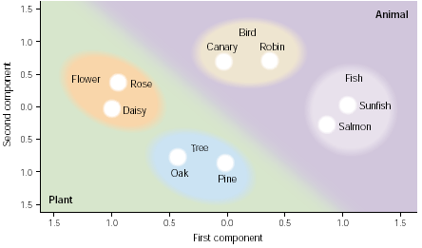

Slide 19
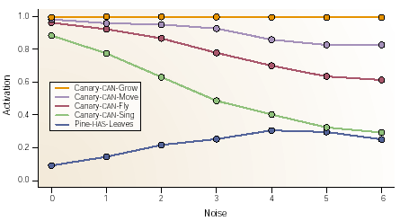

Slide 20
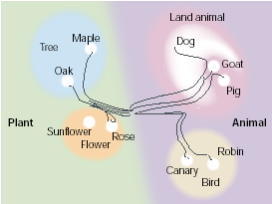

Slide 21
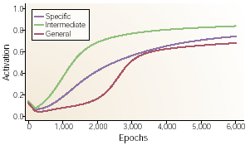

Slide 22
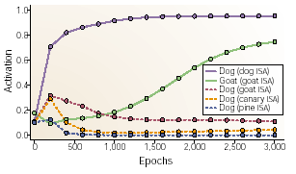

Slide 23
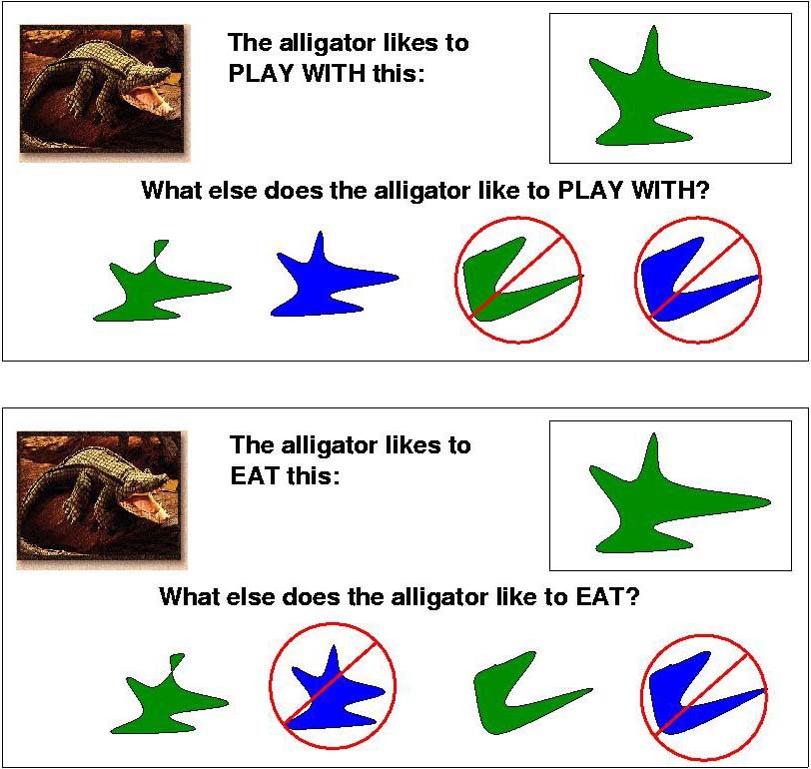
3-4 yr old children see a puppet and are told he likes to eat, or play with, a certain object (e.g., top object at right)
  Children then must choose another one that will “be the same kind of thing to eat” or that will be “the same kind of thing to play with”.
  In the first case they tend to choose the object with the same color.
  In the second case they will tend to choose the object with the same shape.

Slide 24
To address this they added some new property units and created clear cases of feature-dependencies in the model:
Among the plants:
  All trees are large
  All flowers are small
  Either can be bright or dull
Among the animals:
  All birds are bright
  All fish are dull
  Either can be small or large
Though partially counter-factual, these assignments allow us to explore domain specificity of feature dependencies in the model.

Slide 25
After partial learning, model is shown eight test objects:
  Four “Animals”:
    All have skin
    All combinations of bright/dull and large/small
  Four “Plants”:
    All have roots
    All combinations of bright/dull and large/small
Representations are generated by using
back-propagation, training the item-to-representation weights only.
Representations are then compared to see which animals are treated as most similar, and also which plants are treated as most similar.

Slide 26
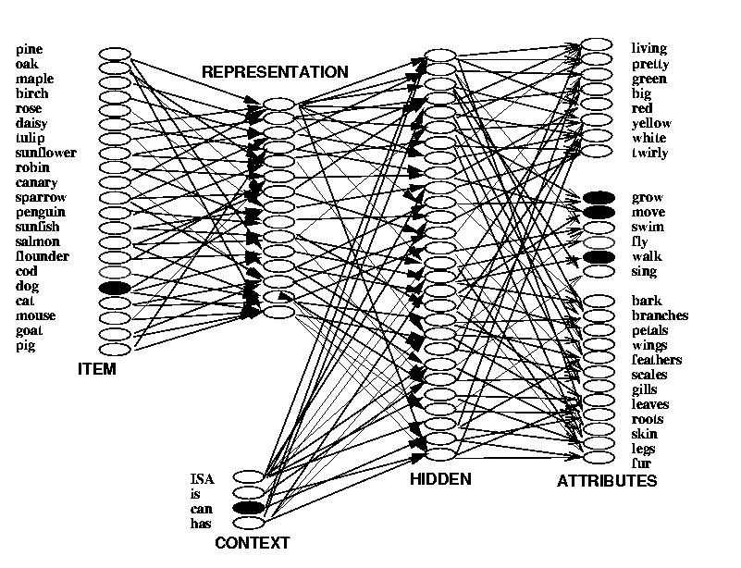
(One unit is added
for each test object)

Slide 27
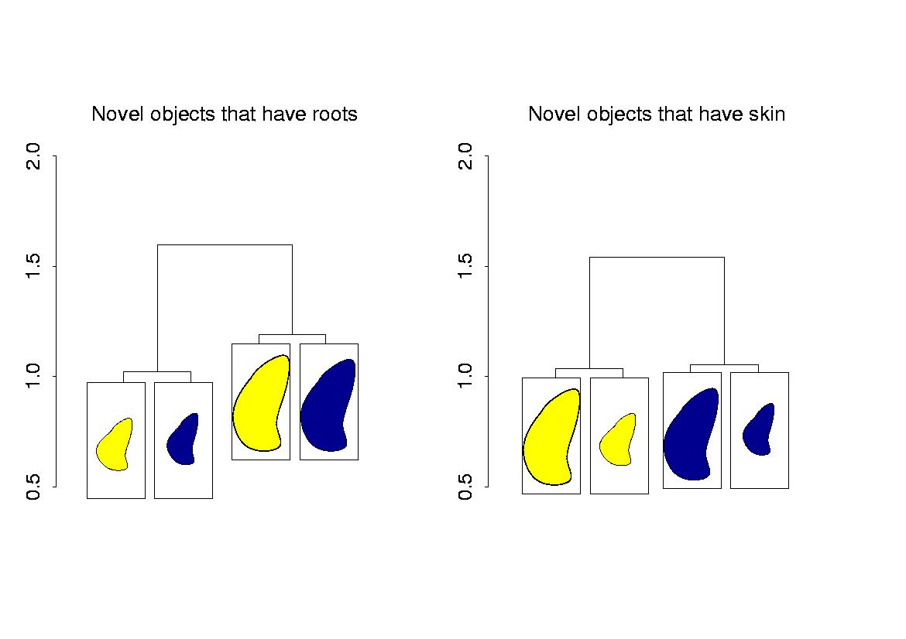
Similarities of Obtained Representations
Size is relevant
for Plants
Brightness is relevant
for Animals
32

Slide 28
Differential Feature Importance
The simulation suggests that domain-general learning mechanisms can learn that different features are important for different concepts.
The network has acquired domain-specific knowledge of just the sort theory theorists claim children know about concepts.
It does so from the distributions of properties of concepts, without the aid of initial domain knowledge.

Slide 29

Conceptual Reorganization (Carey, 1985)
Carey demonstrates that young children ‘discover’ the unity of plants and animals as living things only around the age of 10.
She suggests that the emergence of the concept of living thing coalesces from assimilation of different kinds of information, including:
  Need for nutrients
  What it means to be dead vs. alive
  Reproductive properties
35

Slide 30
Conceptual Reorganization in the Model
The simulation model provides a vehicle for exploring how conceptual reorganization can occur.
  The model is capable of forming initial representations based on superficial appearances
  Later, it can discover shared structure that cuts across several different relational contexts, and use the emergent common structure as a basis for a deeper organization.
36

Slide 31
Reorganization Simulation
They considered the coalescence of the superordinate categories plant and animal, in a situation where the training data initially supports a superficial organization based on appearance properties.
In each training pattern, the input is an item and one of the three relations: ISA, HAS, or CAN.
The target includes all of the superficial appearance properties (IS properties) plus the properties appropriate for the relation.
The model quickly learns representations that capture the superficial IS properties.
Later, it reorganizes these representations as it learns the relation-dependent properties.

Slide 32
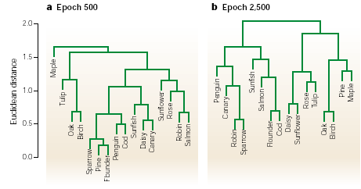

Slide 33

Sam’ thesis The Main Questions:
1. What is the psychological structure of non-referring concepts, and does it differ in any way from ordinary, referring concepts?
2. Are there any other significant psychological differences between referring and non-referring concepts?

Slide 34
These questions came from the reference-based approach to semantics: If most words get their meanings by referring to things, then how do seemingly meaningful words with no existing referent get their meanings?
The default position in a reference-based framework is that non-referring words, and the concepts that they express, are semantic special cases.
Fodor and Dretske’s: non-referring concepts have a radically different structure from referring concepts,
Taylor’s prediction that non-referring concepts have an identical structure, but require an extra processing step, and
Sam’s suggestion: there is no difference in either structure or processing – I called this position “Psychological Meinongianism”.

Slide 35
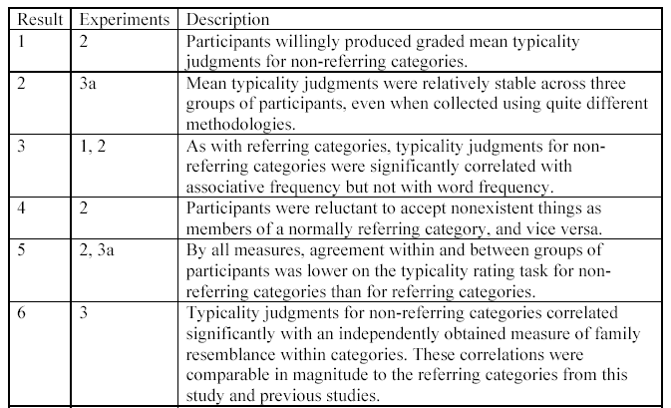

Slide 36
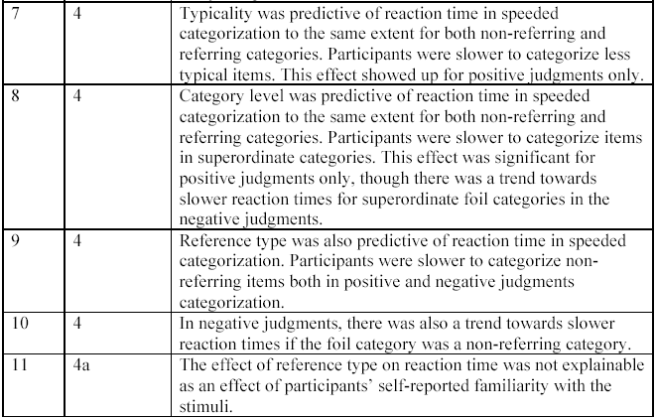
Contd.

Slide 37
The structure story is relatively simple, but the story about processing is less so. Results 9, 10, and 11 in Table 5-1 strongly suggest that non-referring concepts are more difficult to process than referring concepts. Participants take significantly longer to respond in categorization tasks, for both positive and negative judgments, also showing a trend towards even longer reaction times for negative judgments when the foil category is also non-referring. This effect is not explainable as an effect of familiarity with the experimental stimuli. Though I believe this result can and should be investigated further
(see the Future Directions section), in this section, I will assume for the sake of argument that it is firmly established.

Slide 38
Sam’s Suggestion
The source of the difference is to be found in the knowledge of the real world that participants bring to the categorization task – knowledge that is external to the concepts themselves.
The real world knowledge that there are no smurfs, dragons, and so on causes participants to be a lot
more cautious in their judgments about the terms in question.
Generally speaking, things that we know to be nonexistent need to be ignored most of the time – at least they need to be prevented from playing a role in the explanations and inferences we use to navigate the real world.
Reading a story in which one learns, for example, that a werewolf killed the prime minister of Canada, should have no effect on one’s beliefs about the real prime
minister of Canada.

Slide 39
Note
{frequency - sample - random -length and other at least in speeded categorization}
negative resemblance: rejecting non-refering as animal more=> could reject Taylor?
two type of knowledge Meinongian and people
Top-down and bottom-up interaction?

Slide 40
Neurosemantics: Ryder
We now have very strong evidence that the human mind is identical with or somehow realized in the brain, specifically in the cerebral cortex, so the cortex is a suitable place for us to begin our investigations.
Since the cortex is not unique to humans, if our investigation is successful it will reveal the nature of mental representation beyond our paradigm case.

Slide 41
“SINBAD” stands for “Set of INteracting BAckpropagating Dendrites; it is a cellular level theory of cortical plasticity based on functional considerations as well as anatomical and physiological evidence.
If the theory is correct, networks in the cortex have a powerful tendency to structure themselves isomorphically with regularities in their environment. This tendency is enormously useful, because it allows our brains to yield reliable predictions. Thus if the SINBAD theory is correct, it is reasonable to suppose that it is the biological function of cortical networks to structure themselves isomorphically with their environment.This means that they represent, or more specifically, model their environment.
The SINBAD theory of the cortex may be understood with the help of the following metaphor. One view of the cells in the cortex (not the SINBAD view) is that they are faithful associative instruments that record and remember pairwise regularities. A flash of lightning and a boom of thunder occur together, so the Flash cell and the Boom cell tie a string between them, as it were; the next time Flash sees lightning, she tugs on the string to let Boom know he is to expect some thunder.

Slide 42
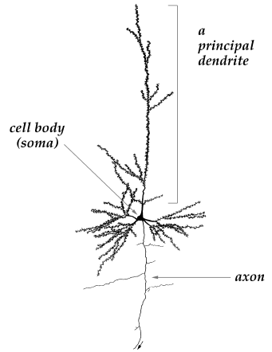

Slide 43
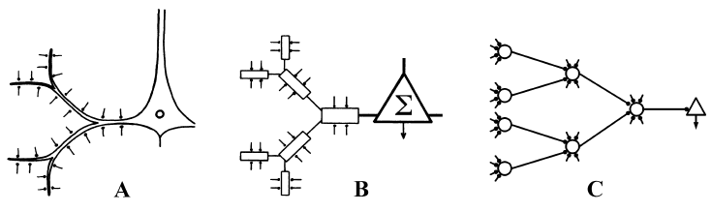

Slide 44
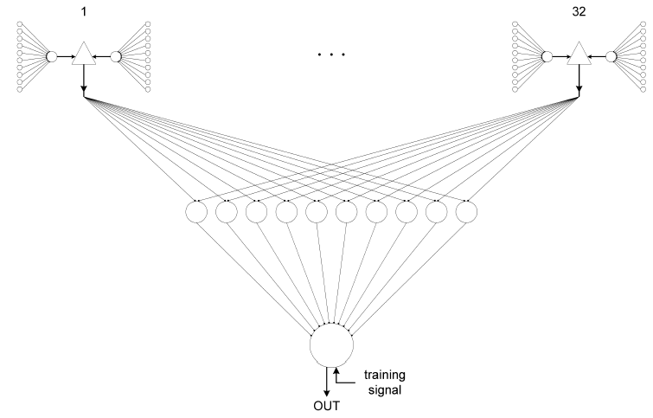

Slide 45
The only reason SINBAD cells yield reliable “predictions” is because they tend to correspond (in the context of an isomorphism) to sources of
correlation in the environment, due to the tendency of their dendrites to discover non-accidentally correlated functions of their inputs. If they did not come to correspond to genuine sources of multiple correlations, they would not yield reliable “predictions.” So SINBAD cells are present in the brain because they come to correspond, in the context of an isomorphism, to sources of multiple
correlations.

Slide 46
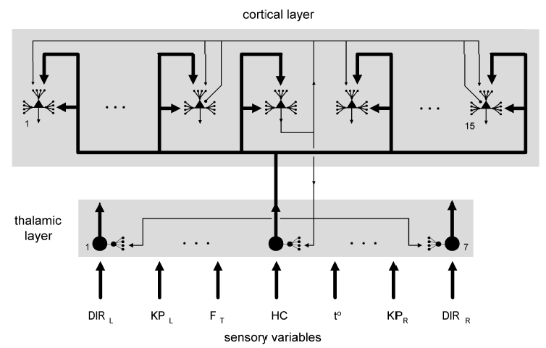

Slide 47
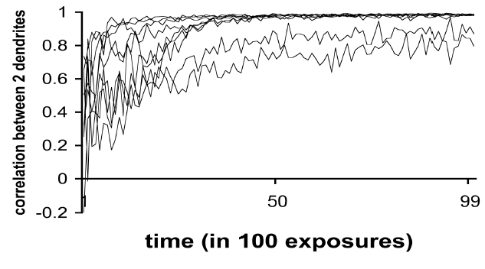

Slide 48
Since the cerebral cortex is the seat of the mind, this gives us some reason to believe that SINBAD representation realizes mental representation in us, and other creatures with a cerebral cortex. This conclusion can be bolstered by showing in addition that SINBAD representation exhibits the features characteristic of mental representation, as described by both scientific and folk psychology.
Error (penny and dime) false or miss-representation)
Twine case: H²O twin-water XYZ twin-earth, Twinbad

