Slide 1
Attention and conflict in masked priming: Implications for the accessibility of consciousness
Ahmad Sohrabi
Institute of Cognitive Science
Carleton University

Slide 2
Outline
Review of priming paradigms
Experiment 1:Perceptual magnitude (line length) priming
Behavioural result
fMRI result
Experiment 2: Symbolic magnitude (number and symbol) priming
Experiment 1a
Experiment 2b
Neurocognitive modeling
Our results
Previous results
Discussion

Slide 3
Some definitions
Priming: A brief stimulus (the prime) can affect the processing of the following stimulus (the target).
Attentional resources and conflict monitoring play a role in (magnitude) masked priming.
Attention: Modulation or amplification of cognitive processes, especially decision and response.
Conflict: Any incongruity between stimuli and/or responses in terms of the current task set.

Slide 4
Priming paradigms
Masked and unmasked priming
Prime can be masked (cannot be reported) or unmasked (can be reported)
Positive priming or Positive Compatibility Effect (PCE):
A prime that is congruent with the target produces a faster reaction time than a prime that is incongruent with the target
Negative priming or Negative Compatibility Effect (NCE):
A prime that is incongruent with the target produces a faster reaction time than a prime that is congruent with the target

Slide 5
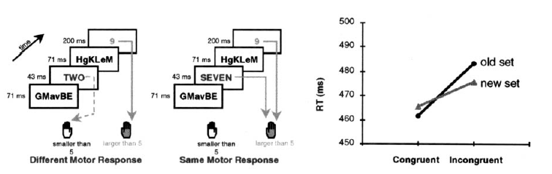
PCE (e.g., Dehaene et al., 1998)
Forward Mask
Prime
Target
Backward Mask
Random Pattern
71ms
Number
Arabic/Verbal
43ms
Number
Arabic/Verbal
200ms
Random Pattern
71ms

Slide 6
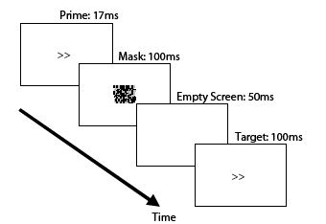
NCE: (Eimer and colleagues)
Prime
Target
Backward Mask
Arrow
16ms-35ms
Arrow
>=100ms
Random Pattern
>=100 ms

Slide 7
Experiment 1: Geometrical Magnitude
Dehaene and colleagues found an effect for number primes.
Numbers are symbols so in this study we looked at whether line length would produce the same result.
Illusory and real line lengths were used
Müller-Lyer illusion was used as it has an automatic nature but activates other processes as well.

Slide 8
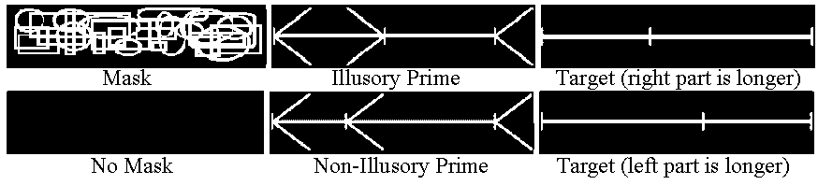
Study 1: Magnitude and Priming
Forward Mask
Prime
Target
Backward Mask
Random Shapes
71ms
Line
43ms
Line
200ms
Random Shapes
71ms

Slide 9
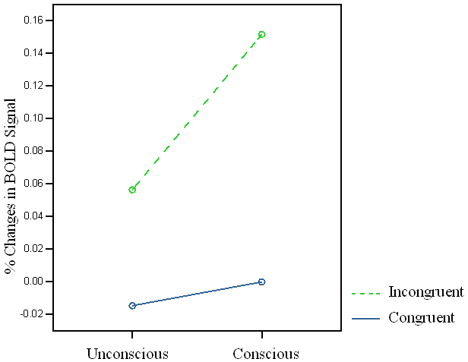
Main point in the fMRI Result:
Unmasked Incongruent – Unmasked Congruent 2nd

Slide 10
Parietal
Summary (fMRI)
dl-PFC
IFG
Occipital
Müller - Lyer
Unmasked
Incongruent
Masked
Congruent
Temporal
rACC
mPFC

Slide 11
Behavioral Data (Masked):

Slide 12
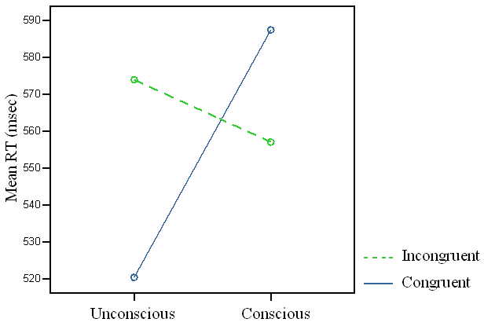
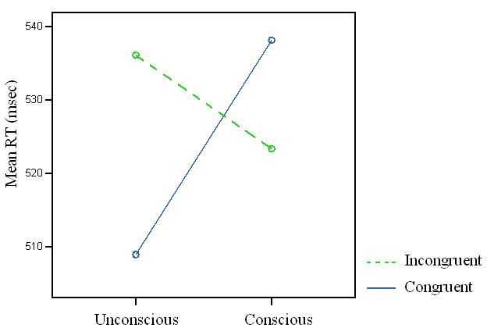
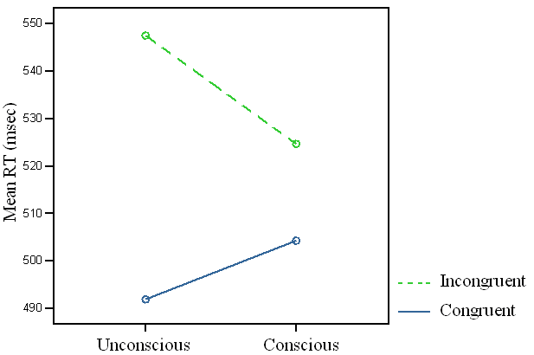
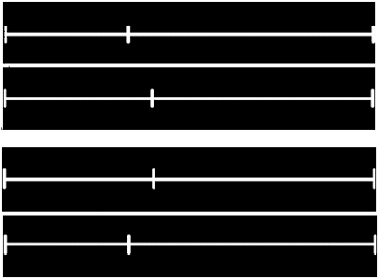
Results (behavioral):
Non-illusory with two ratio primes Illusory
Negative priming
Negative priming
Positive priming
Positive priming
Positive priming

Slide 13
Main Results
Replicate Dehaene et al.’s fMRI results
Show the ACC and mPFC are consistently associated with conflict.
Replicate Dehaene’s behaioral results
So magnitude and illusion of magnitude produces the same effect as number.
However, in addition to the positive priming that Dehaene found, negative priming could also occur (meaning the story is more complicated).

Slide 14
Study 2: Learning and Expectation (Experiment 1a)
This experiment examined the effect of recently learned symbols as opposed to numbers, which are well learned symbols.

Slide 15
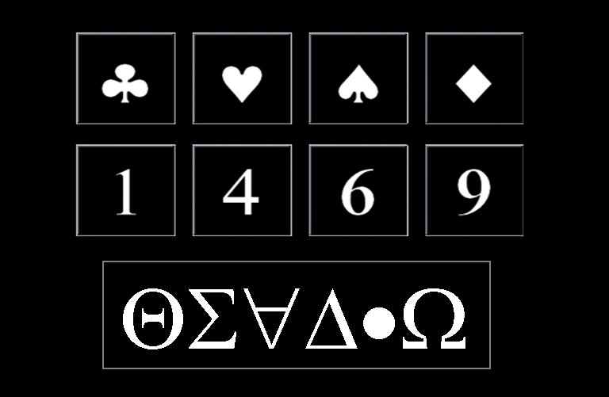
Method
We used Arabic numbers
and symbols representing
those numbers.
The same design from Study 1 was used.
Numbers primed symbols and symbols primed numbers.
Random Mask
71ms
Number/Symbol
43ms
Number/Symbol
Random Mask
71ms
200ms

Slide 16
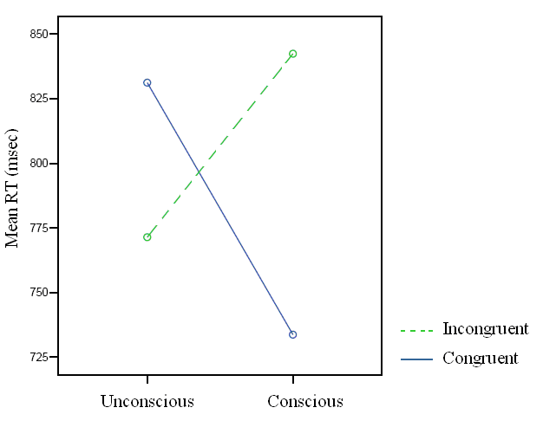
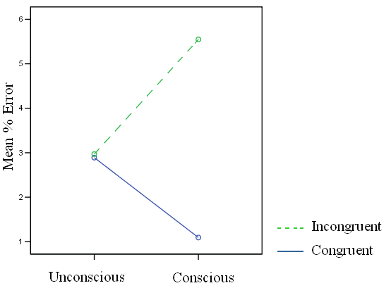
Initial Results
Number primed target symbols with different patterns for masked and unmasked trials:

Slide 17
Symbols primed numbers (not significant)

Slide 18
Experiment 2
In the previous experiment the prime type predicted the target type
Number –> symbol
Symbol – > number
Therefore the effect of predictability was studied:
Number –> Number
Number– > Symbol
Predictabilty:
Unpredictable Target Type (# and * at random)
Predictable Target Type (# for number, * for symbol target)

Slide 20
Result
Generally it replicated results of the previous experiment.
With more effects:
Effect for predictability
Effect for target type
Effect for number distance

Slide 21
Representational strength
Strength representation using connection weights |  |  | Target
 |  |  | Number |  | Symbol
 |  |  | Far | Close | Far | Close
Prime | Number | Far | 4.483 | 1.214 | 2.694 | 2.109
 |  | Close | 1.137 | 2.039 | .463 | -3.031
 | Symbol | Far |  |  | ? | ?
 |  | Close |  |  | ? | ?
3.375
2.516
-1.028

Slide 22
A model
Our experiments showed that “negative” priming can be caused by many factors:
Symbol target & close numerical distance, in the masked condition (significant).
Illusion (marginally significant) or change in line ratio (non-significant), in the unmasked condition.

Slide 23
Encoding Representational strength
Strength representation using connection weights |  |  | Target
 |  |  | Number |  | Symbol
 |  |  | Far | Close | Far | Close
Prime | Number | Far | 1.55-1.55 | 1.55-1.5 | 1.55-1.5 | 1.55-1.45
 |  | Close | 1.5-1.55 | 1.5-1.5 | 1.5-1.5 | 1.5-1.45
 | Symbol | Far | 1.5-1.55 | 1.5-1.5 | 1.5-1.5 | 1.5-1.45
 |  | Close | 1.45-1.55 | 1.45-1.5 | 1.45-1.5 | 1.45-1.45
Line
M-L
Line

Slide 24
Assumptions
Cognitive processing and especially response is boosted or modulated by an Attentional Resource (AR) originating from sub-cortical brain areas.
AR is limited and has a refractory period.
AR is directed by a goal driven control or conflict/performance monitoring.
Limited-capacity AR exposes a constraint:
Congruency effect is affected by AR (it is positive with enough AR and negative when reaches its refractory period, i.e., in difficult and/or long prime target SOA).

Slide 25


Slide 26
Hypotheses
When the task is difficult this pattern can be changed because of reaching the refractory period of AR.
Incongruent speed approaches congruent speed at this time because of decay and getting more gain at the beginning of the change (i.e. highest slope of the sigmoid function).
This may lead to a negative priming if refractory period is decreased by conflict which is higher in the incongruent condition.
Unmasked prime does not invoke AR because it is task irrelevant, but masked prime does, because mask prevents being conscious of representation.

Slide 27
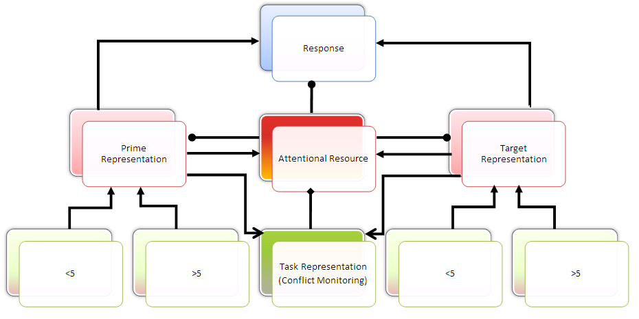
The Improved Model

Slide 28
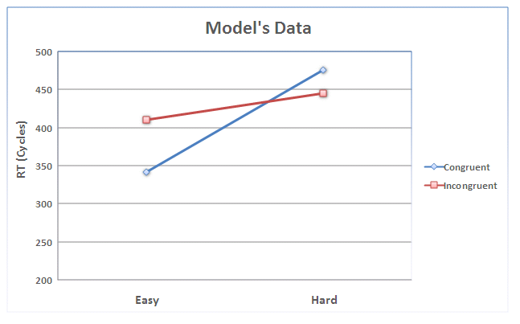
Initial Results of the Improved Model
Masked Unmasked

Slide 29
Discussion: Implications for consciousness
Consciousness comes with representation but it needs enough AR.
If representation reaches a threshold of meaning, it calls for AR then can be reported (accessible).
Probably its main function is conflict monitoring in the ongoing task/goal.

Slide 30
Discussion: Relation to other models
Dehaene et al. (2003, 2004, 2005): low level and complex.
Botvinick et al. (2001): Only response conflict, no role for consciousness.
Bowman et al. (2006): at the level of stimuli processing, might be good for modeling mask itself (has generalizability & biological plausability problems).

Slide 31
Discussion: Future Directions
Looking for the role of ISI, ITI, and between trials effects.
Although the model can simulate symbol, cue, and predictability as well, adding a Working Memory module makes it better.

Slide 32
Discussion: Other Predictions
As congruency effect can be reduced by task difficulty, “attentional blink” can be changed by difficulty and/or conflict.
Task conflict, not just response conflict (as with previous studies), has a role.
Mask type has a role, it is not neutral.
Patterns of priming are different in pathological cases such as schizophrenia, psychopathy, and Parkinson disorders.

Slide 33
Discussion: Limitations
Experiments:
Small sample sizes (about 10 in each experiment)
Modeling:
Real time
Mask
Between-trial effects

Slide 34
Discussion
Questions?

Slide 35
Study 3 (Experiment 1)
Negative priming in Study 1 and Dehaene (2003, schizophrenic patients) needed more exploration.
A negative priming has been found when there is a longer time between prime and target, long (> 90 msec) SOA and/or prime -mask ISI.
Arrow
17
Variable ISI
0-100
Arrow
133
Arrow Pattern
117

Slide 36
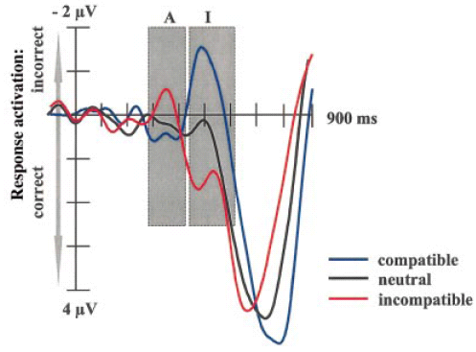
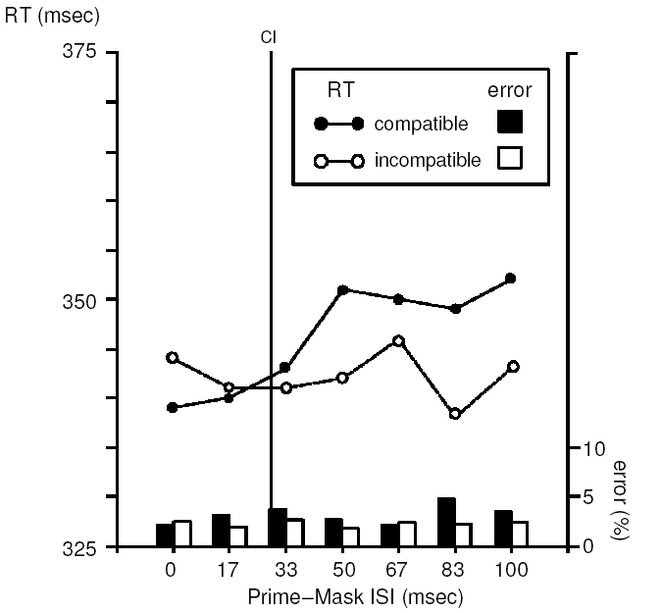
Explanation of the result: Focusing on Negative Priming
Schlaghecken and Eimer (2000) argued that:
when SOA is short, response selection can already take place during the initial response activation phase, and this should result in congruency effects.
when SOA/ISI is longer, responses have to be selected during the subsequent inhibitory phase, and this should be reflected as a negative priming effect.

Slide 37
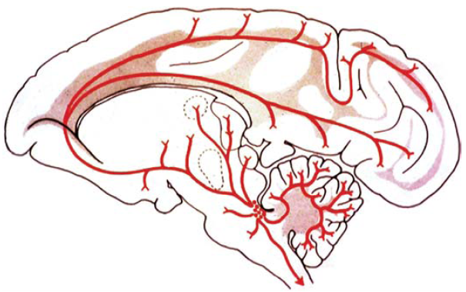
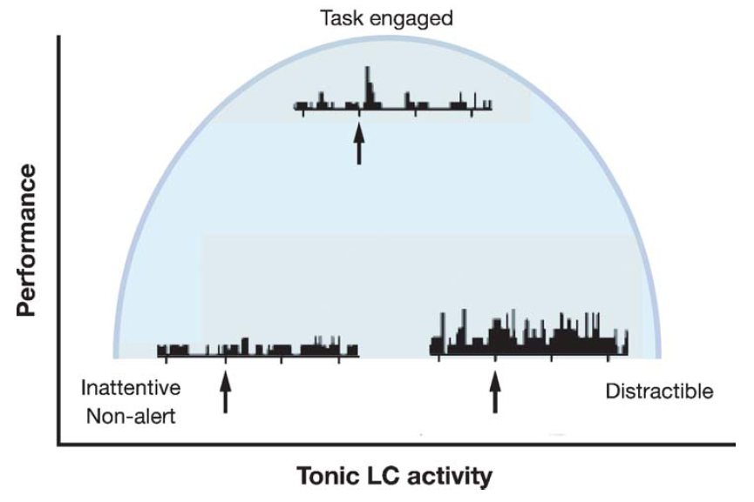
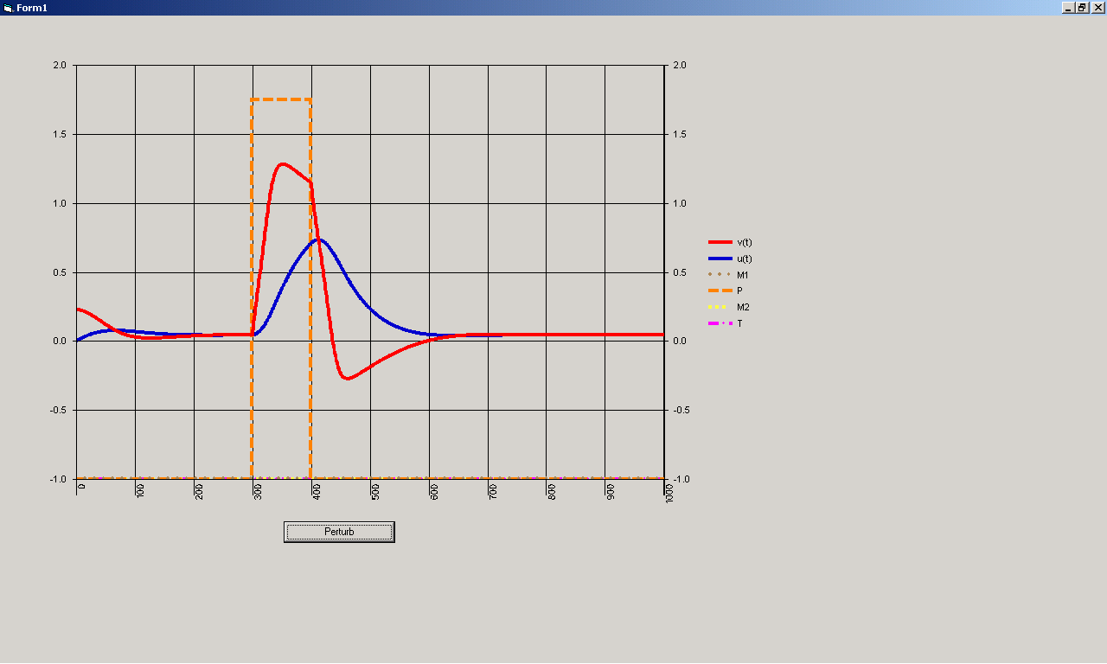
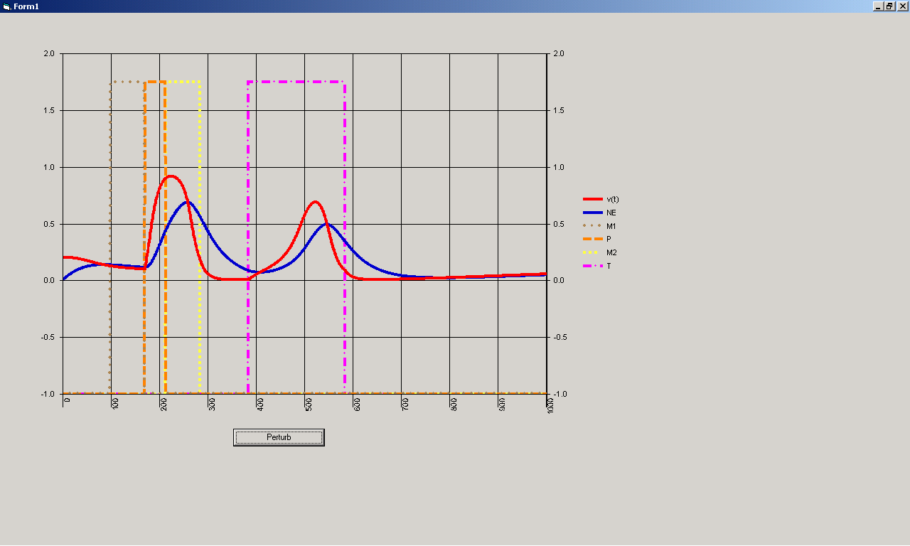
Subcortical AR and its refraction
One phasic response Two phasic responses

Slide 38
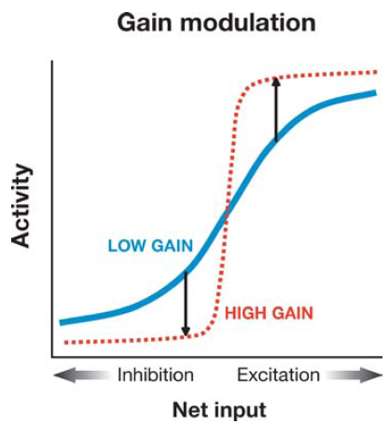
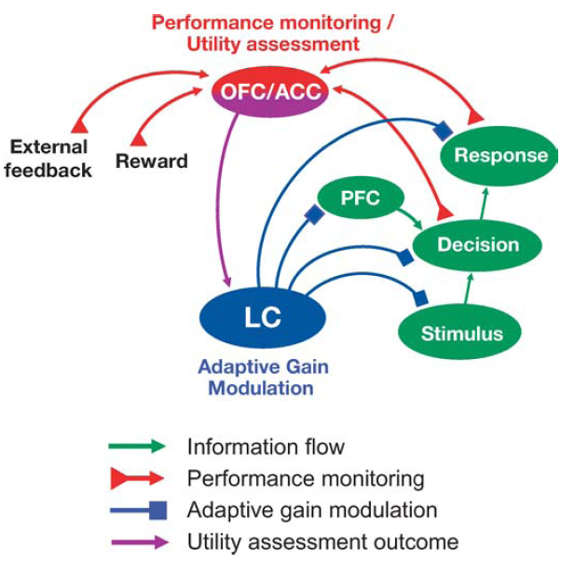
Astone-Jones and Cohen (2005)
Effect of gain modulation on nonlinear activation
function. The activation (or transfer) function
relates the net input of a unit to its activity state
(e.g., the firing rate of a single neuron or the mean
firing rate of a population). The function
illustrated here is given by activation

Slide 39
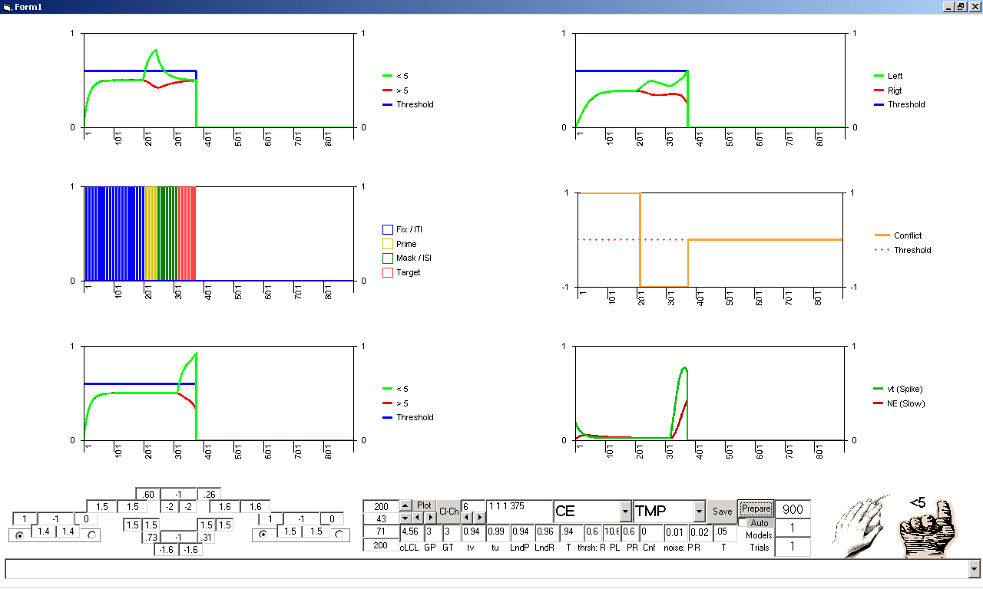
Unmasked, Congruent, Easy

Slide 40
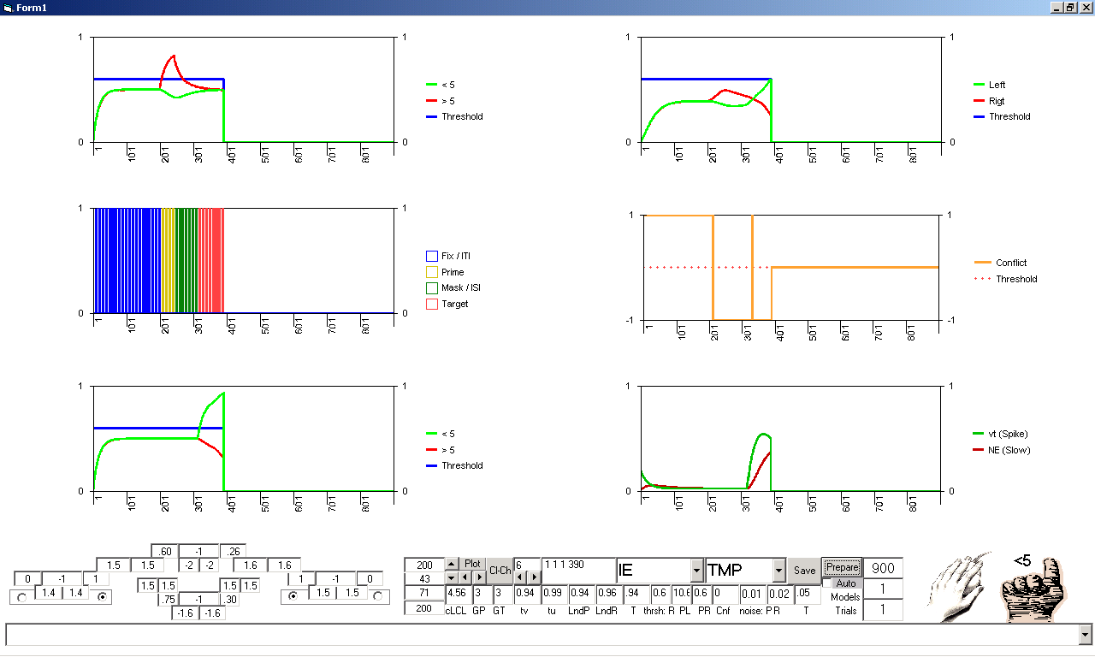
Unmasked, Incongruent, Easy

Slide 41
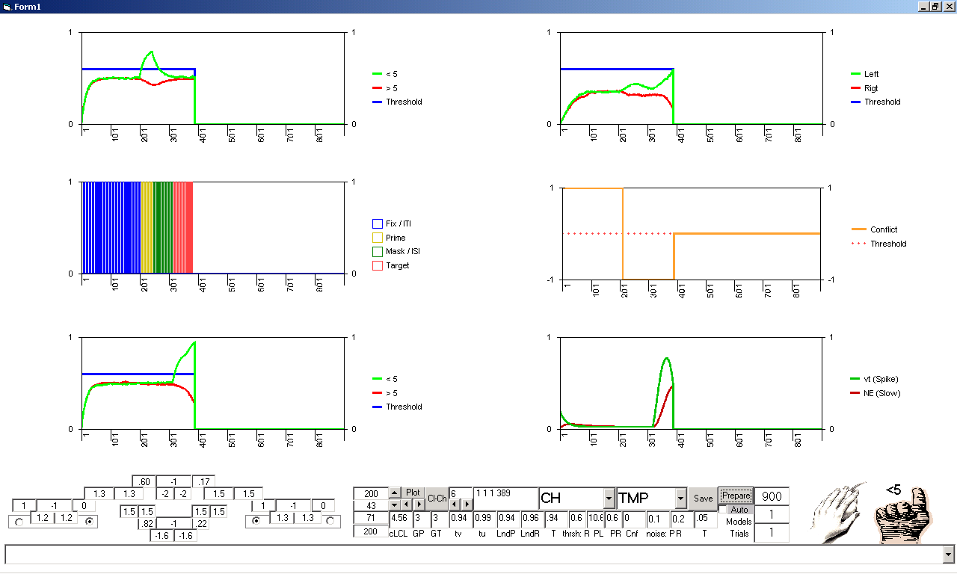
Unmasked, Congruent, and Difficult

Slide 42
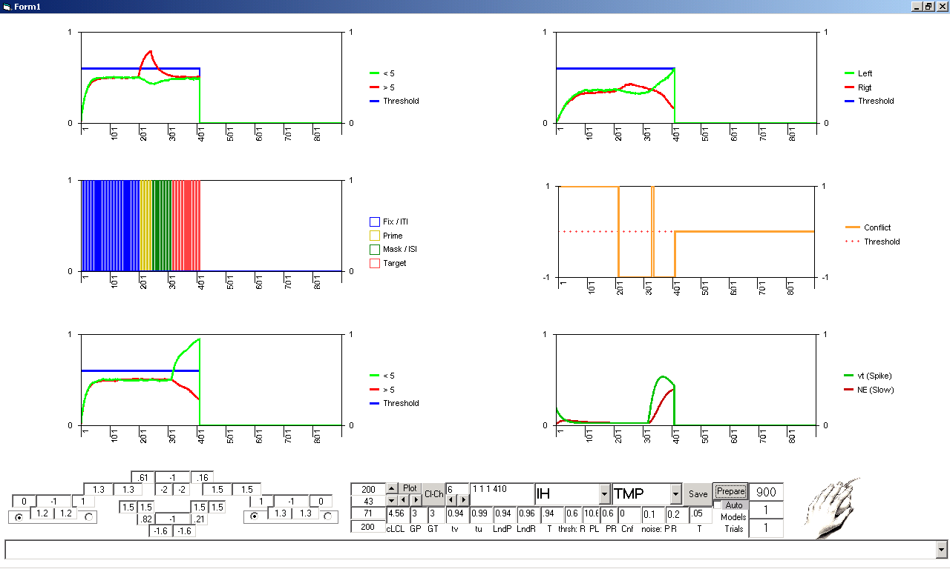
Unmasked, Incongruent, and Difficult

Slide 43
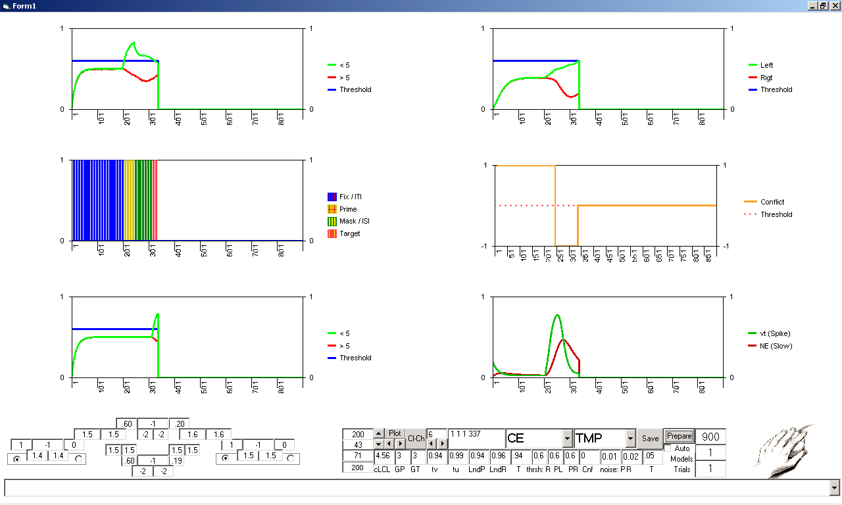
Masked, Congruent, and Easy

Slide 44

Masked, Incongruent, and Easy

Slide 45
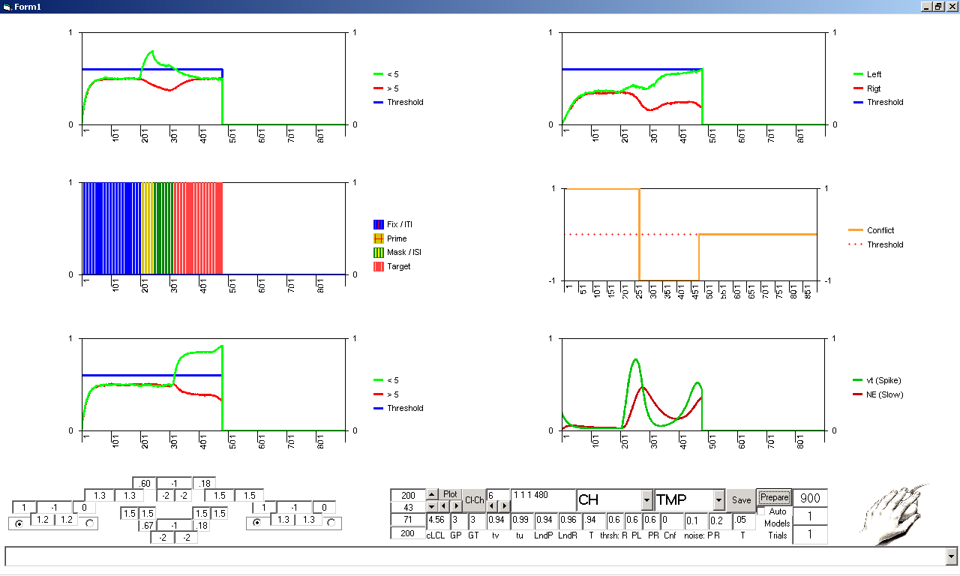
Masked, Congruent, and Difficult

Slide 46
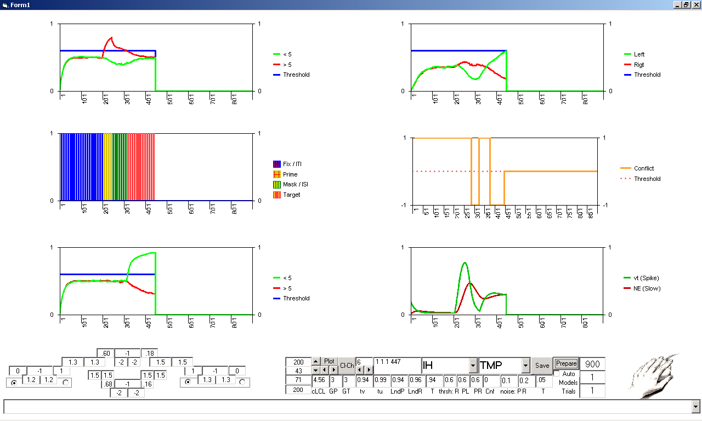
Masked, Incongruent, and Difficult

