Slide 1


Diminished brain connectivity and volume in HIV-infected addicts under ART and MMT
Ahmad Sohrabi¹, Jamil Abdolmohammadi², Shahin Fakhraei², Fereidun Malaei¹
¹University of Kurdistan, Sanandaj
²Medical University of Kurdistan, Sanandaj

Slide 2
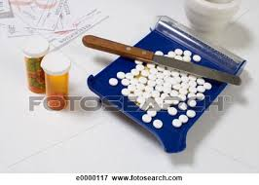

Introduction
The effects of HIV virus on the brain can be seen, even after antiretroviral treatment.

Slide 3
Current study
Brain imaging including Volumetric Brain Morphometry (VBM) and resting-state fMRI (rs-fMRI) have shown problems in their brain structures and connectivities.
We aimed our study to replicate previous studies by employing both VBM and rs-fMRI methods.

Slide 4
methods
A series of structural and functional images (5 minute resting state) were acquired from 40 individuals, 20 HIV-infected under ART and MMT and 20 non-clinical ones, using Siemens 1.5 tesla MR scanner.

Slide 5
Procedure
All images were preprocessed (i.e., spatial normalization with modulation, segmentation, and smoothing) using SPM12 and relevant toolboxes under Matlab.
The structural MRI images (axial, T1-weighted) were analyzed using VBM.
The BOLD images were analyzed for functional connectivities.

Slide 6
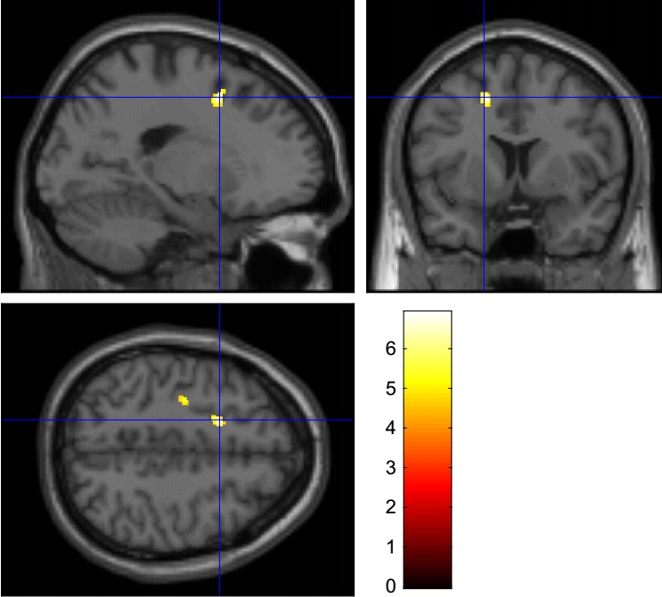
Results: VBM
The result of VBM analysis at second-level (t-test, p < 0.001, corrected) revealed a decreased volume in HIV-infected addicts compared to Control all over the brain.

Slide 7
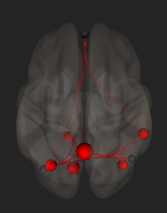
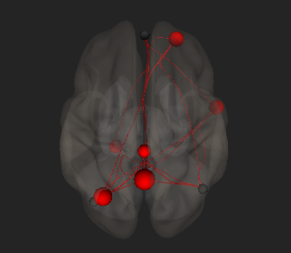
Results: ROI-Based
The ROI-to-ROI and seed-to-voxel maps (ALFF and fALFF, < 0.1 Hz frequency band) were compared between HIV-infected patients and the control group (applying p < 0.001, corrected).

Slide 8
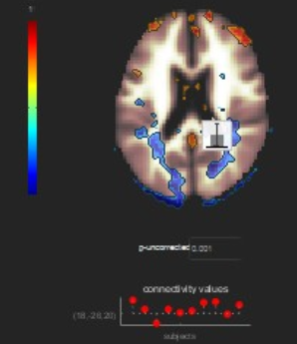
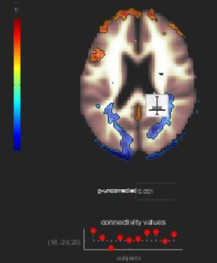
Results: voxel-based
Also, lower connectivity (spatial component with seed-to-voxel maps) was found, all over the brain, especially in default mode network.

Slide 9
Conclusion
The results of HIV-infected patients showed a decrease in brain volume which was mainly left-lateralized, and involved white matter.
The functional connectivity results also revealed differences between patients and control groups, but it was right-lateralized, especially in frontoparietal connections.

Slide 10
Thank You!
…From Our Crew!

