Slide 1
Control on Cognition
Proseminar Course
Ahmad Sohrabi
Carleton University
Cognitive Science Program
2003

Slide 2
Introduction
The current study tries to investigate the relationship between thinking styles and working memory,
and its implications for cognitive control and individual differences in information processing,
especially in goal-directed tasks

Slide 3
Cognitive Control
It has been suggested that Goal-related information must be:
appropriately selected for maintenance;
maintained for arbitrary lengths of time;
protected against interference; and 4) updated at appropriate intervals (e.g.Miller and Cohen 2001).
Baddeley (1986) included a specific sub-component, “the central executive,” responsible for utilizing goal-related information in the service of control.
In parallel, researchers (Bianchi 1922; Damasio 1985; Luria 1969), based on the clinical observation, found that patients with frontal lesions often exhibit impairments in tasks requiring control over behavior-the so-called “dysexecutive syndrome.”

Slide 4
In computational models
e.g. production system models, goal states represented in declarative memory are used to coordinate the sequences of production firings involved in complex behaviors (Anderson 1983). One critical feature of goal representations in production systems is that they are actively represented and maintained throughout a sequence of behaviors. Shallice (Norman and Shallice 1986; Shallice 1982; Shallice 1988) has relied upon the production system framework to put forth his Supervisory Attentional System (SAS) as a mechanism by which complex cognitive processes are coordinated and non-routine actions are selected.

Slide 5
In connectionist models, Cohen and colleagues have suggested that the active maintenance of context information is critical for cognitive control (Braver et al 1999; Cohen et al 1996; Cohen and Servan-Schreiber 1992).
They have defined context as any task-relevant information that is internally represented in such a form that it can bias processing in the pathways responsible for task performance.
Goal representations are one form of such information, that have their influence on planning and overt behavior.
Because context representations are maintained on-line, in an active state, they are continually accessible and available to influence processing. Consequently, context can be thought of as one component of WM.
Specifically, context can be viewed as the subset of representations within WM that govern how other representations are used.

Slide 6
Source of Control
On what basis is control recruited? It cannot be the case that one always knows before beginning to act whether a given task will require high levels of control.
Kahneman(1973) has argued, to the contrary, that it is often the actual attempt to perform a difficult task that leads to the recruitment of cognitive resources.
This appears consistent, for instance, with the finding that participants performing the Stroop task show greater interference on the initial one or two trials in each block than on subsequent trials in the series
(Henik, Bibi, Yanai, & Tzelgov, 1997).

Slide 7
What processes govern how and when control is withdrawn? With practice on some initially difficult tasks performance becomes increasingly automatic (e.g., Anderson,1982 ; Shiffrin & Schneider, 1977 ).
In the psychological literature, a number of studies have demonstrated clear distinctions that can be made between controlled processes and more automatic ones. These distinctions have been made in terms of factors such as processing speed, attentional requirements, and capacity (Posner & Snyder, 1975; Shiffrin & Schneider, 1977).
More contemporary studies have acknowledged that there is actually a continuum between controlled and automatic processing (Cohen, Dunbar, & McClelland, 1990; Kahneman & Treisman, 1984).

Slide 8
Reinforcement learning:
Neuroscientific method (e.g. Goldman-Rakik 1995 ; Shultz et al 1993)
Computational model (e.g. Sutton and Barto 1990 ; Montage et al 1996 ; Braver and Cohen, 2000).
Braver and Cohen have suggested that the role of dopamine in reward-prediction learning provide it with a pattern of activity dynamics that can simultaneously be exploited to "gate" information into PFC.
They have argued that this gating function of dopamine serves to both update context representations at task appropriate junctures while simultaneously protecting these representations from being disrupted by task-irrelevant inputs (e.g. interference from distracktors).

Slide 9
Conflict as the source of control
The potential usefulness of conflict as a basis for the regulation of control was recognized early on by Berlyne (e.g., 1960 ), working within an information-theoretic framework.
In the production system architecture known as Soar Newel and colleagues (Laird, Newell, & Rosenbloom, 1987 ) proposes that problem-solving algorithms are triggered by the occurrence of impasses, one important class of which involves conflicts between simultaneously selected but incompatible productions.

Slide 10
Conflict appears to play a similar role in the theory of control put forth by Norman andShallice (1986) . Here, a supervisory attentional system (SAS) is understood as monitoring the processes by which action schemas are routinely selected, intervening when these contention scheduling processes prove inadequate.
A more explicit instance is provided by the work of Schneider and Detweiler (1987 , 1988 ). This specifies a connectionist-control framework within which a central control module regulates the exchange of information among a number of domain-specific processing modules. In this scheme, input from control is recruited when conflict occurs between messages converging on a single module.

Slide 11
Botvinik et al (2001) proposed a model in which the demand for control may be evaluated in part by monitoring for conflicts in information processing. This hypothesis is supported by data concerning the anterior cingulate cortex, a brain area involved in cognitive control, which also appears to respond to the occurrence of conflict.

Slide 12
Cognitive Neuroscientific Evidence for the Detection of Conflict
Anterior Cingulate Cortex
The ACC, situated adjacent to the corpus callosum on the medial surface of the frontal lobe, is widely believed to play a role in cognitive control (e.g., 'Esposito et al., 1995 ; LaBerge,1990 ; Mesulam, 1981 ; Posner & DiGirolamo, 1998 ).

Slide 13
Two system of thinking
Dennett (1987) Anderson (1990) Marr (1982) Newell (1982) Epstein (1994) Stanovich and West (1998) Classification of
the algorithmic/design level and the rational/intentional level of analysis in cognitive science.
The latter provides a specification of the goals of the system’s computations (what the system is attempting to compute and why).
The former goals of the system, beliefs relevant to those goals, and the choice of action that is rational given the system’s goals and beliefs (Anderson 1990; Bratman et al. 1991; Dennett 1987; Newell 1982; 1990; Pollock 1995).
Even if all humans were optimally rational at the intentional level of analysis, there may still be computational limitations at the algorithmic level (e.g., Cherniak 1986; Goldman 1978; Oaksford & Chater 1993; 1995).

Slide 14
Dual mechanism theories make a distinction between: formal, deliberate, rule-based processes and implicit, unschooled, automatic processes and predict the involvement of two different brain systems in human reasoning depending on which system is engaged.
dual mechanism theories come in various flavours that differ on the exact nature and properties of these two systems. Theories differentially emphasize explicit and implicit processes (Evans & Over, 1996), conscious and preconscious processes (Stanovich & West, 2000), formal and heuristic processes (Newell & Simon, 1972), and associative and rule based processes (Goel,1995; Sloman, 1996).
Individual differences in actual performance (despite equal rational-level competence) due to differences at the algorithmic level. for the normative/descriptive gap (Stanovich and West, 2000).

Slide 15
Current Study
testing the significance of a hypothesis is easy, finding a ...
I haven't found my favorite hypothesis yet (analytically/rationally)
but, heuristically/intuitively, I feel it is possible to find it latter.
General Question: to what extent WM is cognitively penetrable and penetrative ?
The relationship between thinking style and Working Memory

Slide 16
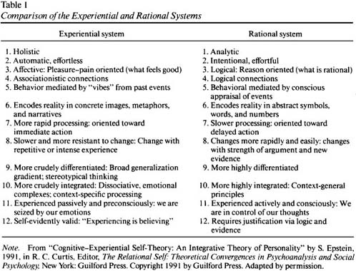
Thinking Style

Slide 17
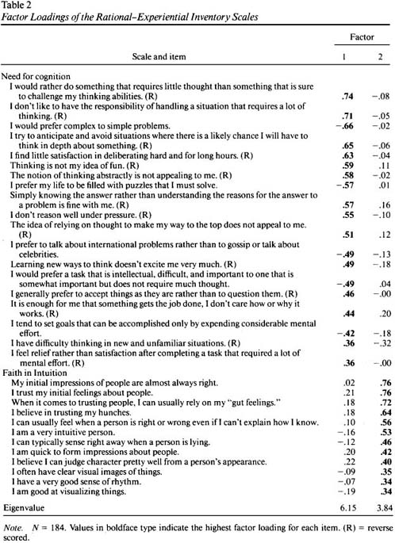

Slide 18
Framing Effect:
Tversky and Kahneman (1981) presented the following problem:
Imagine that the United States is preparing for the outbreak of
an unusual Asian disease, which is expected to kill 600 people. Two
alternative programs to combat the disease have been proposed. Assume
that the exact scientific estimates of the consequences of the
programs are as follows:
If Program A is adopted, 200 people will be saved.
If Program B is adopted, there is a 1/3 probability that 600 people
will be saved and a 2/3 probability that nobody will be saved.
Which of the two programs would you favor?
Now consider this problem with a slightly different verbal description
of the outcomes:
If Program C is adopted, 400 people will die.
If Program D is adopted, there is a 1/3 probability that nobody will
die and a 2/3 probability that 600 people will die.
Which of the two programs would you favor?

Slide 19
The example above clarifies the structure of the Asian-disease task: Participants have to choose one of two options, where one option offers a sure outcome (sure option) and the other option offers a risky outcome with identical expected value (risky option). The reference point is manipulated in such a way that the situation appears to incorporate either gains or losses.
The probabilities (e.g., 1/3 for risky gain, 2/3 for risky loss) and the payoffs (e.g., 200 and 600 for gains, 400 and 600 for losses) are explicitly stated.
The general hypothesis of framing is that there is a tendency for risk aversion for positively framed problems and a tendency for risk seeking for negatively framed problems. This tendency is termed the framing effect.
"Presenting outcomes as gains tends to induce risk-aversive
choices, and presenting outcomes as losses tends to induce risk-seeking choices.
This tendency is not stronger for losses than for gains."

Slide 20
Adopted from Wang 1996
1. Imagine that 600 people are infected by SARS. Two alternative medical plans to treat the disease have been proposed. Assume that the exact scientific estimates of the consequences of the plans are as follows:
If plan A is adopted, 200 people will be saved.
If plan B is adopted, there is a one-third probability that all 600 people will be saved, and two-thirds probability that none of them will be saved.
Which of the two plans would you favor?
2. Imagine that 600 people are infected by SARS. Two alternative medical plans to treat the disease have been proposed. Assume that the exact scientific estimates of the consequences of the plans are as follows:
If plan A is adopted, 400 people will die.
If plan B is adopted, there is a one-third probability that none of them will die, and two-thirds probability that all 600 people will die.
Which of the two plans would you favor?

Slide 21
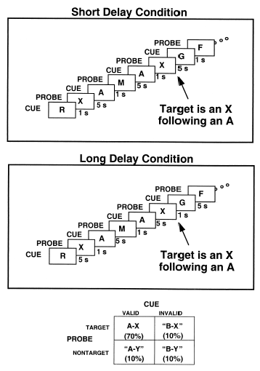
Working Memory

Slide 22
In the AX-CPT, subjects observe single letters presented one at a time at the center of a visual display, and are required to respond to a target probe letter (X) but only when it follows a designated cue (A). Performance is dependent on the representation and maintenance of context information, insofar as the correct response to the probe depends on knowledge of the previous cue (A or not-A).
In standard versions of this task, target sequences (e.g., A-X) are typically of low frequency (e.g., 20%), and stimuli are presented at a relatively fast rate (every 1-2 seconds).

Slide 23
In the current study at least two aspects of the task will be modified:
delay between cue and probe in order to vary the demand on active memory changing the frequences of target and non-target to examine the role of context in both biasing response competition situations, and inhibiting dominant response tendencies.
This should produce two effects:
1) a prepotent tendency to make a target response to an X probe, irrespective of the preceding cue; and
2) an expectancy to make a target response following an A cue, irrespective of the subsequent probe.

Slide 24
In such a situation, response competition effects can be examined by comparing performance in nontarget trials where the context information conflicts with the probe (BX and AY, where "B" corresponds to any non-A stimulus, and "Y" to any non-X) against performance in a third type of trial (BY) in which context agrees with the probe.
1: context representations of the cue should facilitate appropriate responses while inhibiting inappropriate ones. Thus, following an A cue, context should act to prime the target response pathway. On AX trials, this should facilitate robust responding. However, on AY trials, the effects of context should have a negative consequence. effects of context will be most apparent in BX and AY trials, since these are the conditions involving response competition.
2: As mentioned, context is actively maintained. Thus, strong representations of context should be sustained across the delay period between cue and probe. The delay manipulation provides an opportunity to examine this prediction. so this in BX trials cause a delay-related decrement in performance. In contrast, for AY trials, decaying representations should lead to a delay-related improvement in performance.

Slide 25
Questions or Hypotheses
1: the relationship between Style, NFC,Open-mindness, Framing, and Task Switching===>Creativity
2: the relationship beteen WM performance normative (rational/)/heuristic(intuitional/experiential) normative good statician not framed Levels of the task by occurnce percents of CPT-AX levels 25 50 75 , N-back & delay and its interaction with general system=====> Cognitive Control Latter: content and task=>reasoning & decision making
3: the performance change gragually iand its interacton with style and ability==> using knowledge and based on the relationship between items (coopration based on conflict monitoring)
4: a search task to see the two WM LTM system effects on it (directed attention) or set (activate letter then see its effect on WM AX)
5: to what extent conflict-monitoring is involved? does it depend just on current task or general state of cognition e.g. prediction, experience and reasoning (normative)
6: Word reading strategies the use of two route (semantic mediated or directly) are the two route for thinking=> fMRI PFC Parietal or even two LTM:LTM & Predictive LTM ?
7: if the reward (utility theory?) is the source of control, what is the relationship between the win/loss in problems and the pattern of control on/from WM? exitation is reward even in loss?
8: making a framing effect in the NNet? using reward and/or punish to investigate the nature of framing

Slide 26
Variables
moderative variable:
IQ- g-factor
WM capacity-.g. WISC
academic knowledge of statistic- student whose major is statstic or have taken statistic course

Slide 27
Independent Variables:
1: thinking style (cognitive psychological systems): analytic (rational/huristic) vs expriential (intuitive/holistic)
in other word use of strategies ---> inventory (e.g. Epstin, 1994,1998)
2: statistcal normative ------> objective measurement
3: framing (Gain/Loss or Risk) ------> Fear and Punish as well as reward
also
4: Open-Minded Perspective Swiching ....(Stanowich & West) ----> Creativity
5: NFC (Smith & Lewin ; Cacioppo & Petty) -----> Motivation
6: Task Switching and Set-----> facilitation and inhibition

Slide 28
dependent variables:
1: Top-down attentional control on WM: performance in CPT-AX (facilitation and inhibition)
2: Bottom-up information to WM: Performance in search, number stroop and gestalt (holistic)
also
3: Task Switching e.g. CPT-AX --> CPT-MZ
4: Teasoning and decision making
operational definition of Dependent variable:
Error and RT in an Contiuous Performance Test (CPT)

Slide 29
Outgoing information
(Processed) e.g. motor, thoughts, emotions
Monitoring system (all the Brain especially ACC which is sensitive to conflict and LC for gating WM )
ABased
LTM
Saved
information
(HCMP)
WM
sustained
information
(PFC)
WBased
LTM
Saved information
(Parietal)
A Continuum:
Division of Labor
Incoming information
e.gStimuli,motives,arosal

Slide 30
Discussion
A return to the old question? intelligence, personality, motivation, rationality levels of consciousness, levels of memory, mental models
Interaction between different part of brain through a kind of constraint satisfaction may be relate to consciousness, most activated one at a time but relates to rest.
If there is need to separation and also integration how it is resolved?
Does investigation on LTM and WM relate it?

Slide 31
Latter extensions
+CogLoad and see the effect of set on load or task
+uncertainty (in game or gamble stuation) e.g. not prefering uncertain situation is the result of predicted uncontrol ? ...
+verbal and spatial WM
+constraint satisfaction related to consciousness, most activated one at a time but relates to rest. If there is need to seperation and also integration how it is resolved? does LTM and ... solve it?
+related to Dynamic and Rule-based- is it a key to find the relationship
+whether this differences are due to LTM or current engaged mechanisms and also the debate of causality and intention
+: using these findings in developing a connectionist model of cognitive control...> autonomus
if gating control is raised by conflict still probably managed by another mechanism (prediction/evaluation/decision?>stimuli-history-dependent alteration Small et al 01
low pleasure(+reinforcement) and/or fear(-punish) or inability to relate task/stimuli to + -
Depression and other mental disorders creativity culture
Attitude Prejudice interpretation...cross-culture warm-cold item->hot stimuli e.g. valuable/ more weight/attention drawer/tabo/ Age

