Slide 1



Attaching Meaning to Symbols in a Short Time: Numerical Representation and the Symbol-Grounding Problem
Ahmad Sohrabi, Robert L. West, Andrew Brook, and John Logan
Institute of Cognitive Science
Carleton University
of 13

Slide 2
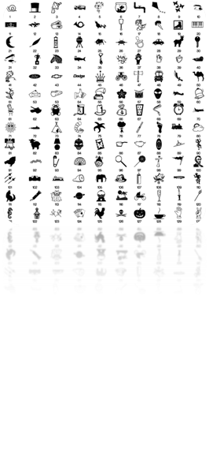

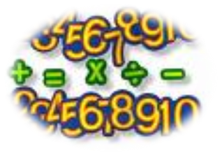
Introduction
How are symbols connected to meaning?
It has been proposed that symbols are learned by being linked to their corresponding non-symbolic representations (e.g., Harnad, 1990).
of 13

Slide 3






Numerical Representation and Mental Number Line
(Buckley & Gillman, 1974; Dehaene, Bossini, & Giraux, 1993)
of 13

Slide 4
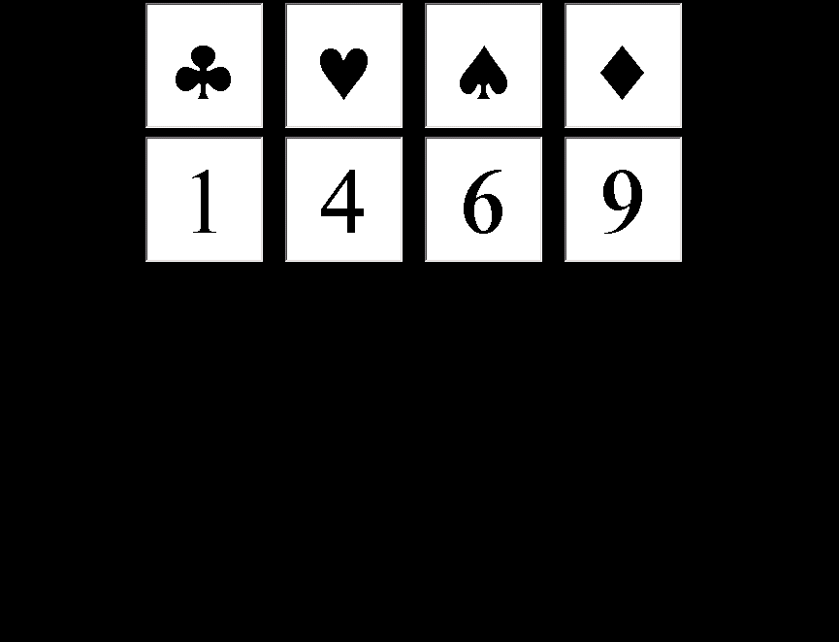
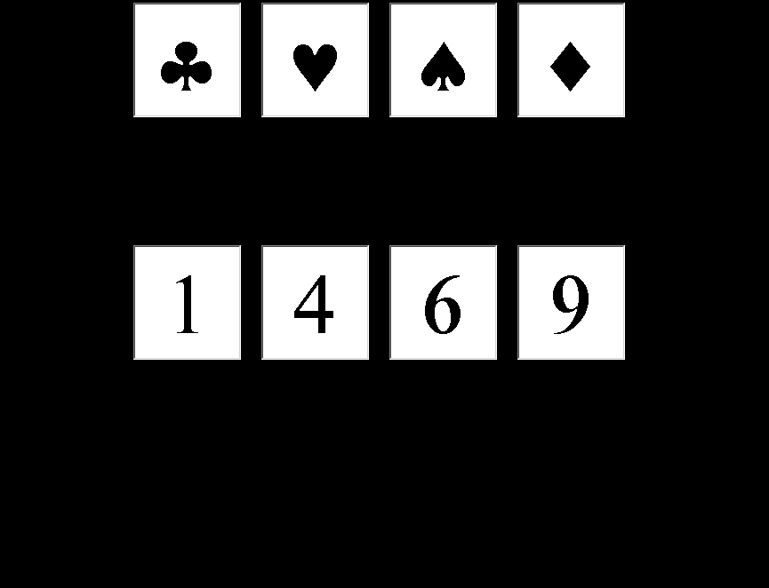
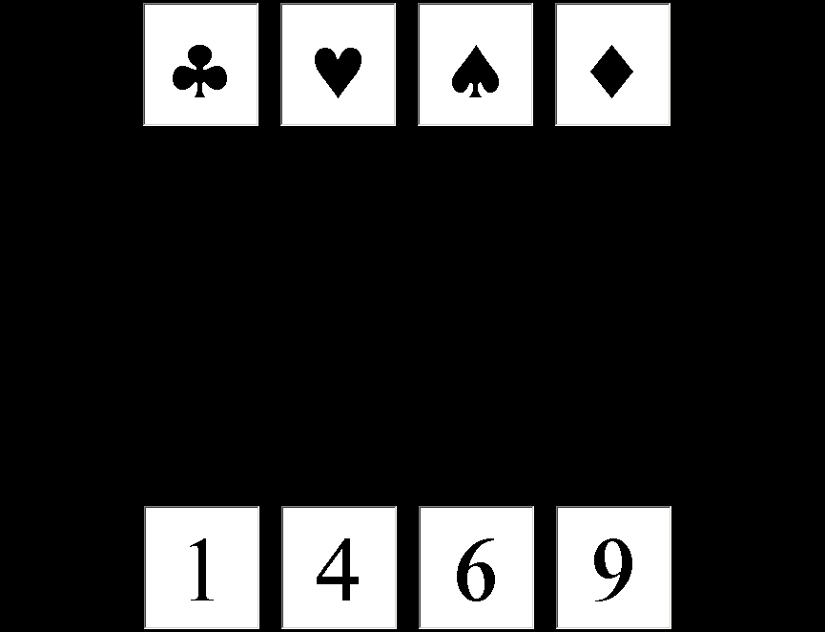
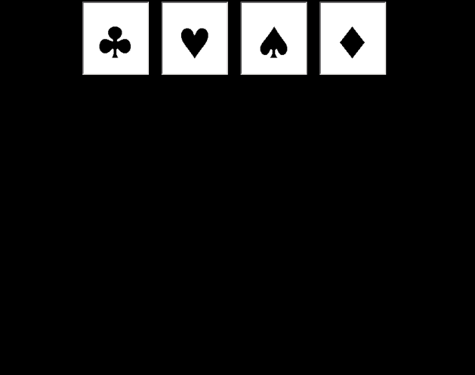
The Current Study
<number> of 13

Slide 5
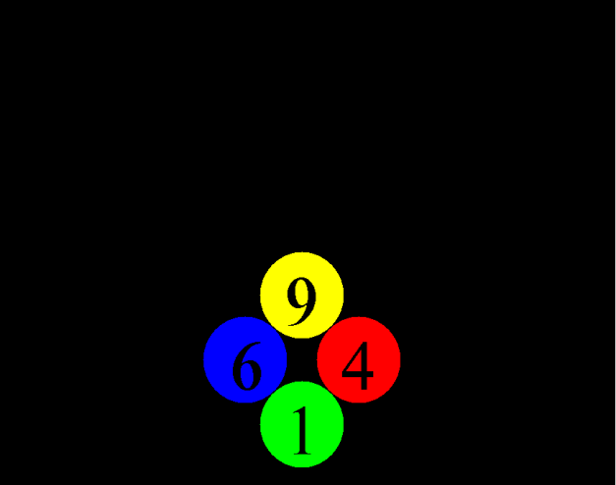
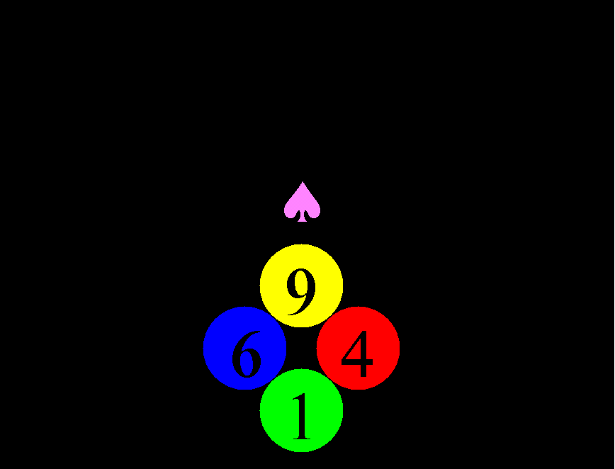

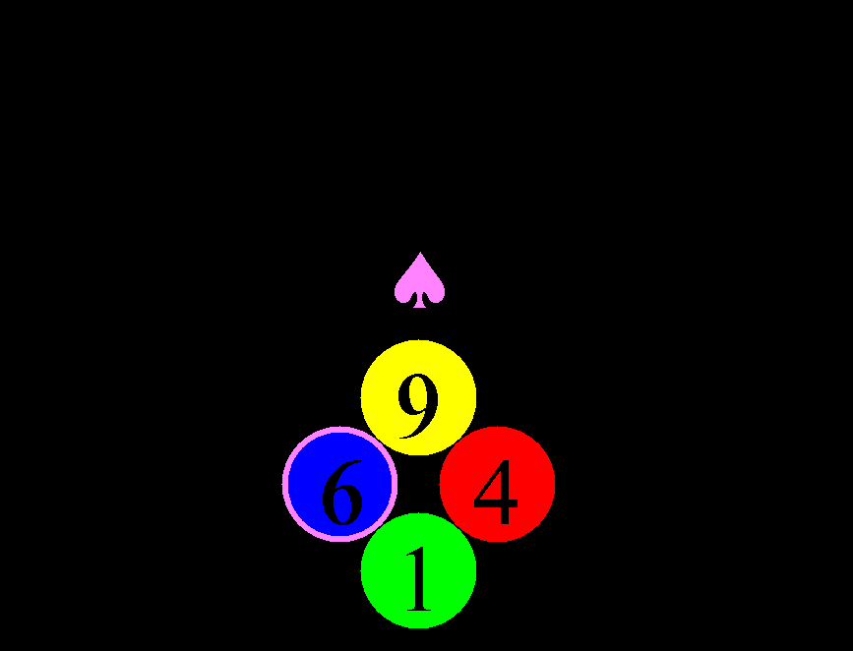
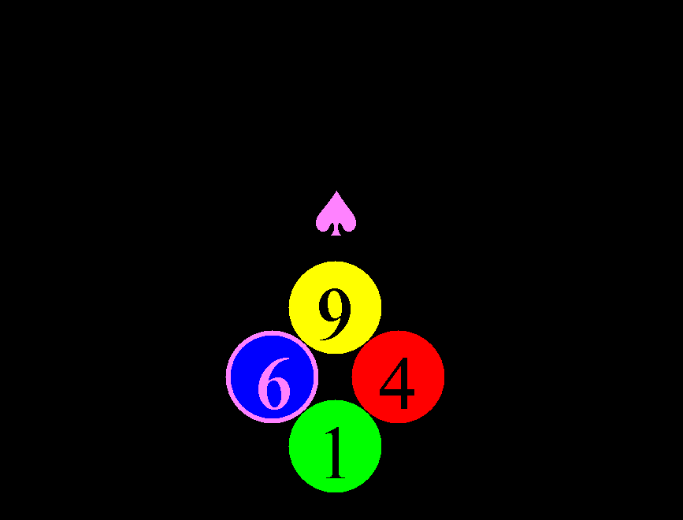
Test and Feedback (a correct trial)
An example of a correct trial (4s). The top-left image for 1s, followed by the top-right image until the participant pressed a button that highlighted the selected option. Then the correct option was shown by highlighting the corresponding number.
of 13

Slide 6

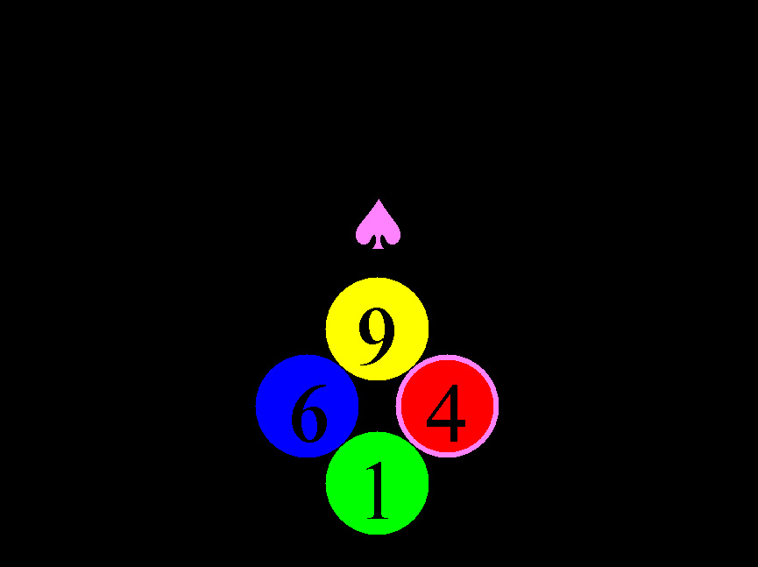
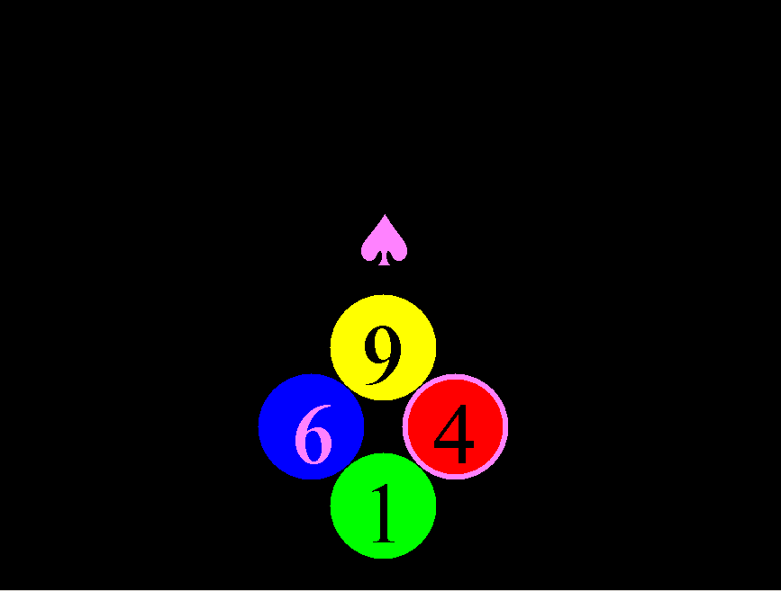
Test and Feedback (an incorrect trial)
of 13

Slide 7
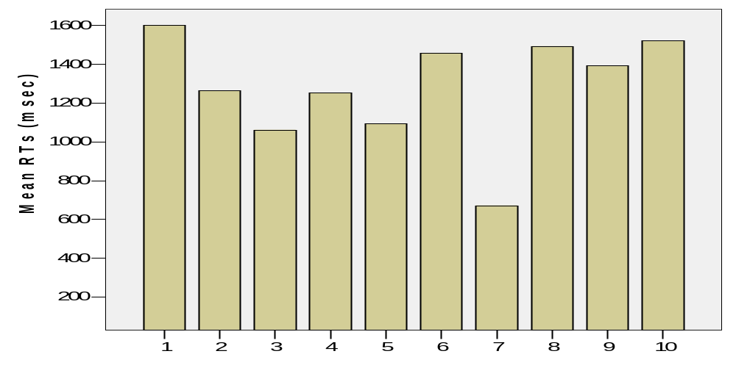
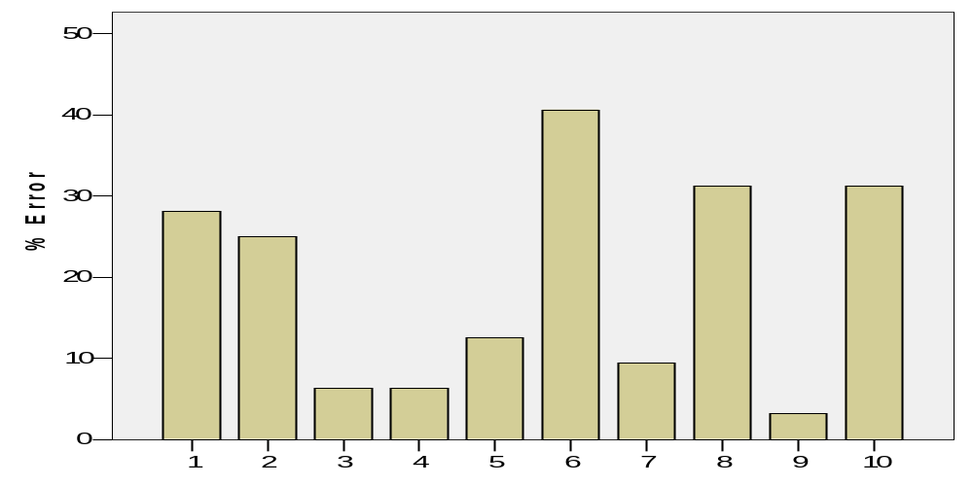
Experiment 1: RTs and Errors in 32 trials (eight blocks) for each participant
Slow RTs reflect emphasis on accuracy versus speed.
Participants
of 13

Slide 8
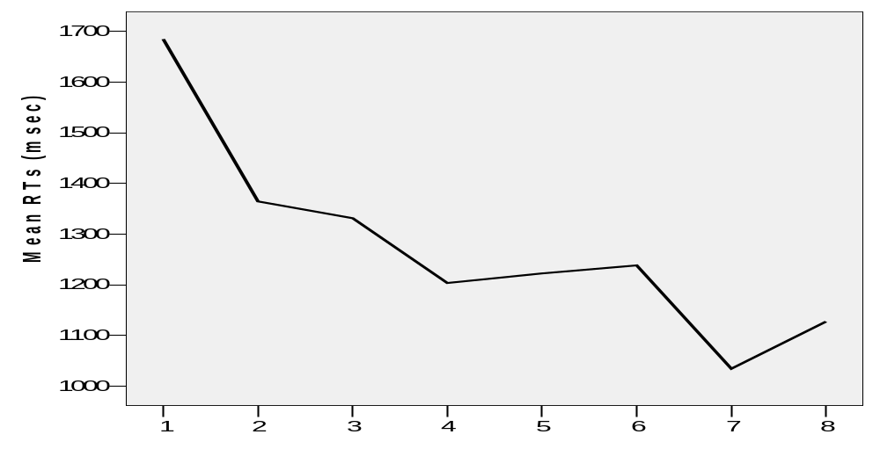
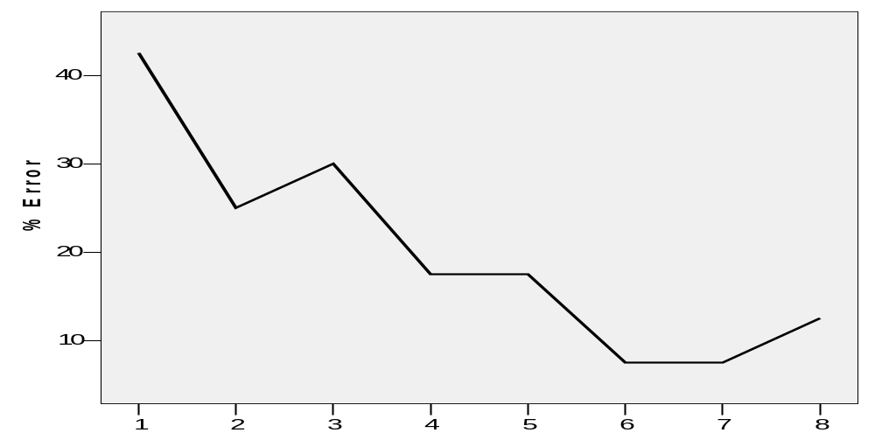
Experiment 1: Mean RTs and Errors in the eight blocks
RTs decreased by time.
Errors occurred especially in earlier trials.
Blocks
of 13

Slide 9
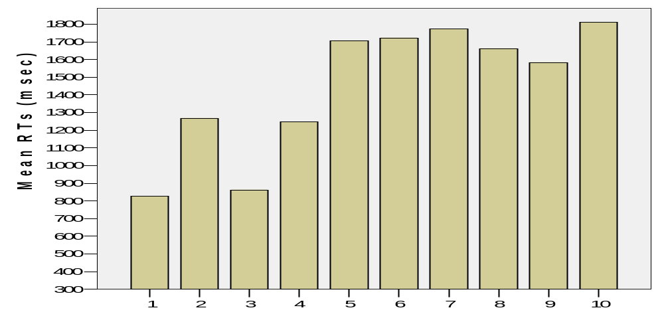
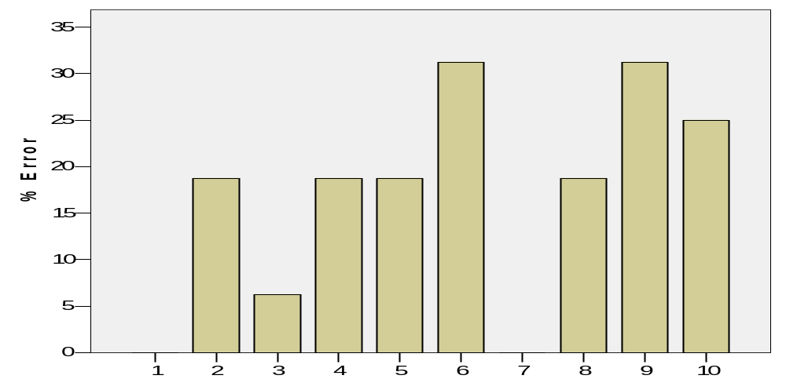
Experiment 2: Mean RTs and Errors in 16 trials (four blocks) for each participant
Here participants had less errors, compared to Experiment 1, as they had more time for memorizing.
Participants
of 13

Slide 10
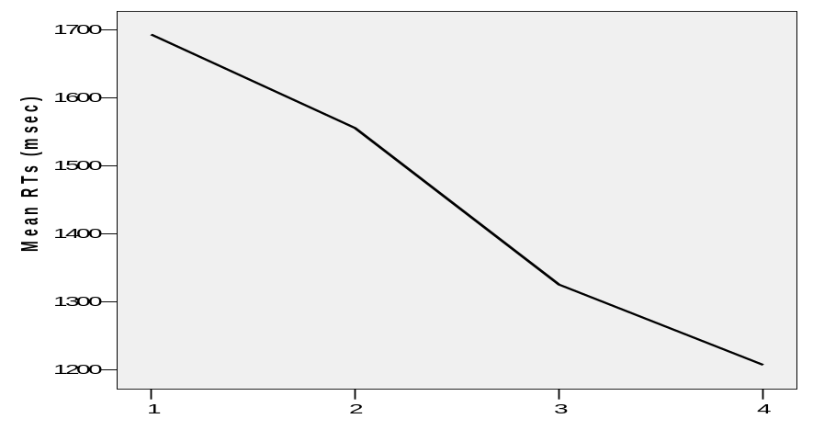
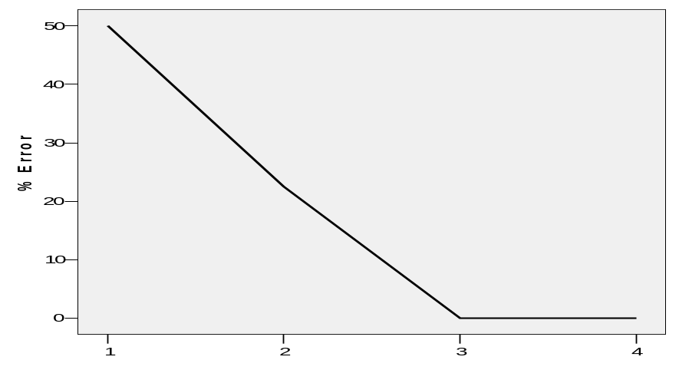
Experiment 2: Mean RTs and Errors in the four blocks
Note a faster learning compared to Experiment 1, as a result of extra time for memorizing.
Blocks
of 13

Slide 11
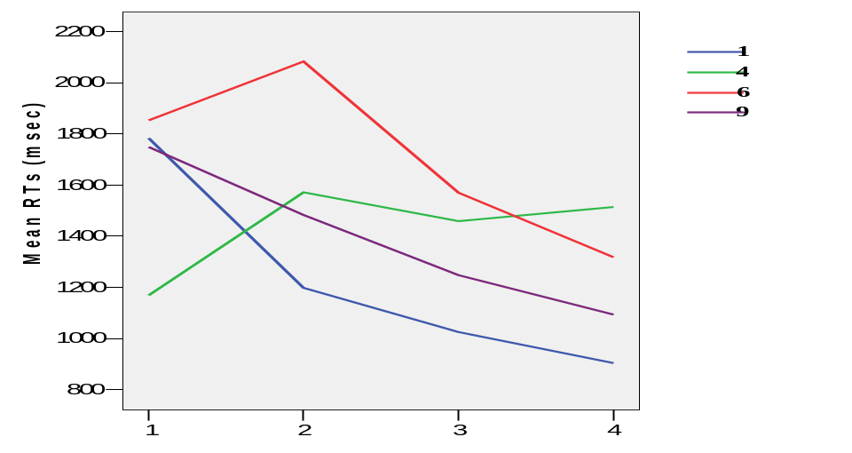
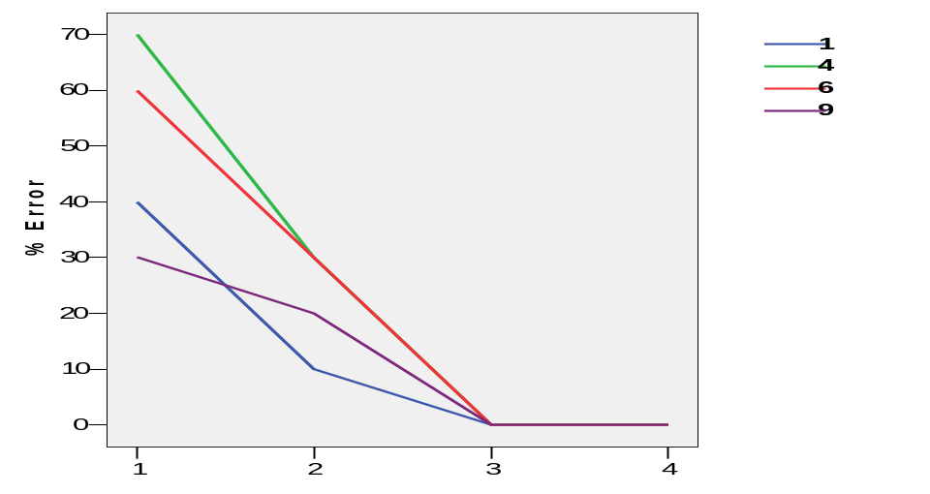
Experiment 2: Mean RTs and Errors in the four blocks for each symbol-number map
Experiment 2: Mean RTs (Top) and % error (bottom) in the four distance levels, for each block separately.
Both graphs show the distance effect in memorizing.
Blocks
of 13

Slide 12
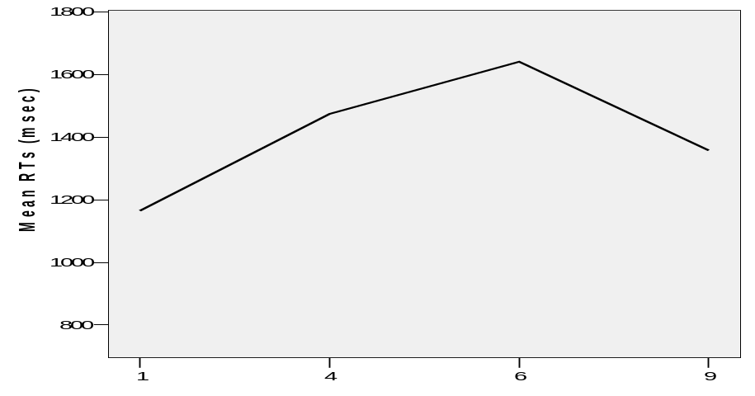
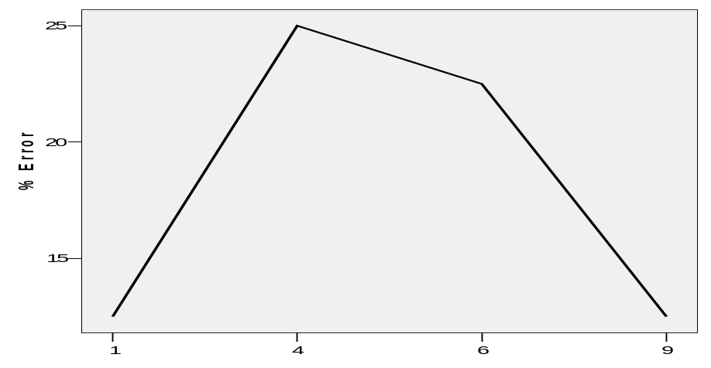

Experiment 2: Mean RTs and Errors in all blocks for each symbol-number map
ANOVA on RTs in the four levels of distance factor showed a sig. distance effect (F=3.915, p=.019) and a quadratic trend (F=9.910, p=.012), meaning that participants were faster in trials with “far” compared to “close” numerical distance from five.
A similar result was found for errors, showing a marginally sig. distance effect (F=2.603, p=.073) and a sig. quadratic trend (F=6.688, p=.023).
of 13

Slide 13
Discussion
Apparently, participants categorized the numbers according to their distance from five without being asked to do so in this task.
Harnad (1990):
  Symbolic representations must be grounded bottom-up in nonsymbolic representations of two kinds: (1) "iconic representations" , which are analogs of the proximal sensory projections of distal objects and events, and (2) "categorical representations" , which are learned and innate feature-detectors that pick out the invariant features of object and event categories from their sensory projections.
The fact that human can connect symbols to previous representation easily and quickly, may imply that “symbols are grounded” by a quick learning mechanism (in the brain) for valuation and categorization.
References
Buckley, P. B. & Gillman, C. B. (1974). Comparison of digits and dot patterns. Journal of experimental psychology, 103, 1131–1136.
Dehaene, S., Bossini, S., & Giraux, P. (1993). The mental representation of parity and number magnitude. Journal of experimental psychology: general, 122, 371-396.
Harnad, S. (1990). The symbol grounding problem. Physica D: Nonlinear Phenomena, 42, 335–346.
of 13

