Slide 1


Positive and Negative Congruency Effects in Masked Priming
Ahmad Sohrabi
Department of Psychology, University of Kurdistan
& Carleton Cognitive Modeling Lab
Robert L. West
Department of Psychology & Institute of Cognitive Science, Carleton University
& Carleton Cognitive Modeling Lab
3rd International Conference of Cognitive Science, Tehran, Iran
Notes:
I am going to present a summary of my thesis. Here is the title …

Slide 2


Introduction
In priming, a masked/unmasked stimulus (prime) can affect the processing of the following stimulus (target).
Congruent
< ###### <
< ###### >
Incongruent
task
Prime Mask Target
43 ms 71 ms 200 ms
< >
Notes:
In my study I have used priming and masking techniques. So, I am briefly saying what the priming and masking are. In priming a masked or unmasked stimulus (called prime) can affect the processing of the following stimulus (called target). For example, the task could be to press a right key when the target is a happy face and to press the left key when the target is a sad face. The prime, mask, and target are presented in order. Here is an example of a congruent trial. The prime is presented, followed by a mask, and the mask is followed by the target. The stimuli are presented at the same location and because the prime is presented briefly and followed by the mask, the prime is not visible but it still can facilitate the decision on the target. The trial could also be incongruent. Here the prime is a sad face but the target is a happy face. Two opposite effects in priming:
Positive Congruency Effect (PCE); congruent trials are faster than incongruent.
Negative Congruency Effect (NCE); incongruent trials are faster than congruent!

Slide 3
Priming effects: PCE & NCE
  Two opposite effects in priming:
  1. Positive Congruency Effect (PCE); RTs in congruent trials are faster than incongruent.
    (found using short Prime-Target SOA)
  2. Negative Congruency Effect (NCE); RTs in incongruent trials are faster than congruent!
    (found using long Prime-Target SOA)
PCE NCE
Congruent
Incongruent
Reaction Times (RT)
Condition A Condition B

Slide 4
Goals
Push the envelope for masked priming with new stimuli
Develop a neural cognitive model that can account for the wide variety of effects in this area

Slide 5
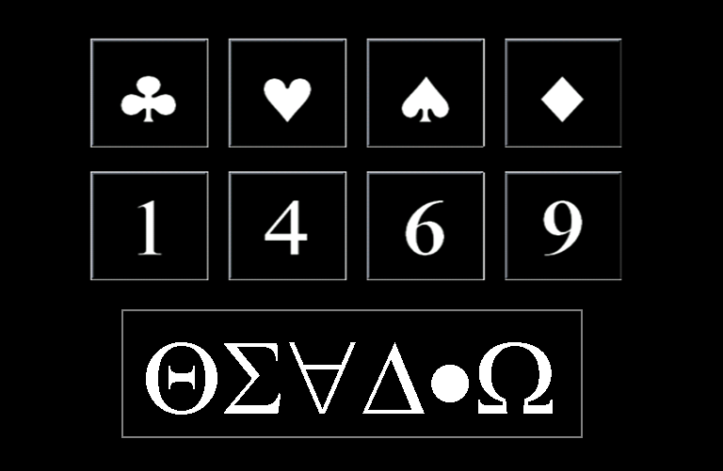
The Experiment (symbolic representation)
Far (from 5)
Can recently learned symbols produce priming effects?
Training and priming phases
The priming task was to press the left key for numbers <5 and the right key for numbers >5.
Two conditions in the priming task:
  Symbol-Number
  Number-Number
Close (to 5)
Prime or Target
Mask
Stimuli in the Experiment(s)
Notes:
Experiment 2. This experiment and following ones tested the factors involved in priming in a symbolic representation domain; well-learned vs. recently learned symbols. These are the stimuli: playing card symbols and Arabic numeral symbols as the prime or target and irrelevant symbols as the mask. There was a training phase and a priming phase. In the training phase, participants memorized these symbols as numbers. They were trained, and tested, to associate each symbol to a number and to treat the symbols as numbers in the priming phase. There were two types of trials. In Symbol-Number, a symbol primed a numeral and conversely in Number-Symbol, a numeral primed a symbol. The task was to press the left key for numbers less than 5 and the right key for numbers greater than 5 (including the symbols).

Slide 6
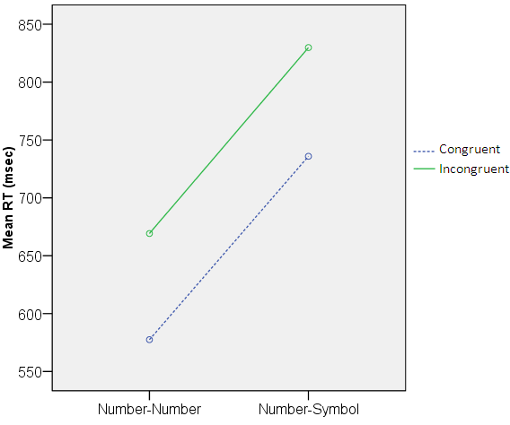
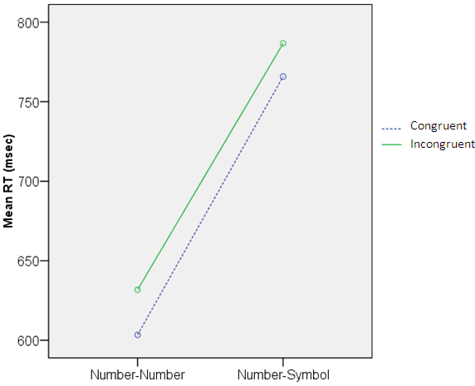
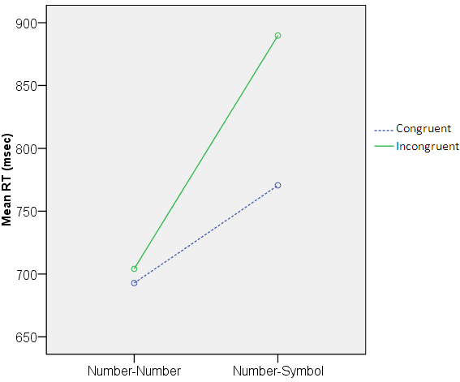
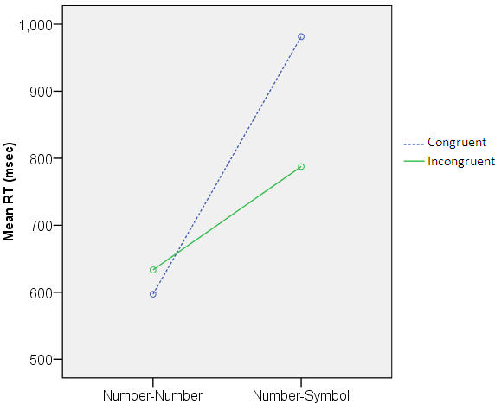
Experimental results: Distance and Type
Far Prime-Far Target Close Prime-Far Target
Far Prime-Close Target Close Prime-Close Target
PCE
NCE
Notes:
Here is the result for Number-Number and Number-Symbol conditions and different distances separately. As you see, there was a significant PCE in Number-Number at Far prime-Far target trials and at the other extreme, a significant NCE in Number-Symbol at Close prime-Close target trials. So, in general when the prime and target were easy or had stronger representation they were processed faster than when the prime and target were hard or had weaker representation.

Slide 7
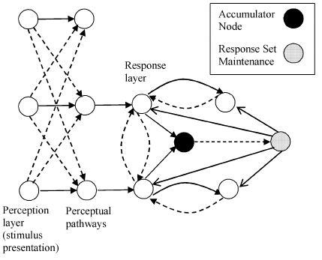
Previous Models
Bowman, Schleghecken, & Eimer (2006) is the only model that produces both PCE and NCE
Weaknesses
  AI inspired neural network model
  Not neurally or cognitively plausible
  Does not reproduce some core findings

Slide 8
Modeling Goals
Able to model a wide variety of effects with minimal and realistic parameter changes
Create a model that is neurally plausible
  Based on established neural mechanisms and algorithms
Create a model that integrates basic cognitive mechanisms in a plausible way
  It consists of different layers that are shown in the following slides: Input layer (IL), representation layer (RL), alert attention layer (AA), cognitive layer (CL) and motor layer (ML).

Slide 9
Different types of connections
  Excitatory connection 
  Excitatory crosstalk -
  Self excitation ☹
  Inhibitory connection •-•
  Modulatory connection −♦

Slide 10
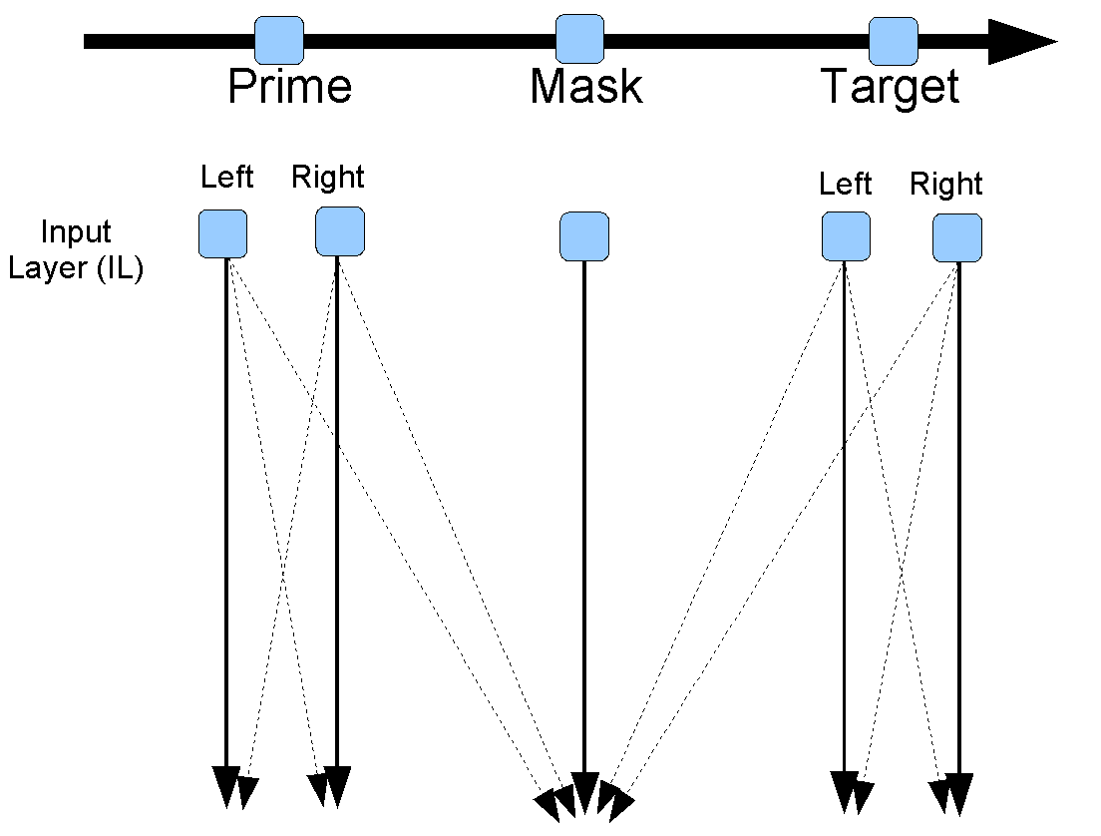

Slide 11
Weights determined by the relevance of the input for the
task

Slide 12
Weights determined by the relevance of the input for the
task
Projects to representation layer

Slide 13
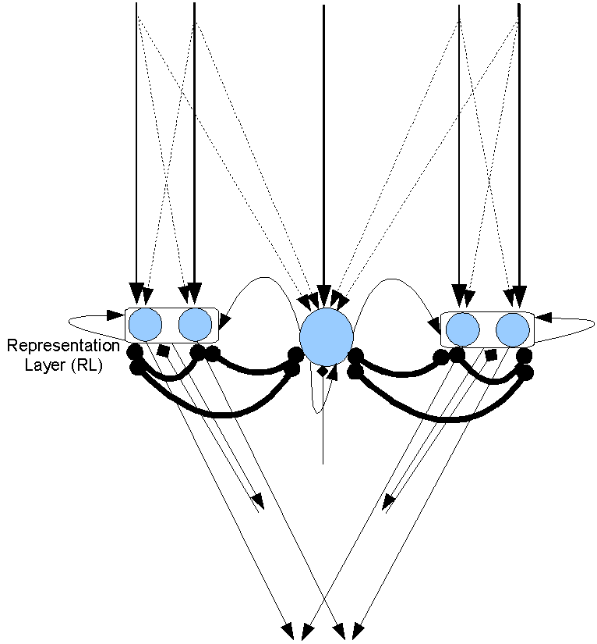
Prime
Mask
Target

Slide 14
Connections go to the attention system

Slide 15
Connections go to the attention system
And to the motor and cognitive systems (not shown here)

Slide 16
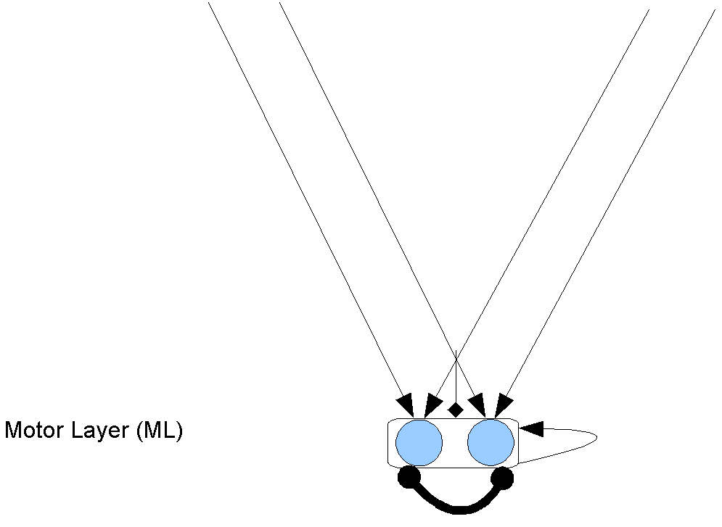
The motor layer does not feed back into the model. It just fires when it exceeds a threshold.
To simplify the presentation the motor layer will not be included in future diagrams of the model

Slide 17
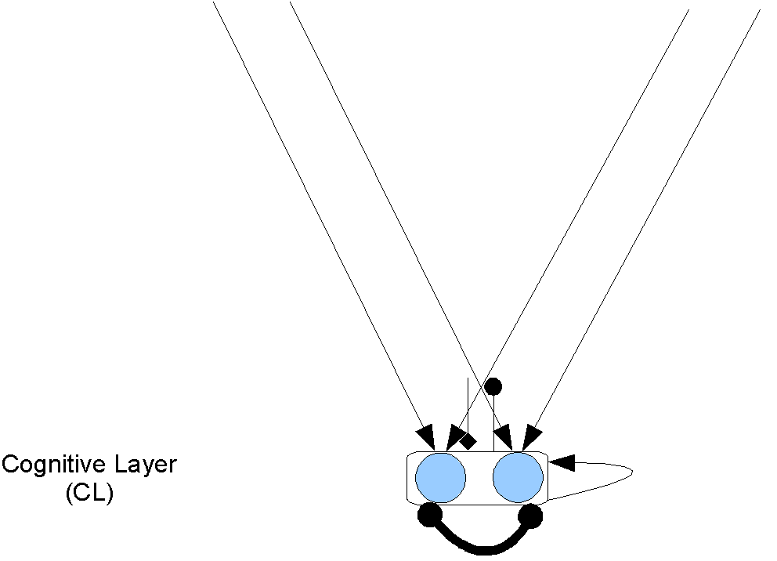
The cognitive layer is similar to the motor layer
Conflict causes inhibition, which changes the attentional mode from phasic to tonic

Slide 18
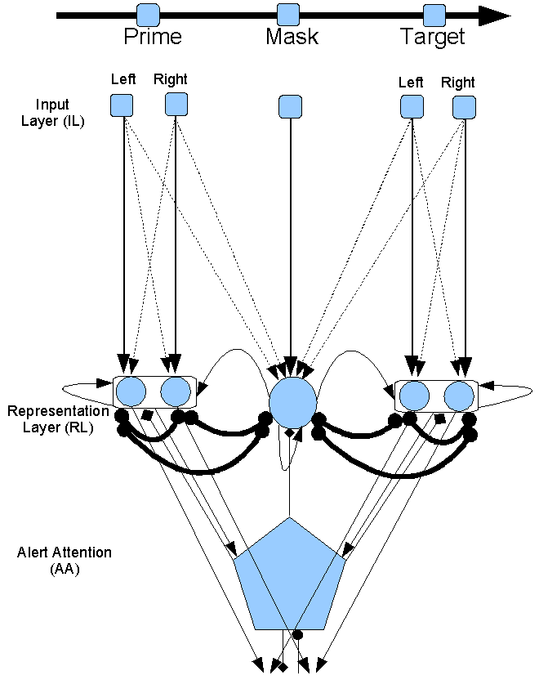
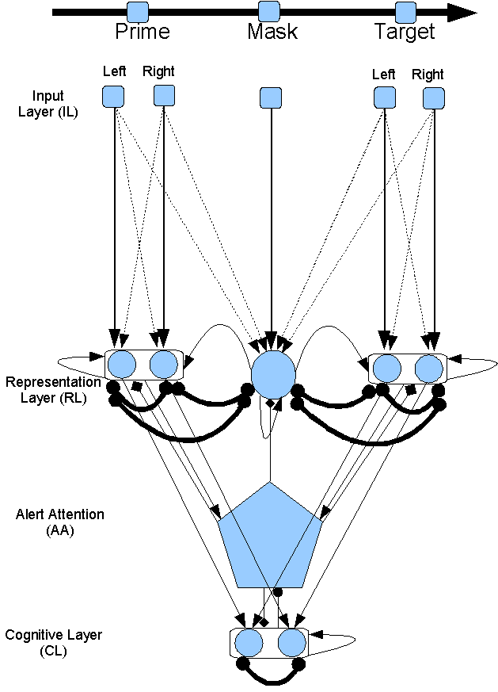
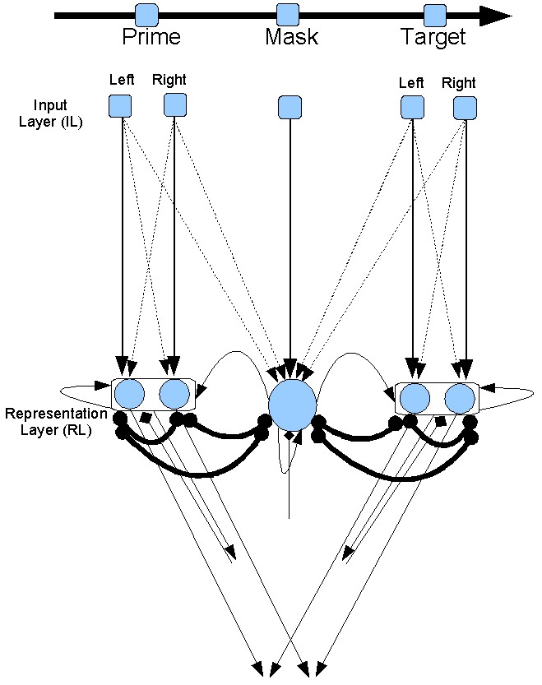
All layers together

Slide 19
Fitting the model
As noted, only the weights of IL-RL were adjusted in main conditions
No scaling was done, only the raw modeling results are shown
At this point the goal was to achieve qualitative fits across a range of results

Slide 20
Simulations of other studies

Slide 21
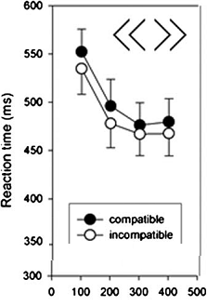
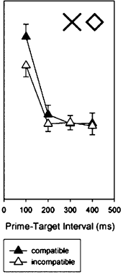
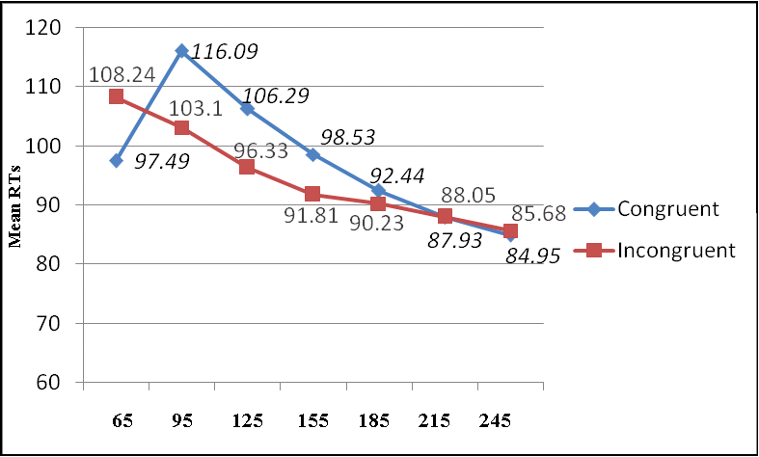
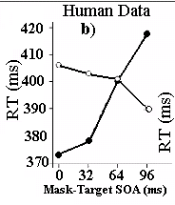
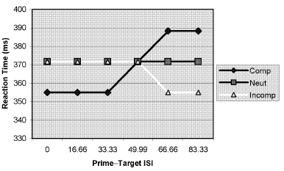
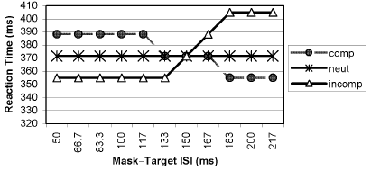
Current Model
PCE
NCE
NCE
NCE
Human Data
(previous studies)
SOAs (cycles)
Short SOA
Long SOA
Simulation data (Bowman et al.’s model):
NCE
PCE
NCE
PCE
PCE
NCE
Notes:
There are some other factors that affects priming direction shown in previous studies. The main one is mask-target SOA or stimuli onset asynchrony or prime-mask SOA. A PCE has been shown with short SOA and an NCE with longer SOAs. The model simulated this effect. There is a model of this effect shown here. As you see it does not show a gradual decrease in RT and a slow decrease in NCE by time.

Slide 22
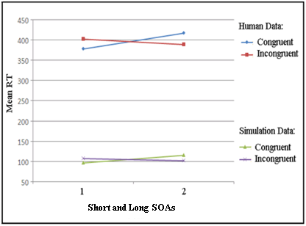
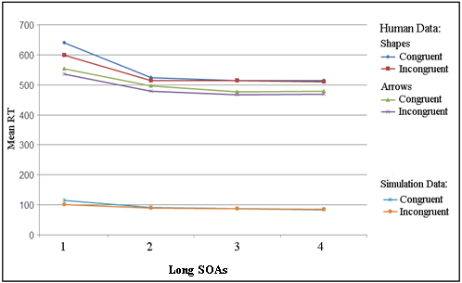
Simulation of PCE at short and NCE at long mask-target SOA
Short SOAs
Long SOAs
Left: (Schleghecken & Eimer, 2000).
Right: (Jaśkowski & Ślósarek, 2006).
Notes:
This is the same result to compare with human data. The simulation is similar to human data.

Slide 23
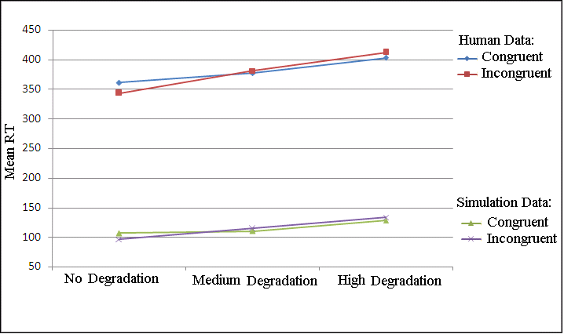
Simulation of stimuli degradation
Degradation result compared to human data (Schleghecken & Eimer, 2002, Exp. 4).
No degradation: 1 (vs. 0), Medium degradation: .85 (vs. .15), High degradation: .75 (vs. .25), and a small increase in noise in RL.
Notes:
Stimuli degradation (adding random dots to the background of the stimuli) turns NCE to PCE as happens in the simulation.

Slide 24
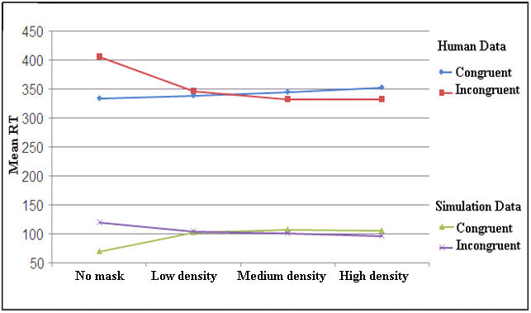
Simulation of mask density
Four levels of mask density (Eimer & Schleghecken, 2002, Exp. 1).
No mask, low density, medium density, and high density, simulated by mask unit’s activations 0, .45, .55, and 1 compared to ≥ 15, 10, 5, 0 random line masks in human data, respectively
Notes:
Decreasing mask density turns NCE to PCE as happens in the simulation (right to left).

Slide 25
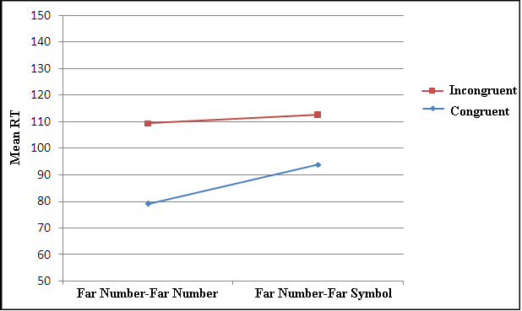
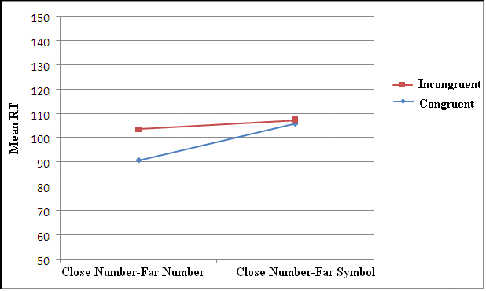
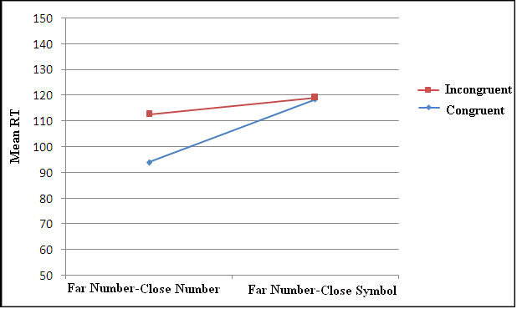
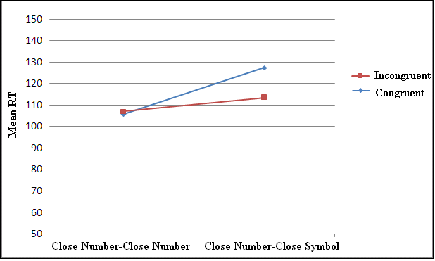
Simulation of type and distance effects in the Experiment
Far-Far Close-Far Far-Far Close-Far
Far-Close Close-Close Far-Close Close-Close Human data Simulation results
Notes:
Simulation 3 simulated Experiment 3. As you see, the PCE and NCE was found in the simulation results similar to human data. If needed I will get back to this later for more details.

Slide 26
Discussion
An NCE was found using recently learned symbols as targets and Close numerical distances.
Previous NCE found by increasing Prime-Target SOA using “arrows” and the current one were simulated by the model.
In the model the NCE is caused by refractory period of attention and the conflict, showing a similar basis for NCE and “Attentional blink”.
Neural units in the model had a decaying STM causing the priming effect however a separate “working memory” component might do a better job, especially in the unmasked priming.

Slide 27
Questions?

