Slide 1
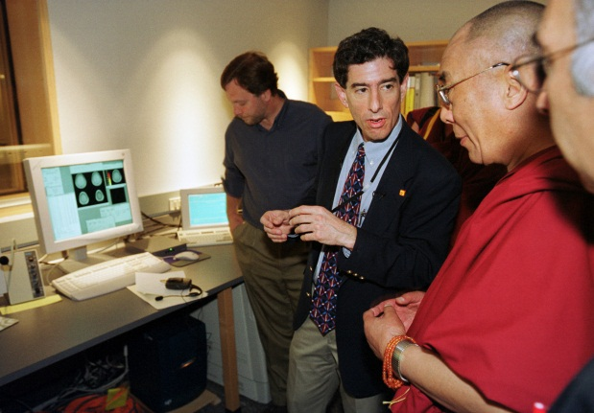
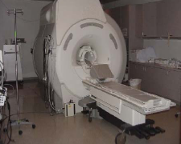
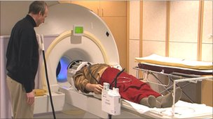
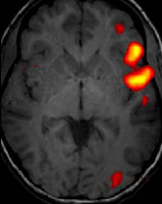
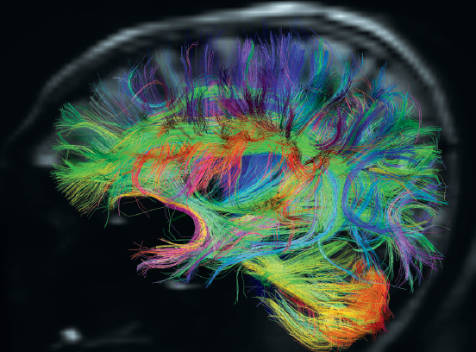
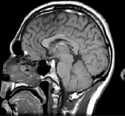
New Mind and Brain Sciences Ahmad Sohrabi, PhD
Scientific Kurdish Congress, Erbil, 2012

Slide 2
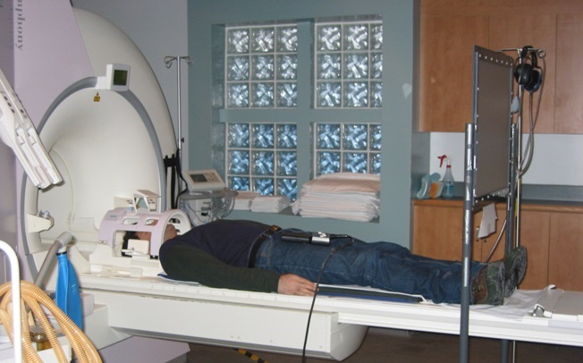
MRI
Magnetic Resonance Imaging
taking high resolution pictures from the brain (when a person do nothing)

Slide 3
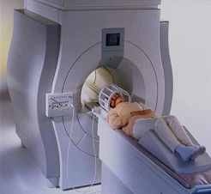
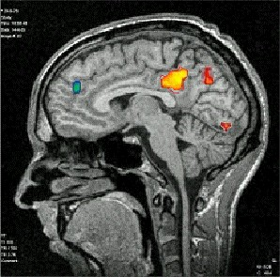
fMRI
functional MRI
taking pictures of the brain when the person is asked to do “something”, such as reading, counting, attending

Slide 4
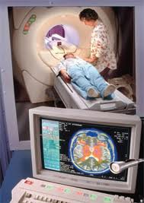
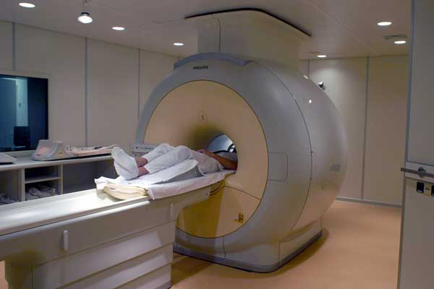
Example 1: Love hurts!
a person is asked to imagine himself/herself, a loved one, or a stranger “in pain”

Slide 5
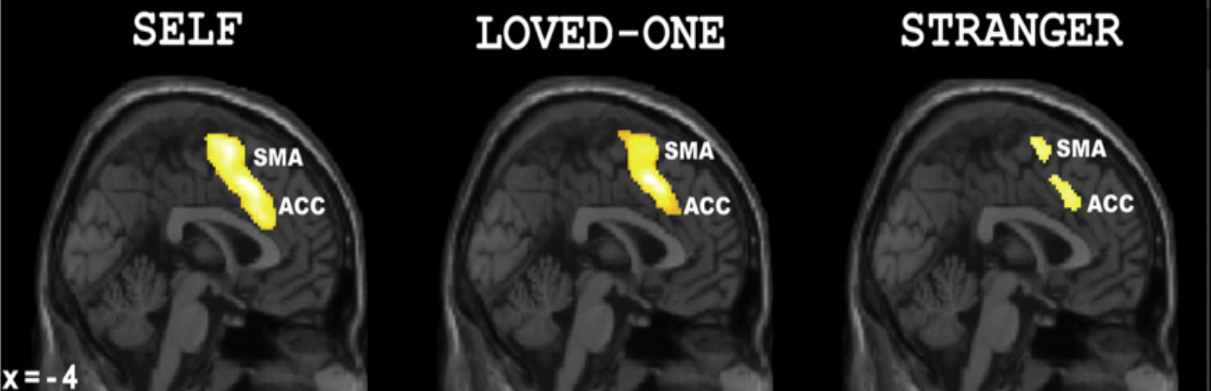
When imagining a loved-one in pain, brain activation is similar to when ourselves in pain, but not when imagining a stranger (Chang et al., 2010)

Slide 6
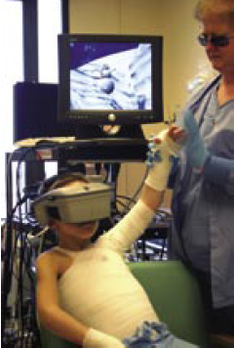
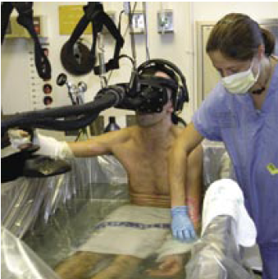
Example 2: Pain is decreased by virtual reality (Hoffman et al., 2006)

Slide 7
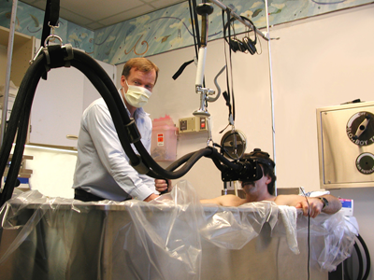

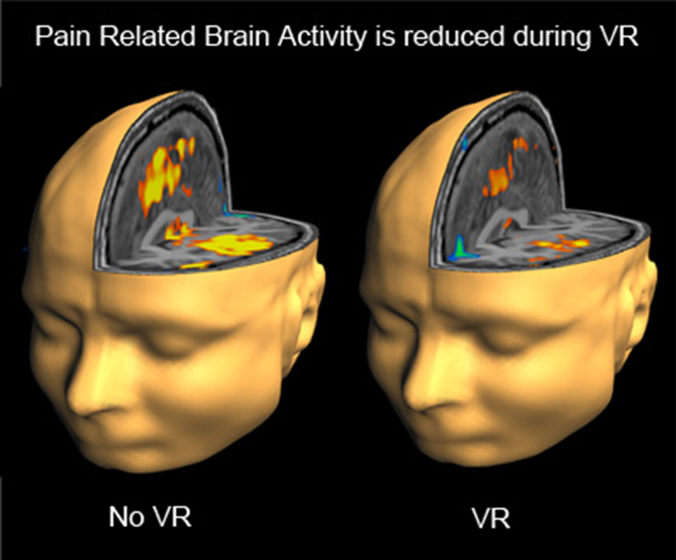

Slide 8

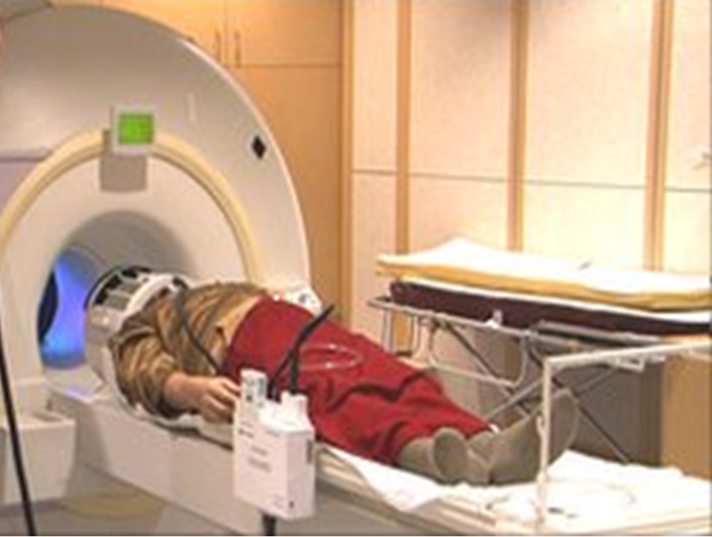
Example 3: Meditation
fourteen meditators were doing breath meditation inside the MRI scanner (Hasenkamp et al., 2012)

Slide 9
Brain areas known as attention network were activated by focused attention and was related to the lifetime meditation experience of the person.

Slide 10
brief meditation by “ordinary people” can activate brain areas involved in attention such as PFC (Dickenson et al., 2012).

Slide 11
Meditation affects behaviour
Meditation reduces “reaction to unfairness”
Some people accept low portions (including meditators), others don’t!

Slide 12
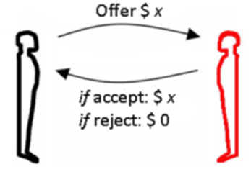
Someone has got $20, takes $18, and offers you $2
Accept or Reject?
How about 15/5?

Slide 13
Reaction to unfairness
Irrational, but can enforce social norms (Boyed et al 2003) and gradually to establish a cooperative environment
(Fehr & Gachter, 2002)

Slide 14
Not good for health
millionaires envy billionaires, billionaires envy still richer billionaires
Any cure? Meditation?

Slide 15
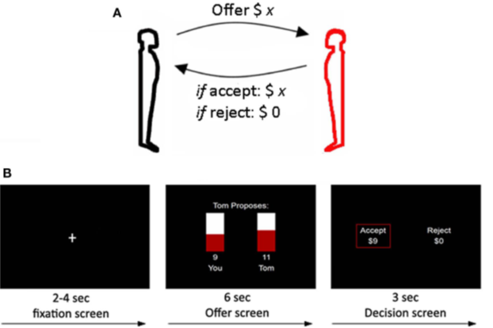
Kirk et al., 2011 compared meditators to non-meditators

Slide 16
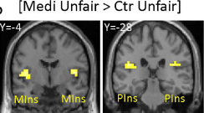
Insula is more activated by unfairness in meditator than non-meditators

Slide 17
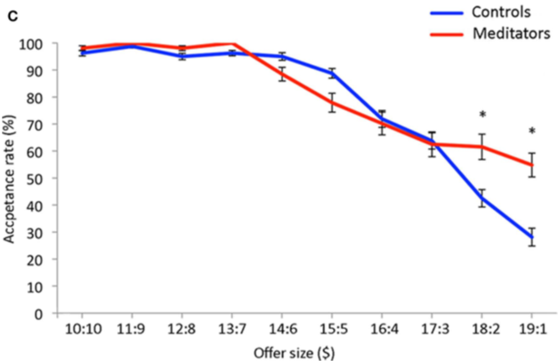
Behavioural results

Slide 18
Marital satisfaction & fairness game
Less reaction to un-fairness => Happier marriage?

Slide 19
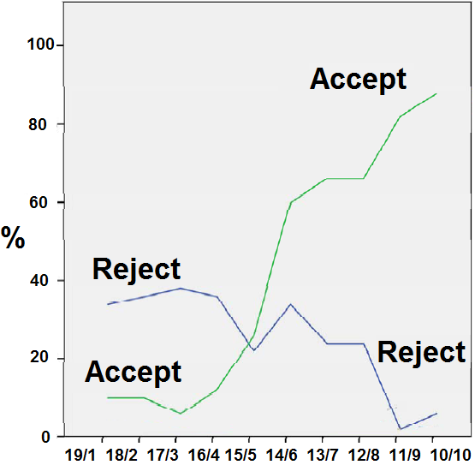
Couples with low marital satisfaction

Slide 20
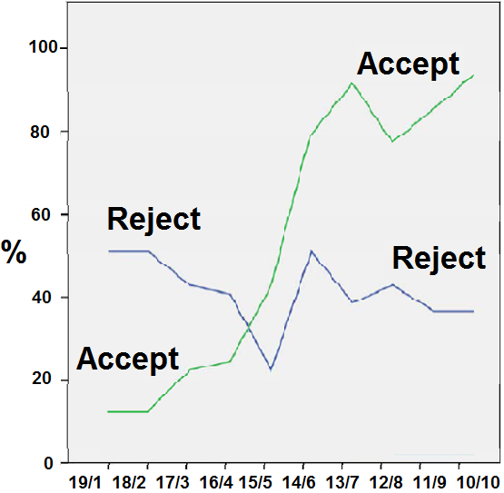
Couples with high marital satisfaction

Slide 21
Conclusion
fMRI has shed light on many issues
from basic cognitive processes to emotion and social cognition
Meditation as an example
affects the brain/mind, as shown by fMRI and behavioural data
has health and social benefits
we can learn it!

