Slide 1


Current Debates on Masked Priming Effects:
Experiments, Models, and Theories
IPM Lecture Series
Ahmad Sohrabi
University of Kurdistan
30 JAN 2011

Slide 2


Introduction
In priming, a masked/unmasked stimulus (prime) can affect the processing of the following stimulus (target).
Congruent
< ###### <
< ###### >
Incongruent
task
Prime Mask Target
43 ms 71 ms 200 ms
< >
Prime-Target SOA
Notes:
In my study I have used priming and masking techniques. So, I am briefly saying what the priming and masking are. In priming a masked or unmasked stimulus (called prime) can affect the processing of the following stimulus (called target). For example, the task could be to press a right key when the target is a happy face and to press the left key when the target is a sad face. The prime, mask, and target are presented in order. Here is an example of a congruent trial. The prime is presented, followed by a mask, and the mask is followed by the target. The stimuli are presented at the same location and because the prime is presented briefly and followed by the mask, the prime is not visible but it still can facilitate the decision on the target. The trial could also be incongruent. Here the prime is a sad face but the target is a happy face. Two opposite effects in priming:
Positive Congruency Effect (PCE); congruent trials are faster than incongruent.
Negative Congruency Effect (NCE); incongruent trials are faster than congruent!

Slide 3
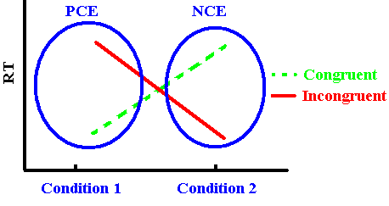
Introduction cntd.
  Two opposite effects in priming:
  1. Positive Congruency Effect (PCE); RTs in congruent trials are faster than incongruent.
    (found using short Prime-Target SOA)
  2. Negative Congruency Effect (NCE); RTs in incongruent trials are faster than congruent!
    (found using long Prime-Target SOA)
+
*
Congruent- Incongruent
(Congruency Effect)
-
*

Slide 4
Introduction cntd.
The changes in priming direction are caused by a variety of different factors, including but not limited to:
  Prime-target SOA
  Prime duration
  Mask density
  Mask type
  Degradation
  Attention

Slide 5
Previous studies
Positive Congruency Effect (PCE)
age of using tachistoscopes, Marcel (1983), word naming experiment and a colour naming experiment (Stroop-like).
In his word priming experiment, he found the usual masked priming, i.e., a PCE, by words:
  the target words (e.g., tree) were named faster when they were preceded (primed) by relevant (congruent) masked words (e.g., wood) than when they were preceded by irrelevant (incongruent) masked words (e.g., glass).

Slide 6
Previous studies PCE, cntd.
Later studies on unmasked and masked conditions showed similar results, i.e., PCE-type masked priming effect (e.g., Neumann & Klotz, 1994; Dehaene et al., 1998; Eimer & Schleghecken, 2002; Reynvoet & Brysbaert, 2004; Cheesman & Merikle, 1986; Dehaene, Artiges, et al., 2003; Schleghecken & Eimer, 2002; Eimer & Schleghecken, 2006;).

Slide 7
Previous studies: NCE
Paradoxically, a negative priming effect, i.e., NCE (e.g., Schleghecken & Eimer, 2000, 2002, 2006; Eimer, 1999; Eimer & Schleghecken, 1998; 2001, 2002; Lleras & Enns, 2004, 2006; Verleger et al., 2004; Jaśkowski & Ślósarek, 2006).
NCE has been shown mainly with arrow stimuli and a long mask (e.g., >100 ms).
Recently, it has been replicated with other stimuli, for example shapes (Jaśkowski & Ślósarek, 2006) and faces (Bennett, Lleras, Orient, & Enns, 2007).

Slide 8
Previous studies NCE, cntd.
Schleghecken and Eimer (2000), using ERP, argued that when SOA is short, response selection can already take place during the initial response activation phase (shown by an early increase in ERP.
When SOA is longer, responses have to be selected during the subsequent (motor) inhibitory phase (shown by a decrease in ERP for congruent compared to incongruent trials), and this should be reflected as a negative priming effect (NCE).

Slide 9
Previous studies NCE, cntd.
Their computational model (Bowman, Schleghecken, & Eimer, 2006) uses an inhibitory activation from a layer that inhibits the preceding layer.
It is based on previous neurocomputational models of self-inhibition (e.g. Arbuthnott, 1995; Houghton, Tipper, Weaver, & Shore, 1996).
However, Eimer and colleagues’ motor self-inhibition hypothesis has been challenged recently.

Slide 10
Previous studies NCE, cntd.
Taking into account the similarity of the mask and the prime, Lleras and Enns (2004) argued that the mask has some features in common with the prime, but the opposite features also exist that can activate the opposite response by itself, because it “updates” the initial response (in an opposite way).
Verleger et al. (2004) and Lleras and Enns (2004) hypothesized that the NCE is not caused by self-inhibition but results from two consecutive positive priming processes with opposite directions.

Slide 11
Previous studies NCE, cntd.
Lleras and Enns’s hypothesis is called “object-updating” and argues that stimuli are searched for task-relevant features to be used in directing behaviour.
Only new elements need updating. A mask that is similar to the prime stops the prime and/or evokes the opposite response, because the new parts need updating but not the repeated parts.

Slide 12
Previous studies NCE, cntd.
Similarly, Verleger et al.’s “active-mask” hypothesis is also based on the interactions between prime and mask.
In their “dialectics” hypothesis, Verleger et al. (2007) argued that “object updating” accounts only for similarity, not type (letters versus arrows) of mask, prime, and target.
They argued that behavioural data and ERP evidence indicate that an interruption of the prime arrow causes activation opposite to the arrow direction, and it is because arrows form natural pairs that they can cause NCE.

Slide 13
Previous studies NCE, cntd.
Jaśkowski and Ślósarek (2006) showed that NCE is stronger with arrows than with other shapes, consistent with Verleger et al.’s (2006) dialectics hypothesis.
They also found that NCE can be found with reversed hand-arrow assignments (i.e., responding with the left hand to the right pointing arrows and vice versa), showing that negative priming is not due to the ‘‘natural’’ meaning of arrows, but due to “natural”
pairing, consistent with the dialectics and object updating hypotheses.

Slide 14
Previous studies NCE, cntd.
In both Lleras and Enns’s and Verleger et al.’s hypotheses, the mask plays a role by providing evidence for the primed response, not by removing the evidence, as is argued by Eimer and colleagues.
In a reply, Schleghecken and Eimer (2006) claimed that these counter-arguments do not provide a complete explanation of NCEs for all conditions.
They found NCEs using random pattern masks that apparently had no similarities to arrow primes.

Slide 15
Previous studies NCE, cntd.
In response to the findings showing NCEs for random masks, Lleras and Enns (2005) argued that when prime and target appear at the same location, attentional or perceptual processes are triggered, not a low-level motor inhibition.
But NCE has also been found for primes and targets presented at different locations (Eimer, 1999; Praamstra & Seiss, 2005; Schleghecken & Eimer, 2000; Seiss & Praamstra, 2004; Jaśkowski & Ślósarek, 2006).

Slide 16
Previous studies NCE, cntd.
In a recent reply especially to Schleghecken and Eimer (2006), Lleras and Enns (2006) showed the effect of the prime and mask relationship using geometrical similarity.
They found that NCE is increased if prime and mask have more features in common (geometrical, spatial, and temporal, and in relation to the target).
Increasing the number of lines in the mask increases the possibility of creating arrow-like patterns (Lleras and Enns, 2006) .

Slide 17
Summary of the previous studies
Motor Inhibition
  With long SOA , responses have to be selected during the subsequent (motor) inhibitory phase, reflected as an NCE.
  A mask that is similar to the prime evokes the opposite response, because the new parts need updating but not the repeated parts.

Slide 18
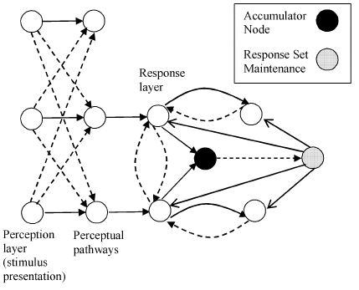
Models
Bowman, Schleghecken, & Eimer (2006) is a model that produces both PCE and NCE
Weaknesses
  AI inspired neural network model
  Not neurally or cognitively plausible
  Does not reproduce some core findings

Slide 19
Summary of previous studies cntd.
Perceptual account
  perceptual delay could occur through adaptation-like processes such as “repetition blindness” (Hochhaus & Johnston, 1996; Johnston, Hochhaus, & Ruthruff, 2002; Huber, 2008), whereby the visual system becomes less sensitive to stimuli it has just previously been exposed to.

Slide 20
Summary of previous studies cntd.
Perceptual account cntd.
  inverse priming effects could result in conditions with long SOA because the perceptual system habituates to the prime stimulus (Huber, 2008).

Slide 21


Models: Huber 2008, habituation

Slide 22
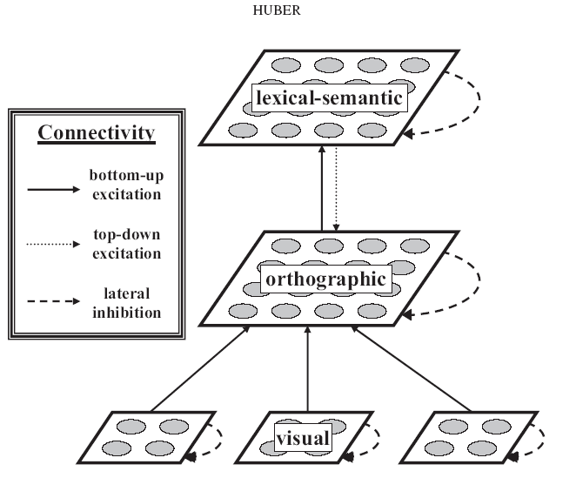

Slide 23
Our model

Slide 24
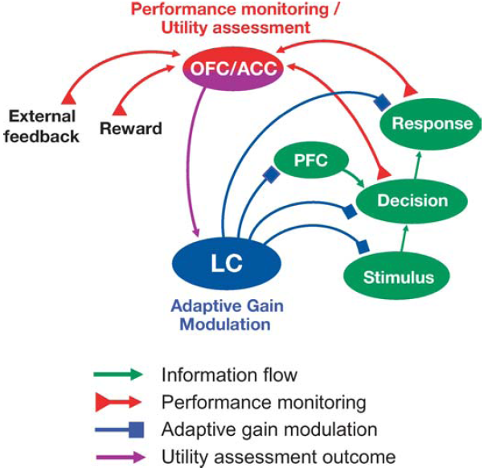
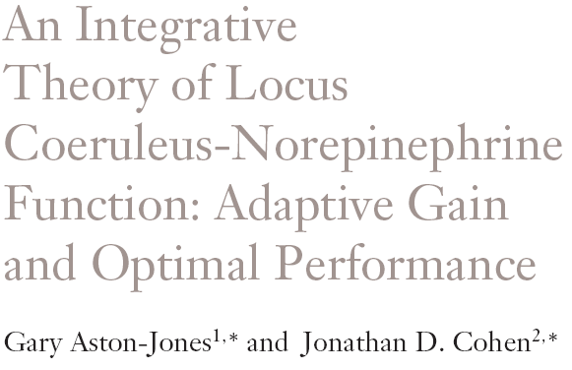

Slide 25
Modeling Goals
Able to model a wide variety of effects with minimal and realistic parameter changes
Create a model that is neurally plausible
  Based on established neural mechanisms and algorithms
Create a model that integrates basic cognitive mechanisms in a plausible way
  It consists of different layers that are shown in the following slides: Input layer (IL), representation layer (RL), alert attention layer (AA), cognitive layer (CL) and motor layer (ML).

Slide 26
Different types of connections
  Excitatory connection 
  Excitatory crosstalk -
  Self excitation ☹
  Inhibitory connection •-•
  Modulatory connection −♦

Slide 27
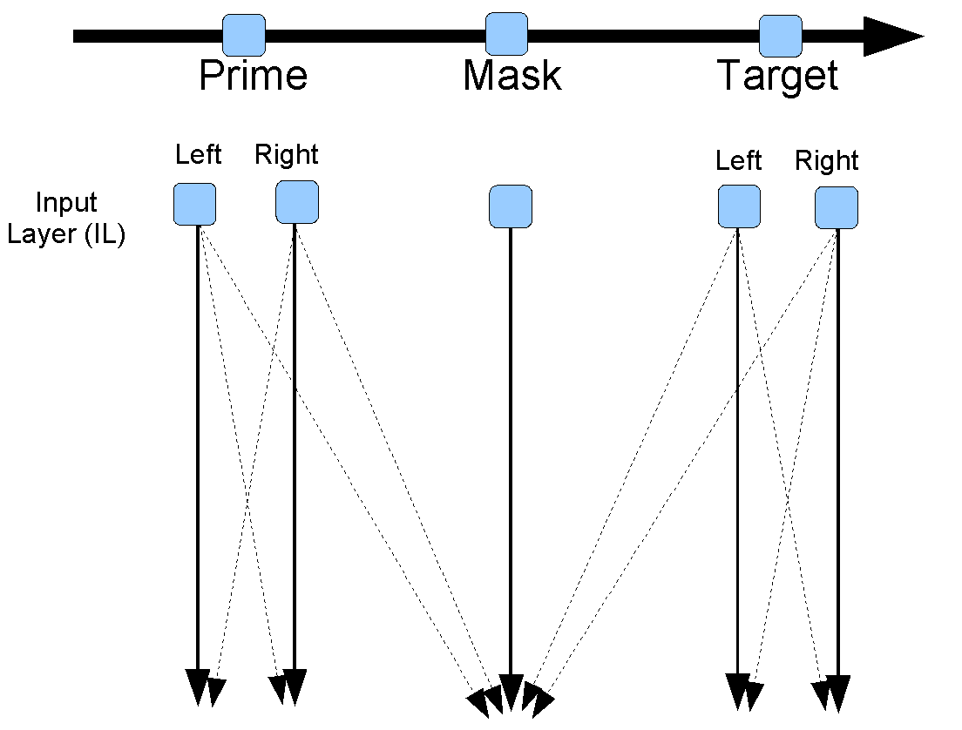

Slide 28
Weights determined by the relevance of the input for the
task

Slide 29
Weights determined by the relevance of the input for the
task
Projects to representation layer

Slide 30
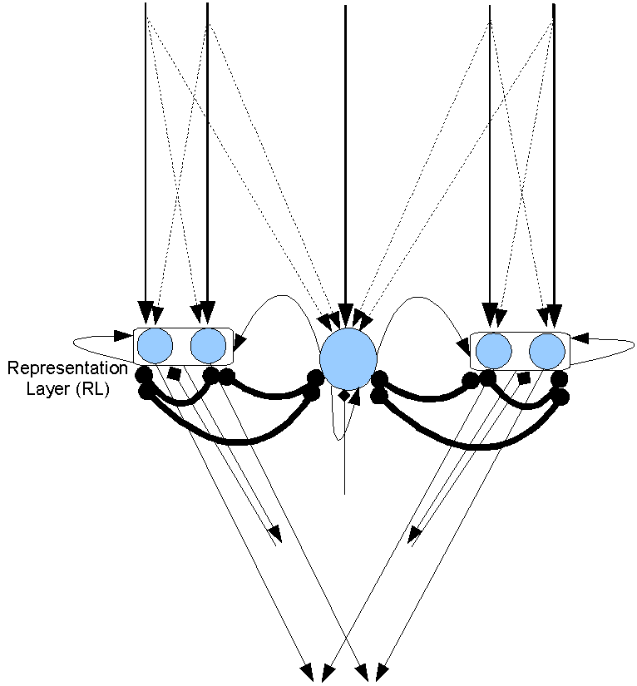
Prime
Mask
Target

Slide 31
Connections go to the attention system

Slide 32
Connections go to the attention system
And to the motor and cognitive systems (not shown here)

Slide 33
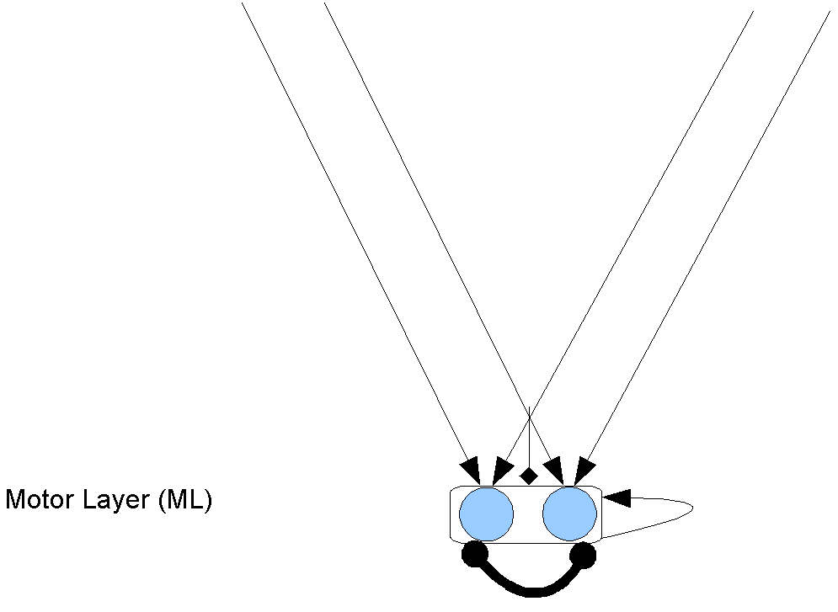
The motor layer does not feed back into the model. It just fires when it exceeds a threshold.
To simplify the presentation the motor layer will not be included in future diagrams of the model

Slide 34
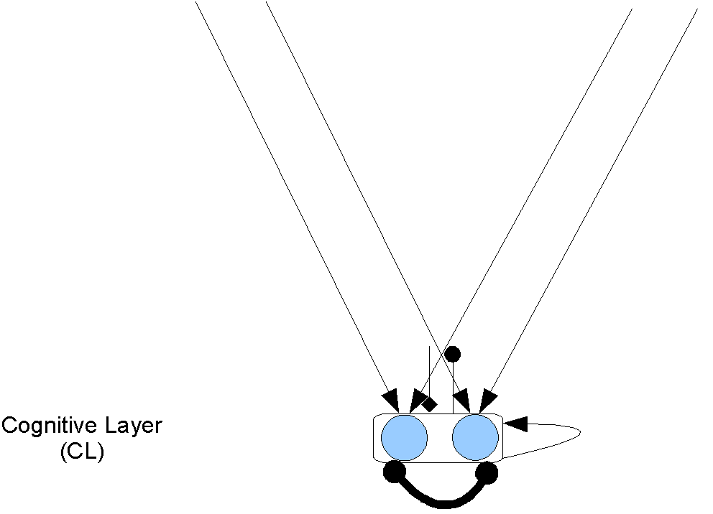
The cognitive layer is similar to the motor layer
Conflict causes inhibition, which changes the attentional mode from phasic to tonic

Slide 35
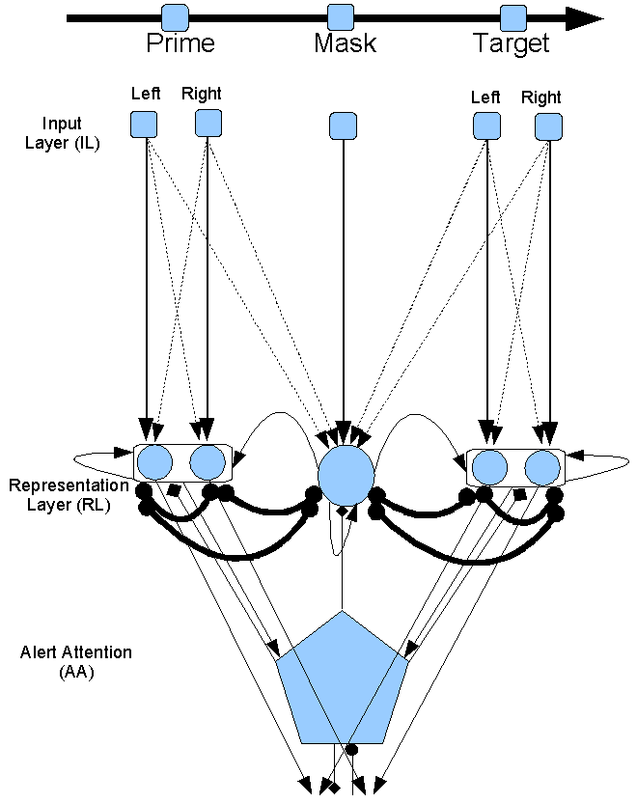
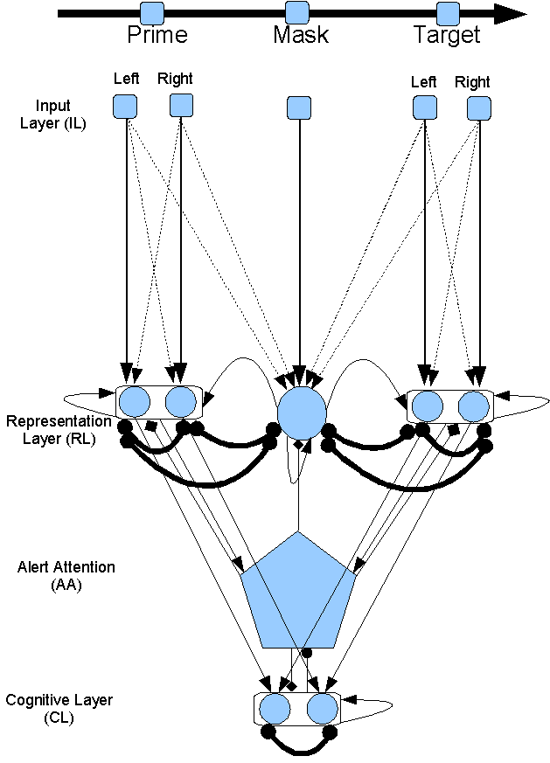
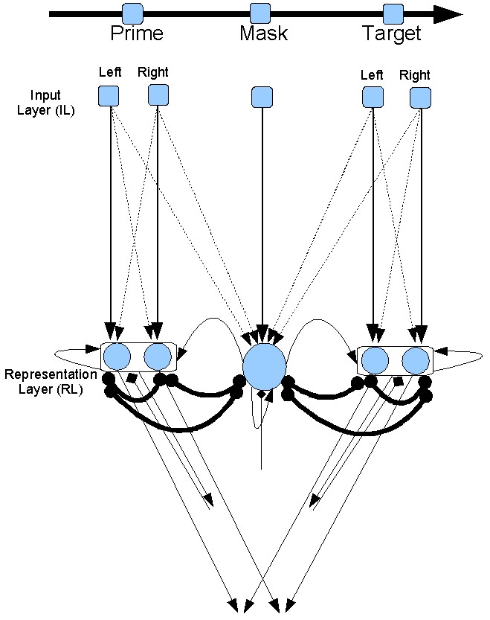
All layers together

Slide 36
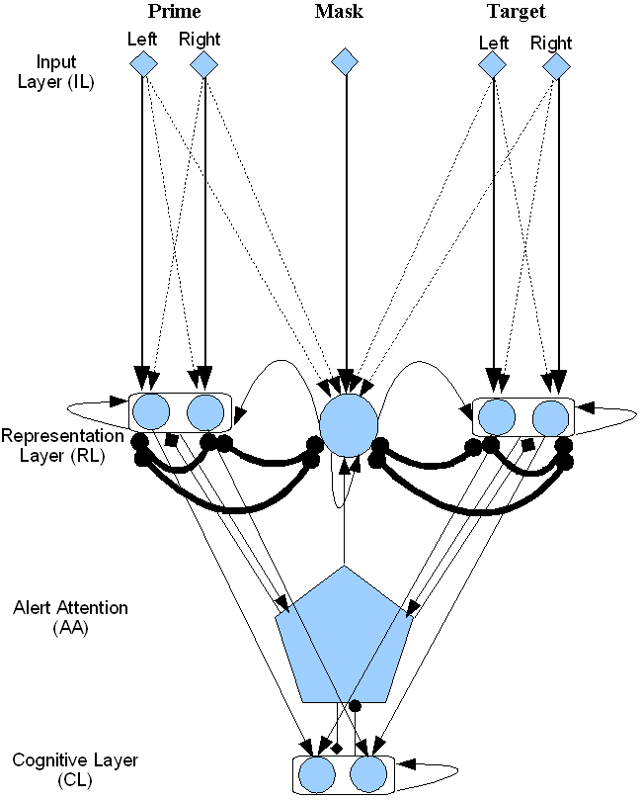
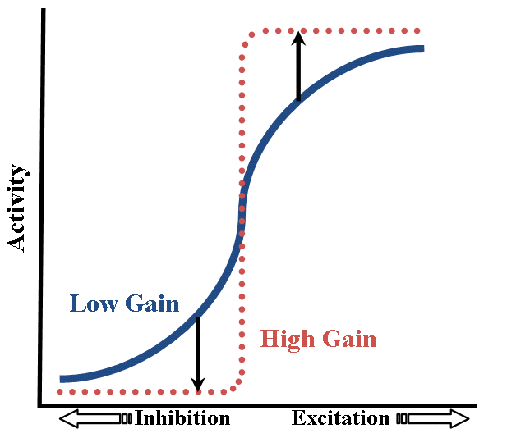
Modelling
• IL;  RL, CL, and ML (not shown) ; AA.
−♦Alert (NE); −• Executive (DA); Orient (OA, not shown).
☹ Self-excitation and recurrent excitation; ⬄ Lateral inhibition; Feed-forward activation.

Slide 37
Simulations

Slide 38
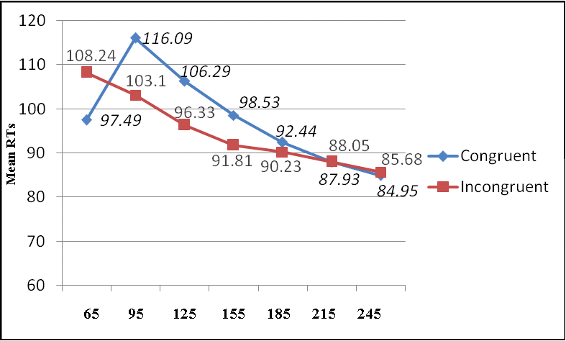
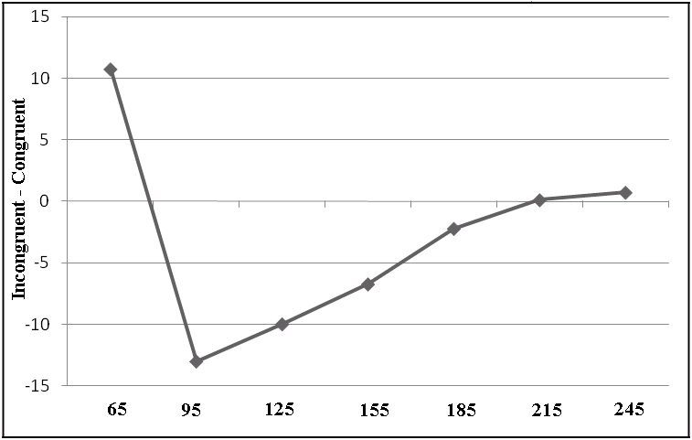
Simulation of different mask-target SOAs
Left: Modelling result at seven mask-target SOA lags.
Right: The same result in terms of Incongruent – Congruent (cycle).

Slide 39
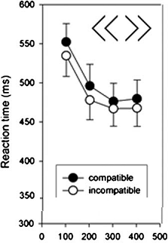
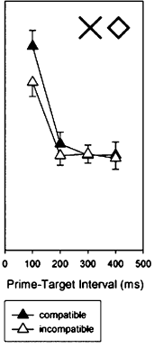
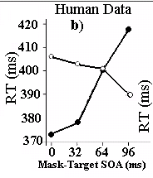
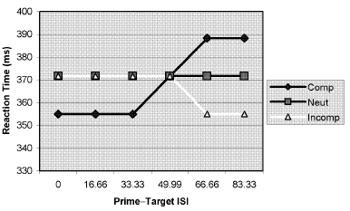
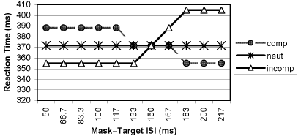
Current Model
PCE
NCE
NCE
NCE
Human Data
(previous studies)
SOAs (cycles)
Short SOA
Long SOA
Simulation data (Bowman et al.’s model):
NCE
PCE
NCE
PCE
PCE
NCE
Notes:
There are some other factors that affects priming direction shown in previous studies. The main one is mask-target SOA or stimuli onset asynchrony or prime-mask SOA. A PCE has been shown with short SOA and an NCE with longer SOAs. The model simulated this effect. There is a model of this effect shown here. As you see it does not show a gradual decrease in RT and a slow decrease in NCE by time.

Slide 40
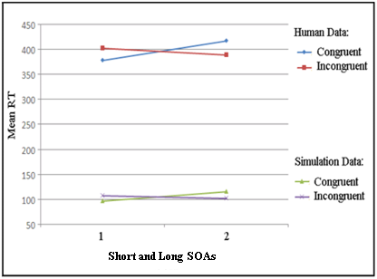
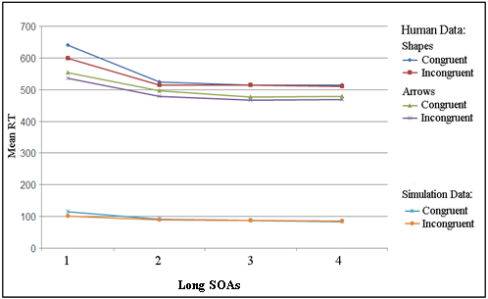
Simulation of PCE at short and NCE at long mask-target SOA
Short SOAs
Long SOAs
Left: (Schleghecken & Eimer, 2000).
Right: (Jaśkowski & Ślósarek, 2006).
Notes:
This is the same result to compare with human data. The simulation is similar to human data.

Slide 41
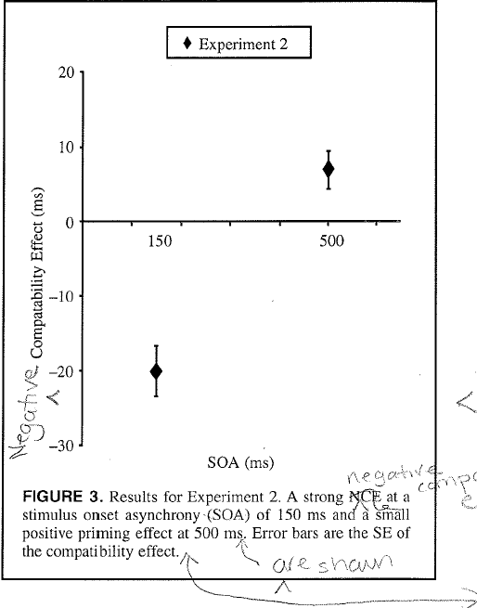
Sumner & Brandwood 2010?

Slide 42
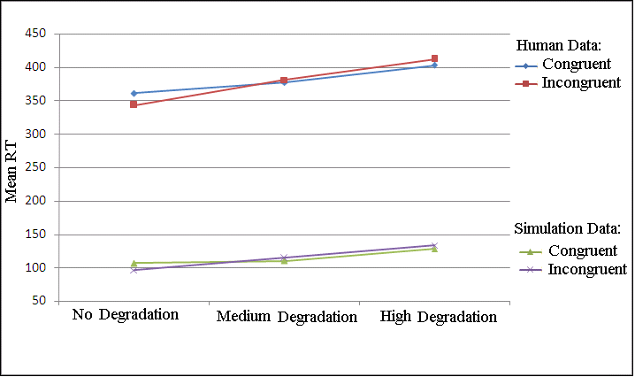
Simulation of stimuli degradation
Degradation result compared to human data (Schleghecken & Eimer, 2002, Exp. 4).
No degradation: 1 (vs. 0), Medium degradation: .85 (vs. .15), High degradation: .75 (vs. .25), and a small increase in noise in RL.
Notes:
Stimuli degradation (adding random dots to the background of the stimuli) turns NCE to PCE as happens in the simulation.

Slide 43
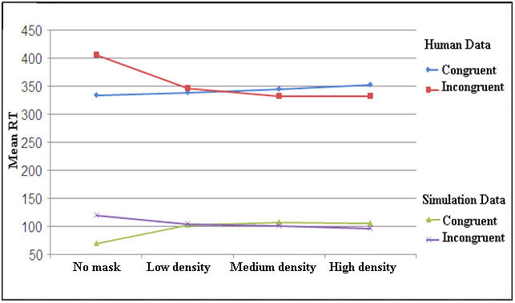
Simulation of mask density
Four levels of mask density (Eimer & Schleghecken, 2002, Exp. 1).
No mask, low density, medium density, and high density, simulated by mask unit’s activations 0, .45, .55, and 1 compared to ≥ 15, 10, 5, 0 random line masks in human data, respectively
Notes:
Decreasing mask density turns NCE to PCE as happens in the simulation (right to left).

Slide 44
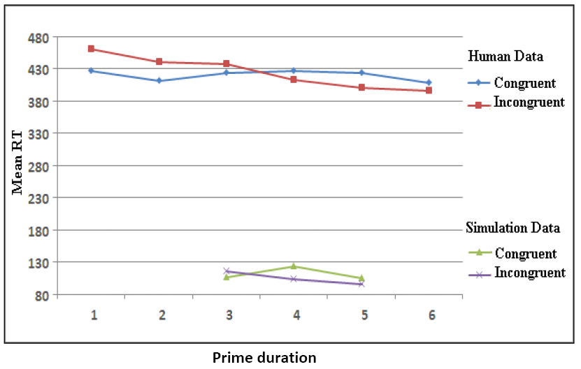
Simulation results for three levels of prime duration: 53 ms (long), 48 ms (medium), and 43 ms (short), shown as 3, 4, and 5, respectively. For the human data, 1, 2, 3, 4, 5, and 6 indicating 96, 80, 64, 48, 32, 16 ms, respectively.

Slide 45
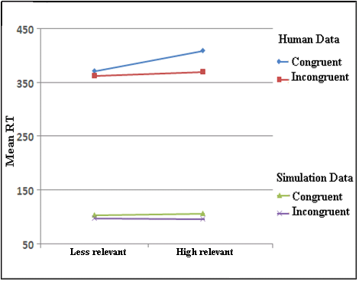
Simulation of mask relation
Mask relation compared to human data (Lleras & Enns, 2005).
By changing excitation from mask to Prime and target: low excitation (.65 ) and high excitation (.75) for less and high relevant mask, respectively.
Notes:
Larger NCE in the relevant masks.

Slide 46
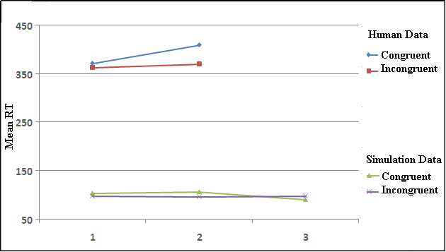
Simulation of mask relation
Mask relation simulated with three levels of excitation, 1 (.65 or low excitation), 2 (.75 or medium excitation), and 3 (.85 or high excitation) and human data (e.g., Lleras & Enns, 2006; Bennett, Lleras, Orient, & Enns, 2007) .

Slide 47
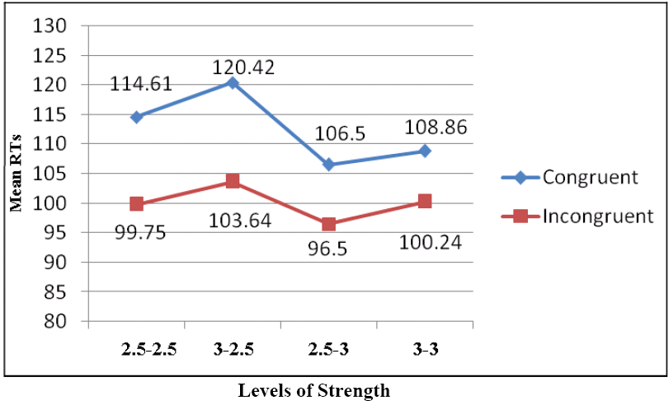
Interaction between SOA and prime and target strength (2.5-2.5, 3-2.5,2.5-3, and 3-3 weights at mask-target SOA 105.

Slide 48
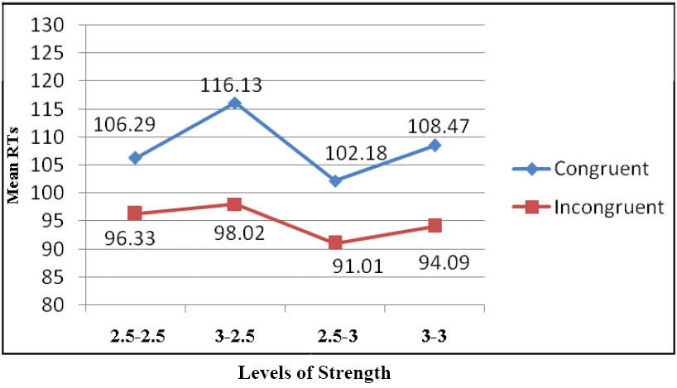
Interaction between SOA and prime and target strength (2.5-2.5, 3-2.5,2.5-3, and 3-3 weights at mask-target SOA 125.

Slide 49
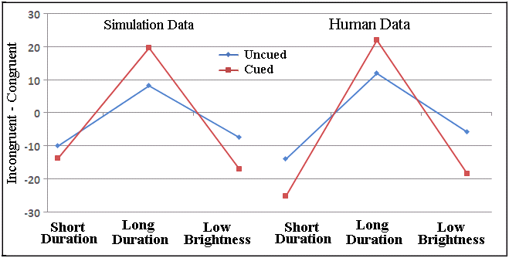
Simulation of spatial cueing
RT difference (Incongruent - Congruent) in the spatial attention to the prime compared to human data ( Summer et al., 2006).
Notes:
Cueing the prime location increases NCE and PCE as you see. This is the RT differences in Incongruent – congruent.

Slide 50
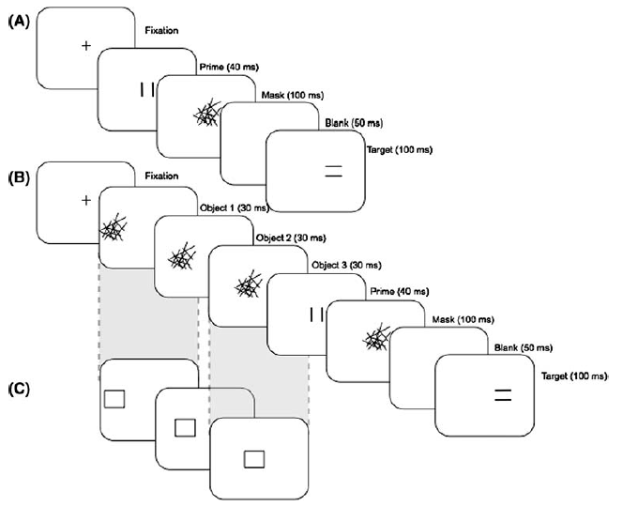
F. Boy, K. Clarke, P. Sumner 2008

Slide 51
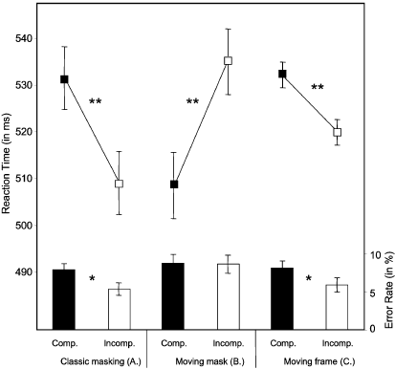

Slide 52
No forward mask

Slide 53
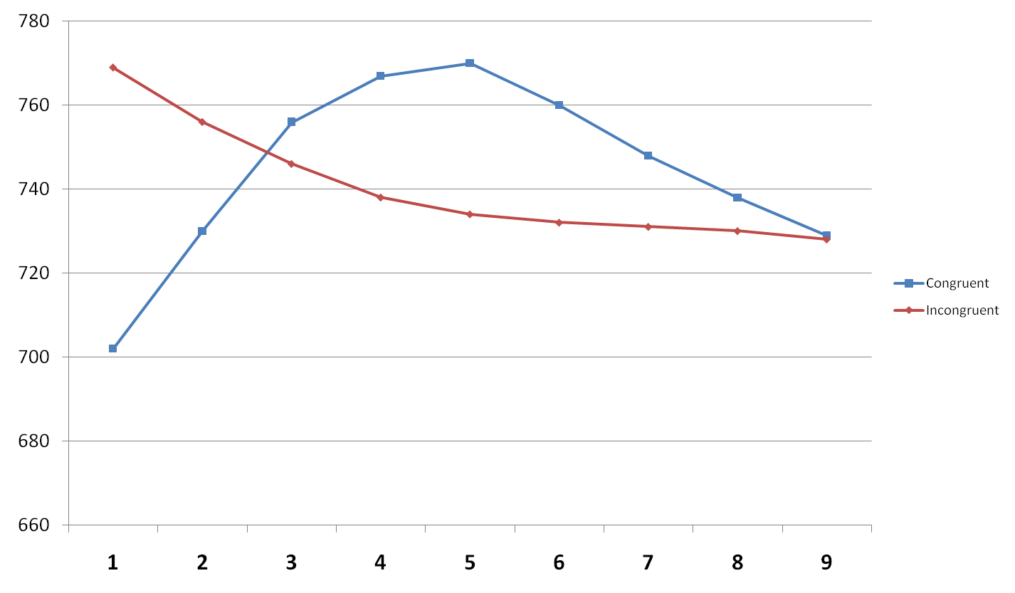
At the time of forward mask,
Prime gets .2 activation
120 145 170 195 220 245 270 295
SOAs

Slide 54
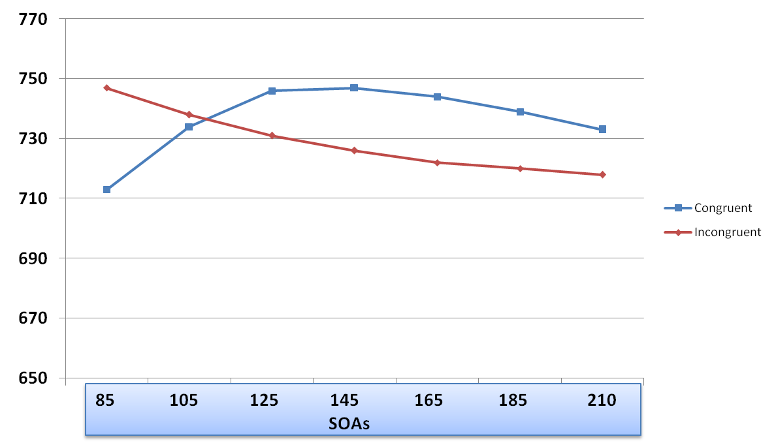
At the time of forward mask,
Prime gets .1 activation

Slide 55
Discussion
PCE and NCE found by short and long Prime-Target SOA, respectively, were simulated by the model.
In the model the NCE is caused by refractory period of attention (and conflict), showing a similar basis for NCE and “Attentional blink”.

Slide 56
Daniel Krüger et al.
Recently, …assign inverse priming to an attentional or perceptual source. Sohrabi and West (2009) put forward a computational model which assumes attentional modulation as the source for inverse priming effects.
According to this view, attention has two phases on congruent trials: With short SOAs target processing is facilitated by attention, but with long SOA target processing is deteriorated due to an attentional refractory period.

Slide 57
Daniel Krüger et al. cntd.
On incongruent trials, in contrast, prime and target stimuli induce a conflict which draws attention to the target stimulus and diminishes the effect of the attentional refractory period.
Therefore, positive priming occurs with short SOA and inverse priming with long SOAs.

Slide 58
Frederic Boy & Petroc Sumner
An alternative perceptual account of the NCE has recently been developed as a computational model by Sohrabi and West (2008).
In this model the NCE emerges due to an attentional refractory period, and it claims …
For our purposes, an attentional refractory period is essentially the same as perceptual habituation—both act to slow the perceptual processing of the target in compatible trials.

Slide 59
Frederic Boy & Petroc Sumner cntd.
Thus, in sum, the NCE may have an entirely perceptual or attentional source, occurring through modulation of the processing of target features, rather than a sensorimotor source relying on priming of responses associated with those features.

Slide 60
Frederic Boy & Petroc Sumner cntd.
However it also has been suggested that the NCE may have a perceptual source (e.g., Bavelier et al., 2000; Huber, 2008; Lleras & Enns, 2005) or an attentional source (Sohrabi & West, 2008), in which case it would not be expected to show dependence on the PCE.

Slide 61
Thanks!
Questions/Comments?

Slide 62
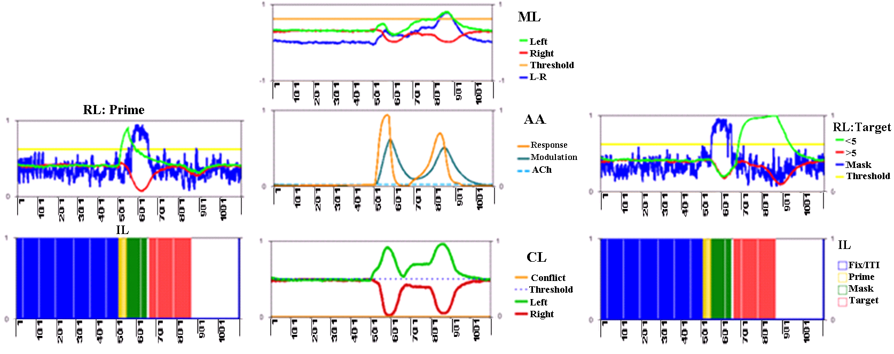
Activations in the model (a congruent trial, SOA 125)

Slide 63
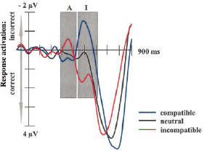
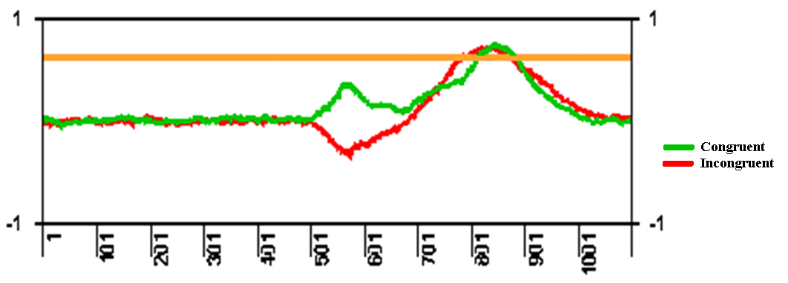
Left-Right in ML (congruent and incongruent trials)
Left: Domination of activation in the congruent and incongruent trials at short and long SOAs, respectively.
Right: ERP data (Eimer & Schleghecken, 1998)

Slide 64
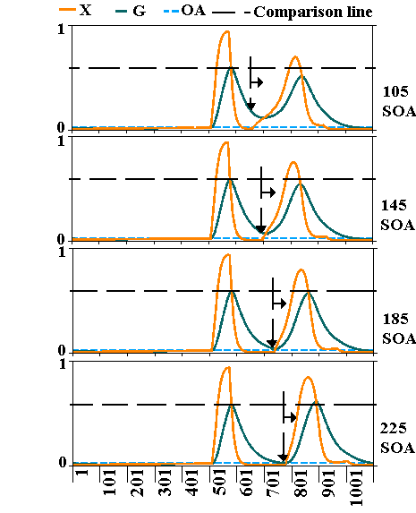
AA response
The changes in the
refractory period as
a function of SOA (in
masked congruent
trials and prime-target
strength 3-3) for
mask-target SOAs 105,
145, 185, and 225.

Slide 65
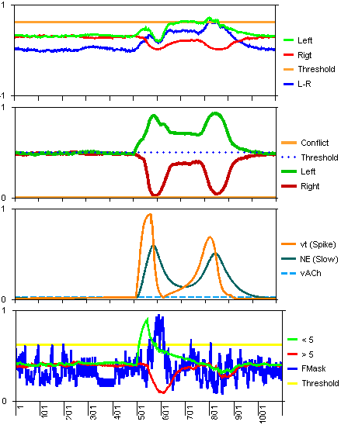
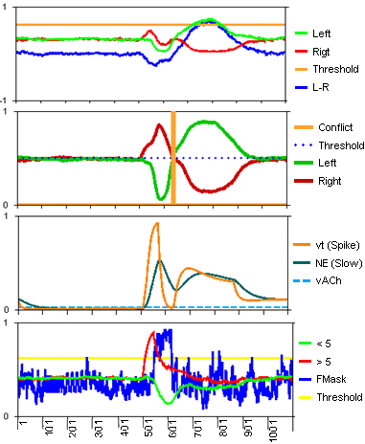


SOA 71, strength 3-3:
Congruent (698 ms) vs. Incongruent (721 ms)

Slide 66
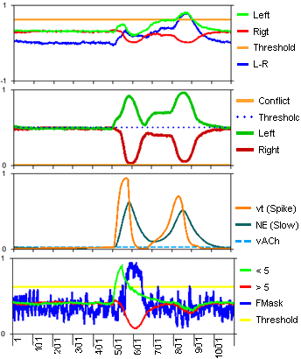
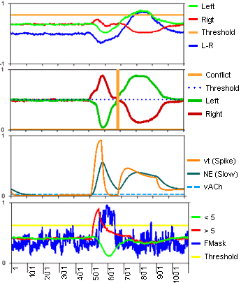
SOA 125, strength 3-3:
Congruent (779 ms) vs. Incongruent (762 ms)

Slide 67
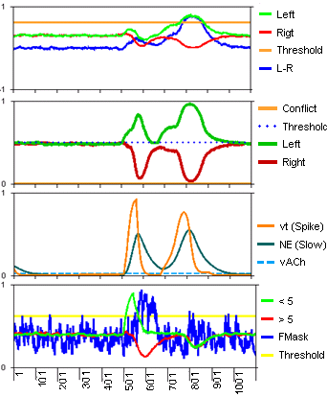
SOA 125, strength 3-3: Congruent (779 ms) vs. Congruent but irrelevant mask (772 ms)

Slide 68
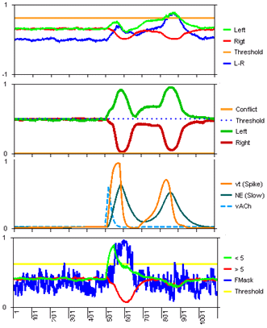
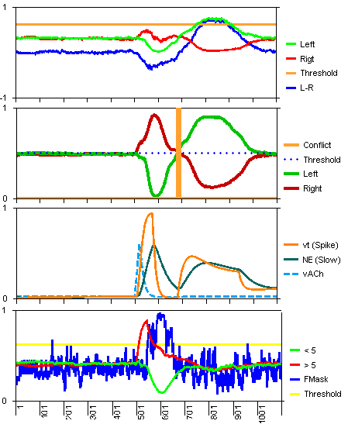
SOA 125, strength 3-3, cued prime:
Congruent (821 ms) vs. Incongruent (762 ms)

Slide 69
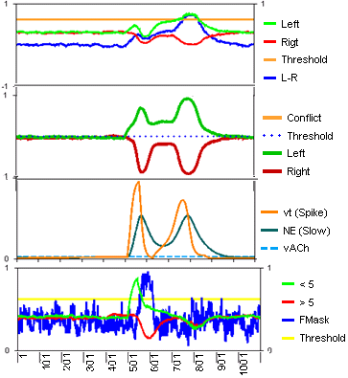
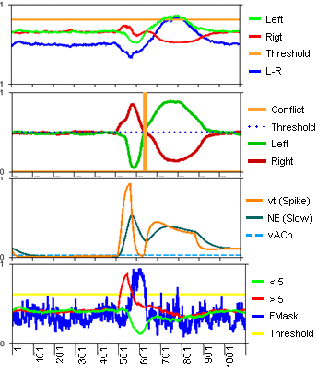
SOA 71, strength 2.5-2:
Congruent (744 ms) vs. Incongruent (727 ms)

Slide 70
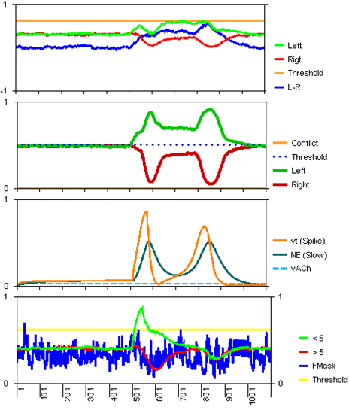

SOA 71, strength 2.5-2, unmasked:
Congruent (735 ms) vs. Incongruent (738 ms)

Slide 71




Equations
RL
ML
& CL
F
E
AL

