Slide 1
Current Debates on Masked Priming Effects:
Experiments, Models, and Theories
Ahmad Sohrabi
University of Kurdistan
2011

Slide 2
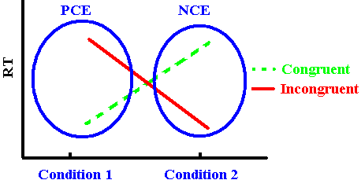
Introduction
In priming, a masked/unmasked stimulus (the prime) can affect the processing of a following stimulus (the target).
Priming can have two,
opposite effects:
Positive Congruency Effect (PCE), congruent faster than incongruent.
Negative Congruency Effect (NCE), incongruent faster than congruent!

Slide 3
Introduction cntd.
The change in priming direction is caused by a variety of different factors, including but not limited to:
Prime-target SOA (or mask-target SOA)
Prime duration
Mask density
Mask type
Degradation
Cueing the prime location
And three new factors: type, distance, and cueing the target type

Slide 4
Current study
Experiment 1 (fMRI study) tested the effect of masking and illusion.
Experiment 2 tested the effect of recently learned representation versus well-learned.
Experiment 3 tested the distance factor.
Experiment 4 tested the effect of cueing.
The model produced results similar to human data in these experiments and other studies.

Slide 5
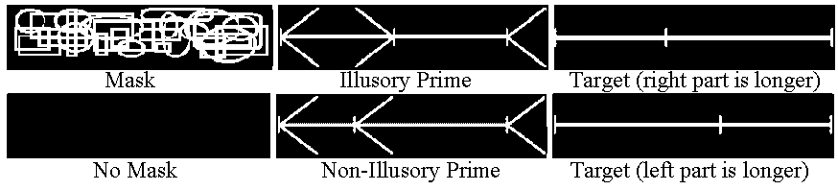
Current study cntd.
Masked and unmasked priming design in all experiments
Stimuli in Experiment 1
Masked
Forward Mask
Prime
Backward Mask
Target
Unmasked
No Mask
Prime
No Mask
Target
71
43
71
200
➔
Time (ms)

Slide 6
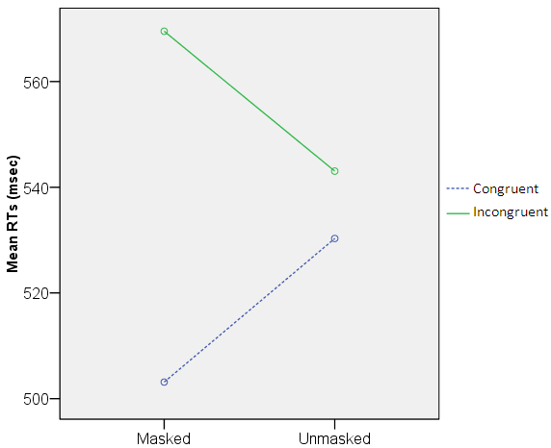
Experiment 1: Results
Interaction between Masking and Congruency

Slide 7
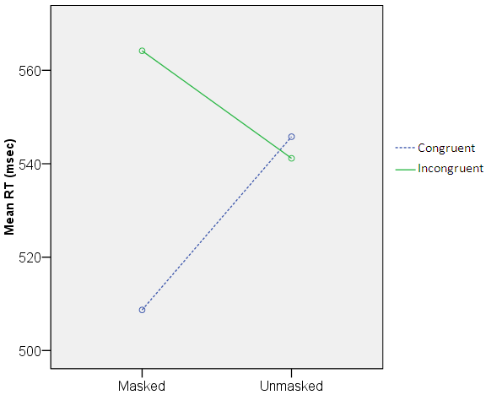
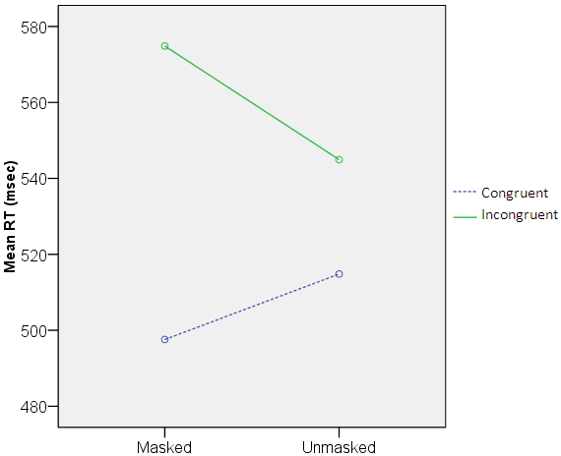
Experiment 1: results cntd.
Interaction between Masking and Congruency: Non-Illusory Illusory

Slide 8
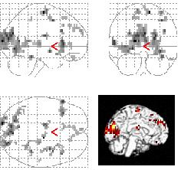
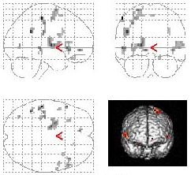
Experiment 1: fMRI results
Activation results :
Unmasked – Masked Illusory-Non-Illusory

Slide 9
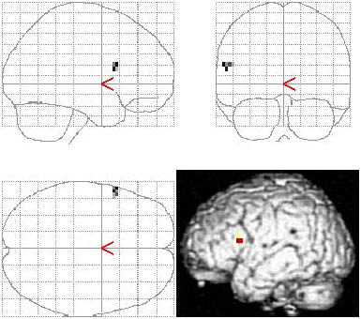
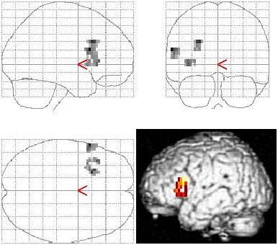
Experiment 1: fMRI results cntd.
Activation results (left IFG and dl-PFC):
Unmasked Illusory – Masked Illusory Unmasked Illusory – Unmasked Non-Illusory

Slide 10
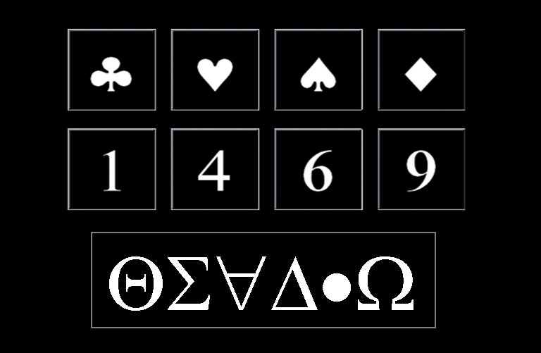
Experiment 2
Numbers were assigned to arbitrary symbols with enough training.
Conditions in priming section:
Symbol-Number
Number-Symbol

Slide 11
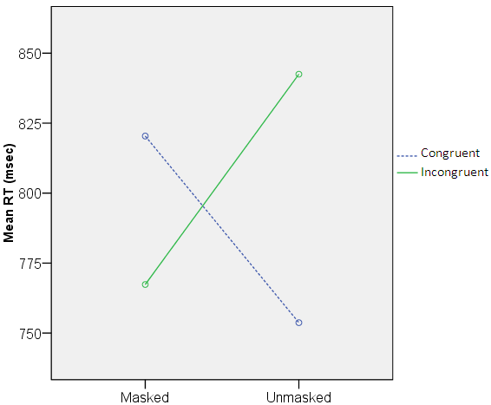
Experiment 2: results
Masking by Congruency interaction
Number-Symbol

Slide 12
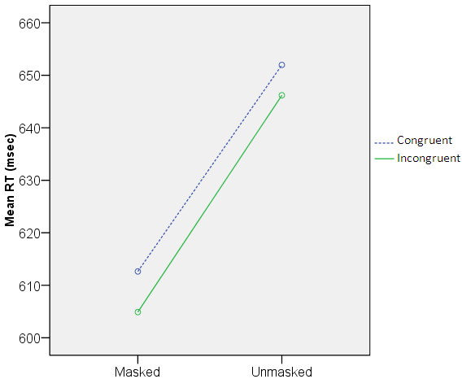
Experiment 2: results cntd.
Masking by Congruency interaction
Symbol-Number

Slide 13
Experiment 3
Here a fixation point (# or * ) came before other stimuli.
Two conditions (both masked):
Number-Number
Number-Symbol (as in Experiment 2).
For example: # => blank => masked prime=> target

Slide 14
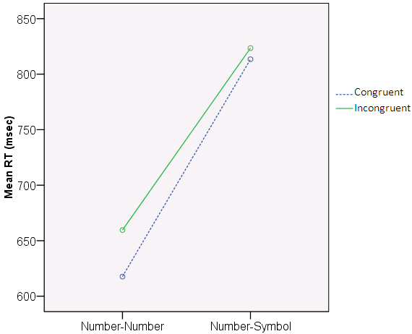
Experiment 3 cntd.
significant PCE in Number-Number (t=3.737, p=.005) and non-significant PCE in Number-Symbol (t=.665, p=.522), regardless of Distance.

Slide 15
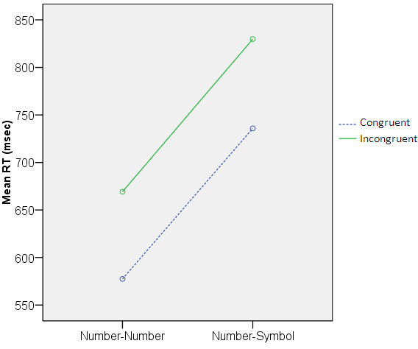
Experiment 3 cntd.
Significant PCE in Number–Number (t=4.555, p=.001) and marginally significant PCE for Number–Symbol (t=2.084, p=.067), at Far Prime-Far Target distance.

Slide 16
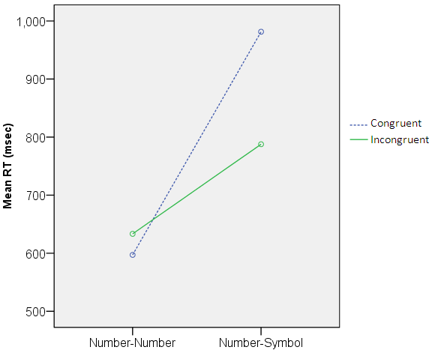
Experiment 3 cntd.
A non-significant PCE for Number–Number (t=1.545, p=.157) and a significant NCE for Number–Symbol (t=3.692, p=.005) ,at Close Prime-Close Target.

Slide 17
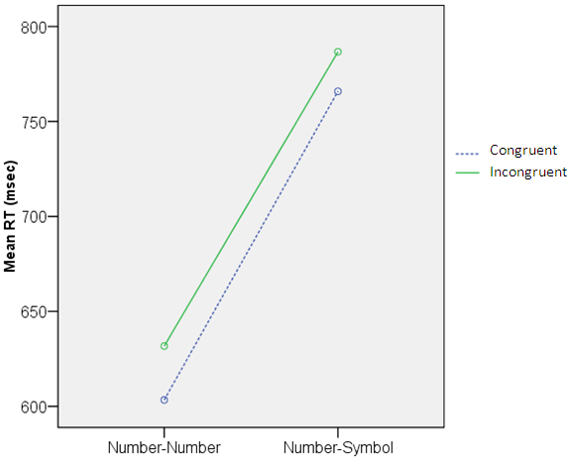
Experiment 3 cntd.
Non-significant PCE in Number–Number (t=.980, p=.352) and in Number–Symbol (t=.657, p=.527), at Close Prime-Far Target distance .

Slide 18
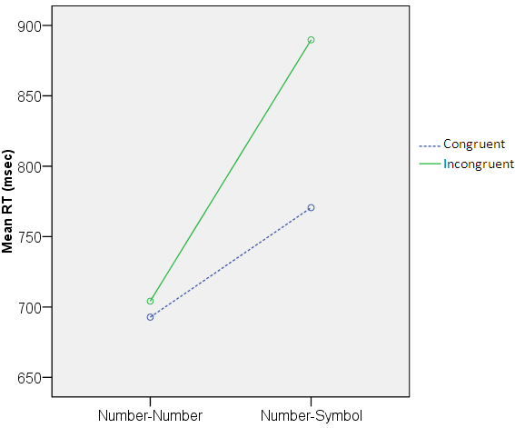
Experiment 3 cntd.
non-significant PCE in Number–Number (t=.441, p=.67) and marginally significant PCE in Number–Symbol (t=2.039, p=.072), at Far Prime-Close Target distance.

Slide 19
Experiment 4
The fixation cues revealed the target’s identity, because # always came with Number-Number and * came with Number-Symbol.
ANOVA showed no significant results.

Slide 20
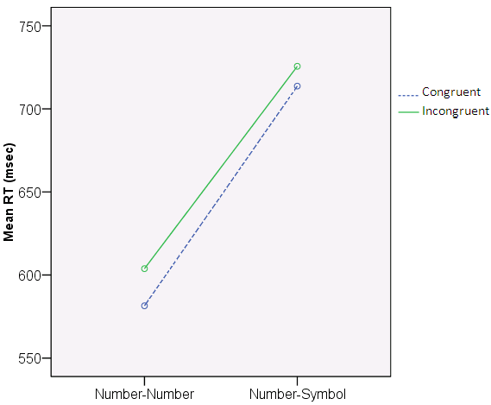
Experiment 4 cntd.
significant PCE for Number-Number (t=4.063, p=.003) and non-significant PCE for Number-Symbol (t=.521, p=.615), regardless of Distance.

Slide 21
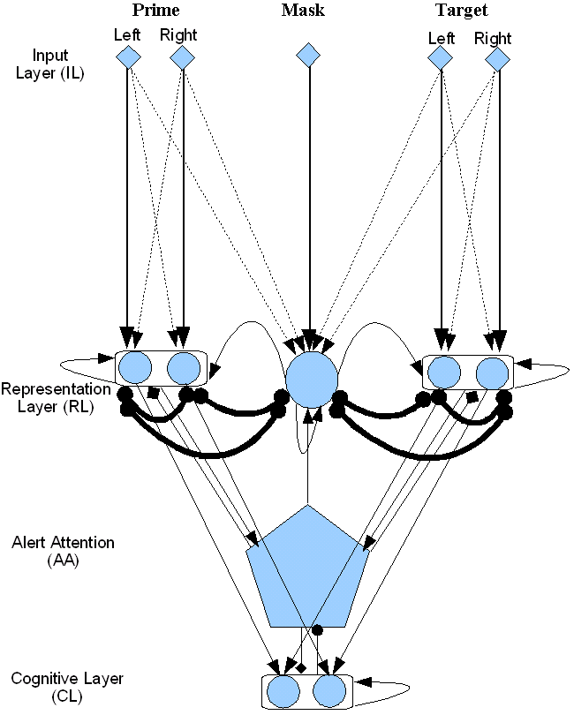
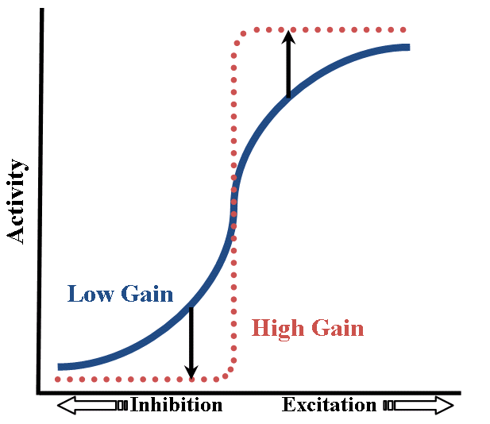
Modelling
• IL;  RL, CL, and ML (not shown) ; AA.
−♦Alert (NE); −• Executive (DA); Orient (OA, not shown).
L Self-excitation and recurrent excitation; ó Lateral inhibition; Feed-forward activation.

Slide 22
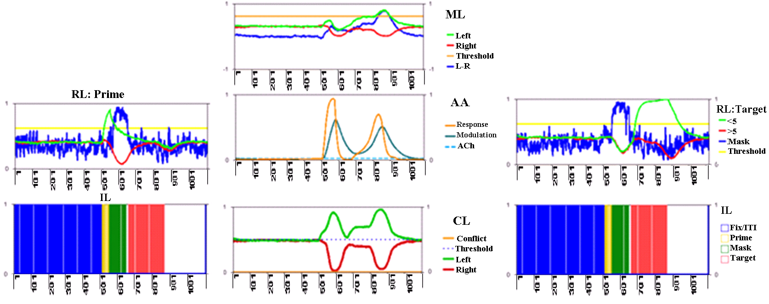
Activations in the model

Slide 23
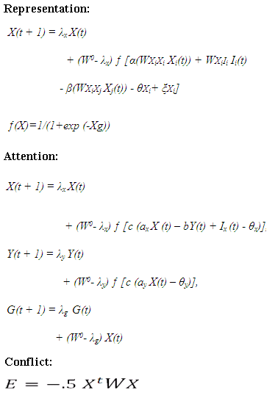
Equations

Slide 24
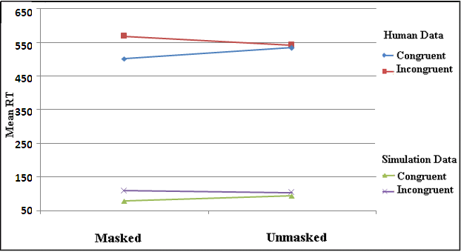
Simulation 1: masking effect in Experiment 1
Prime-target strength 3-3 (IL to RL weights),
with less phasic attention to the prime in the unmasked

Slide 25
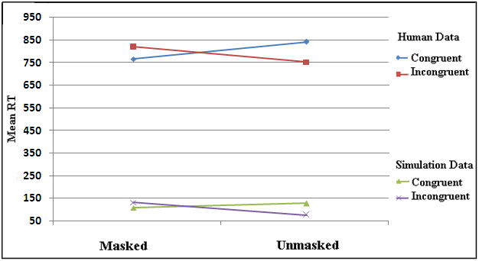
Simulation 2: masking and type effects in Experiment 2
Prime-target strength 2.75-2.25 (IL to RL weights),
with medium phasic attention to the prime

Slide 26
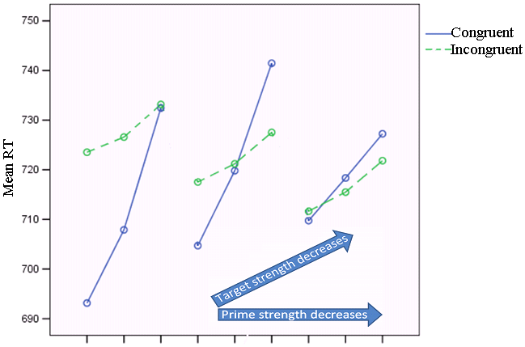
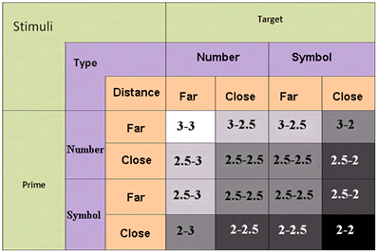



Simulation 3: type and distance effects in Experiment 3
Modelling results for all prime-target weight combinations.

Slide 27
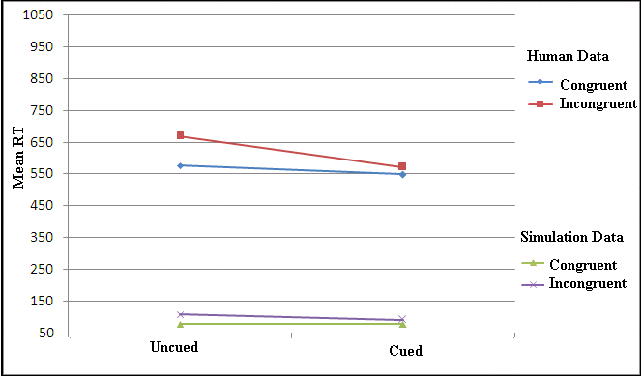
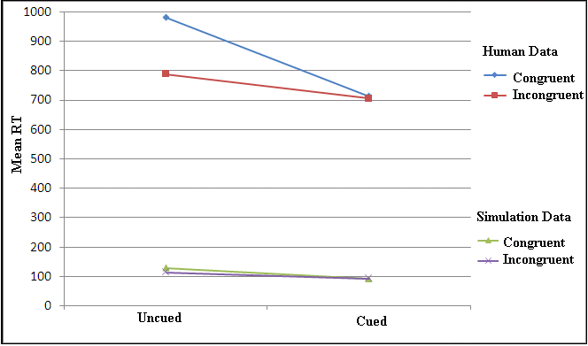
Simulation 4: cueing effect in Experiment 4
Far Number Prime-Far Number Target Close Number Prime-Close Symbol Target strength (IL to RL) 3-3 strength (IL to RL) 2.5-2
Cue created an attentional refractory period for the prime, making it weaker, but made the target stronger, so it caused NCE and PCE disappear.

Slide 28
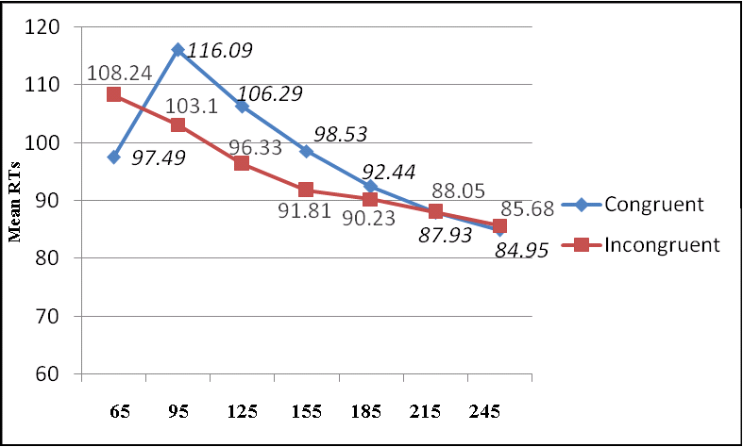
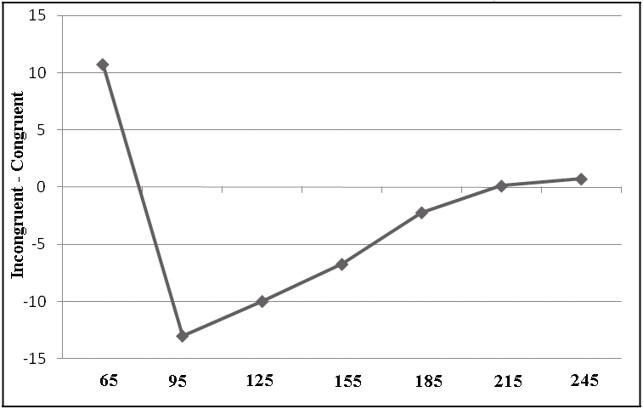
Simulation of different mask-target SOAs
Left: Modelling result at seven mask-target SOA lags.
Right: The same result in terms of Incongruent – Congruent (cycle).

Slide 29
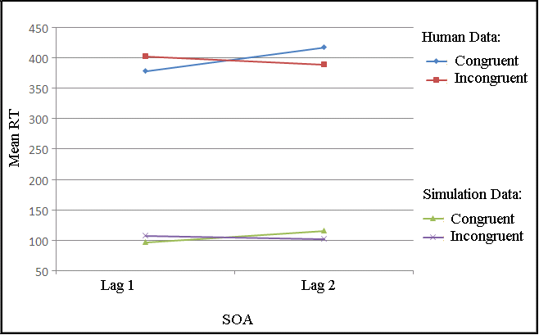
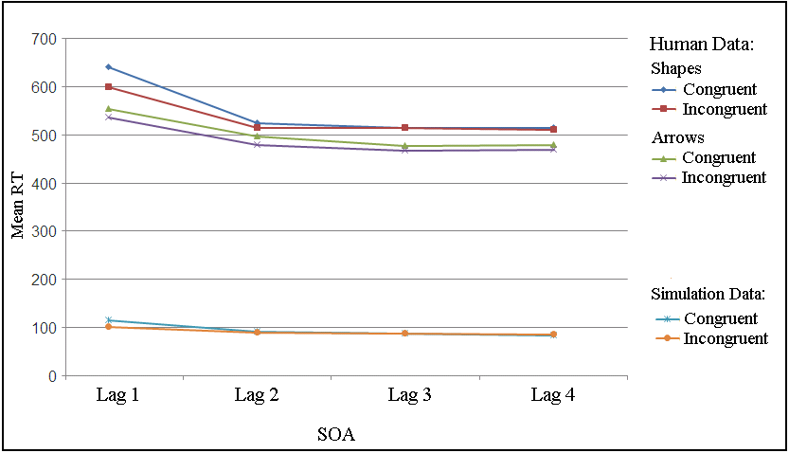
Simulation of PCE and NCE and corresponding human data
Left: Simulation data at 65 (lag 1) and 95 (lag 2) SOAs, to compare with human data at 48 (lag 1) and 112 (lag 2) SOAs (Schleghecken & Eimer, 2000).
Right: Simulation data at 95 (lag 1), 185 (lag 2), 215 (lag 3), and 245 (lag 4) SOAs, to compare with human data at 100 (lag 1), 200 (lag 2), 300 (lag 3), and 400 (lag 4) SOAs (Jaśkowski & Ślósarek, 2006).

Slide 30
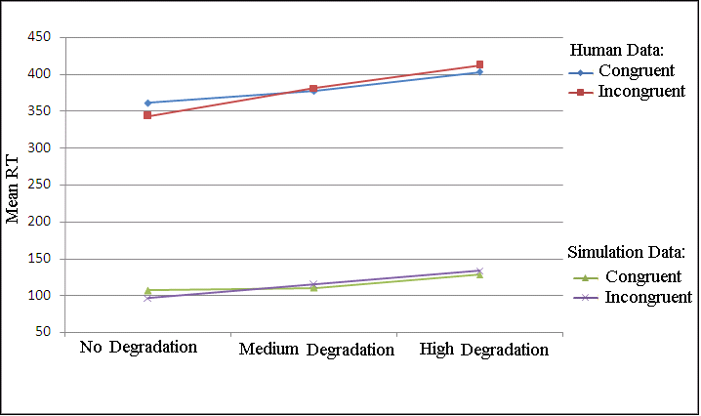
Simulation of stimuli degradation
Degradation with three levels of prime and target activation in IL: 1 (vs. 0), .85 (vs. .15), .75 (vs. .25), and an increase in noise.
With degraded unit activations NCE turned into PCE and RTs increased, as in Schleghecken & Eimer (2002, Exp. 4).

Slide 31
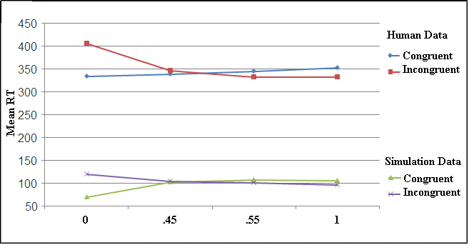
Simulation of mask density
Four levels of mask density, 1 (very high), .55 (medium), low (.45), and 0 (no mask) and human data (Eimer & Schleghecken, 2002, Exp. 1).

Slide 32
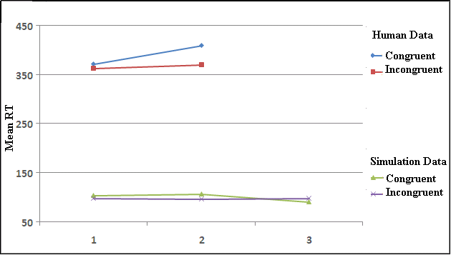
Simulation of mask relation
Mask relation simulated with three levels of excitation, 1 (.65 or low excitation), 2 (.75 or medium excitation), and 3 (.85 or high excitation) and human data (e.g., Lleras & Enns, 2006; Bennett, Lleras, Orient, & Enns, 2007) .

Slide 33
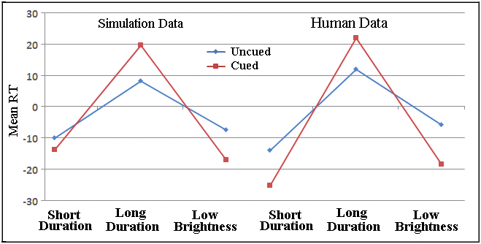
Simulation of spatial cueing
RT difference (Incongruent - Congruent) in the spatial attention modulatory effect on priming compared to no effect (human data from Summer et al., 2006).

Slide 34
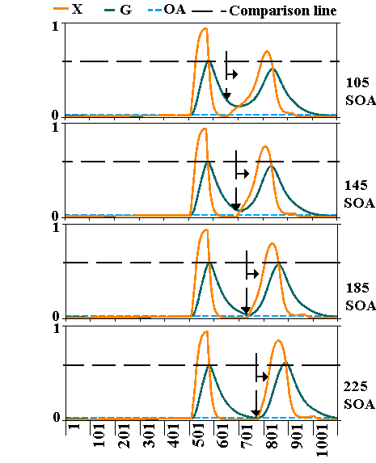
AA response
The changes in the
refractory period as
a function of SOA (in
masked congruent
trials and prime-target
strength 3-3) for
mask-target SOAs 105,
145, 185, and 225.

Slide 35
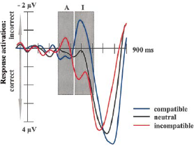
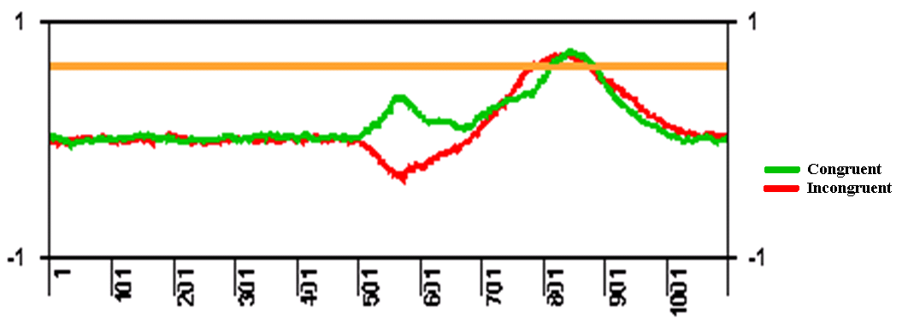
Left-Right in ML
Left: Domination of activation in the congruent and incongruent trials at short and long SOAs, respectively.
Right: ERP data (Eimer & Schleghecken, 1998)

Slide 36
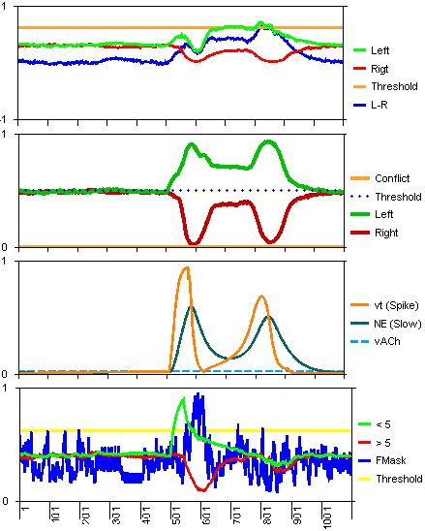
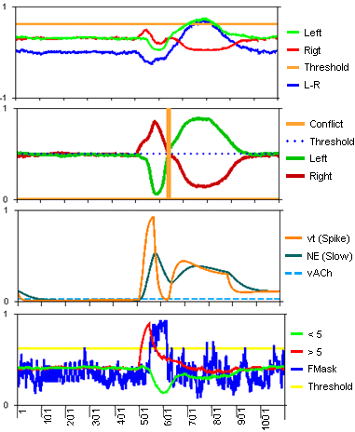


SOA 71, strength 3-3 Congruent (698 ms) Incongruent (721 ms)

Slide 37
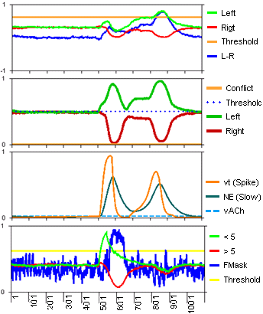
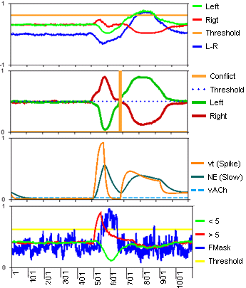
SOA 125, strength 3-3 Congruent (779 ms) Incongruent (762 ms)

Slide 38
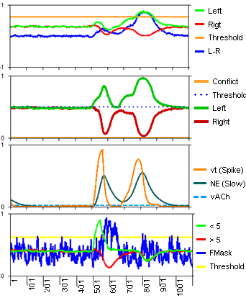
SOA 125, strength 3-3 Congruent (779 ms) Incongruent (772 ms)

Slide 39
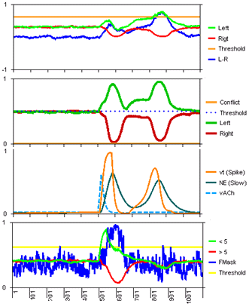
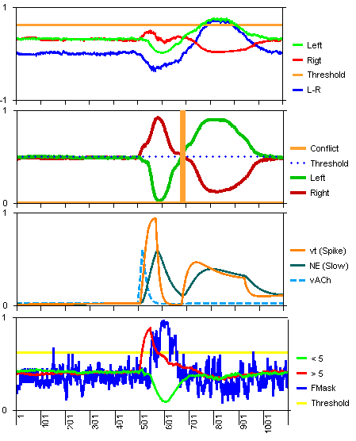
SOA 125, strength 3-3 Congruent (821 ms) Incongruent (762 ms)

Slide 40
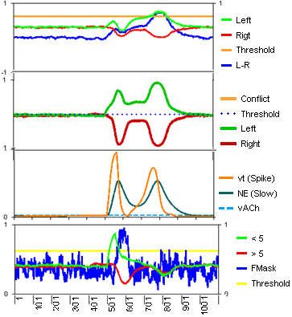
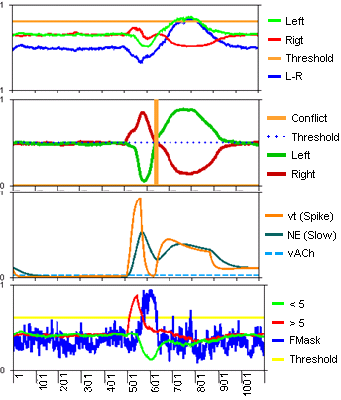
SOA 71, strength 2.5-2 Congruent (744 ms) Incongruent (727 ms)

Slide 41
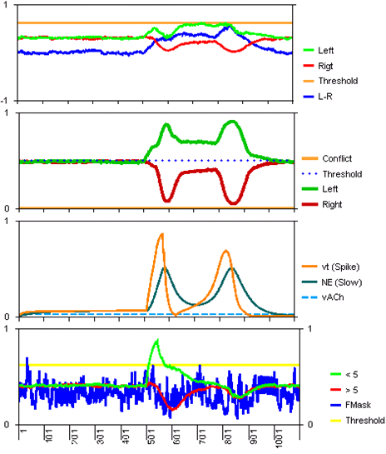
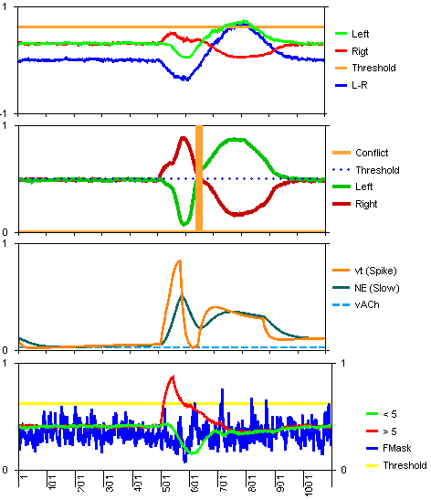
SOA 71, strength 2.5-2, unmasked Congruent (735 ms) Incongruent (738 ms)

Slide 42
Summary of results
Illusory line length made a priming effect similar to non-illusory.
Symbols learned as numbers could not prime but when used as target, and the prime was a numeral, an NCE was found, especially when the distance of prime and target was close to five.
Cueing the target type made the priming effects disappear.
The model simulated the current experiments and similar studies.

Slide 43
Conclusion
Response activation caused by a congruent prime is added to the one caused by the target and response activation caused by the incongruent prime competes with the one caused by the target, causing a PCE when the prime-target SOA is short (although the refractory period is removed by the conflict in the incongruent trials).
When the target comes late (long prime-target SOA) the prime activation decays and the target faces the refractory period of attention. Here, a congruent trial is slower than an incongruent one because the refractory period is removed by the conflict in the latter case.
A strong prime causes larger PCE and NCE at short and long SOAs, respectively.

