Slide 1


Normal and Abnormal Reading: Phonology and Dyslexia
Ahmad Sohrabi
Department of Psychology
University of Kurdistan

Slide 2
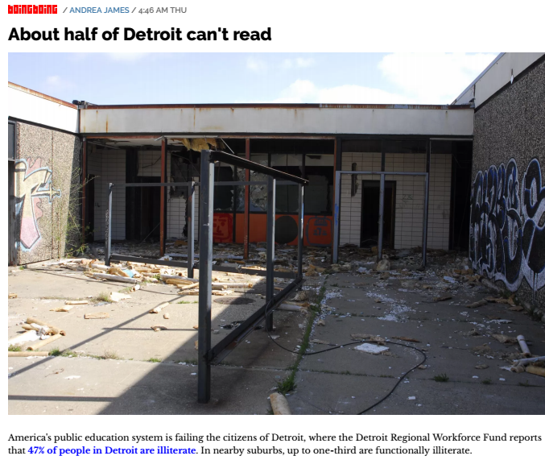
Introduction
Despite progress in educational and informational domains, many developed countries are not satisfied with their students’ reading competency level.
Studying factors playing roles in normal and abnormal reading can be helpful for tackling the problem (e.g., Seidenberg, 2013).

Slide 3
Intro, cntd.
Learning to read is a complex process, involving many aspects of vision, language, motor control, and attention.
Aoccdrnig to a rscheearch at Cmabrigde Uinervtisy, it deosn't mttaer in waht oredr the ltteers in a wrod are, the olny iprmoetnt tihng is taht the frist and lsat ltteer be at the rghit pclae. The rset can be a toatl mses and you can sitll raed it wouthit porbelm. Tihs is bcuseae the huamn mnid deos not raed ervey lteter by istlef, but the wrod as a wlohe.

Slide 4


Slide 5
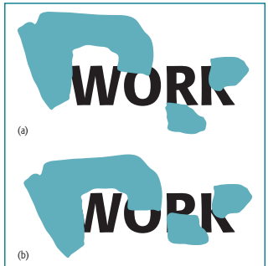

Slide 6
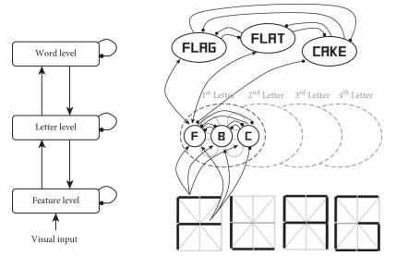

Slide 7
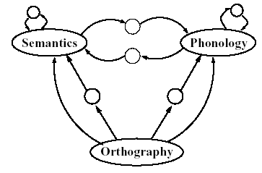
Visual perception (orthography) is important but it is a part of the whole story
Connectionist model of Seidenberg and McClelland (1989) re-implemented in Harm and Seidenberg (2001).

Slide 8
So where is the reading network in the brain-Symbols and brain (NFA and VWFA)
Written symbols such as letters or numbers are an addition to the mental toolkit of humanity.
Written symbols are too recent an invention, and not widely spread, for genetic evolution, to have had an impact.
So no surprise that the brain dedicates significant resources to recognizing them.
Recently extended to congenitally blind subjects.

Slide 9
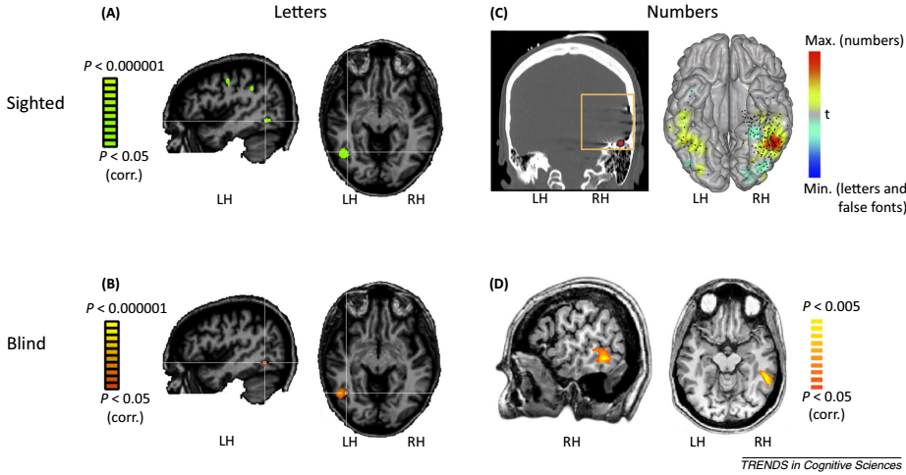

Slide 10
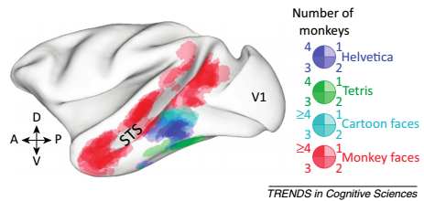
However, new evidence suggests that a brain symbol form system is shared by Old World monkeys and humans.

Slide 11
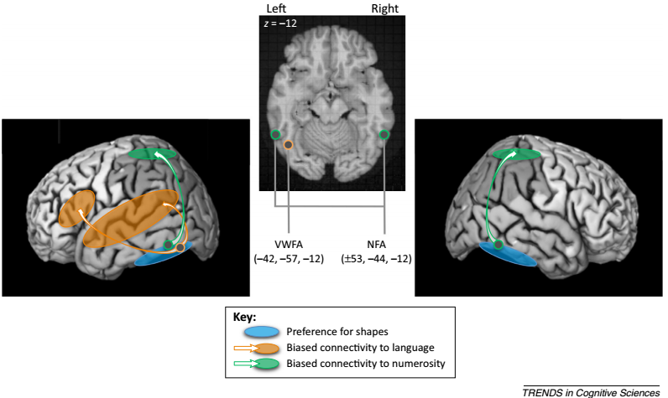
NFA and VWFA: former network is significantly more connected to regions that are involved in representing quantities (such as the rIPS), whereas the latter is significantly more connected to the left temporal cortex and the left inferior frontal gyrus (lIFG), which are notably recruited in language processing.

Slide 12
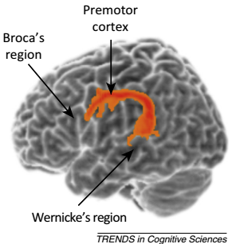
Dyslexia and Brain

Slide 13
Phonology
Evidence of inner speech and auditory imagery being, perceptual simulation and embodiment at the heart of textual comprehension (Zwaan, 2004; Zwaan, Madden, Yaxley, & Aveyard, 2004)
-It seems common for readers (and writers) to report ‘‘hearing” the voices of fictional characters, having a life of their own (Vilhauer, 2016
-When characters’ words are referred to in direct speech, voice-selective regions of auditory cortex are more active than during indirect reference (e.g., ‘He said, ‘‘I hate that cat”’ vs. ‘He said that he hates that cat’), suggesting auditory simulation of character’s voices (Yao, Belin, & Scheepers, 2011).
-Phonologically longer stimuli take longer to read than shorter stimuli of the same orthographic length (Abramson & Goldinger, 1997

Slide 14
Dyslexia
Dyslexia is defined as the failure to show age-appropriate reading skills among children (5-7 percent) despite their normal intelligence, education, and social background (e.g., Stanovich 1986; Ramus 2003).
It is either caused by brain damage or by abnormal development of reading such as less exposure to specific phonological or orthographic patterns,
What is left is the dysfunctional connection between the frontal and temporal language regions,
which behaviorally manifests itself as a deficit in access to otherwise intact phonological representations,
and which is evident in tasks requiring higher-level phonological processing such as conscious attentional control, noise tolerance, short-term memory of speech sounds.

Slide 15
Training
Many studies have shown that intervention in phonological awareness and decoding techniques can dramatically help dyslexic individuals (Tallal et al 1996; Merzenich et al 1996; McCandliss and Noble 2003).
Neuropsychological research has shown that phonological training causes neural changes in the brain of dyslexics (Habib & Demonet 2000; Simons et al 2002; Temple et al 2003).
video games containing tasks like speech and non-speech discrimination and phoneme manipulation in syllables and words, as a result of exposure to grapheme-phoneme mapping (e.g. Wagner et al, 1994) which illustrates the interaction between phonological skills and literacy.

Slide 16
Thanks!

