Slide 1
محاسبات عصبی-شناختی
در هوش مصنوعی
احمد سهرابی
دانشگاه کردستان

Slide 2
ذهن و بدن: فلاسفه قدیم
ارسطو: نفس، مجاورت
دکارت: ثنویت

Slide 3
هوش مصنوعی و علوم شناختی
عصب شناسی
دونالد هب
نوام چامسکی
ج. میلر
پردازش نماد
سیستمهای خبره
جان سیرل
شبکه های عصبی (گروسبرگ، راملهارت، ...)
آندرسون، نیوئل، ...

Slide 4
شبکه های عصبی
گروهی از واحدهای نرونی مرتبط
با نظارت - بدون نظارت
مبتنی بر وزن – مبتنی بر فعالیت

Slide 5
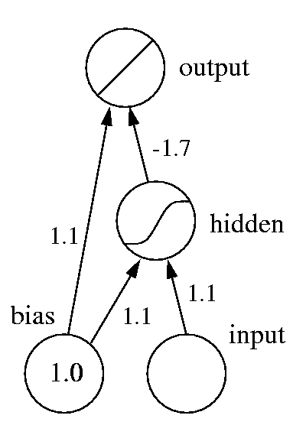
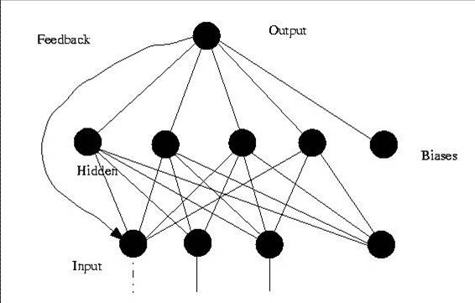
شبکه های عصبی چند لایه-با نظارت

Slide 6
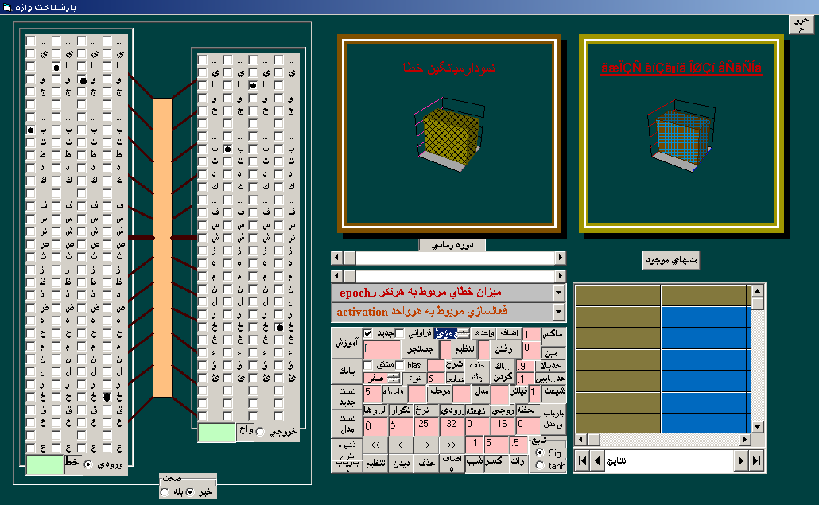
مثال: بازشناسی کلمه نوشتاری

Slide 7
شبیه سازی ترتیب یادگیری
Input patterns were random binary codes with 20% 1s and 80% 0s. The output patterns produced by changing 10% of bits from 1 to 0 or vice versa. 100 patterns were used for L1 and the same number for L2.

Slide 8
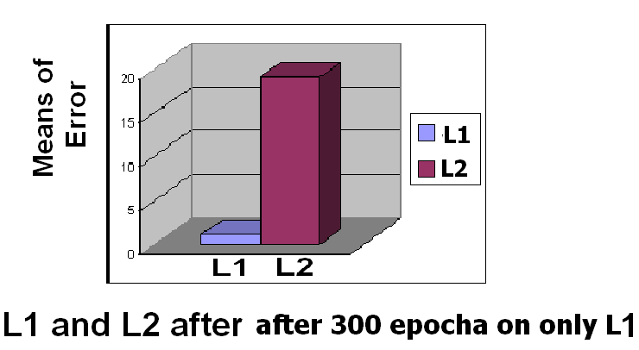
In simulation 1, only L1 was trained for 300 epochs. The model has not been trained on L2 at this moment.

Slide 9
In simulation 2, the trained model of simulation 1 was trained on L2 for another 300 epochs. As a catastrophic effect. the learning of L2 destroyed the learning of L1 because L1 has no longer been trained alongside L2.

Slide 10
In the last and main simulation, the trained model of simulation 1 was trained on both L1 and L2 for 600 epochs but L2 was trained with a higher frequency (1200 sweeps on L2 compared to 600 sweeps on L1). As shown, L1 keeps superiority for a long time even with rarely refreshing.

Slide 11
The nonlinear (logistic activation) function that its slope is greatest when its input is around 0, as at the start of training while decreases in both positive and negative directions as training proceeds.

Slide 12
Conclusion
This effect is due to the loss of plasticity in neural networks trained with error back propagation in which neurons have more capacity to change at the beginning of the learning L1 and leave less space for L2 to be learned. The nonlinear activation in these neurons gradually approaches its extreme levels of activation and doesn't change easily in latter training. This is like “first come, first served”.

Slide 13
آخرین مطالعه
آزمایش روی انسان
مدلسازی

Slide 14


آماده سازی حرکتی-معنایی
Introduction
In priming, a masked/unmasked stimulus (prime) can affect the processing of the following stimulus (target).
3 dhnpg 2
8 wfjnh 2
congruent
Incongruent
task
<5 >5
Prime Mask Target
Two opposite effects in priming:
Positive Congruency Effect (PCE); RTs in congruent trials are faster than incongruent.
Negative Congruency Effect (NCE); RTs in incongruent trials are faster than congruent!

Slide 15
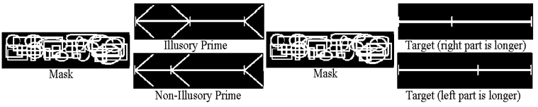
Experiment 1
Can illusions act as primes?
71 ms 43 ms 71 ms 200 ms
Examples of stimuli in Experiment 1 (perceptual representation)
The task was to select the longer part with a left or right key.

Slide 16
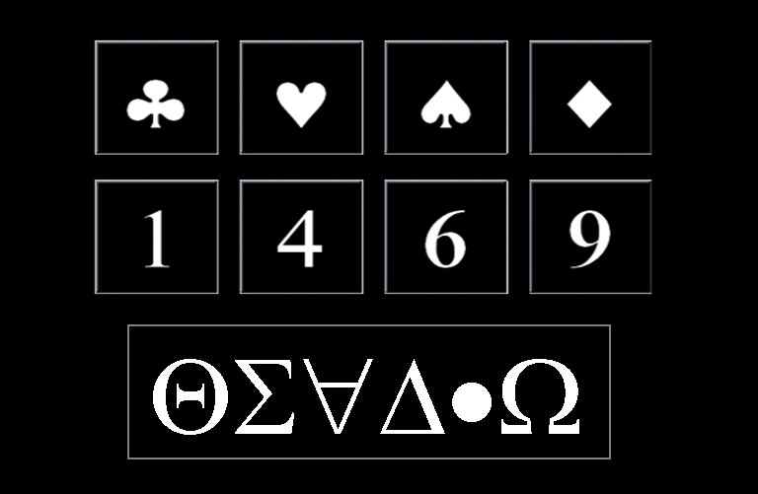
Experiment 2 (symbolic representation)
Can recently learned symbols produce priming effects?
Training and priming phases
The priming task was to press the left key for numbers <5 and the right key for numbers >5.
Two conditions in the priming task:
Symbol-Number
Number-Symbol
Prime or Target
Mask
Stimuli in Experiments 2-4

Slide 17
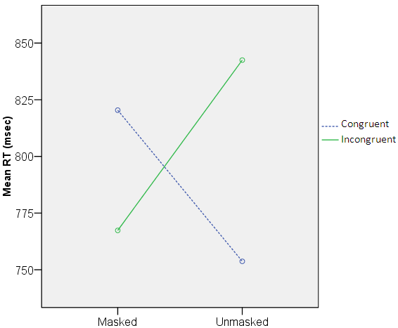
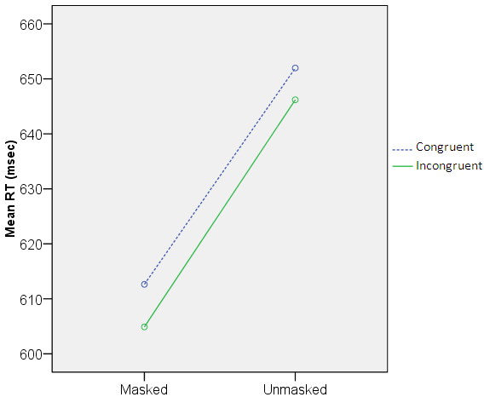
Experiment 2: results
Masking and Congruency effects
Number-Symbol Symbol-Number
NCE

Slide 18
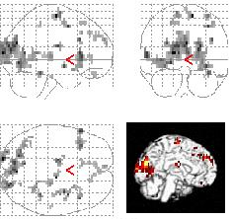
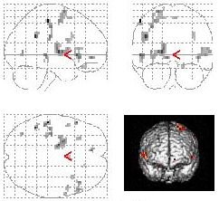
Experiment 1: fMRI results
Activation results :
Unmasked – Masked Illusory – Non-Illusory

Slide 19
Modeling Goals
Able to model a wide variety of effects with minimal and realistic parameter changes
Create a model that is neurally plausible
Based on established neural mechanisms and algorithms
Create a model that integrates basic cognitive mechanisms in a plausible way
It consists of different layers that are shown in the following slides: Input layer (IL), representation layer (RL), alert attention layer (AA), cognitive layer (CL) and motor layer (ML).

Slide 20
Different types of connections
Excitatory connection 
Excitatory crosstalk -
Self excitation L
Inhibitory connection •-•
Modulatory connection −♦

Slide 21
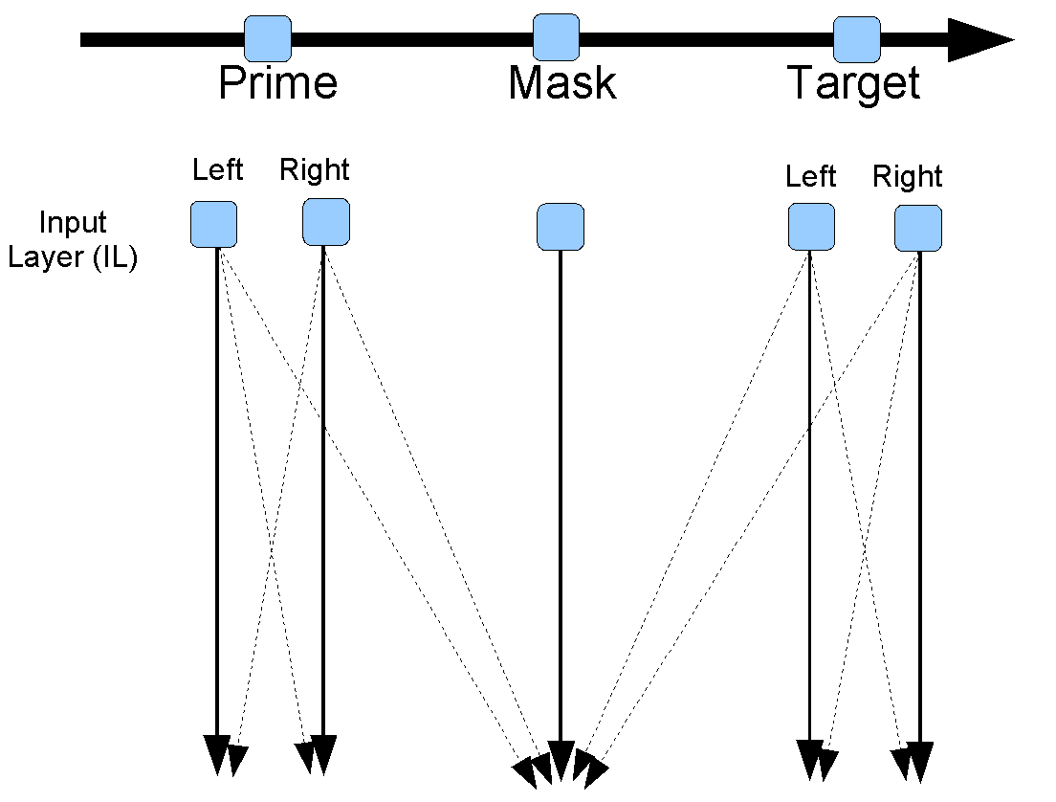

Slide 22
Weights determined by the relevance of the input for the
task

Slide 23
Weights determined by the relevance of the input for the
task
Projects to representation layer

Slide 24
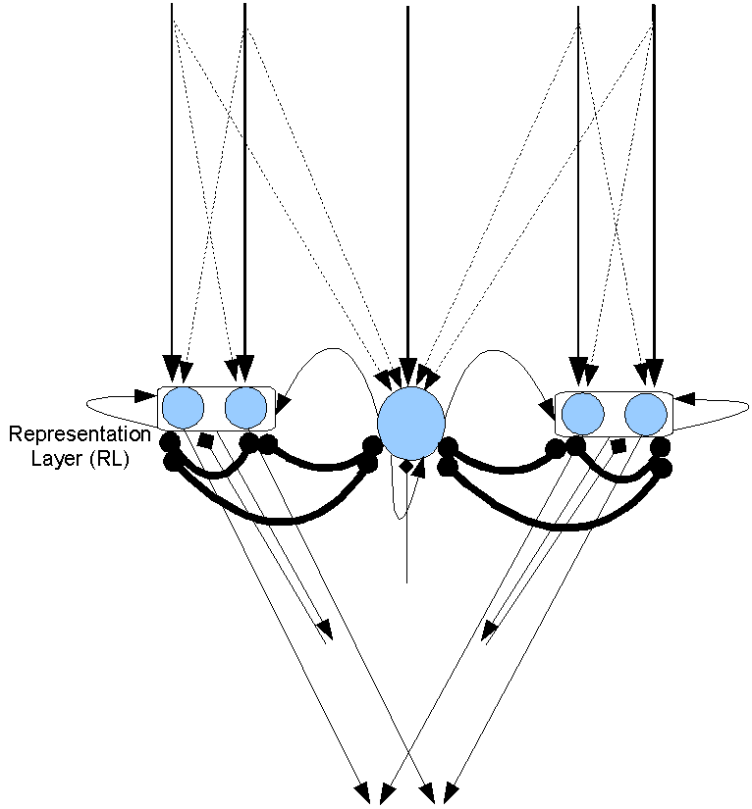
Prime
Mask
Target

Slide 25
Connections go to the attention system

Slide 26
Connections go to the attention system
And to the motor and cognitive systems (not show here)

Slide 27
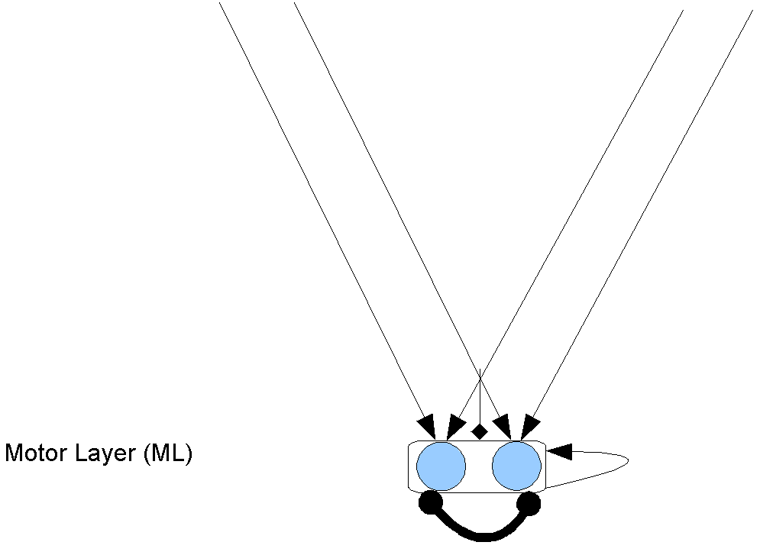
The motor layer does not feed back into the model. It just fires when it exceeds a threshold.

Slide 28
The motor layer does not feed back into the model. It just fires when it exceeds a threshold.
To simplify the presentation the motor layer will not be included in future diagrams of the model

Slide 29
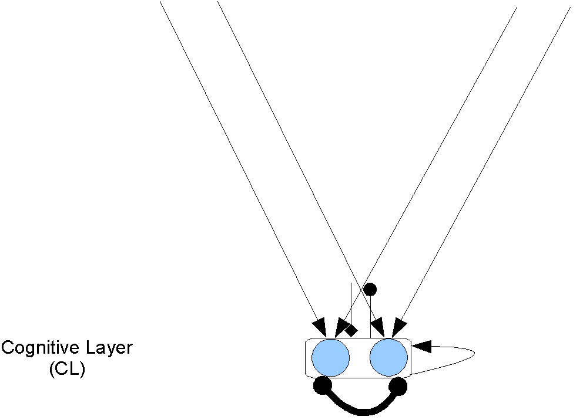
The cognitive layer is similar to the motor layer

Slide 30
The cognitive layer is similar to the motor layer
Conflict causes inhibition, which changes the attentional mode from phasic to tonic

Slide 31
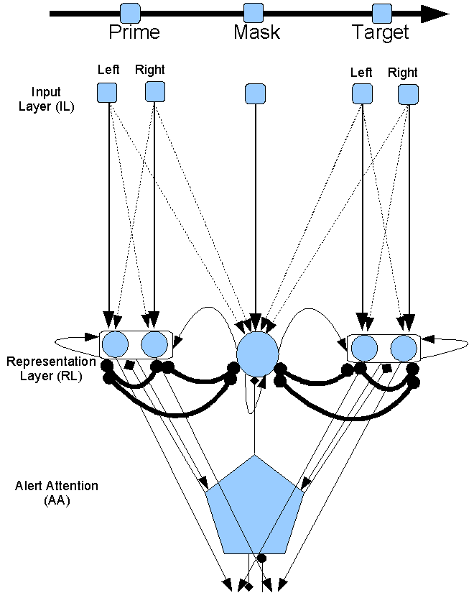
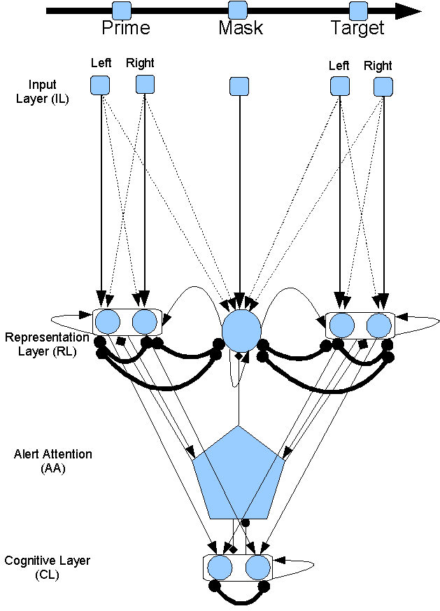
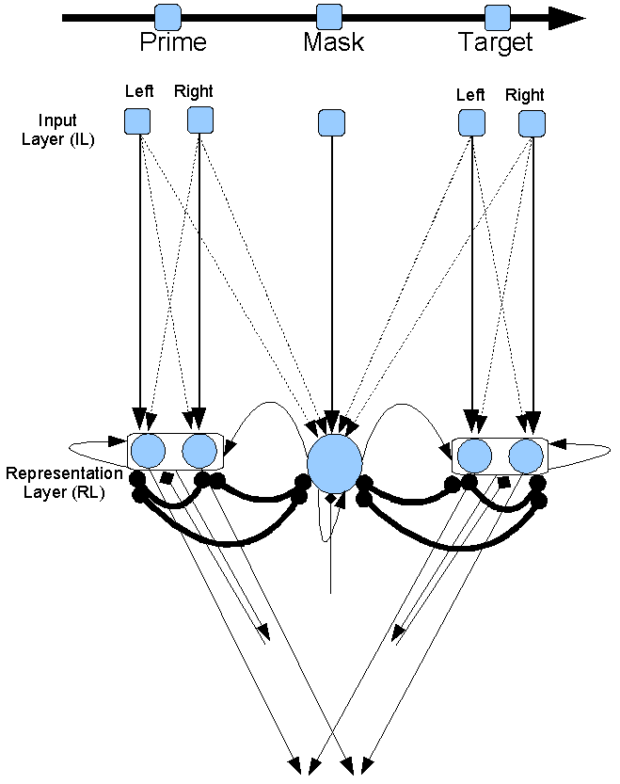
All layers together

Slide 32
Fitting the model
As noted, only the weights of IL-RL were adjusted in main conditions
No scaling was done, only the raw modeling results are shown
At this point the goal was to achieve qualitative fits across a range of results

Slide 33
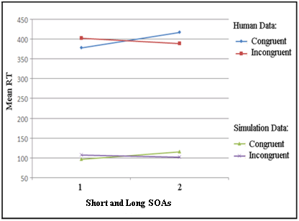
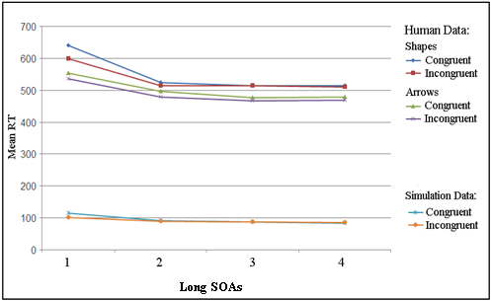
Simulation of PCE at short and NCE at long mask-target SOA
Shorter SOAs
Longer SOAs
Left: (Schleghecken & Eimer, 2000).
Right: (Jaśkowski & Ślósarek, 2006).
Notes:
This is the same result to compare with human data. The simulation is similar to human data.

Slide 34
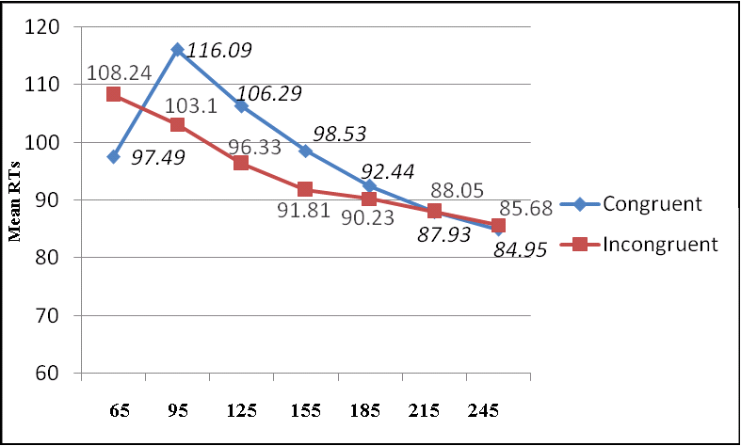
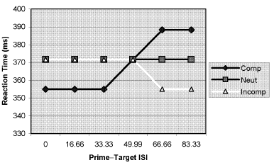
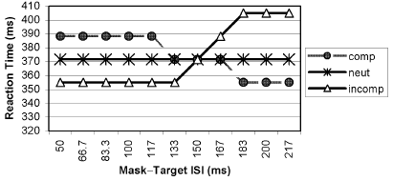
Current Model
Shorter
SOAs
Longer
Bowman et al.’s model
NCE
PCE
PCE
NCE
Notes:
There are some other factors that affects priming direction shown in previous studies. The main one is mask-target SOA or stimuli onset asynchrony or prime-mask SOA. A PCE has been shown with short SOA and an NCE with longer SOAs. The model simulated this effect. There is a model of this effect shown here. As you see it does not show a gradual decrease in RT and a slow decrease in NCE by time.

Slide 35
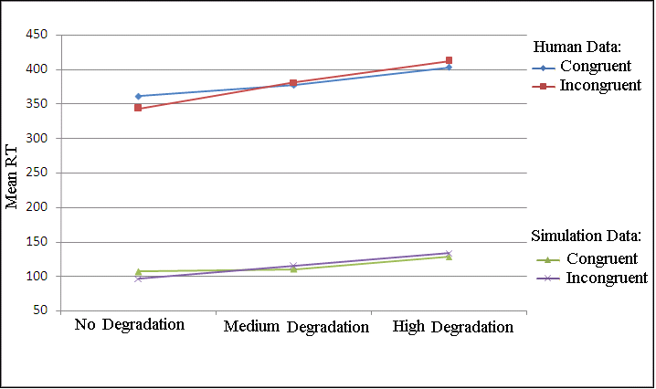
Simulation of stimuli degradation
Degradation result compared to human data (Schleghecken & Eimer, 2002, Exp. 4).
No degradation: 1 (vs. 0), Medium degradation: .85 (vs. .15), High degradation: .75 (vs. .25), and a small increase in noise in RL.
Notes:
Stimuli degradation (adding random dots to the background of the stimuli) turns NCE to PCE as happens in the simulation.

Slide 36
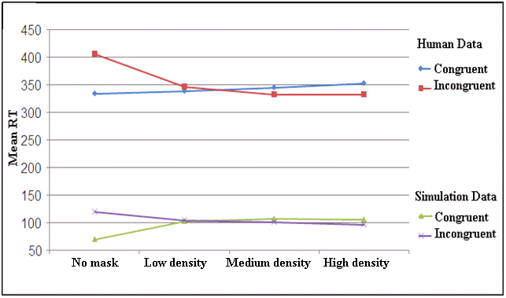
Simulation of mask density
Four levels of mask density (Eimer & Schleghecken, 2002, Exp. 1).
No mask, low density, medium density, and high density, simulated by mask unit’s activations 0, .45, .55, and 1 compared to ≥ 15, 10, 5, 0 random line masks in human data, respectively
Notes:
Decreasing mask density turns NCE to PCE as happens in the simulation (right to left).

Slide 37
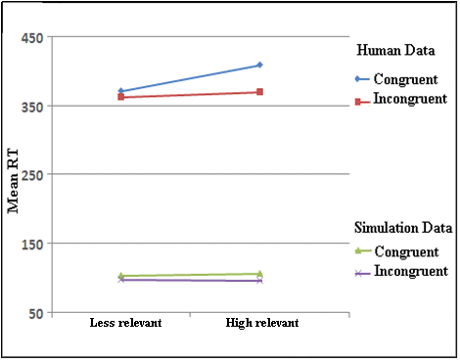
Simulation of mask relation
Mask relation compared to human data (Lleras & Enns, 2005).
By changing excitation from mask to Prime and target: low excitation (.65 ) and high excitation (.75) for less and high relevant mask, respectively.
Notes:
Larger NCE in the relevant masks.

Slide 38
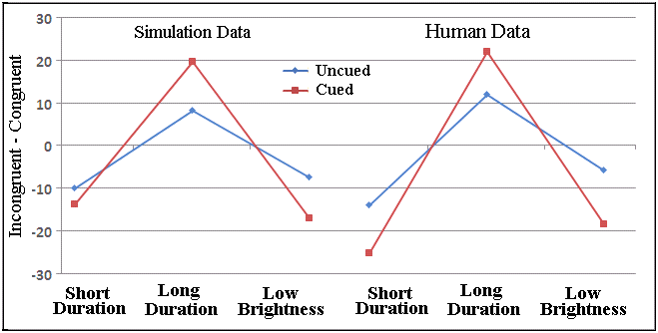
Simulation of spatial cueing
RT difference (Incongruent - Congruent) in the spatial attention to the prime compared to human data ( Summer et al., 2006).
Notes:
Cueing the prime location increases NCE and PCE as you see. This is the RT differences in Incongruent – congruent.

Slide 39
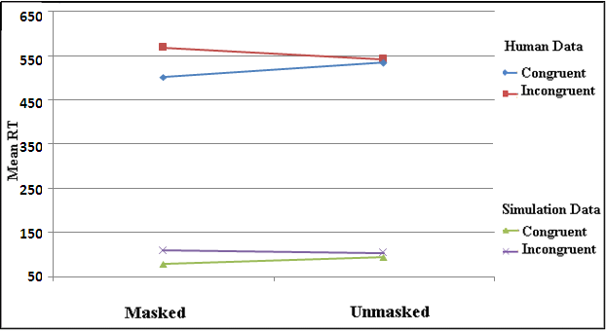
Simulation of masking effect in Experiment 1
Prime-target strength 3-3 (IL to RL weights),
with less phasic attention to the prime in the unmasked
Notes:
Simulation 1 simulated Experiment 1. As you see the PCE in the masked decreased in the unmasked similar to human data. Here are more details on this, if needed I will get back to this later.

Slide 40
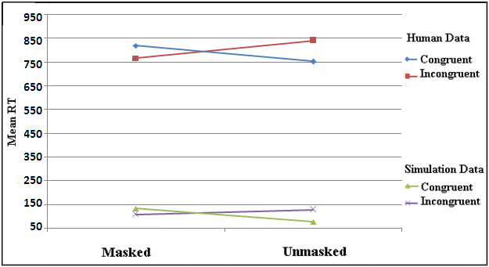
Simulation of masking effect in Experiment 2 (Number-Symbol)
Prime-target strength 2.75-2.25 (IL to RL weights),
with medium phasic attention to the prime.
Notes:
Simulation 2 simulated Experiment 2. As you see the NCE in the masked turned into PCE in the unmasked similar to human data. Here are more details on this, if needed I will get back to this later.

Slide 41
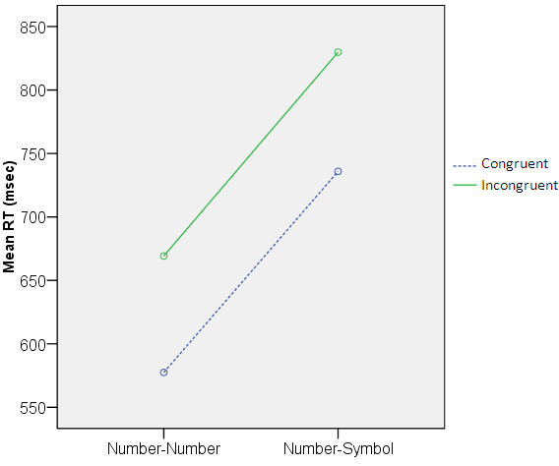
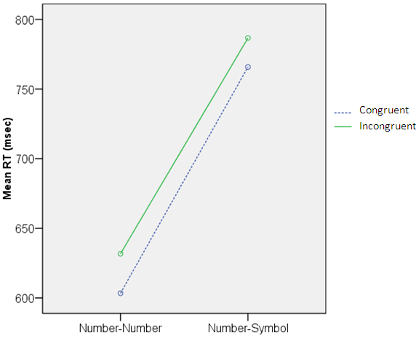
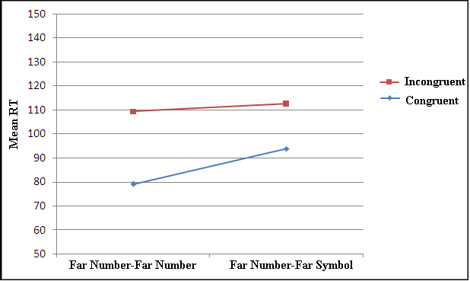
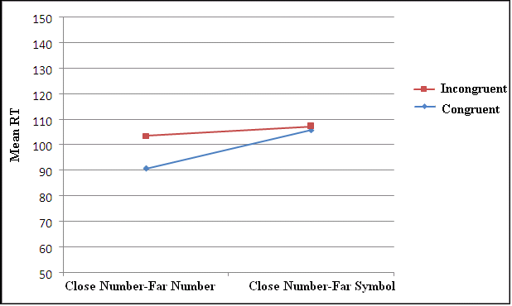
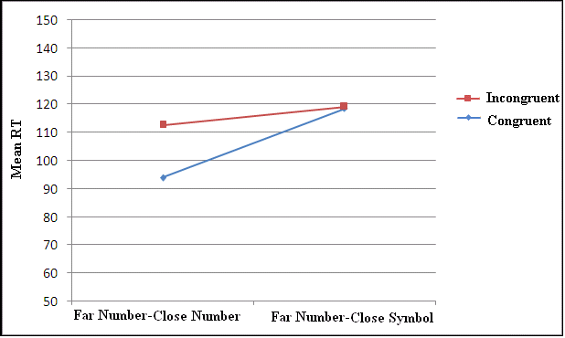
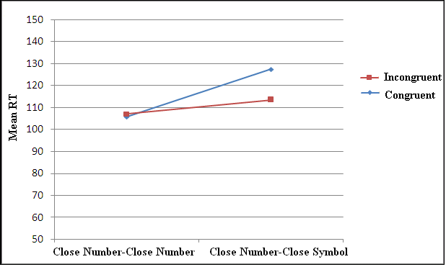
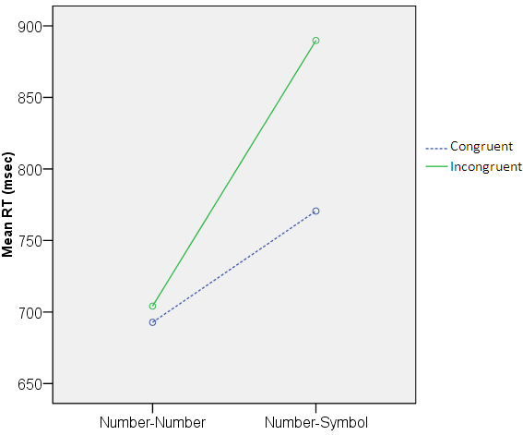
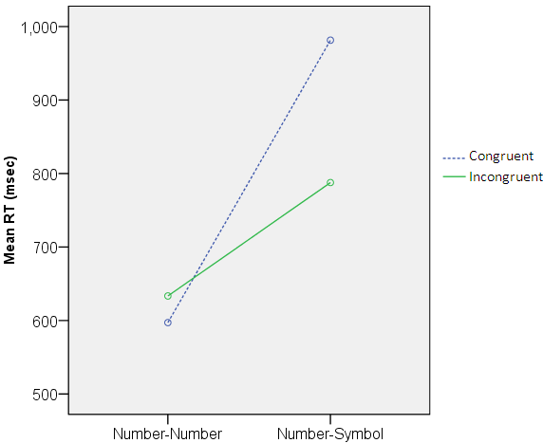
Simulation of type and distance effects in Experiment 3 cntd.
Far-Far Close-Far Far-Far Close-Far
Far-Close Close-Close Far-Close Close-Close
Human data Simulation results
Notes:
Simulation 3 simulated Experiment 3. As you see, the PCE and NCE was found in the simulation results similar to human data. If needed I will get back to this later for more details.

Slide 42
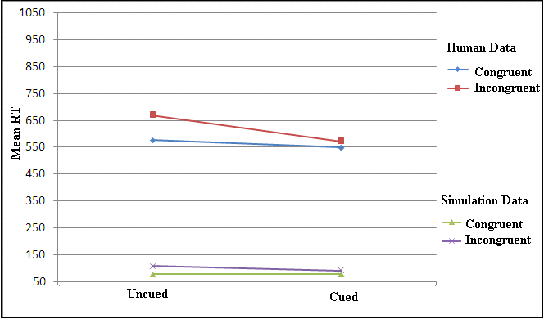
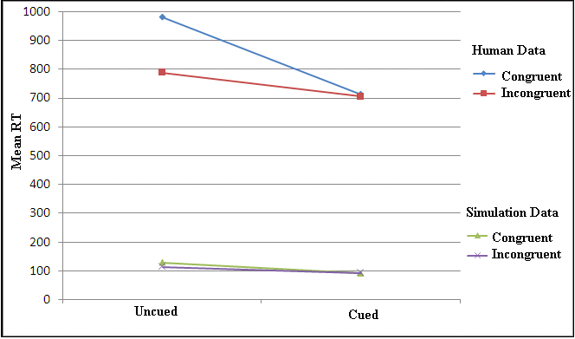
Simulation of Experiment 4 (cued) compared to Experiment 3 (uncued)
Far Number Prime and Far Number Target Close Number Prime and Close Symbol Target
Cue created an attentional refractory period (in AA) for the prime, making it weaker, but made the target stronger (modulated by OA), so it caused NCE and PCE disappear.
Notes:
Simulation 4 simulated Experiment 4. As you see the PCE and NCE disappeared by the cue similar to human data. More details on this if needed I will get back to this later.

Slide 43
Questions?

Slide 44
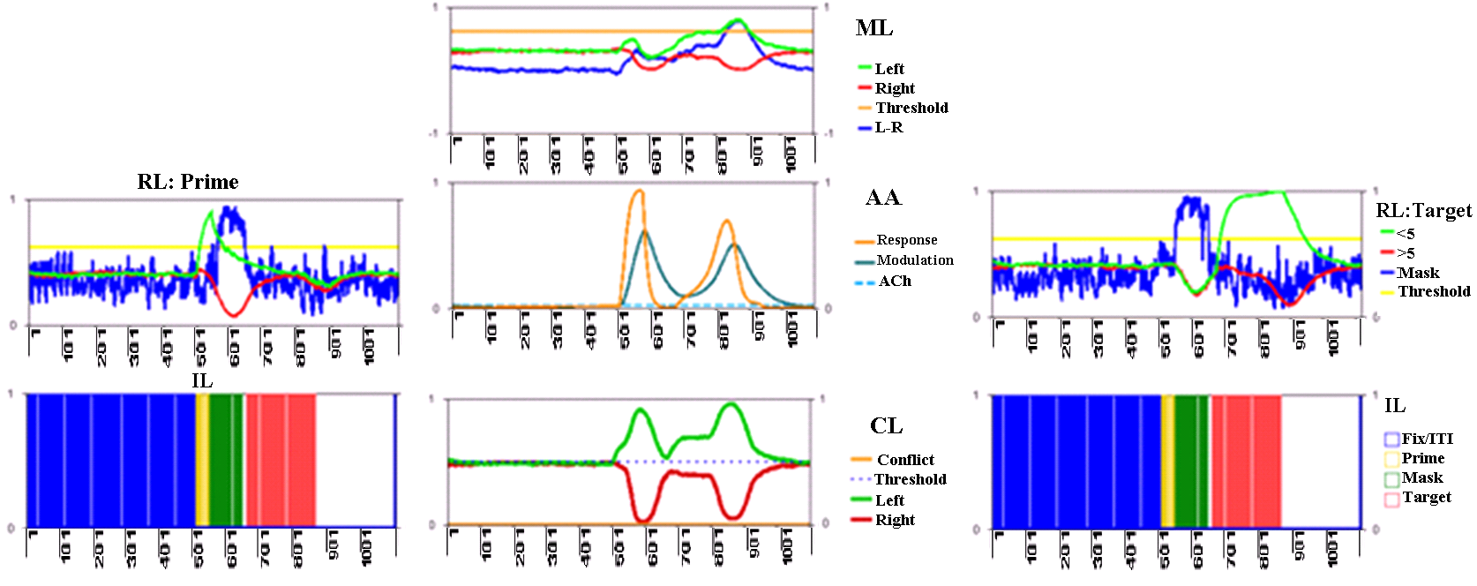
Activations in the model (a congruent trial, SOA 125)

Slide 45
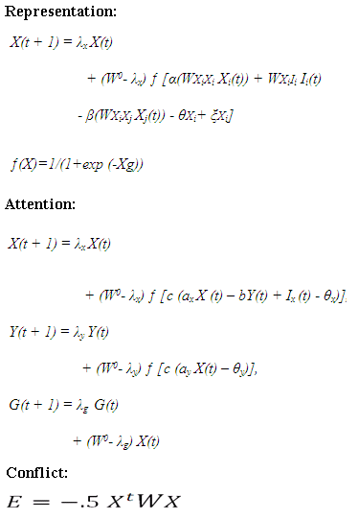
Some equations

Slide 46
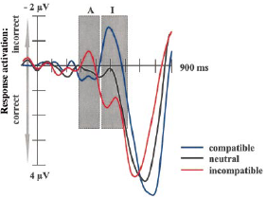
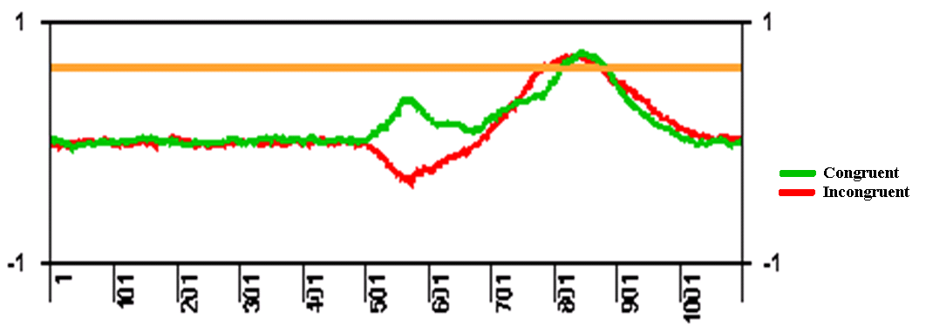
Left-Right in ML (congruent and incongruent trials)
Left: Domination of activation in the congruent and incongruent trials at short and long SOAs, respectively.
Right: ERP data (Eimer & Schleghecken, 1998)

Slide 47
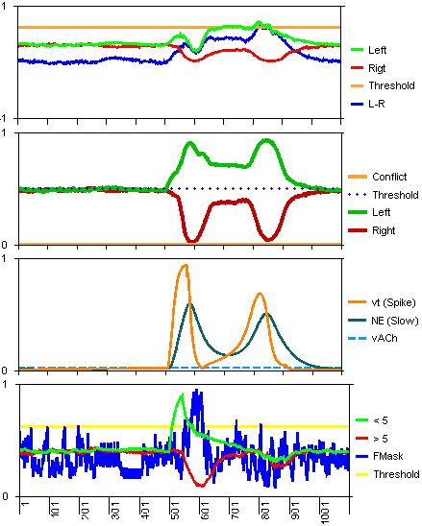
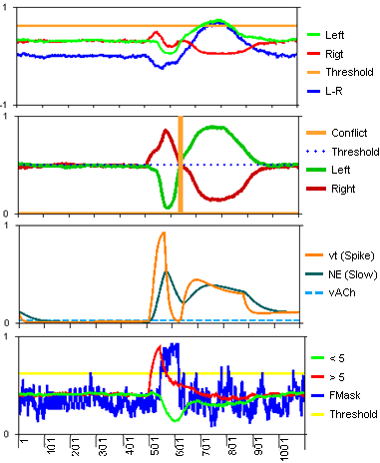


SOA 71, strength 3-3: Congruent (698 ms) vs. Incongruent (721 ms)

Slide 48
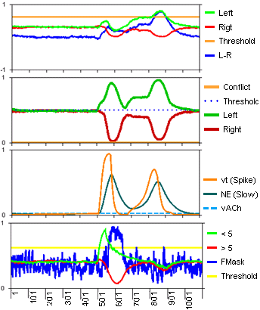
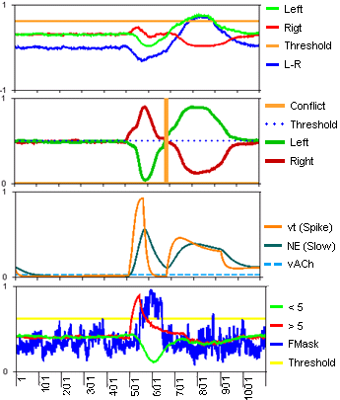
SOA 125, strength 3-3: Congruent (779 ms) vs. Incongruent (762 ms)

Slide 49
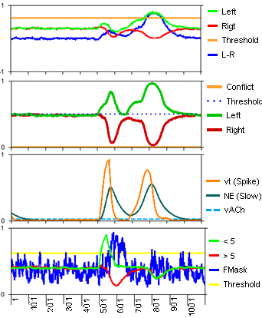
SOA 125, strength 3-3: Congruent (779 ms) vs. Congruent but irrelevant mask (772 ms)

Slide 50
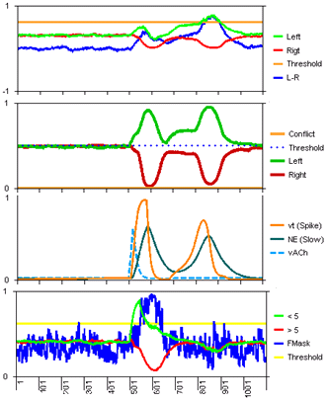
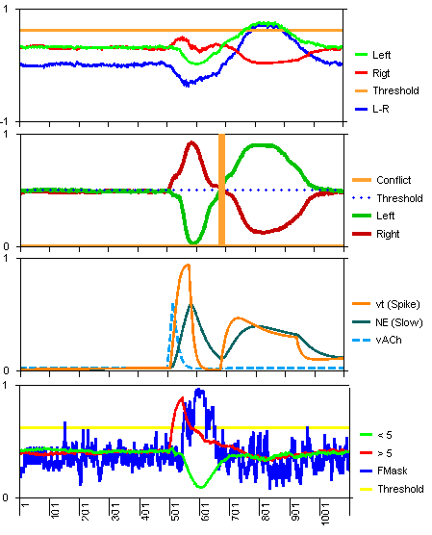
SOA 125, strength 3-3, cued prime: Congruent (821 ms) vs. Incongruent (762 ms)

Slide 51
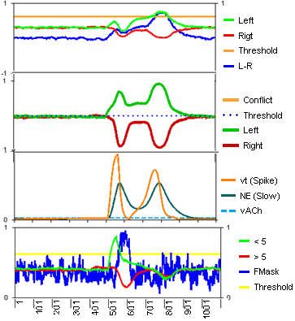

SOA 71, strength 2.5-2: Congruent (744 ms) vs. Incongruent (727 ms)

Slide 52


SOA 71, strength 2.5-2, unmasked: Congruent (735 ms) vs. Incongruent (738 ms)

Slide 53

AA response
The changes in the
refractory period as
a function of SOA (in
masked congruent
trials and prime-target
strength 3-3) for
mask-target SOAs 105,
145, 185, and 225.

Slide 54






Simulation 3: type and distance effects in Experiment 3
-Modelling results for all prime
target weight combinations.

