Slide 1
Cardiovascular Disease & Risk Factors
Andrew Sooklall, Guisha Ceus, Robert Mendoza, Varun Athreya, Zane Lynch

Slide 2
Intro
Cardiovascular Disease or better known as heart disease is the leading cause of death for both women and men in the United States.
About 630,000 Americans die from heart disease each year that’s about 1 in every 4 deaths
Some common risk factors for Cardiovascular Disease are hypertension, cigarette usage and obesity.
Another variable that can increase the risk of Cardiovascular Disease is a location’s temperature. Typically, prolonged and intense exposure to hot temperatures can lead to heat related illnesses or deaths.
Understanding Cardiovascular Disease is important because it is among the least understood, least researched, and least discussed chronic diseases.

Slide 3
Objective
The effects of risk factors such as Cigarette usage, Obesity, and Hypertension on Cardiovascular Disease (CVD) by death rate
The correlation of deaths in each state based on the Sex
Test whether or not temperature has an effect on CVD
Goal :
To gain clarification on what attributes to cardiovascular disease deaths.
Our goal is to educate individuals on what increases the risk of Cardiovascular Disease and how they can help prevent it through their health goals.

Slide 4
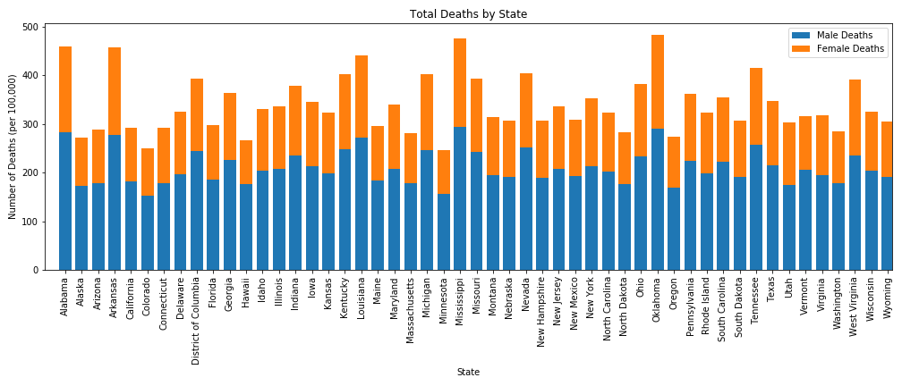
Total Deaths by State and Gender
CVD deaths are generally higher for males than females
The data is worth using considering that there are no major outliers for total deaths per 100,000

Slide 5
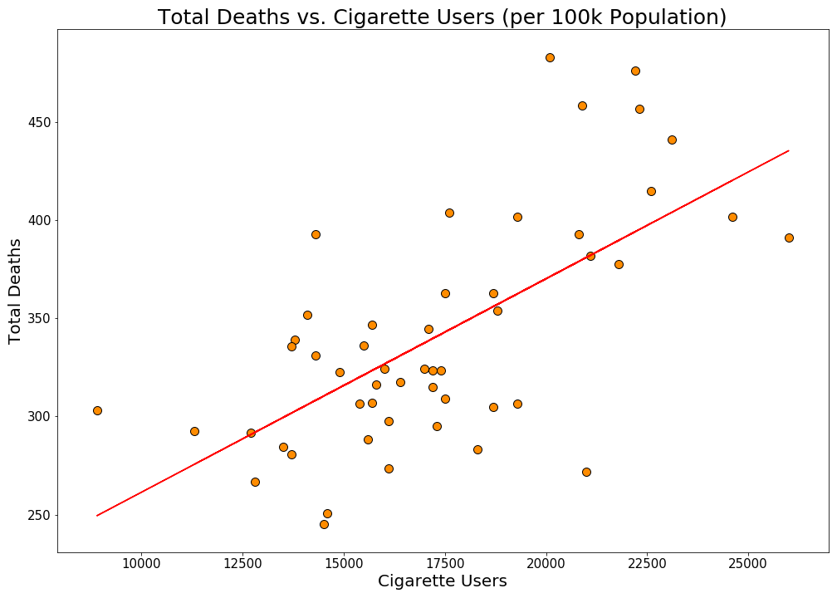
Total CVD Deaths vs. Cigarette Users
From the data shown, There is a correlation between cigarette usage and Cardiovascular Disease.
As shown, Higher Cigarette usage has a impact on total deaths of cardiovascular disease but the connection might need further investigation.
P-Value ≈ 2.145×10⁻⁷ (<5%)
R-Squared ≈ 43%

Slide 6
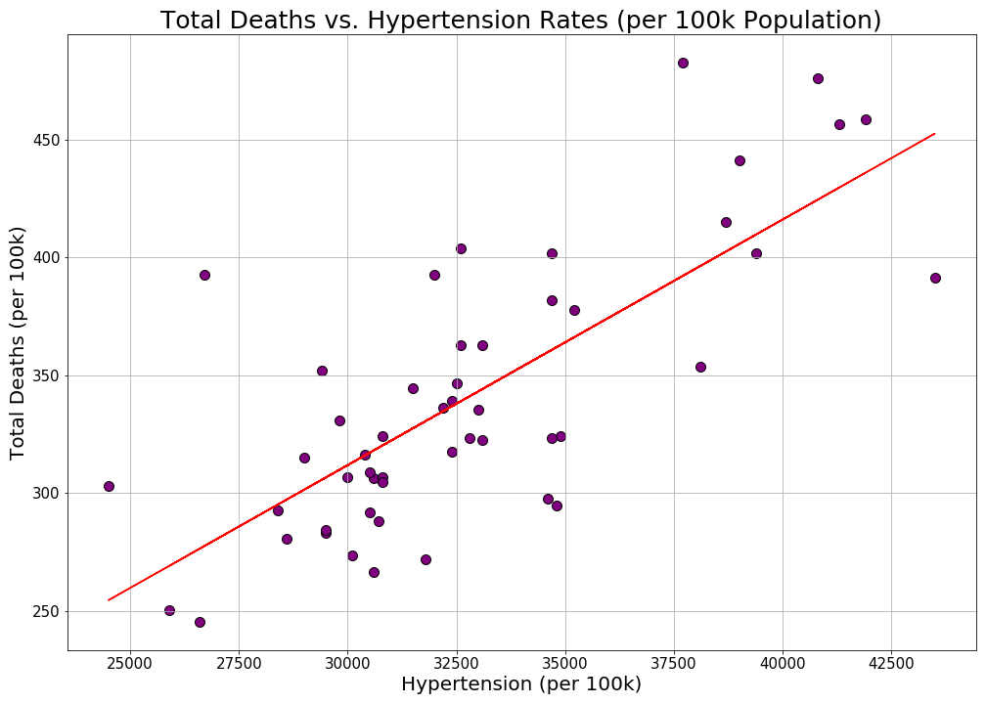
Total CVD Deaths vs. Hypertension
The graph shows that there is a positive correlation between Hypertension and total Cardiovascular deaths.
About half of the observed variation can be explained by the linear model fits the set of observations.
P-Value ≈ 2.280×10⁻¹⁰ (<5%)
R-Squared ≈ 56%

Slide 7
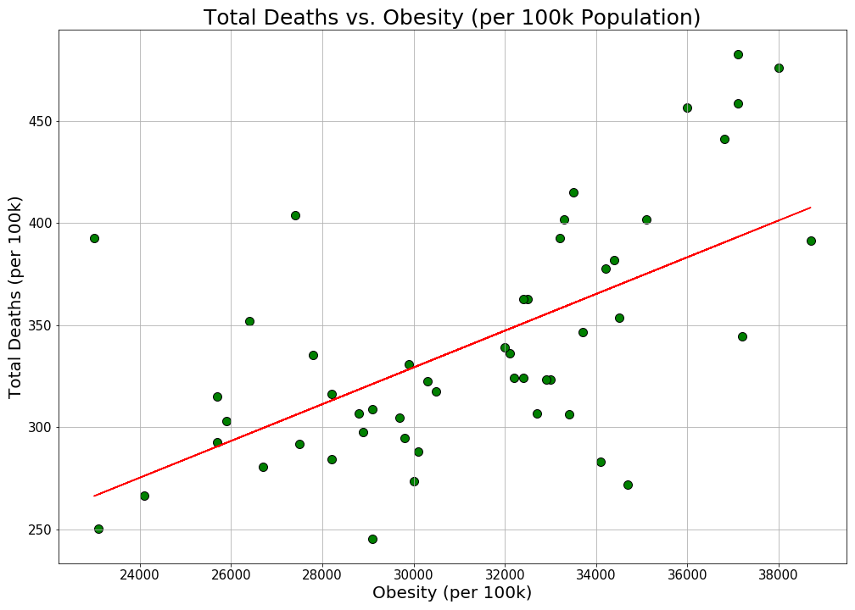
Total CVD Deaths vs. Obesity
This graph shows a positive correlation between total deaths and obesity
We hypothesized that obesity would have a positive correlation with CVD deaths
R-Squared ≈ 37%
P-Value ≈ 2.308×10⁻⁶ (<5%)
Not the most predominant factor of CVD, but is a major contributor

Slide 8
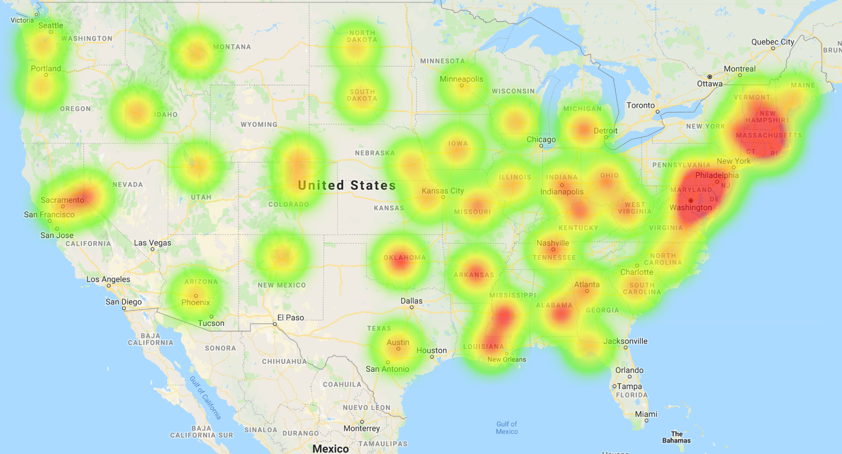
Heatmap of Total CVD Deaths

Slide 9
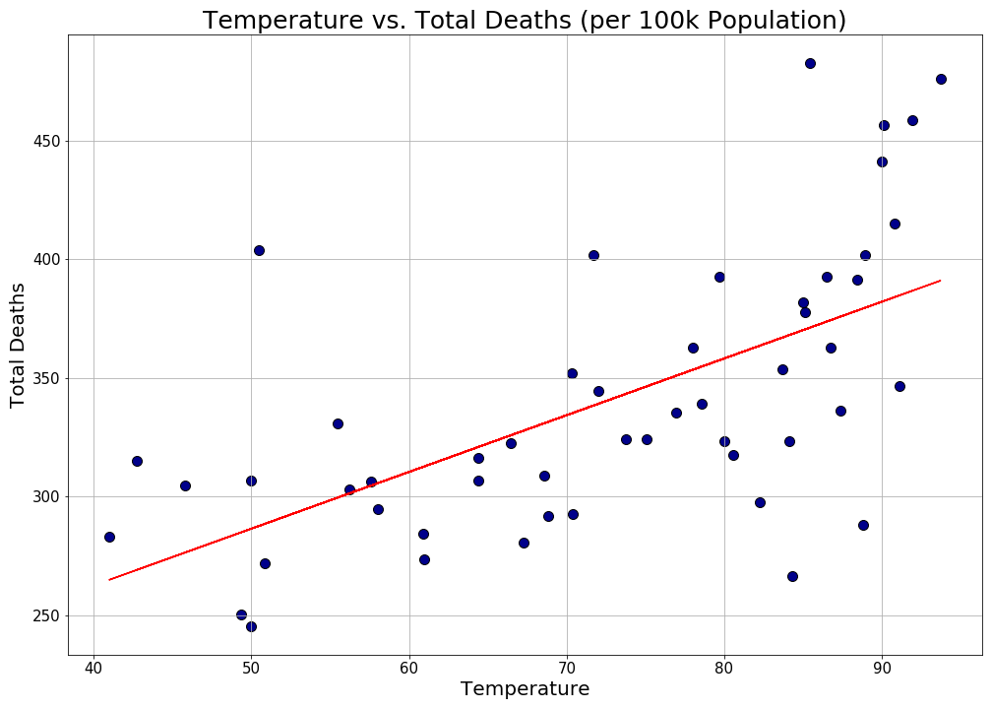
Total Deaths vs. Temperature
We hypothesized that higher temperatures would correlate with an increase in CVD deaths
For example, temperature can increase strain on the heart, thus posing a higher risk of death
R-Squared ≈ 26%
P-Value ≈ 1.455×10⁻⁶ (<5%)
Notes:
-Higher temperature may also increase exercise

Slide 10
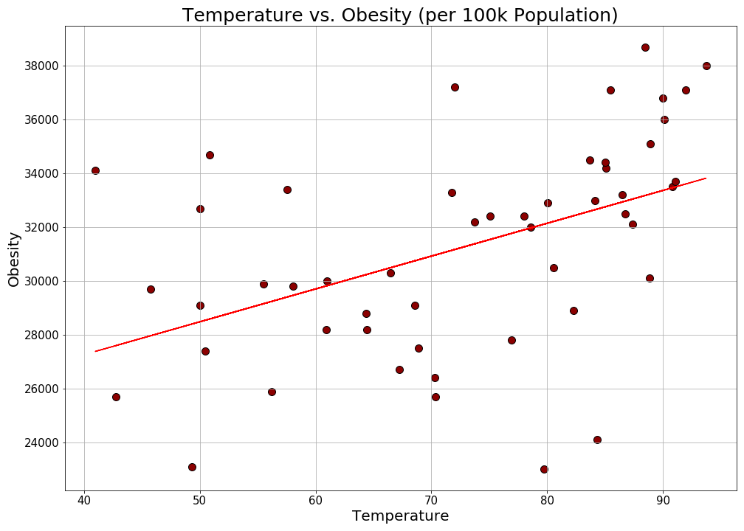
Temperature vs obesity
Based on previous results, we figured that temperature may also affect one of our previous variables, particularly obesity
Considering how in higher temperatures the body spends less energy to maintain thermal homeostasis, we expected a positive correlation
R-Squared ≈ 14%
P-Value ≈ 6.947×10⁻³ (<5%)

Slide 11
Data Collection and Methodology
Data for total CVD deaths, cigarette users, hypertension, and obesity came from the Center for Disease Control
This accounted for the condition of most Americans, but not undiagnosed persons
Data for latitude, longitude, and temperature were pulled from OpenWeatherMap
This was localized by capital
We used bar graph for total deaths by state to show how varied the data on CVD is as well as the difference in risk based on gender
For other variables based on health or temperature, we used scatter plots with linear regressions to test for correlation between data points

Slide 12


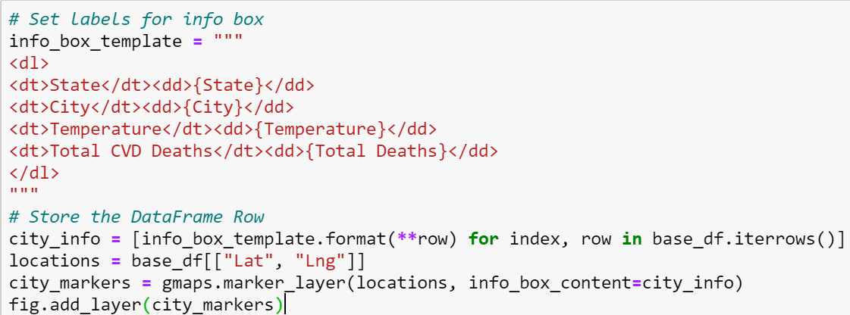
Data Collection and Methodology (cont.)
OpenWeatherMap API
Went by zipcodes instead of cities
Collected lat, lng, temps per capital
Added to dataframe
Heatmap and Markers
Mapped states using their capitals as a marker
Gmaps cannot map an entire state
Weights based on CVD deaths
Intensity based on max CVD deaths
Temperature & Total CVD deaths per city used as markers
For geographic/interactive perspective

Slide 13
Conclusion
Cardiovascular Disease remains a major cause of death in many regions. While Cigarette Use, Hypertension, and Obesity are definite risk factors associated with CVD, Temperature also has a positive correlation and should be looked into further.
FOR A FUTURE ANALYSIS
Evaluate the effects other variables have on Cardiovascular Disease such as stress, age, family history etc
Analyzing treatment options and how effective they are to the risk factors
Further investigate the correlation with temperature and potential lurking variables
Extrapolate the process to an international scale after finding a way to correct for inaccuracy of international data
WHAT WOULD WE DO DIFFERENT?
Collecting more data points for a deeper analysis (eg; multiple cities per state, or countries)
Doing box and whisker plots to check for outliers in larger data sets

Slide 14
Dataset Sources
https://www.cdc.gov/heartdisease/maps_data.htm
https://www.cdc.gov/dhdsp/maps/dtm/index.html
Smoking:
https://nccd.cdc.gov/DHDSP_DTM/rdPage.aspx?rdReport=DHDSP_DTM.ExploreByTopic&filter=area&islPriority=P2&islTopic=T9&islFilterby=1&go=GO
https://www.cdc.gov/tobacco/data_statistics/sgr/50th-anniversary/pdfs/fs_smoking_CVD_508.pdf
HTN:
https://nccd.cdc.gov/DHDSP_DTM/rdPage.aspx?rdReport=DHDSP_DTM.ExploreByTopic&filter=area&islPriority=P2&islTopic=T9&islFilterby=1&go=GO
https://www.cdc.gov/dhdsp/data_statistics/fact_sheets/fs_bloodpressure.htm
Obesity:
https://nccd.cdc.gov/DHDSP_DTM/rdPage.aspx?rdReport=DHDSP_DTM.ExploreByTopic&filter=area&islPriority=P2&islTopic=T9&islFilterby=1&go=GO
https://www.cdc.gov/heartdisease/men.htm?CDC_AA_refVal=https%3A%2F%2Fwww.cdc.gov%2Fdhdsp%2Fdata_statistics%2Ffact_sheets%2Ffs_men_heart.htm
OpenWeatherAPI for Latitude/Longitude and Temperatures
Google Maps API for heatmap and markers

