Slide 1
Surrounding Venues vs Real Estate Prices
SOWMYA ANNADATHA
Applied Data Science Capstone
IBM Data Science Professional Certificate

Slide 2
Problem Description
The main goal will be exploring the neighborhoods of New York city in order to extract the correlation between the real estate value and its surrounding venues.
The idea comes from the process of a normal family finding a place to stay after moving to another city.
It’s common that the owners or agents advertise their properties are closed to some kinds of venues like supermarkets, restaurants or coffee shops, etc.; showing the “convenience” of the location in order to raise their house’s value.

Slide 3
The target audience for this report are:
Potential buyers who can roughly estimate the value of a house based on the surrounding venues and the average price
Real estate makers and planners who can decide what kind of venues to put around their products to maximize selling price.
Houses sellers who can optimize their advertisements.

Slide 4
Problem Description
Part 2: Data We Need
The dataset will be composed from the following two main sources:
CityRealty which provides the neighborhoods average prices.
https://www.cityrealty.com/nyc/market-insight/features/get-to-know/average-nyc-condoprices neighborhood-june-2018/18804
FourSquare API which provides the surrounding venues of a given coordinates.

Slide 5
The process of collecting and clean data:
Scrap the CityRealty webpage for a list of New York city neighborhoods and their corresponding 2-bedroom condo average price.
Find the geographic data of the neighborhoods. Both their center coordinates and their border.
For each neighborhood, pass the obtained coordinates to FourSquare API. The “explore” endpoint will return a list of surrounding venues in a pre-defined radius.

Slide 6
The process of collecting and clean data:
Count the occurrence of each venue type in a neighborhood. Then apply one hot encoding to turn each venue type into a column with their occurrence as the value.
Standardize the average price by removing the mean and scaling to unit variance.

Slide 7
The result dataset
The result dataset is a 2 dimensions data frame
Each row represents a neighborhood
Each column, except the last one, is the occurrence of a venue type. The last column will be the standardized average price.

Slide 8
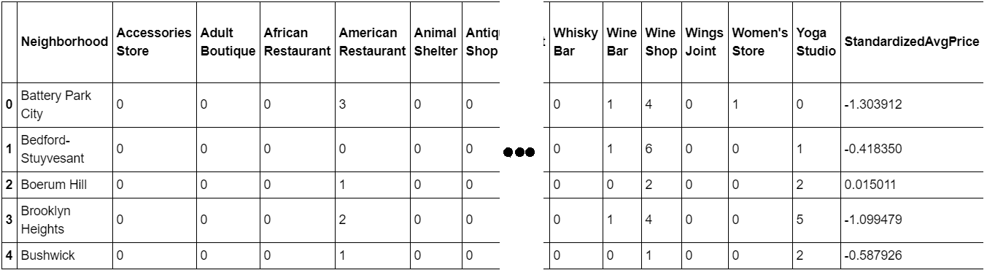
Result DATASET

Slide 9
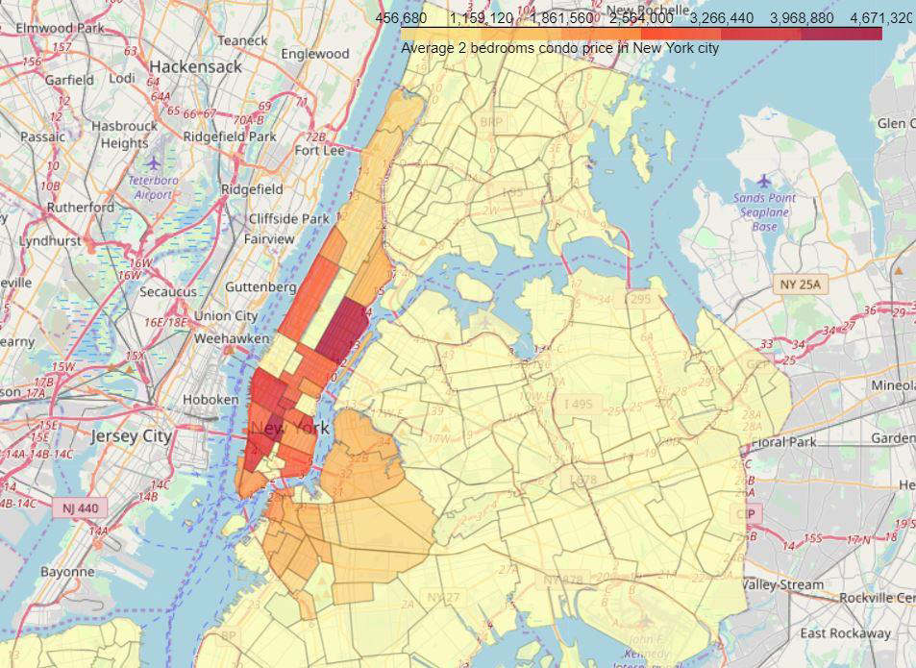
First insight using visualization: New York city real estate price spread between neighborhoods

Slide 10
Methods APPLIED

Slide 11
Linear Regression:
The model will contain a list of coefficients corresponding to venue types.
R2 score (or Coefficient of determination)
Mean Squared Error (MSE) will be used to see how well the model fit the data.

Slide 12
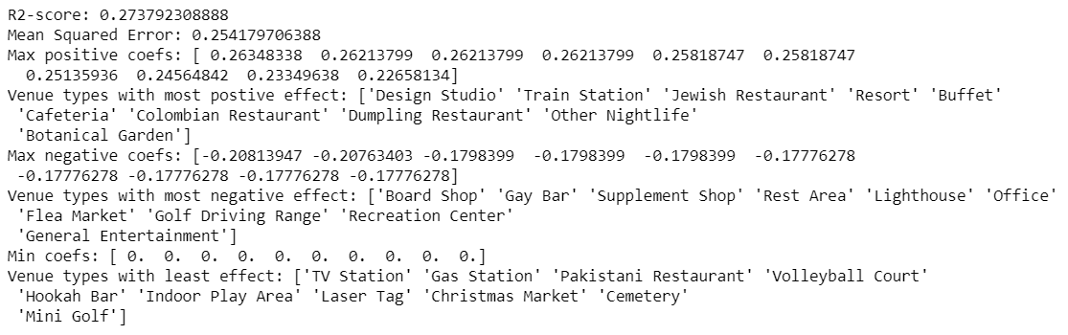
Linear Regression result

Slide 13
Linear Regression result
The result doesn’t seem very promising. R2 score is small, which means the model may not be suitable for the data.

Slide 14
Principal Component Regression (PCR):
PCR can be explained simply as the combination of Principal Component Analysis (PCA) with Linear Regression.
PCR employs the power of PCA, which can convert a set of values of possibly correlated variables into a set of values of linearly uncorrelated variables called principal components.
As the result, the number of features is reduced while keeping most of the characteristic of the dataset.

Slide 15

Principal Component Regression (PCR):
Then PCR use Linear Regression on the converted set to return a coefficient list
Again, R2 score and MSE are used to see how well the model fit the dataset.
The result is promising as it shows improvement over the simple Linear Regression.

Slide 16
Conclusion
Even though the scores seem to be improved after applying a more sophisticate method, the model is still not suitable for the dataset.
Thus, even better model can be used to precisely predict a neighborhood average price.

Slide 17
THANK YOU

