Slide 1
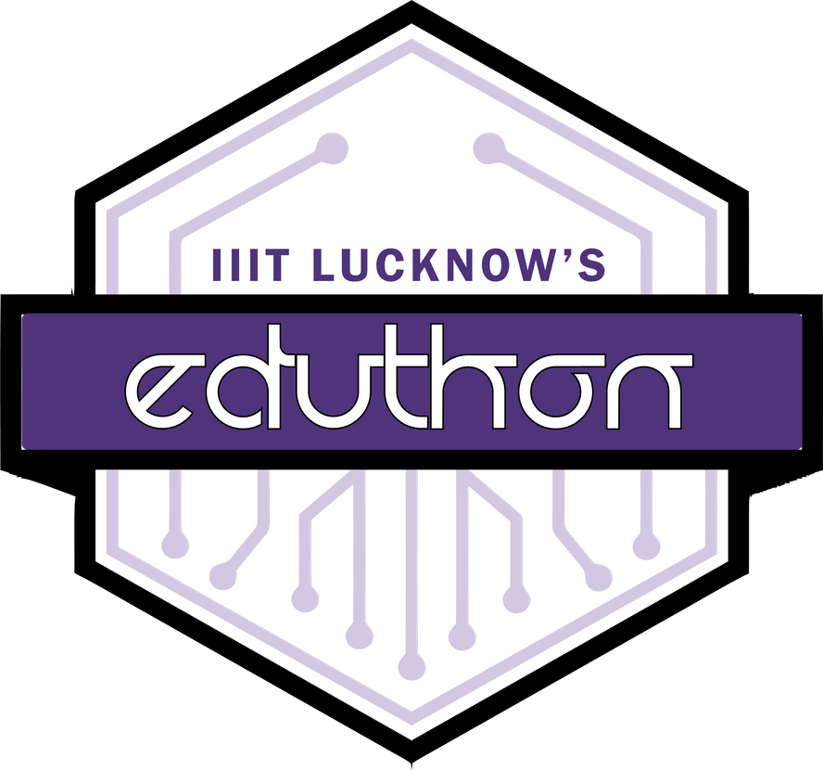

D-ELECTIONS
Voting In The New Era
A3-Trios
Aakash Tomar
Aditi Srivastava
Anmol Sharma
EDUTHON-EDUCATION THEMED HACKATHON
01

Slide 2

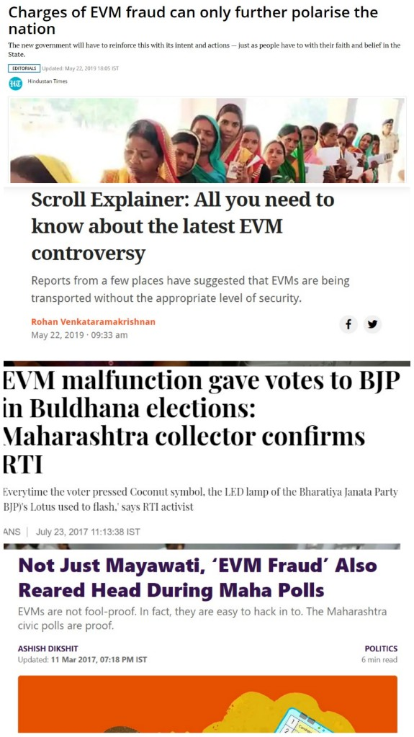
PROBLEM STATEMENT
Electronic voting machines have been viewed as flawed, by the security community, primarily based on physical security concerns. Anyone with physical access to such machine can sabotage the machine, thereby affecting all votes cast on the aforementioned machine.
As mentioned here,the EVM system is questioned for it’s security and working ,various times in the past.
Current EVM system is not quite transparent and most of the important powers has been given to a third party authority .
It gives a single entity control over tallying votes and determining an elections result.

Slide 3

PROPOSED SOLUTION
Decentralized Elections makes the public electoral process cheaper, faster, and easier, is a compelling one in modern society. Making the electoral process cheap and quick normalizes it in the eyes of the voters, removes a certain power barrier between the voter and the elected official by making it a transparent and more fair process, and puts a certain amount of pressure on the elected official. It also opens the door for a more direct and transparent form of democracy. These Blockchain networks can work as voting booths with each constituency having their own private blockchain network and their voters as it's nodes. This new decentralized system takes us in the new era by providing highly secured and transparent blockchain technology. It makes the process fairer as it doesn't give much power to a third party to tamper with any vote. It makes the process more transparent as it ensures and proof to a voter, that the voters vote, was counted and counted correctly. It's also quite fast as the voting smart contract deployed on the network is designed in such a way that it gives us results very fast and in a well-ordered manner by using time data typed variables. It cuts off the transportation process of EVMs.

Slide 4

4.
UNIQUE SELLING POINTS
Although the Blockchain Technology sounds more complex and difficult but It gives a very easy and simple client interface.
1.
Publicly Distributed, Transparent ,fairer,fast and most secure way to conduct elections
5.
It's also quite fast as the voting smart contract deployed on the network is designed in such a way that it gives us results very fast and in a well-ordered manner by using time data typed variables. It cuts off the transportation process of EVMs.
2.
It cuts off the transportation process which was an essential and most difficult job in EVMs system
3..
4.
It gives people the real powers and making the process more transparent to elect there representative.

Slide 5

YOUR TECH STACK
1.
BLOCKCHAIN TECHNOLOGY
Used at Back-End to provide a secured and fast network to the project
2.
Java Script , WEB3 JS
Used to integrate and connect the blockchain network and the client interface
3.
HTML and CSS
Used at the Front-End for the simple and sophisticated client interface..

Slide 6
THANK YOU

