Slide 1
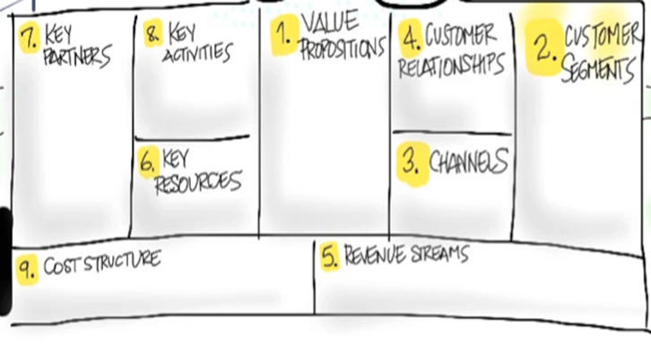
Kohl Morris, John Gravois, Curtis Laborde, and Tristan Evans
We need help in advertising, so we should partner up with an advertising company.
The key activities involves networking and providing a good experience to the customer.
Many gamers need someone to play video games with, and we offer the solution. We help gamers find their new friends to play with.
We offer a service that helps people that is easy to use.
The majority of players play their games online. However, they often do not have a friend to play with and often half to play with random people.
We will use online advertising because the majority of gamers are on the internet as well.
We need a network, data storage, and programmers.
The costs will mainly consist of money for advertising and takes a lot of time.
We generate our money through ads and subscriptions.

