Slide 1
LUNG CANCER prediction
MENU
ANALYSIS
CONTACT
Data ANALYSIS
PROJECT 2
GROUP 6

Slide 2
GROUP 6 MEMBERS
FATEMA JUNAED
ANJUM SIDDIQUA TANVEER SIDDIQUI
MOAZ ADIL ABDUGADIR JALAL
MUHAMMAD AIMAN HAIQAL SALEHUDDIN
MENU
ANALYSIS
CONTACT
Data ANALYSIS
01
02
A23CS0289
A23CS0016
03
04
B23CS0050
A23CS3025

Slide 3
INTRODUCTION & BACKGROUND
MENU
ANALYSIS
CONTACT
Data ANALYSIS
Hypothesis testing 2 samples
Correlation
Regression
Chi-Square Test of Independence
Anova

Slide 4
Methodology
MENU
ANALYSIS
CONTACT
Secondary data
https://www.kaggle.com/datasets/rashadrmammadov/lung-cancer-prediction?resource=download
Title : Lung Cancer Prediction Dataset
Population data
Variables : 38
Population Size : 23658
Sample Data
Variables : 7
Sample Size : 100

Slide 5
01
MENU
ANALYSIS
CONTACT
Data ANALYSIS
HYPOTHESIS
HYPOTHESIS TESTING 2 SAMPLES

Slide 6
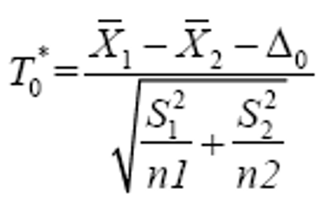
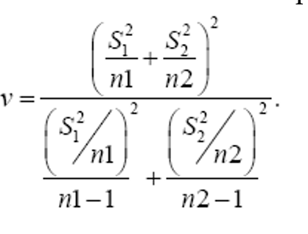
2 Sample Hypothesis testing
Hypothesis statement:
H0 : μ1= μ2
H1 : μ1≠ μ2
Where,
μ1 = Mean of tumor size in non-smoker
μ2 = Mean of tumor size in the smoker
Test statistics: Degrees of freedom:
Results:
Test statistic, t0= 0.977
Degrees of freedom, v = 96.4905
The critical value is,t0 > t0.025,96.2 = 1.9850 or t0 < t0.025,96.2 = -1.985
Conclusion:
Since, t0= 0.977 < t0.025,96.2= 1.985, we reject the null hypothesis. There is evidence to conclude that the mean tumor size in smokers is different from the mean tumor size in non-smokers.

Slide 7
02
MENU
ANALYSIS
CONTACT
Data ANALYSIS
CORRELATION
RELATIONSHIP BETWEEN AGE AND SURVIVAL MONTH

Slide 8
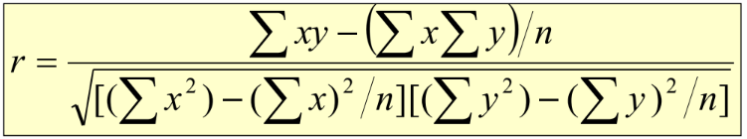
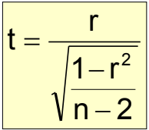
CORRELATION
MENU
ANALYSIS
CONTACT
Data ANALYSIS
H0: ρ = 0 (no linear correlation)
H1: ρ ≠ 0 (linear correlation exists)
α = 0.05, degrees of freedom,
df = 100 − 2 = 98.
Test statistic:
Whereby,
r = Sample correlation coefficient
N = Sample size
X = Value of the independent variable
Y = Value of the dependent variable

Slide 9
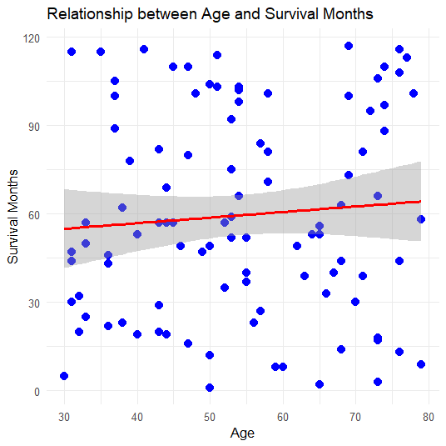
CORRELATION
MENU
ANALYSIS
CONTACT
Data ANALYSIS
Scatter plot of Survival Month of patient with lung cancer and Age of patient with lung cancer

Slide 10
CORRELATION
MENU
ANALYSIS
CONTACT
Data ANALYSIS
Conclusion
Since the P-value is 0.4311, which is greater than the significance level of 0.05, we fail to reject the null hypothesis. There is insufficient evidence of a linear relationship between the age of lung cancer onset and survival months at the 0.05 significance level.
Result
Test statistics: t =0.79065
95% confidence interval:
(-0.1186594, 0.271824)
α = 0.05
P-value: 0.4311

Slide 11
03
MENU
ANALYSIS
CONTACT
Data ANALYSIS
REGRESSION
RELATIONSHIP BETWEEN AGE AND SURVIVAL MONTH

Slide 12
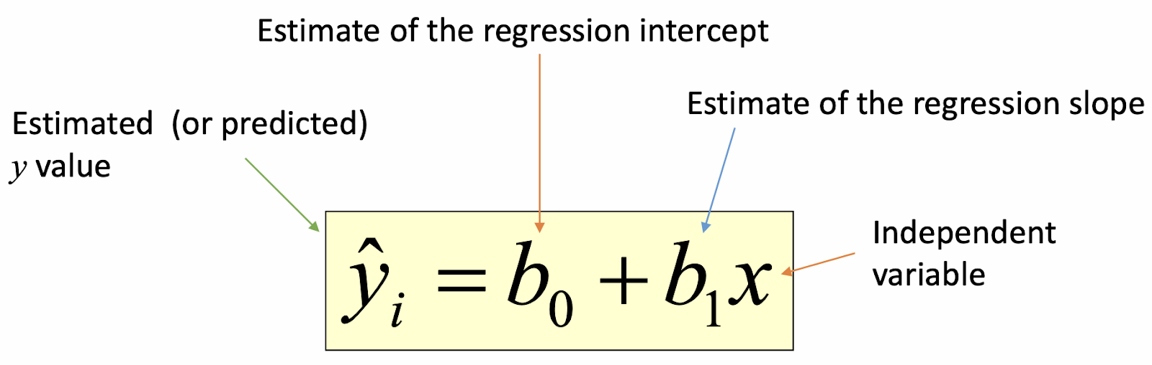
Relationship between age and survival months
Estimated Regression Model:
b0 is the estimated average value of y (survival months) when the value of x (age) is 0.
b1 is the estimated change in the average value of y (survival months) due to a one-unit change in x (age).

Slide 13
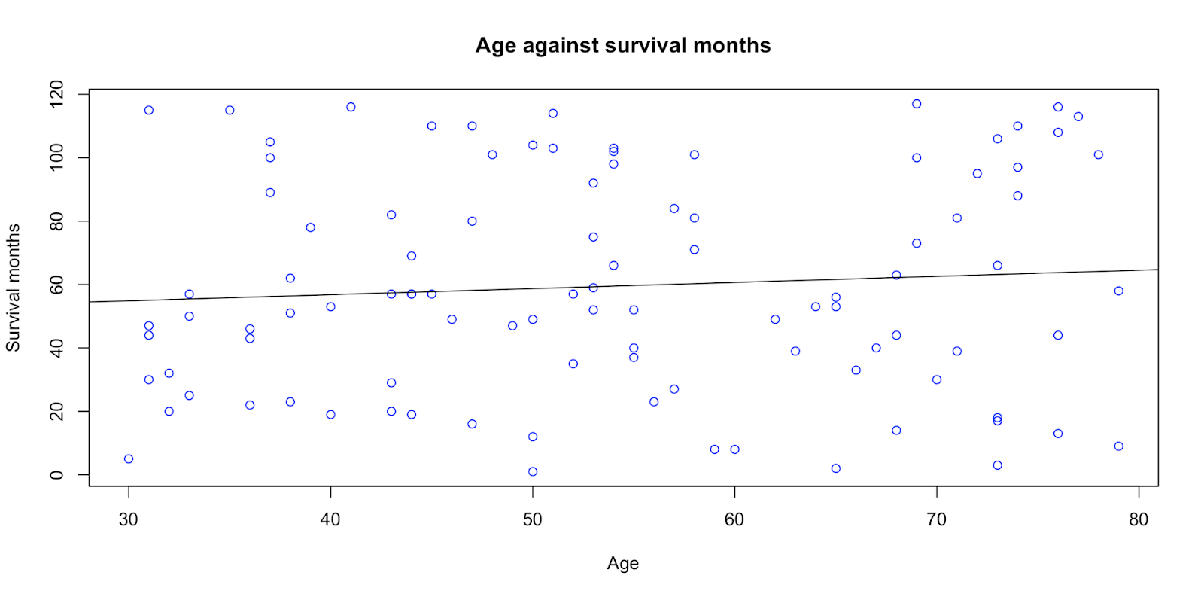
BAr plot
ŷ = 57.0732 + 0.0449x

Slide 14

interpretation
Interpretation:
The survival months are not zero for any age groups, so b0 = 57.0732 indicates that the survival months are within the range of months observed, 57.0732 months is the period that is not explained by the age factor.
Here, b1 = 0.0449 tells us that the average Age increases by 0.0449 years on average for each additional month of survival.

Slide 15
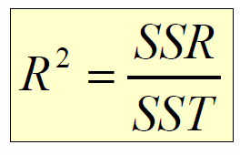


Coefficient of determination
The formula to calculate the coefficient of Determination R² is
From the equation stated above,
SSR is the sum of squares explained by regression.
SST is the total sum of squares.
The formulas for SSR and SST are,

Slide 16
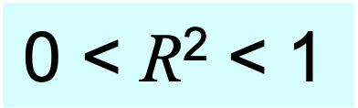
Conclusion
We get R² approximately equal to 0.0004
Interpretation:
The value of R² = 0.0004 indicates that only 0.04% of the variance in patient survival months is explained by their age. This means that the relationship between age and survival months is very weak.

Slide 17
04
MENU
ANALYSIS
CONTACT
Data ANALYSIS
CHI-SQUARE
CHI-SQUARE TEST OF INDEPENDENCE

Slide 18
Chi square test of independence
tests the relationship between two nominal variable.
test involves organizing data into a contingency table with each row corresponding to a category of one variable and each column corresponding to a category of another variable.
we try to determine whether there is a relationship between the gender of lung cancer patients and the location of their tumors.

Slide 19

Hypothesis & formula of the test statistic
Hypothesis:
H₀: The tumor location is independent of the gender of the patient.
H₁: The tumor location is dependent on the gender of the patient.
Formula of the Test Statistic:

Slide 20
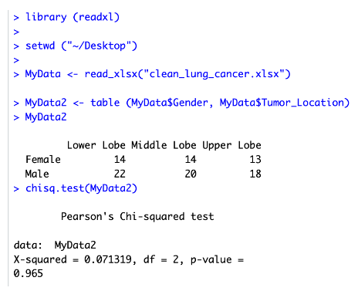
R Programming code output & interpretation
chi-square statistic value: 0.071319
degrees of freedom: 2
P-value: 0.965.
p-value (0.965) is significantly higher than the commonly used significance level of 0.05 -> we do not reject the null hypothesis
based on sample data provided there is no statistically significant association between the gender of the patient and the location of the tumor
any observed differences in tumor location distributions between males and females in this sample are likely due to random chance rather than a true underlying relationship.

Slide 21
05
MENU
ANALYSIS
CONTACT
Data ANALYSIS
ANOVA
TEST

Slide 22
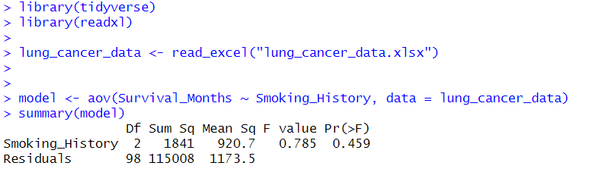
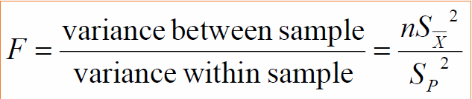
Anova test
MENU
ANALYSIS
CONTACT
Data ANALYSIS
Hypothesis
H₀: μ₁= μ₂= μ₃ (Survival months means are equal for the three smoker categories)
H₁:(At least one of the means is different)
Results
Formula for statistics test:
Significant level = 0.05
Numerator = k - 1 = 3 - 1 = 2
Denominator = k (n-1) = 3 (33-1) = 98
Test statistics F = 0.785
P-value = .459

Slide 23
Conclusion
From the anova test results we see that the p-value (0.459) is greater than our significance level of 0.05. Therefore, we fail to reject the null hypothesis which means that there is not enough evidence to conclude that there are significant differences in the means of survival months among the three smoking history categories.

Slide 24
06
MENU
ANALYSIS
CONTACT
Data ANALYSIS
DISCUSSION & CONCLUSION

Slide 25
DISCUSSION
Hypothesis Test:
significant difference in tumor size between smokers and non-smokers
suggests smoking history may be associated with tumor size in lung cancer patients.
Correlation Analysis:
very weak positive relationship (r = 0.0796) between age of lung cancer onset and survival months
correlation was not statistically significant (p = 0.4311) indicating that there is insufficient evidence to conclude a linear relationship between age and survival duration in lung cancer patients
Regression Analysis:
further supported this finding with only 0.04% (R² = 0.0004) of the variance in patient survival months explained by age.
regression equation (y = 57.0732 + 0.0449x) suggests that for each year increase in age, the survival months increase by only 0.0449 months on average
given the very low R² value, this model has very little predictive power.

Slide 26
DISCUSSION
Chi Square Test of Independence:
showed no statistically significant association between patient gender and tumor location (p = 0.965).
suggests that location of lung tumors is not dependent on the patient's gender in our sample
ANOVA TEST:
comparing survival months among different smoking history categories (current smoker, former smoker, never smoker) did not find significant differences (p > 0.05).
indicates that in our sample smoking history categories do not significantly affect the duration of survival for lung cancer patients

Slide 27

Conclusion
Our analysis found a significant difference in tumor size between smokers and non-smokers but most of our tests did not reveal strong relationships between the variables studied.
Age showed little correlation with survival time
Gender was not associated with tumor location
smoking history categories did not significantly affect survival duration
Findings highlight the complex nature of lung cancer and suggest that other factors not included in this study may play important roles in determining patient outcomes
Further research with larger sample sizes and additional variables may be necessary to uncover more significant relationships and predictors of lung cancer progression and survival

Slide 28
THANKS!
MENU
ANALYSIS
CONTACT
Data ANALYSIS
Do you have any questions?
GROUP 6

