Slide 1













Team Name: NEXUS
Members Name and Affiliation:
Sugandhan A
Vigneshwar J R
Tharoon M K Yazhini S
Elamathi S
Dharshini M
SKCET - Coimbatore

Slide 2


PROBLEM STATEMENT
Design an AI-powered cybersecurity firewall integrated with Generative AI-based threat modeling to dynamically generate adaptive security rules and detect evolving cyber threats within Zero Trust architectures.
Expected Outcomes:
AI-based anomaly detection
Generative threat intelligence models
Dynamic security rule creation
Automated Zero Trust enforcement
Improved enterprise security resilience

Slide 3
SOLUTION
Our Solution: ZeroTrust AI
A Multi-Agent AI Firewall that detects, responds, and permanently hardens itself against every cyber threat — with Zero Trust enforced at every layer.
Four Autonomous AI Agents:
🐍 Loki — Detects and classifies every packet using XGBoost ML + LLM reasoning
🎩 Thomas Shelby — Generates proportional firewall rules based on trust score
🔪 Dexter — Correlates attack patterns and maps to MITRE ATT&CK techniques
🌀 Stephen — Learns from every incident and permanently hardens the system
What Makes It Different:
✅ Hybrid ML + LLM intelligence — fast and explainable
✅ Self-improving — every attack makes the system stronger
✅ True Zero Trust — every device scored 0–100 based on behavior
✅ Human override — every AI decision is reviewable
"We didn't build a firewall that blocks attacks. We built a firewall that learns from them."

Slide 4
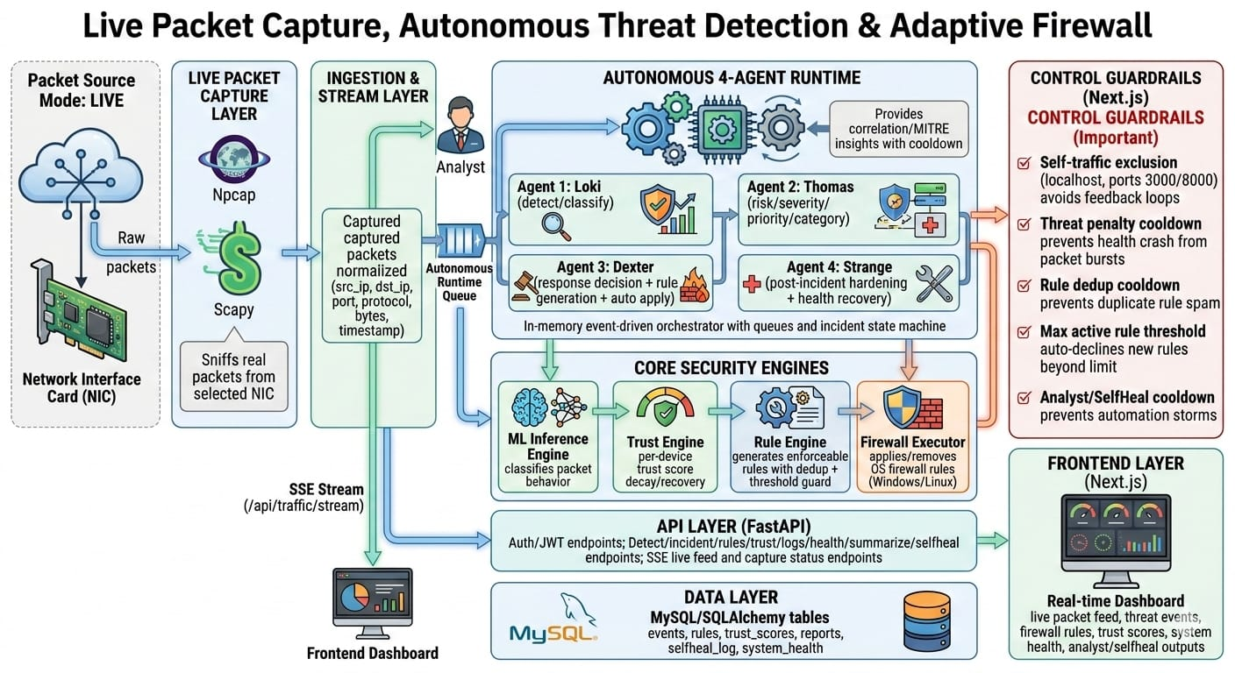
architecture

Slide 5
TECHNOLOGY USED
Layer | Technology | Why We Used It
🧠 ML Model | XGBoost | Fast, accurate threat classification on network packets
🤖 LLM | Claude (Anthropic) | Contextual reasoning for uncertain threat decisions
📊 Dataset | UNSW-NB15 | Real-world network intrusion training data
⚙️ Backend | Python FastAPI | High-performance async REST API + SSE streaming
🗄️ Database | SQLite + SQLAlchemy | Lightweight, persistent storage for all threat events
🔄 Migrations | Alembic | Clean, version-controlled database schema management
🔐 Auth | JWT Tokens | Secure role-based access for admin and analyst users
📡 Streaming | Server-Sent Events | Real-time packet feed to dashboard — zero polling
🖥️ Frontend | Next.js 14 + React | Fast, real-time dashboard with live data rendering
📈 Charts | Recharts | Threat timeline, traffic heatmap, trust score gauge
🛡️ Security | iptables Commands | Actual firewall rule generation at OS level

Slide 6
FEATURE / USP
🧠 Hybrid ML + LLM Intelligence
XGBoost classifies threats in milliseconds. Claude LLM is called only when the model is uncertain — making the system both fast and explainable.
🤖 Four Specialized AI Agents
Loki, Thomas Shelby, Dexter and Stephen each own one job — detection, response, correlation and healing. No single point of failure.
🔐 True Zero Trust Enforcement
Every device starts at trust score 100. Score decays with every threat. Response is always proportional — monitor, rate-limit, block or escalate.
⛓️ MITRE ATT&CK
Mapping Dexter maps live attack patterns to real MITRE techniques and predicts the next attack stage — turning reactive defense into proactive protection.
🔧 Self-Improving System
Stephen analyzes every resolved incident, writes permanent rules and raises the system health score. Every attack makes ZeroTrust AI harder to beat.
👤 Human-in-the-Loop
Every AI-generated firewall rule can be approved or rejected by a human operator — responsible AI at every decision point.
📡 Real-Time Dashboard
Live packet feed, trust score tracking, threat timeline, traffic heatmap and MITRE chain visualization — all updating every 500ms.
"Not just a firewall. A self-evolving AI security system that gets stronger with every attack."

Slide 7
References / links
📂 Project Repository 🔗 https://github.com/ASugandhan/GenAI_KPR
📚 Dataset 🔗 UNSW-NB15 Network Intrusion Dataset https://research.unsw.edu.au/projects/unsw-nb15-dataset
🤖 AI & APIs 🔗 Anthropic Claude API — https://docs.anthropic.com 🔗 XGBoost Documentation — https://xgboost.readthedocs.io
🛡️ Security Frameworks 🔗 MITRE ATT&CK Framework — https://attack.mitre.org 🔗 NIST Zero Trust Architecture — https://www.nist.gov/publications/zero-trust-architecture
⚙️ Core Frameworks 🔗 FastAPI — https://fastapi.tiangolo.com 🔗 Next.js — https://nextjs.org/docs

Slide 8
THANK YOU

